Slide 1
Elizabeth Mwania
Pezesha Assignment

Slide 2
Datasets
There are two distinct datasets:
The loan repayment dataset loan repayment behavior, including customer type (new_repeat), loan details (loan_amount, interest_amount), and repayment status (loan_balance, repaid_amount).
The M-pesa statements contains various transactions showing cash in and cash out. Every transaction updates balance at that time.
The following exploration is done to get various insights from the two datasets.

Slide 3
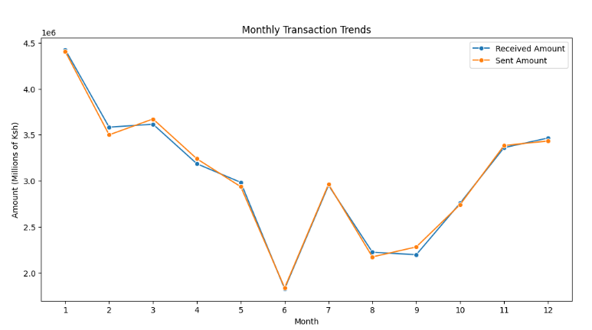
Monthly trends
Peak transactions in January (4.5M+ Ksh) likely school fees.
Possible dip mid-year cash flow squeeze.
July December shoots - business cycles or holiday preparations
High activity month – disburse loans Low activity month - avoid repayments, do marketing
The trend shows consistent expenditure where inflows are equivalent to outflows implies high dependance on cash flow for business and upkeep. There is also little savings.

Slide 4
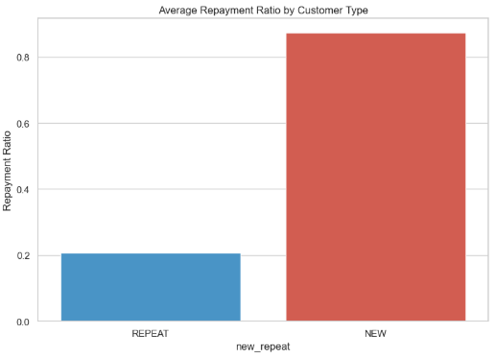
Customer type
Borrowers who retake loans tends to pay slower compare to new borrowers could be lenders have developed overconfidence from previous loans
Consequently, low repayment ratio leads to missed full repayment.
Develop proper credit that tracks repayment over time to adjust creditworthiness dynamically.

Slide 5
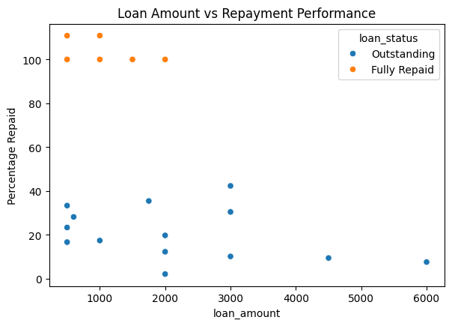
Loan amount
Most of the borrowers with large loans fail to make full repayments.
Smaller loans (Ksh. 2000) are manageable.
As the loan amount grows, repayment performance worsens, a possible indication of overstretched borrowers.
Use behavioral analytics to determine loan size

Slide 6
Model evaluation
Model | AUC-ROC | Accuracy | Precision | Recall | F1-Score
Decision Tree | 0.75 | 0.842 | 1.000 | 0.4 | 0.571
Random Forest | 0.75 | 0.842 | 1.000 | 0.4 | 0.571
Gradient Boosting | 0.75 | 0.842 | 1.000 | 0.4 | 0.571
Logistic Regression | 0.60 | 0.632 | 0.375 | 0.6 | 0.462
Decision tree, random forest and gradient boosting excelled in AUC-ROC, accuracy, and precision. However, they can miss the risky borrowers
Logistic regression showed almost average performance across all metrics except precision. The best recall score means correctly identifying true defaulters.
Random forest has best F1 score showed that can balance both precision and recall.

Slide 7
Credit risk model
Modeling approach – Fitted machine learning classification approach to predict whether a borrower would default on a loan (1) or not (0)
Class imbalance – Applied SMOTE to upsample the minority class (defaulters) during training and class weights
Selected features – New_repeat, loan_duration, loan_amount, interest_rate.
Model evaluation - Stratified 70/30 train-test and evaluated using precision, recall, F1_score. Other metric include Confusion Matrix, Accuracy, AUC-ROC.
Assumptions – The history of borrowing like repeat customers impacts future risk, the 4 selected features capture sufficient predictive signal, SMOTE-generated synthetic samples are valid representations of actual borrowers.
Sources of bias – SMOTE synthetic data, sample bias.
Improvement – More features including repayment history, cross validation, explainability.

Slide 8
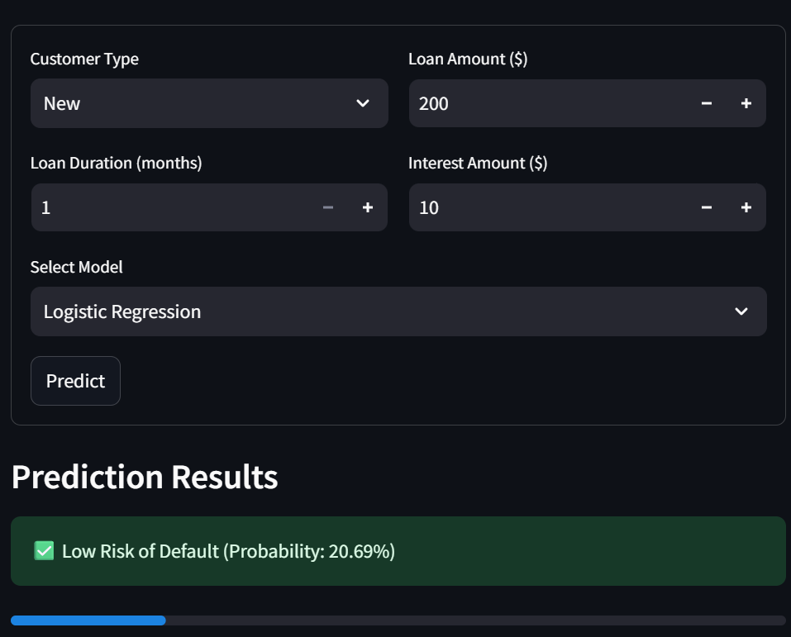
Selected Features
Higher loan amount or interest indicated more financial burden.
Repeat customers showed likelihood of defaulting.

Slide 9

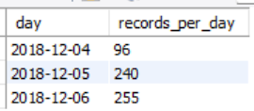
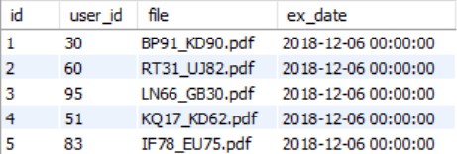
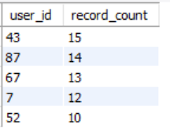
Query Results
Total records and distinct users.
Latest record per user
Number of records per day.
Top 5 users with the most records.

Slide 10
Real-Time M-Pesa Risk Scoring Workflow
1. Ingestion and Data preparation
M-pesa transactions
Kafka
Ingests
200k+ transactions/ second
Pyspark/ Dask
Preprocess, parse, structure data
Spark
/flink
Validation, anomaly detection
Redis/ S3
Storage of extracted feature
GLM, XGBoost, spark ML
Model risk score
Stream scoring
Kafka, S3, Cassandra
API, raw data & processed data storage,

Slide 11
Caching
2. Deployment and monitoring
Docker, Kubernetes,
AWS SageMaker
Containerization and model serving
Evidently AI, Grafana, Istio
Data drift detection, real time dashboard and A/B testing
S3/ HDFS/ TLS
Encrypt shared API (data at rest and in transit)
3. Optimization techniques
- Redis for caching
- PySpark or Dask for parallel parsing

Slide 12
Proposed datascience-driven strategies for Patascore
1. Alternative data and behavioral analytics
Cash flow patterns
Supplier/fintech engagement
Inventory turnover
Websites and social media revies

Slide 13
2. Credit scoring model with alternative data
Supervised machine learning models logistic regression, random forests)
Clustering (K-means) for risk segmentation
ARIMA/LSTM for cash flow forecasting
Analyze business network through graph models

Slide 14
3. High-impact products using the current data
Real-time visualization of revenue, expenses, cash flow.
Actionable recommendations for business’ improvement
Default/growth forecasts with early warnings
NOTE:
For ethical considerations prioritize explainability and ensure privacy.

Slide 15
Thank You

