Slide 1



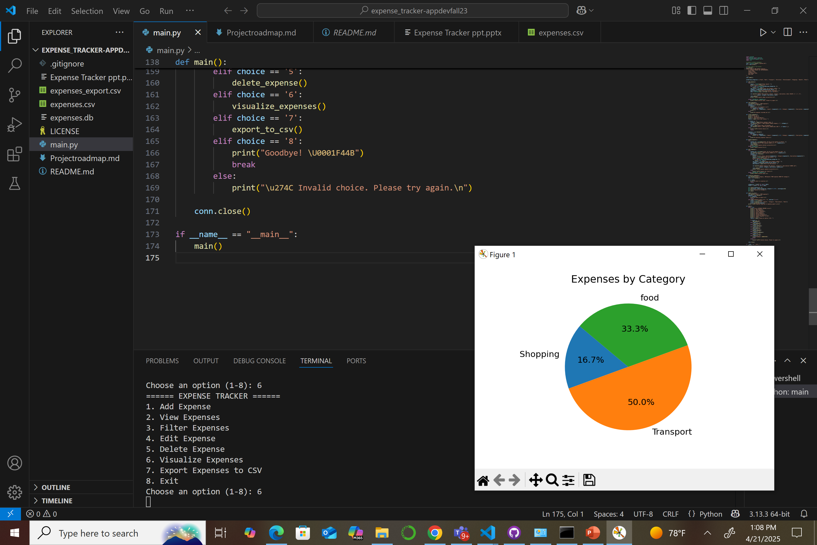

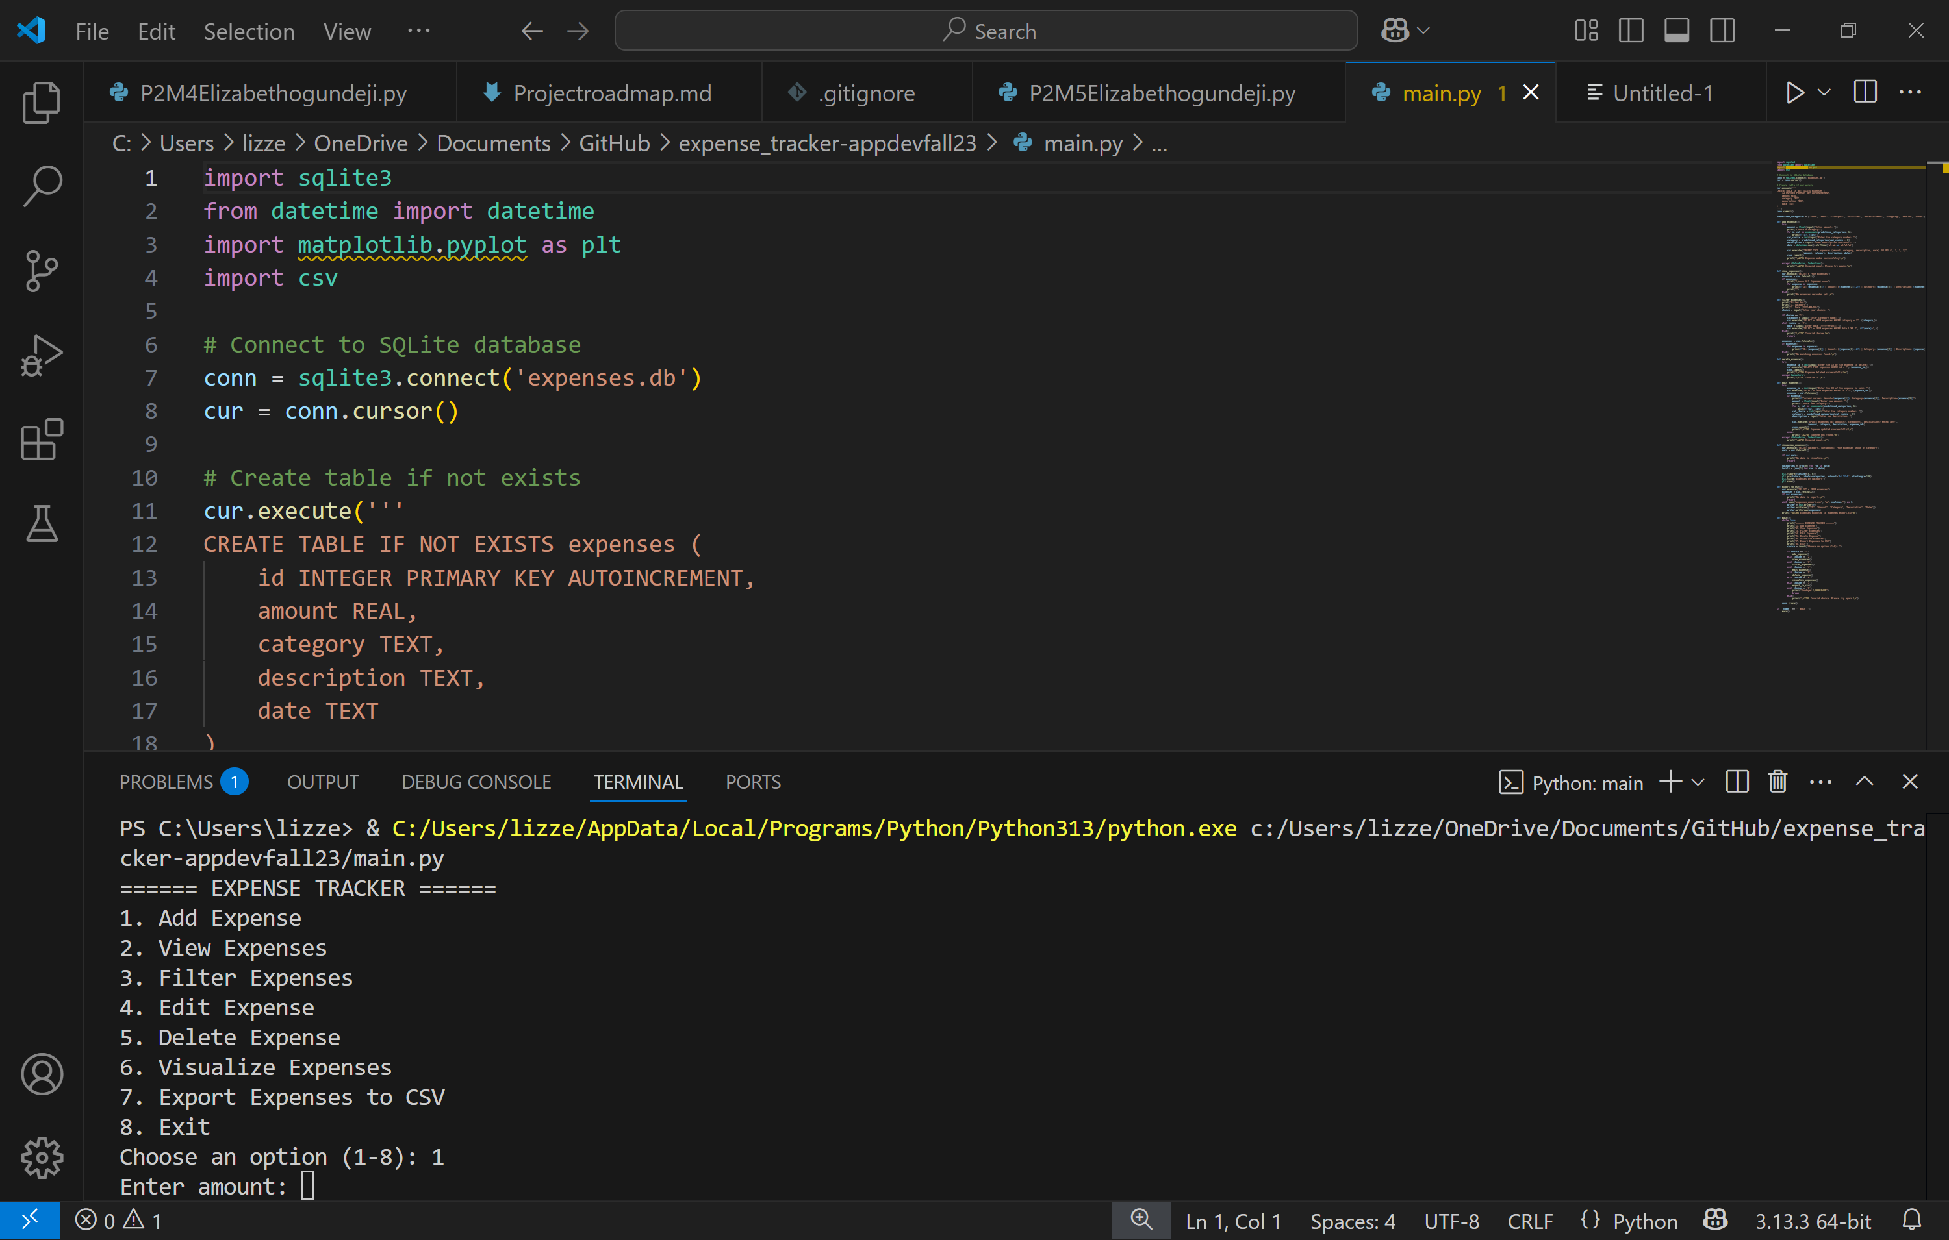
Expense Tracker Application
Team Member(s): Elizabeth Ogundeji
Tagline: Track your spending smartly and visually.
GitHub Repository: https://github.com/Elizabethdej/expense_tracker-appdevspring25

