Slide 1

ENVSOCTY 4GA3 Applied Spatial Statistics
School of Earth, Environment & Society
McMaster University
Antonio Páez

Slide 2
What is spatial statistics?

Slide 3
Applications of spatial statistics
Geosciences
Ecology
Economics
Business intelligence
Policy analysis
Transportation planning
Etc.

Slide 4
Applied spatial statistics @ Mac
Complement to GIS suite of courses
Follow up to ENVSOCTY 3MB3: Emphasis on spatial data and effects

Slide 5
Applied spatial statistics @ Mac
Instructors
Antonio Páez
Patrick De Luca
TAs
Raj Ubhi
John Merrall
Style of course
Flipped classroom
Literate programming

Slide 6
What is a flipped classroom?

Slide 7

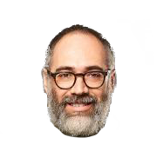
Traditional (pandemic) classroom
Instructor is:
Talking head
Performer
Entertainer
Sage
Granter of wisdom
Yak, yak, yak…

Slide 8
Traditional classroom
Class time is used by the instructor to deliver contents, typically in a lecture format
Instructor is responsible for delivering contents
Students read/cover materials outside of the classroom after each session (in the form of homework, assignments, etc.)
Students are responsible for understanding contents
Verification of compliance happens periodically, in the form of examinations/graded assignments

Slide 9

Flipped (pandemic) classroom
Today’s activity
X
Y
Readings
for next class
Instructor is:
Expert
Guide
Partner

Slide 10
Flipped classroom
Students read/cover materials outside of the classroom prior to each session
Students are responsible for understanding contents
https://paezha.github.io/applied_spatial_statistics/index.html
Class time is used to engage with concepts in a collaborative way
Instructor is responsible for verifying compliance by solving issues, clarifying concepts, assisting with activities
Further verification of compliance in the form of examinations/graded assignments

Slide 11
Structure of a session
Initial 5-10 minutes (instructor) will be used to provide a high-level view of threshold concepts, and to discuss readings/practice, clarify concepts, etc.
To optimize the use of time, take notes when you are completing your readings/practice, bring specific questions to the classroom
Next 30-35 minutes will be used for an in-class activity working collaboratively with a small group
This may include discussion, problem-solving, and practice
Last 5-10 minutes may be used for discussion of the activity

Slide 12
Suggested workflow (see outline)
Check Readings and Practice
These are your assigned contents for the following topic
Labs
Practice the how-to part of the activity (technical skills)
Class
Last part of the activity (brainware)

Slide 13
What is literate programming?

Slide 14
Traditional programming
Code forms the core of a program
Code is documented in natural language

Slide 15
Literate programming
Explanations of process in natural language form the core of a program
Code is used to support explanations

Slide 16
How will literate programming be implemented?

Slide 17
Literate programming
The R Project for Statistical Computing
An open source language for statistics and computing
Free
Convenient
Powerful
Has become a backbone of data science and thus is increasingly required by employers

Slide 18
Software installs
Personal computer
Pat can grant a virtual connection. He will discuss in a bit…

Slide 19
Suggested Readings
Flipped classrooms
https://en.wikipedia.org/wiki/Flipped_classroom
Literate programming
https://en.wikipedia.org/wiki/Literate_programming
The R Project for Statistical Computing
https://en.wikipedia.org/wiki/R_(programming_language)

Slide 20

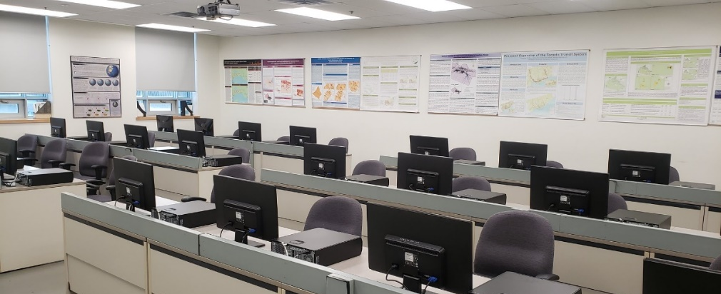
THE GIS LABS: BSB 331 & 332

Slide 21
About the Lab
Updated GIS Lab information can normally be found on the GIS Bulletin Board outside the labs, now it is virtual, posted on Avenue
Up-to-date information about the Labs
GIS/Spatial Stats/Remote Sensing in the News
Program information
Employment Opportunities (including internships, Co-ops etc) that relate to GIS and remote sensing

Slide 22



About the Lab
Current Hardware Environment
Windows 2012 R2 Server
52 Windows 10 x64 Clients
Primary Software used this term
R and R Studio
Secondary Software available for use
ArcGIS Pro 2.7
GeoDa

Slide 23
Lab Software and Ownership Policies
Academic Site License for ArcGIS Pro 2.7
Can obtain a student version of ArcGIS Pro 2.7 (good for as long as you have a McMaster Organizational account for AGOL).
If you need an organizational account, please let Pat know.
If your laptop/PC cannot support ArcGIS Pro 2.7, you can get access to a virtual desktop in the GIS Lab. You will commandeer a specific PC for the term. Pat will assign the PC and send instructions for access.
Other executables
R, RStudio and GeoDA are free! You can download yourself anytime on any device. If you feel your device isn’t good enough, you can be granted access to a GIS Lab PC

Slide 24
Lab Policies (1)
Virtual desktops for academic use only!
ArcGIS Online and GIS Lab user accounts are your own; please do not share them
Local disk storage is not provided, please use your own USB
Please be aware that PCs in the labs may need to be re-formatted from time-to-time.
Be aware that virtual desktops may be shared with others

Slide 25
Lab Policies (2)
Reporting bugs with software/hardware
Please email any issues to Patrick DeLuca
delucapf@mcmaster.ca
Student access is 24/7, EXCEPT that you need to be aware that you may be in a situation where you are sharing a desktop with others. We ask you not to log while another lab is in session
Login ID/Password

Slide 26
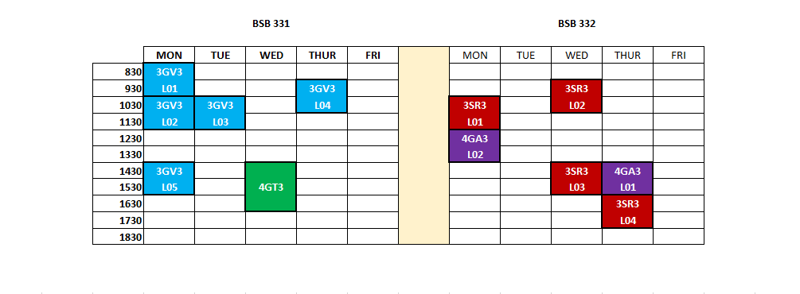
Lab Schedule for Winter 2021

Slide 27

GIS Certificate New for This Year
Required to take 6 courses in total
T2 3GV3:
Advanced Vector GIS
T2 4GT3:
Special Topics in GIS
T1 2GI3:
Geographic Information
Systems
T1 3GI3:
Advanced Raster GIS
T1 4GS3:
GIS Programming
T2 3SR3:
Remote Sensing
T1 4SR3:
Adv Remote Sensing
Either ENVSOCTY 3MB3 or STATS 2B03
T2 4GA3:
Applied Spatial Stats
Certificate Requirement
Certificate Optional
These courses also fulfill all the educational requirements for the GISP certification

Slide 28

One of 12 Centres of Excellence for GIS across Canada
Opportunities for student recognition (Awards, Scholarships)
Esri Canada Higher Education Scholarship in GIS (Friday April 2)
Esri Canada Young Scholar Award (TBA)
App Challenge 2020 and other competitions
https://www.science.mcmaster.ca/geo/gis/esri-canada-centre-of-excellence.html
Date of Challenge will be in March, specific week TBA

Slide 29
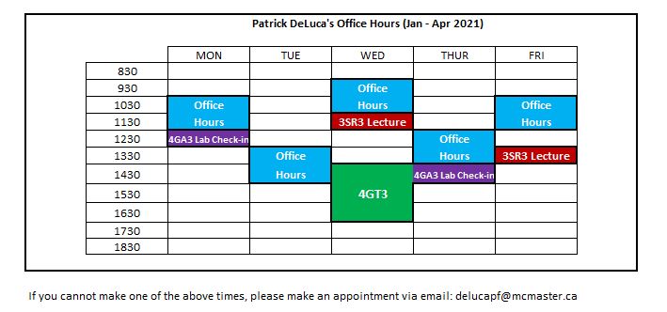
Pat’s Office Hours

