Slide 1
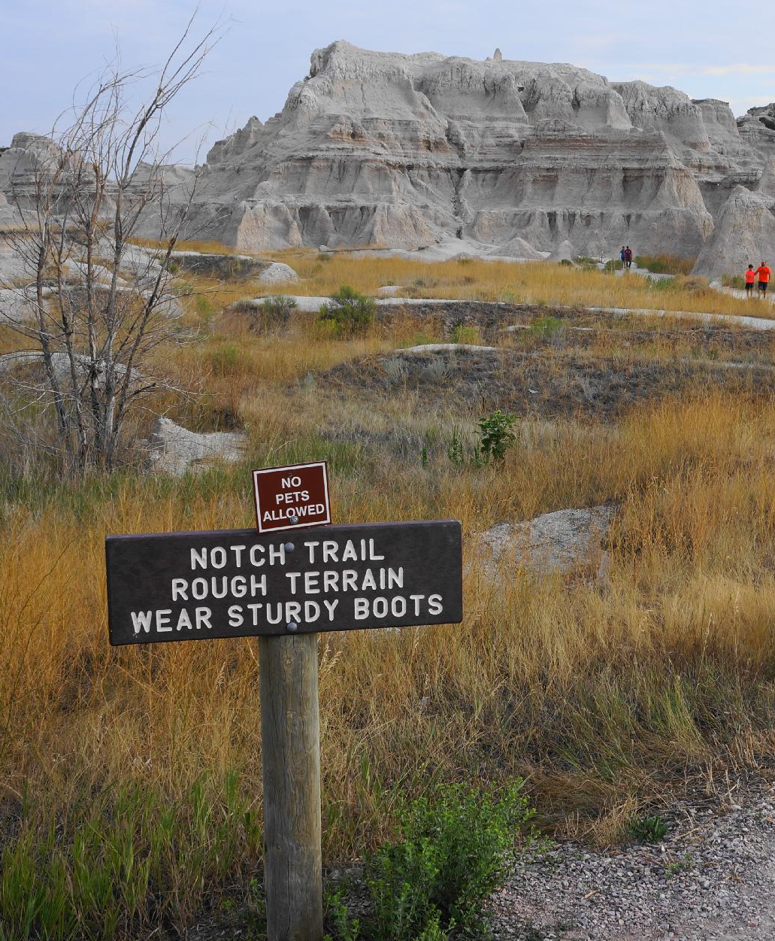
From Park Alerts
to Making Decisions
Classifying National Park Service alerts by practical visitor impact
Notes:
Opening: explain the motivation briefly — visitors need to translate alerts into decisions, not just read broad NPS categories.

Slide 2
The problem: official categories are broad
Visitors need to know what part of the trip is affected.
“Park Closure” can mean different things.
Trail closed
→ choose another route
Road or parking limited
→ change logistics
Facility unavailable
→ prepare differently
Official alert categories do not always answer the visitor’s decision question.
What should I do? Change route? Reserve parking? Avoid an area? Prepare for weather? Just note information?
Can NLP turn official alerts into practical trip-impact categories?
From Park Alerts to Hiking Decisions
Notes:
This slide frames the concrete problem: the same original label can hide different visitor decisions.

Slide 3
Research question and contribution
Can traditional and transformer-based NLP methods classify NPS alerts by six traveler-centered alert-impact categories, especially on parks the model has never seen?
Can NLP models classify alerts into three levels of practical trip impact: trip-changing, preparation required, or informational/minimal impact?
Taxonomy
Dataset
Generalization test
Model comparison
1
2
3
4
Six categories tied to trip decisions
300 eviewed alerts from 199 parks
Held-out parks as the primary evaluation
Rules, TF-IDF, embeddings, and DistilBERT
From Park Alerts to Hiking Decisions
Notes:
Mention that summarization was considered but dropped to keep the project focused and evaluable.

Slide 4
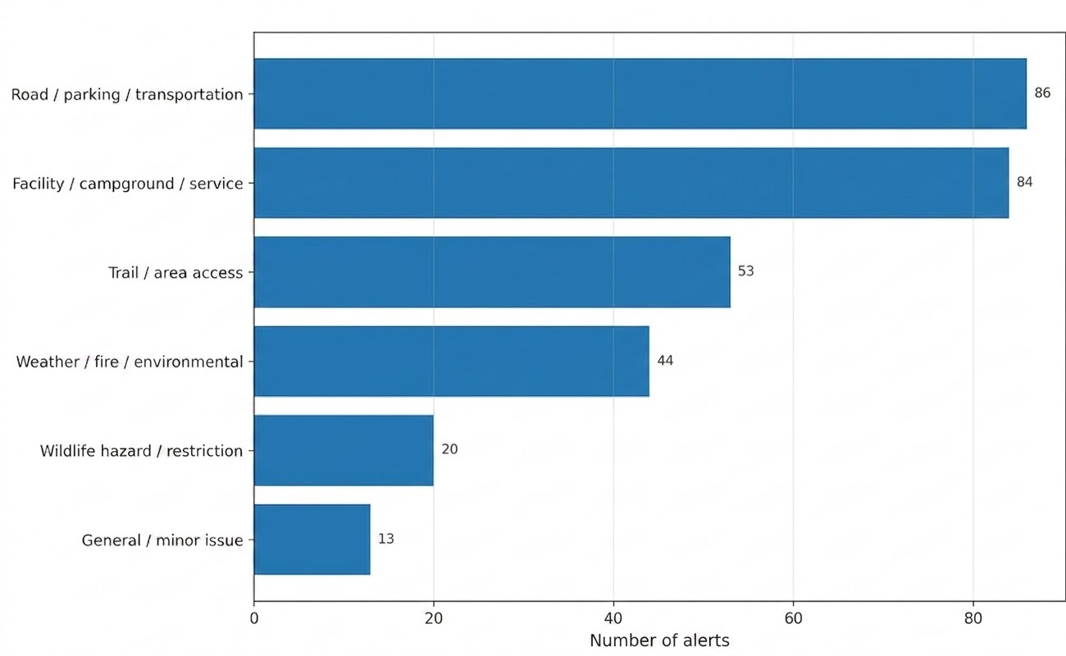
Data: official NPS alerts, manually reviewed
A small, real dataset with many parks and imbalanced classes.
Data Collection
NPS API
Collected active alert titles, descriptions, park codes, and categories
626 usable alerts
After removing one test alert and inspecting raw fields
300 alerts
Manually reviewed and labeled
199 parks
Broad park coverage for transfer evaluation
From Park Alerts to Hiking Decisions
Notes:
Point out the class imbalance: road and facility are common; wildlife and general/minor are rare. This justifies Macro F1.

Slide 5
Traveler-centered taxonomy
Labels represent the main practical consequence for a visitor.
Trail / area access
Wildlife hazard / restriction
Can I still reach this trail, beach, route, or area?
Is wildlife activity creating a hazard or restriction?
Road / parking / transportation
Facility / campground / service
Do I need to change how I get there or move around?
Will visitor services, campgrounds, water, or facilities be unavailable?
Weather / fire / environmental
General / minor issue
Is there a safety condition that changes the risk?
Is this mostly informational or administrative?
Annotation rule: label the visitor-facing consequence, not the underlying cause.
From Park Alerts to Hiking Decisions
Notes:
Give an example: road closed for construction = transportation primary; construction may be secondary context.

Slide 6
Evaluation design
Held-out parks were the primary test of generalization.
Held-out-park split
Mixed-park split
No park appears in more than one partition.
Parks can overlap across partitions.
Train
Validation
Test
Train
Validation
Test
211 alerts
139 parks
44 alerts
30 parks
45 alerts
30 parks
210 alerts
45 alerts
45 alerts
Question answered: Can the model transfer to parks it has never seen?
Question answered: How well does the model classify alerts when park-specific language may be familiar?
From Park Alerts to Hiking Decisions
Notes:
Emphasize professor guidance: report both, but held-out parks are the main result.

Slide 7
Models compared: from simple to modern NLP
1
2
3
4
Majority
Rules
5
TF-IDF
Sentence embeddings
sanity-check baseline
hand-built keyword patterns
DistilBERT
sparse lexical features + logistic regression
all-MiniLM-L6-v2 + logistic regression
fine-tuned sequence classifier
Best Macro F1 performance: sentence embeddings + logistic regression
From Park Alerts to Hiking Decisions
Notes:
The sequence shows that the project was not an LLM-only prompting exercise.

Slide 8
Fine-tuning did not beat frozen embeddings
Held-out Macro F1
DistilBERT trained end-to-end with class-weighted loss and early stopping.
It was stable across held-out and mixed settings, but not the best performer.
Likely reason: 300 labels were not enough for reliable end-to-end fine-tuning.
Frozen embeddings provided semantic information with a much lower-variance classifier.
0.764
0.639
Sentence embeddings
Fine-tuned DistilBERT
NLP Final Project | National Park Service Alerts
Notes:
This slide helps show that you did try BERT and learned something from it. The result is not a failure; it is a useful model-selection finding.

Slide 9
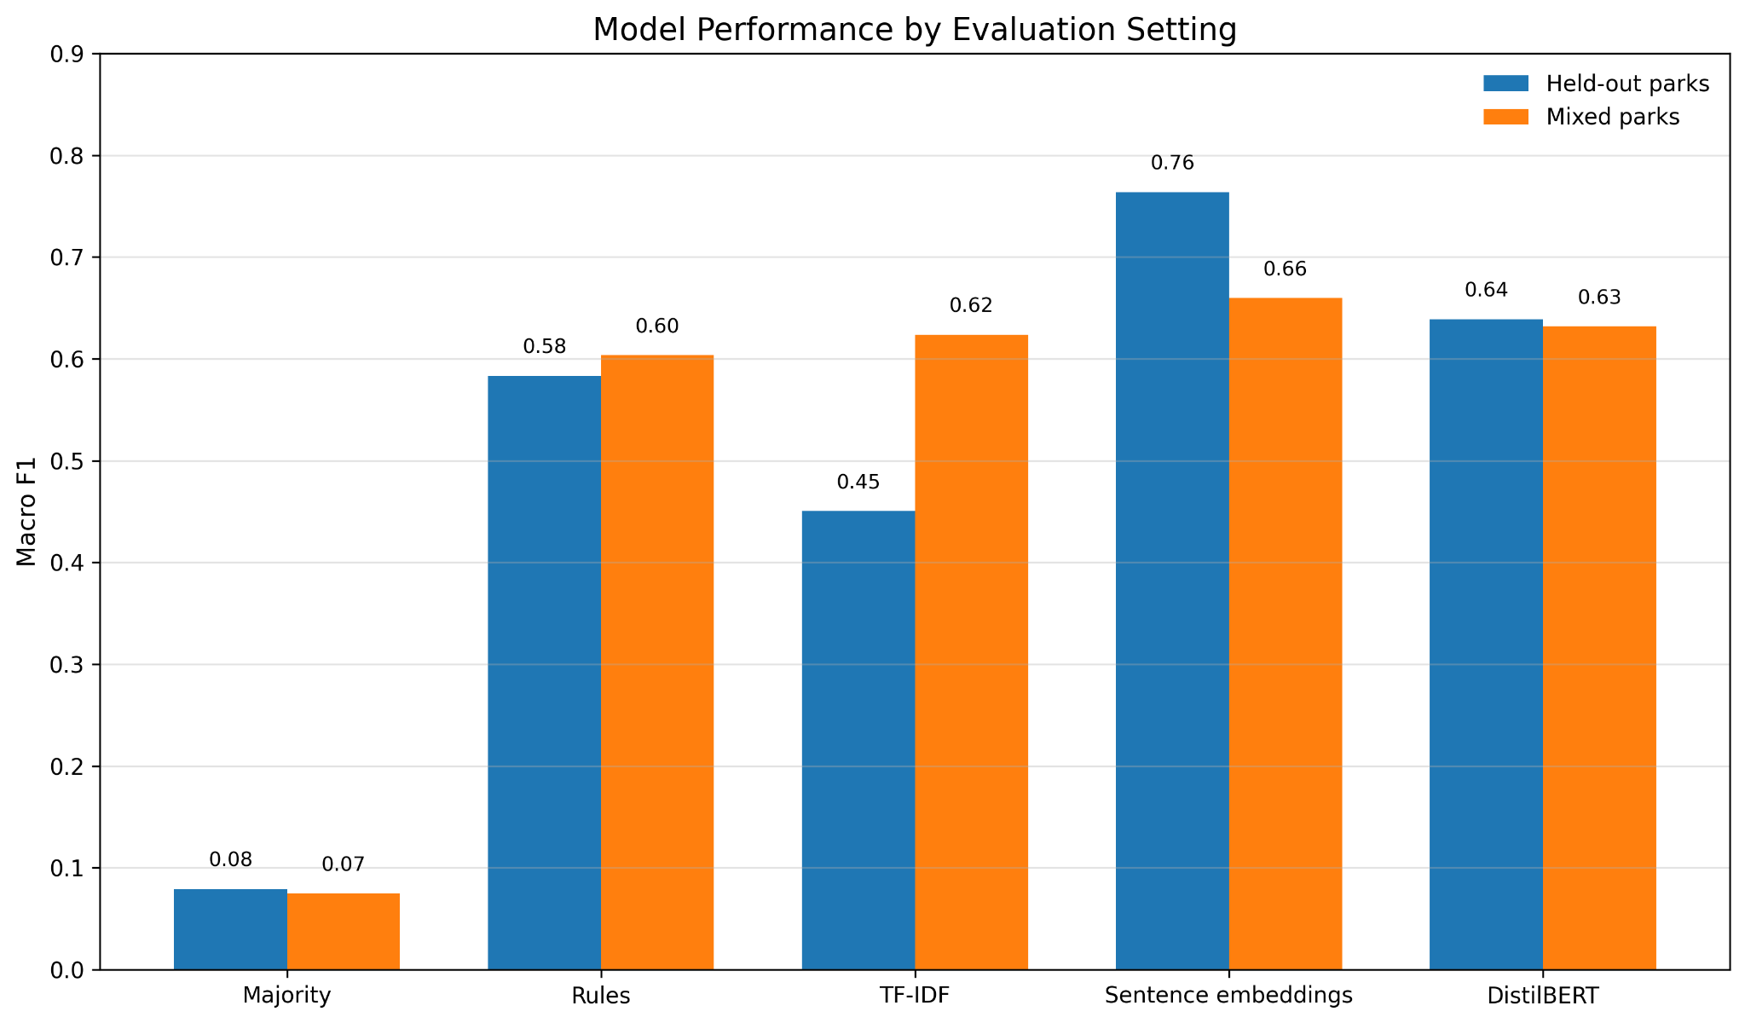
Sentence embeddings were strongest on unseen parks
Primary metric: Macro F1 on held-out parks.
Best held-out Macro F1: 0.764
From Park Alerts to Hiking Decisions
Notes:
Interpret: sentence embeddings were better than TF-IDF and fine-tuned DistilBERT in the primary evaluation.

Slide 10
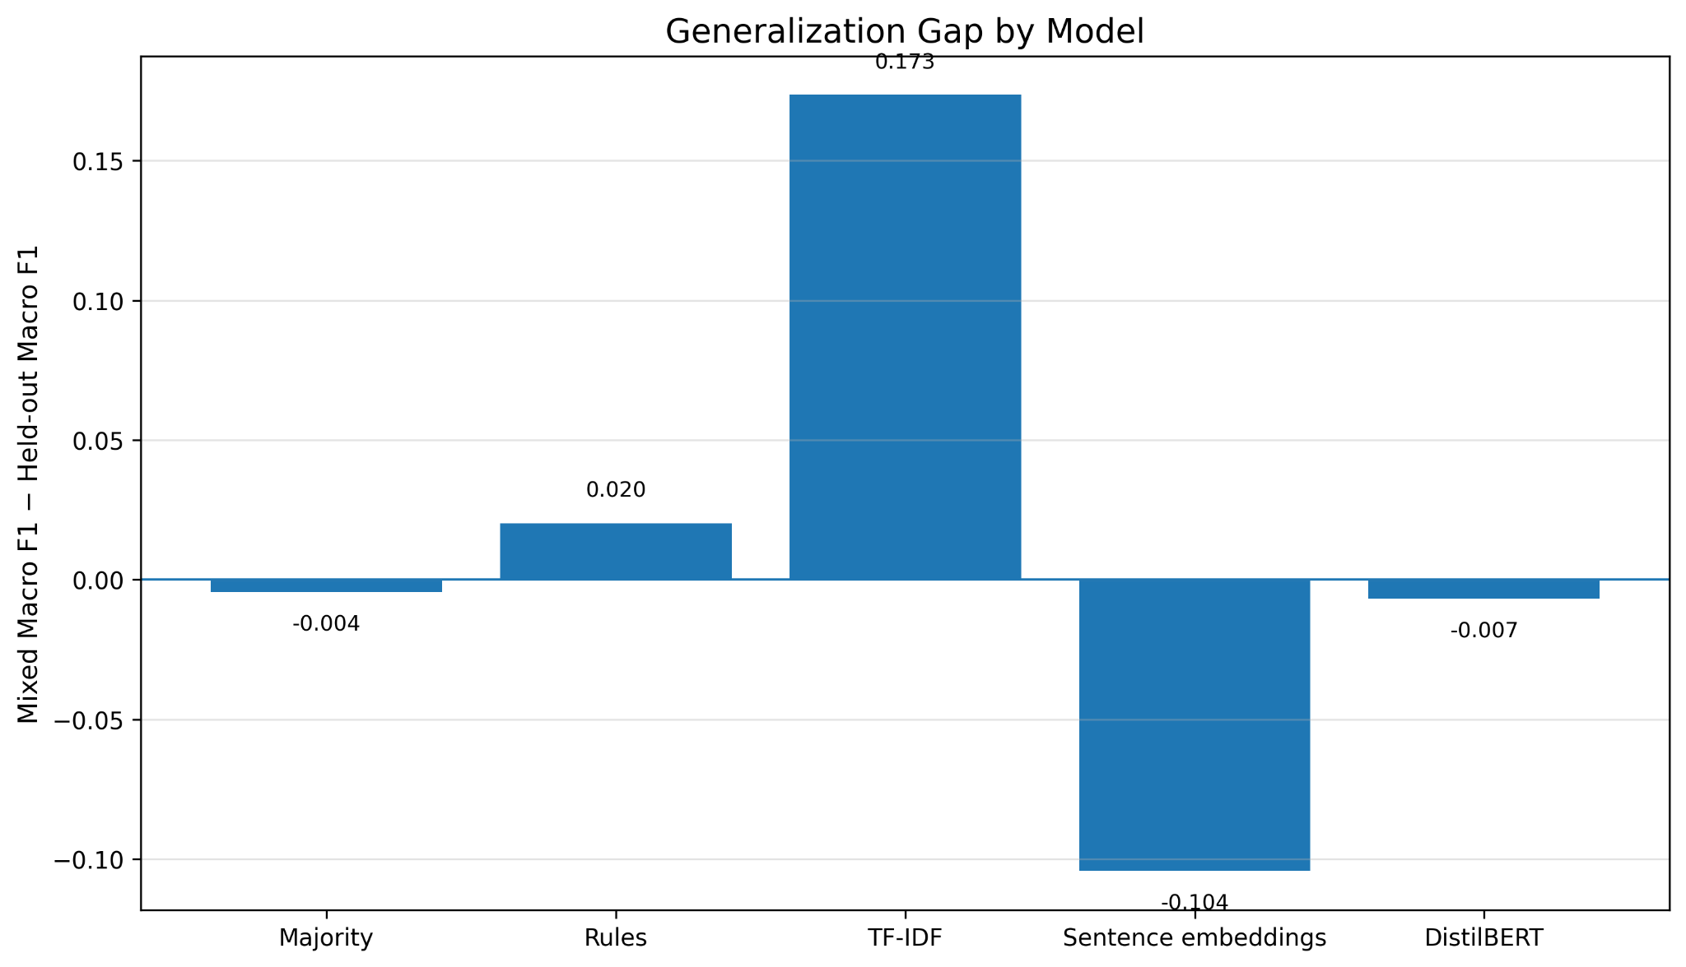
Why held-out parks changed the story
Mixed-park performance alone would overstate TF-IDF generalization.
Interpretation
• TF-IDF gained most when parks were mixed across splits.
• This suggests sensitivity to repeated park-specific wording.
• Sentence embeddings did not show the same held-out decline, but the negative gap should be interpreted cautiously.
• Grouped cross-validation helps contextualize split difficulty.
Held-out parks are the headline result.
From Park Alerts to Hiking Decisions
Notes:
Use this slide to explain why the professor’s held-out-park guidance mattered.

Slide 11
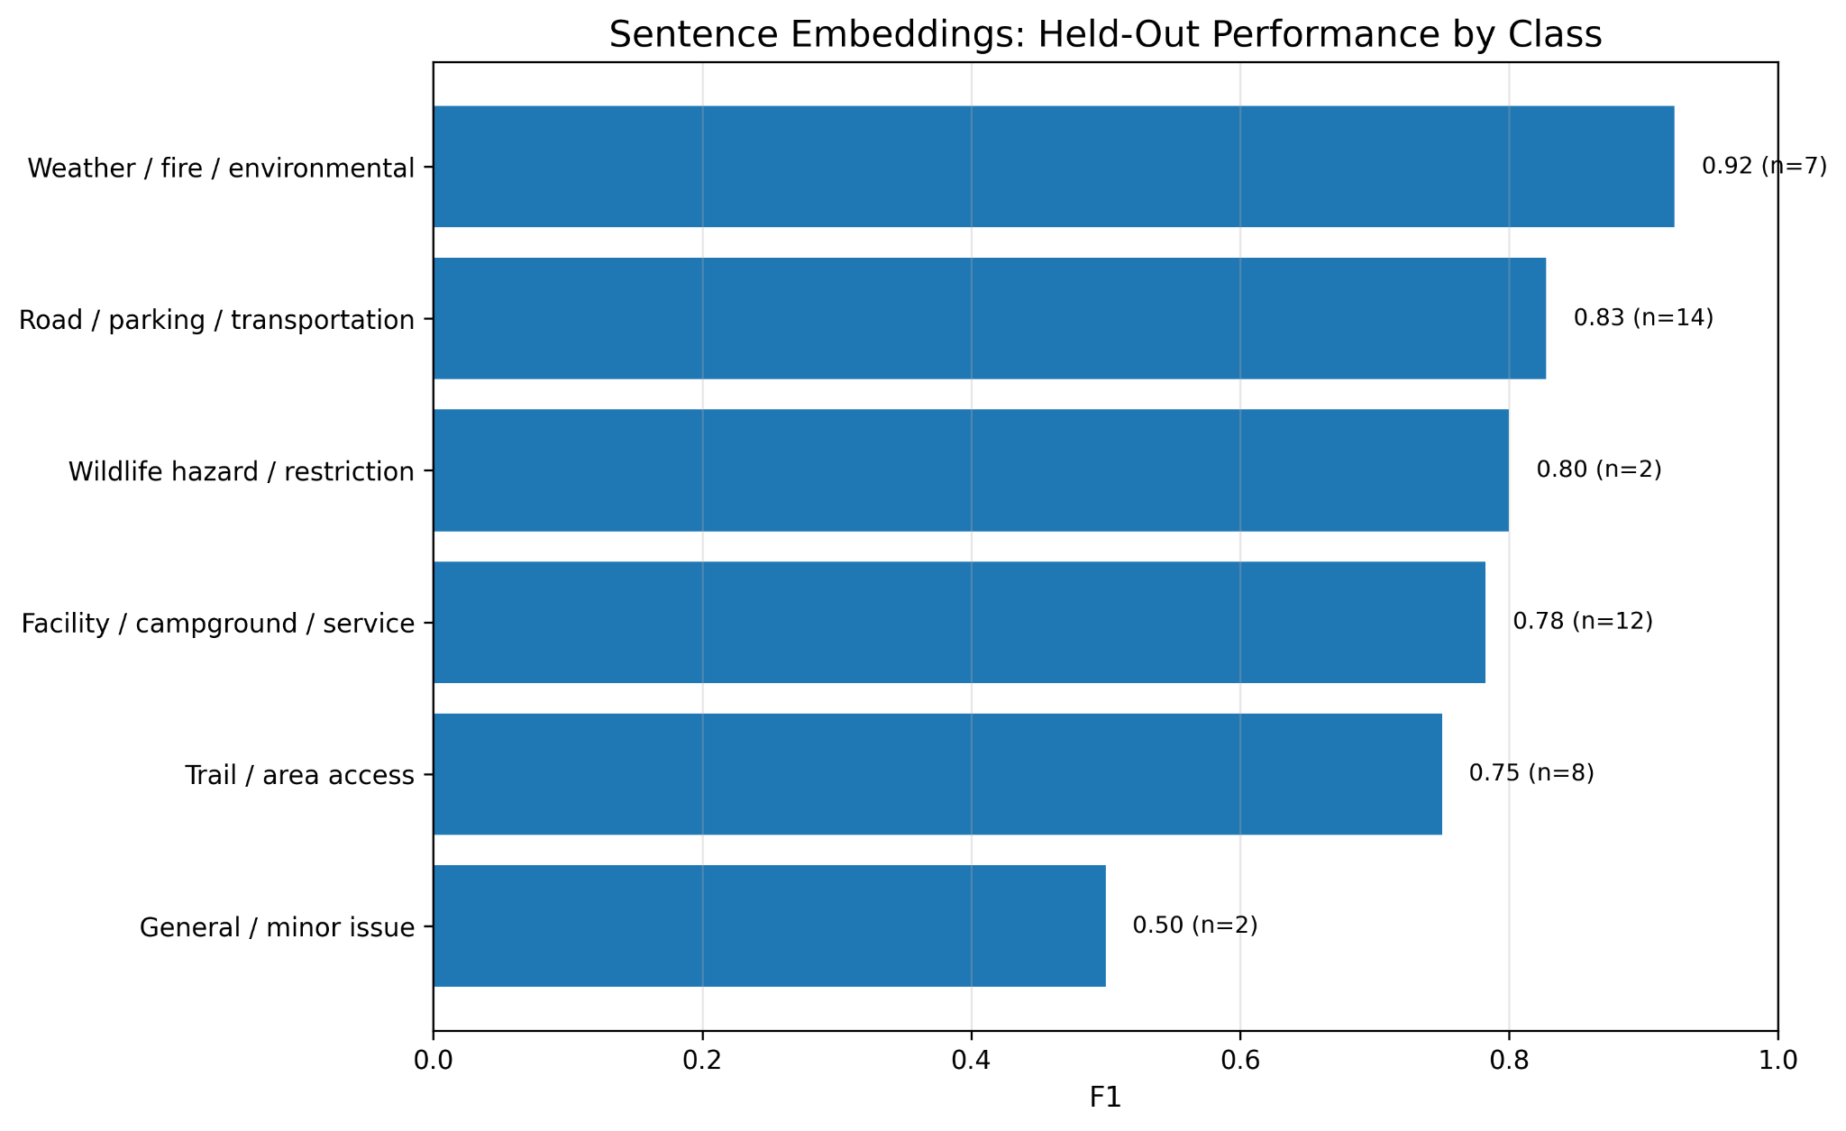
Selected model: where it worked best
Sentence embeddings recovered useful performance across all six classes.
Class-level takeaways
• Strongest on environmental and transportation alerts.
• Wildlife looked strong, but only had 2 test cases.
• General/minor remained weakest and most heterogeneous.
• Macro F1 was appropriate because class sizes were uneven.
Accuracy alone would hide rare-class behavior.
From Park Alerts to Hiking Decisions
Notes:
Make the rare class caution explicit. Wildlife looks good but is not stable with n=2.

Slide 12
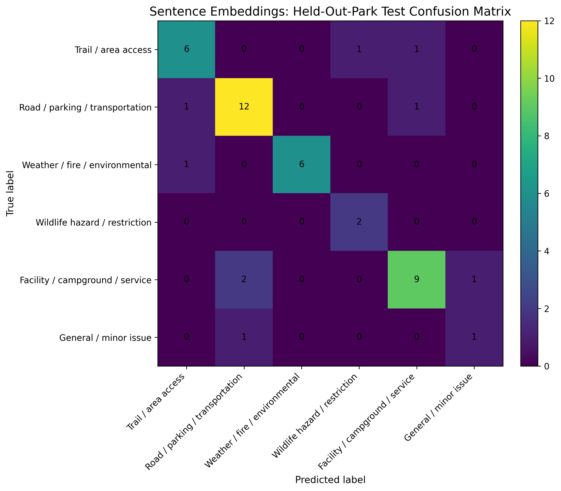
Error analysis: most errors were boundary cases
The model usually confused reasonable neighboring interpretations.
Recurring error themes
Cause vs consequence
Trail closure named in title; hazard described in body
Facility vs area
A lighthouse or plaza can be both a site and an access area
Transportation vs service
Parking reservations and ride-share limits blur categories
Wildlife vs access
Animal language can override the practical restriction
The taxonomy made a deliberate choice: practical consequence over surface wording.
From Park Alerts to Hiking Decisions
Notes:
Use one example: Upper Rhyolite Trail Closure looked like trail access, but the gold label prioritized environmental hazard.

Slide 13
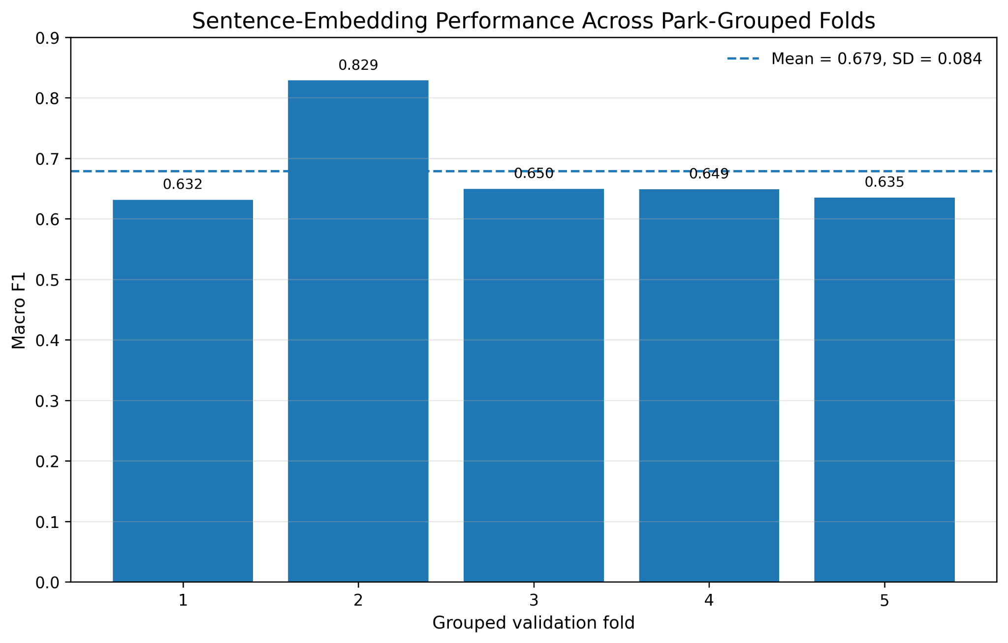
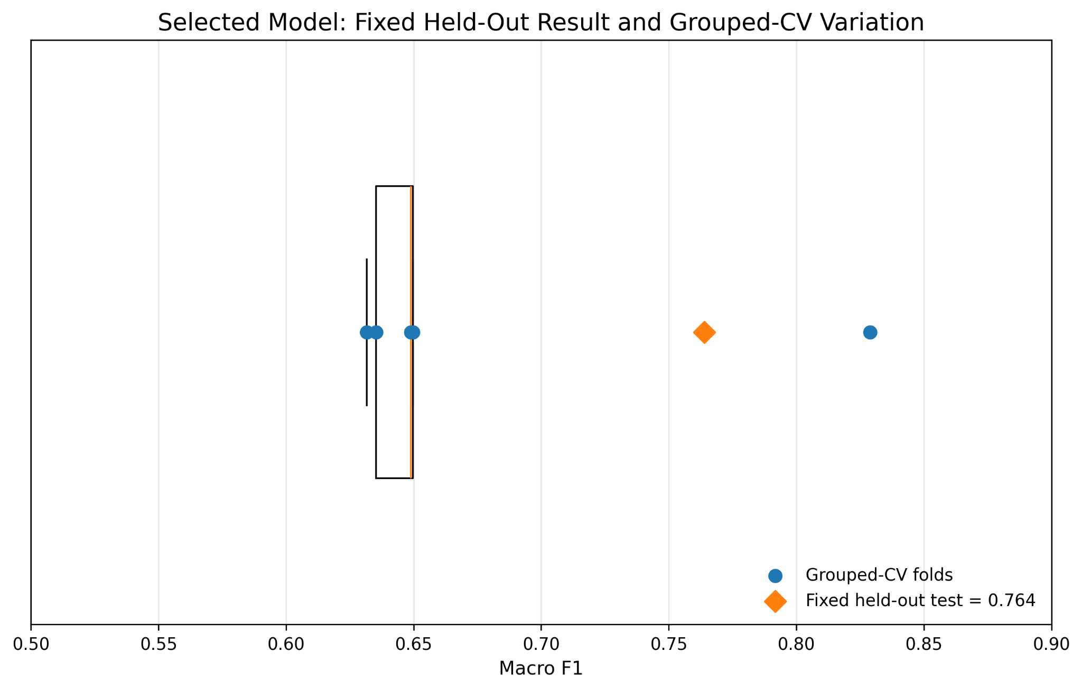
Robustness: performance varied by held-out park group
Grouped cross-validation kept parks together and excluded the fixed held-out test set.
Grouped-CV Macro F1: 0.679 ± 0.084; fixed held-out: 0.764
From Park Alerts to Hiking Decisions
Notes:
The fixed held-out score is strong, but grouped CV shows that some park groups are harder than others.

Slide 14
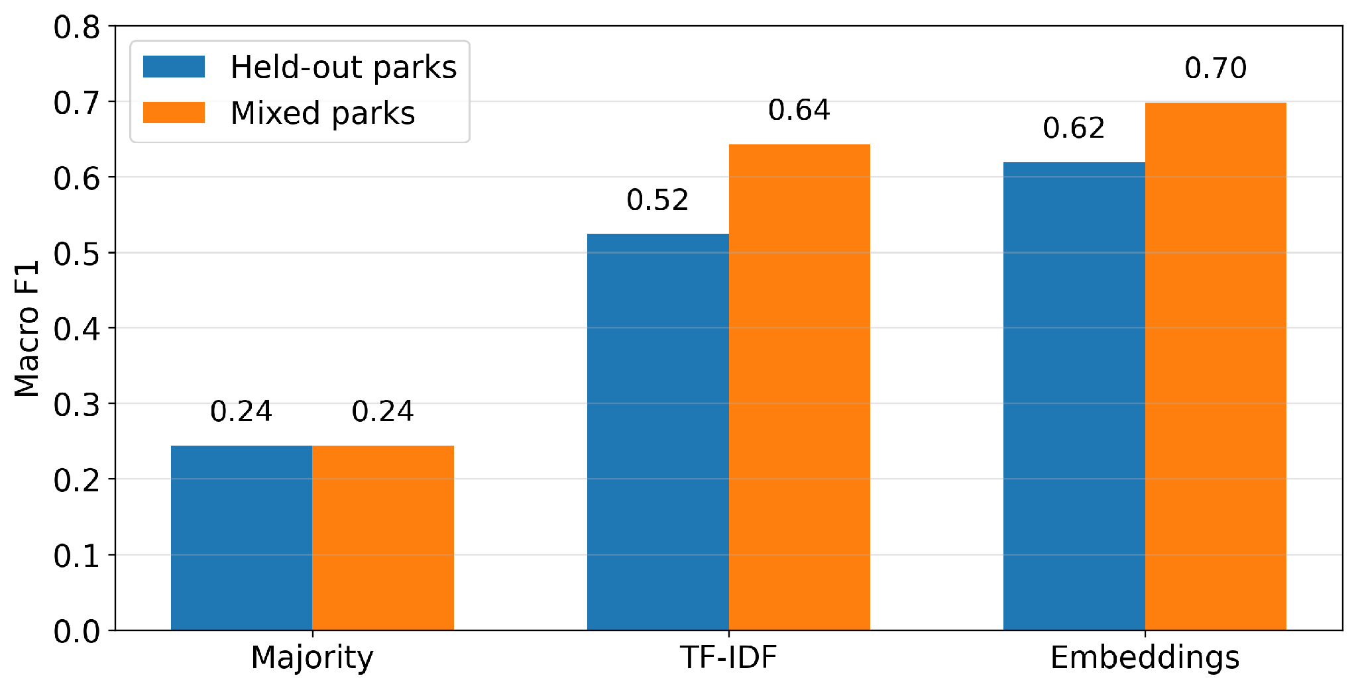
Secondary analysis: predicting practical impact level
Three-level impact classification directly addresses visitor decision-making.
Held-out Macro F1: 0.619
Mixed-park Macro F1: 0.698
Majority baseline: 0.244
Interpretation
• Sentence embeddings had the strongest class-balanced performance.
• TF-IDF had slightly higher held-out accuracy, so Macro F1 is the fairer headline metric.
• The rare informational class still needs more evidence.
From Park Alerts to Hiking Decisions
14

Slide 15
Limitations and next steps
Limitations
Future work
• Only 300 manually labeled alerts.
• Labels were assigned by one annotator; inter-rater reliability was not assessed.
• Rare classes and rare impact levels had small fixed-test support.
• Impact levels were modeled as nominal classes, not ordinal severity.
• Alerts are a snapshot of changing park conditions.
• Use overlapping multi-rater annotation and adjudicate disagreements.
• Expand labels across more seasons and rare classes.
• Refine the general/minor category and impact-severity definitions.
• Test ordinal or cost-sensitive impact models.
• Evaluate whether labels improve visitor decision-making.
Impact labels were modeled as a secondary exploratory task: useful, but limited by rare-class support.
From Park Alerts to Hiking Decisions
15
Notes:
Mention the impact labels if someone asks: they are a good future work layer, not the core classification target.

Slide 16
Final takeaways
Evaluation design mattered.
Sentence embeddings were best.
Errors were meaningful.
TF-IDF looked much stronger when parks were mixed.
Frozen semantic representations outperformed fine-tuning on this small dataset.
Many mistakes reflected real taxonomy boundaries rather than random failures.
NLP can help translate official alerts into visitor-facing decisions, but realistic transfer evaluation is essential.
References: NPS API documentation; Devlin et al. (BERT); Reimers & Gurevych (Sentence-BERT); Sanh et al. (DistilBERT); crisis-text classification literature.
Notes:
Close by returning to the practical goal: turning official alerts into categories that help visitors decide what to do.

Slide 17
Sentence embeddings offered the best balance of semantic transfer, simplicity, and stability for classifying National Park Service alerts.
The held-out-park evaluation was essential: it showed that model performance depends on whether the model can transfer to parks it has never seen.
Questions
Notes:
Close by emphasizing that the project is about turning authoritative alert text into practical decision categories.

Slide 18
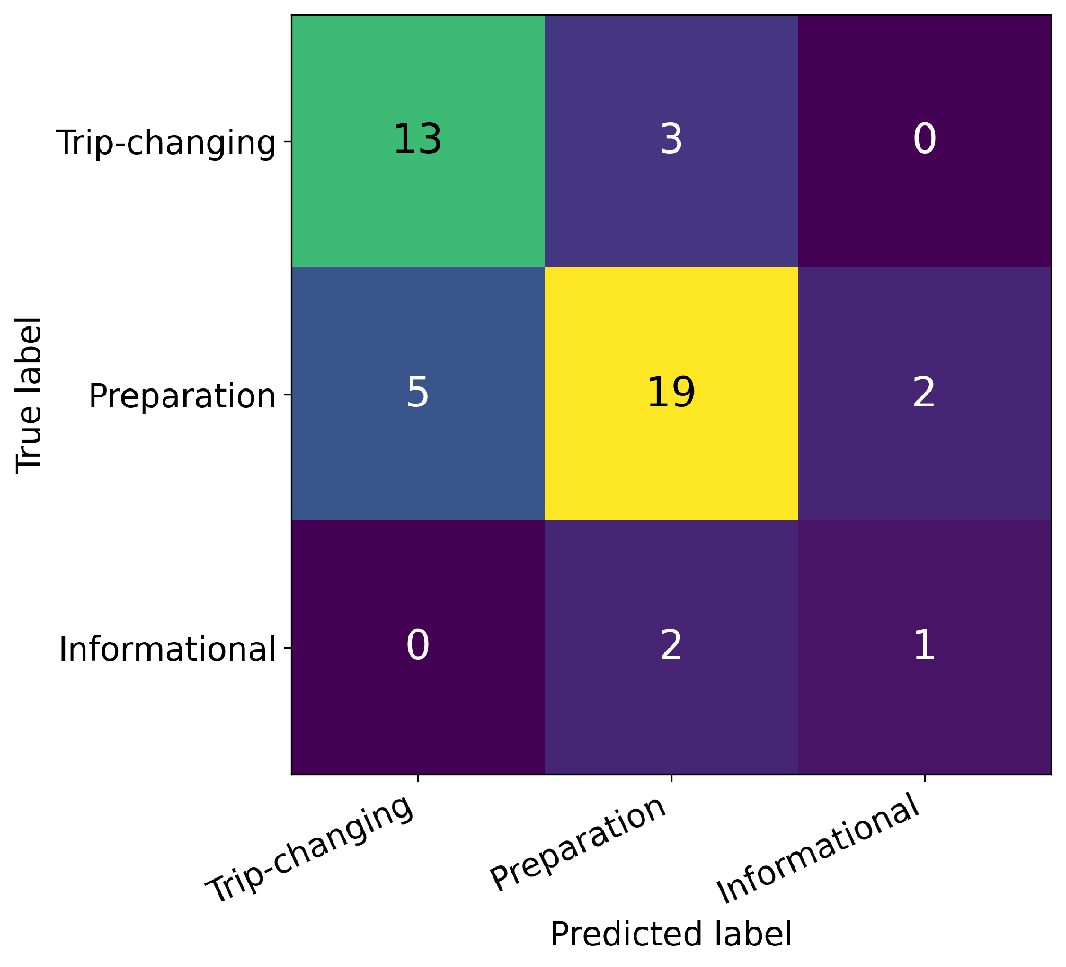
Appendix: impact-level confusion matrix
Most mistakes occurred between neighboring levels of practical disruption.
Held-out parks, selected model
• Correct: 33 of 45 alerts.
• Errors: 12 alerts.
• No direct trip-changing vs. informational/minimal errors.
• Informational support was only n = 3.
Takeaway: errors were understandable boundary cases, not random failures.
Future ordinal or cost-sensitive models could penalize severe under-classification more heavily.
From Park Alerts to Hiking Decisions
18

Slide 19
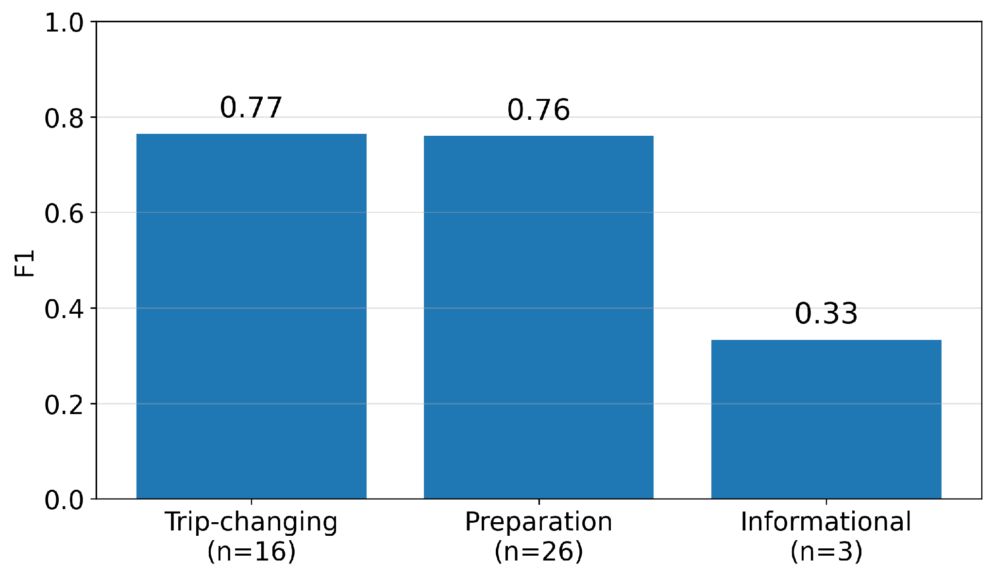
Appendix: rare-class performance requires caution
Per-class F1 shows why Macro F1 and support counts matter.
Class-level reading
• Trip-changing and preparation alerts were classified with similar F1.
• The informational score is unstable because n = 3.
• This supports describing the impact analysis as exploratory.
Main claim: useful signal, not definitive rare-class evidence.
From Park Alerts to Hiking Decisions
19

Slide 20
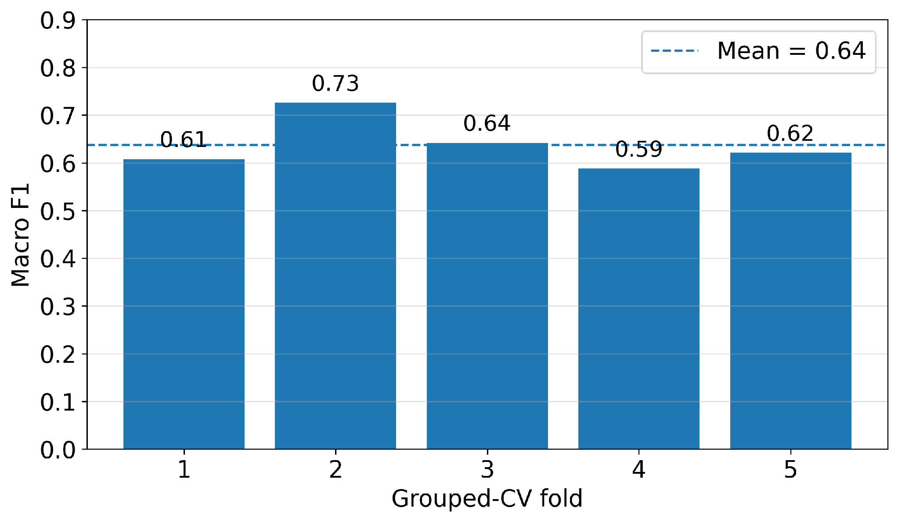
Appendix: impact robustness across held-out park groups
Grouped CV excluded the fixed held-out test set.
Robustness check
Mean Macro F1: 0.637
SD: 0.054
Range: 0.588–0.726
• Performance was reasonably stable across park groups.
• This supplements, but does not replace, the fixed held-out test.
From Park Alerts to Hiking Decisions
20

