Slide 1
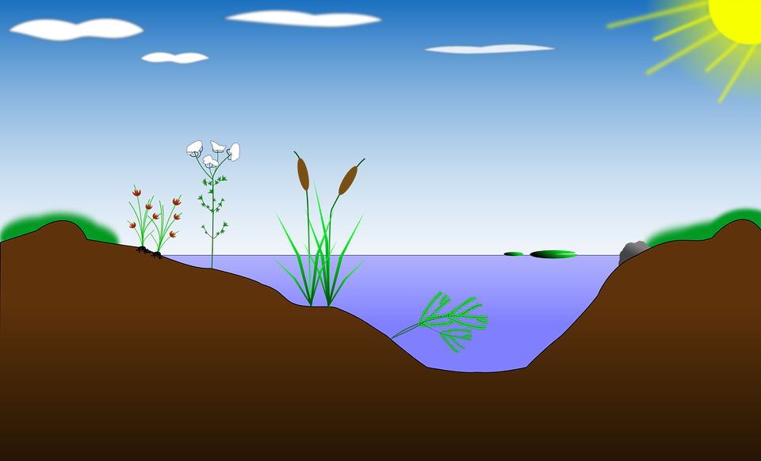
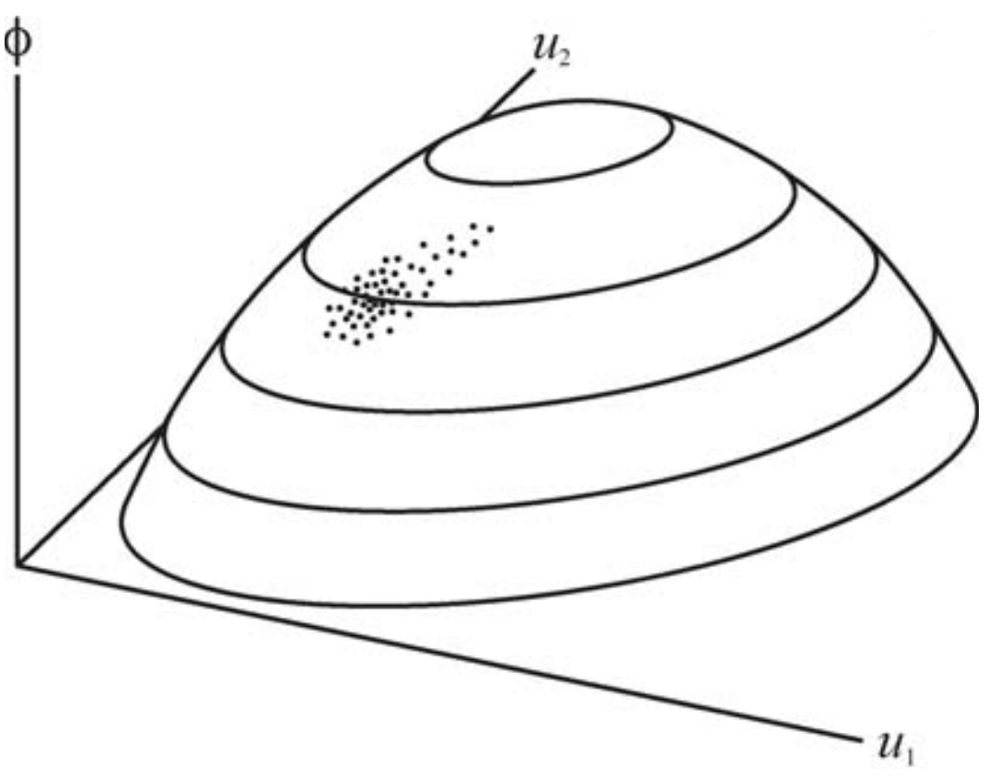

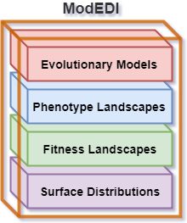
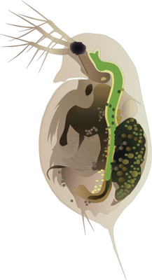
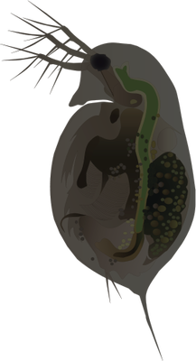

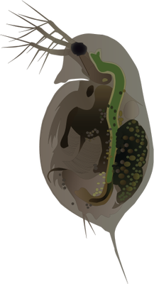
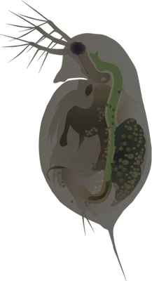
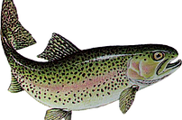



ModEDI: Extensible Models of Evolution with Developmental Interactions
Elizabeth Brooks, Graham Roberts, Filip Jagodzinski, Alison Scoville
Phenotype vs Developmental Factors
Sensitivity to UVB
Melanin
Average Daytime Depth
http://ian.umces.edu/imagelibrary/displayimage-4387.html
https://t3.ftcdn.net/jpg/00/47/53/14/240_F_47531414_8Vj6iYmdowUNtgFrxmmtgPdT8gRTzCdy.jpg
https://pixabay.com/en/biotope-lake-pond-habitat-reed-154853/
Notes:
-Hello I am Elizabeth Brooks and I will be describing ModEDI, a software architecture for modeling the change in physical traits of a species in the presence of non linear developmental interactions.
-So, with this software architecture, biologists may test evolutionary-developmental and quantitative genetic hypotheses.
-Quantitative genetics is the study of complex biological traits, or traits controlled by more than one gene.
-A primary goal of quantitative genetics studies is the development of computational models for predicting the evolution of physical traits in response to selection.
-However, currently available tools employ a constant genetic variance co-variance matrix, which does not sufficiently capture the effects of selection on complex physical traits.
-To investigate these complex genetic dynamics, we have developed models of quantitative trait evolution for Daphnia melanica.
-Daphnia are a freshwater microcrustacean, commonly found in high alpine lakes of the Sierra Nevada.
-In these lakes, Daphnia will swim near the water’s surface, receiving a high amount of UV radiation and will be dark in pigmentation.
-When fish predators are introduced into one of these lakes, as in the case of sport fishing, the Daphnia will migrate lower in the water column to avoid them.
-By being lower in the water column, the Daphnia receive less UV radiation and are lighter in pigmentation.
-These non-linear interactions between a Daphnia’s sensitivity to UVB and their average daytime depth are captured by the unique phenotype surface provided by ModEDI.
-Our code base for ModEDI implements a powerful, general mathematical and conceptual framework of evolutionary models developed by Sean Rice.
-For these models, two elements are needed to predict the evolution of traits due to selection: the strength and direction of selection, and the availability of heritable genetic variation.
-The strength and direction of selection is captured by the individual fitness surface, which describes the expected reproductive success of an individual as a function of its trait values.
-Additionally, this framework utilizes a phenotypic landscape to explicitly incorporate the effects of development on heritable phenotypic variation.
-The phenotype surface is constructed by plotting the value of a phenotype against the values of underlying genetic and environmental factors that interact in its development.
-From this surface, populations of Daphnia are simulated, where each point on the landscape corresponds to an individual.
-Here is an example of the phenotype surface for Daphnia, as described by this linear function for the production of melanin with respect to the underlying genetic factors of sensitivity to UVB and average daytime depth.
-The object-oriented software architecture of ModEDI simulates the evolution of physical traits of a population of a species by describing a blueprint for objects of individuals of that species.
-With our program, users are able to develop custom simulations for analyzing the evolution of multiple physical traits, while allowing for interactions between overlapping sets of developmental factors.
-Initial results from simulations performed with ModEDI do indicate that developmental interactions may substantially alter evolutionary trajectories.

