Slide 1


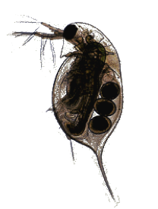
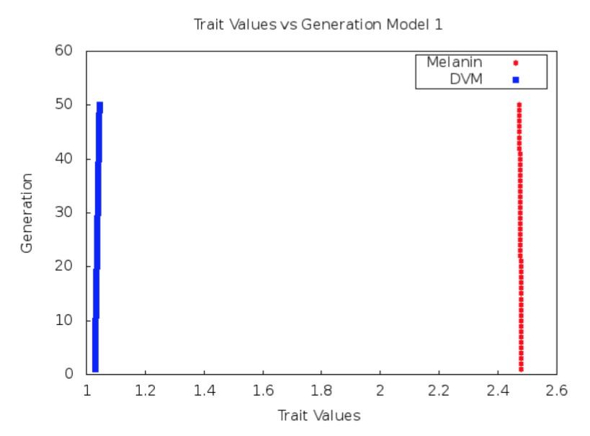
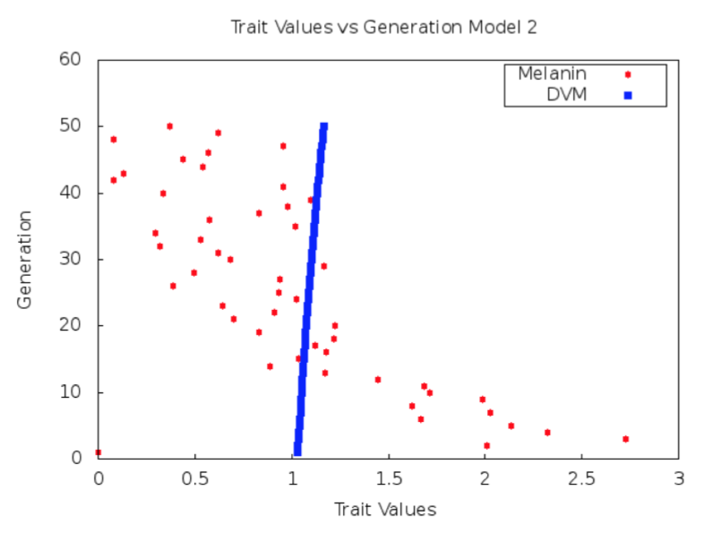
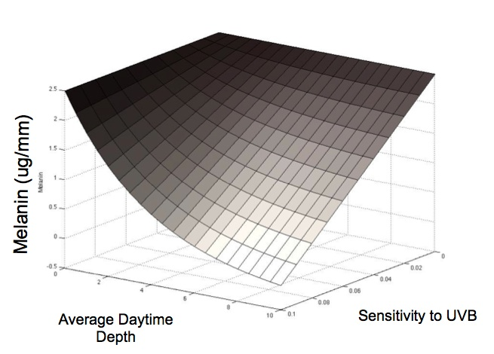



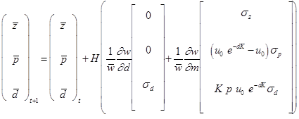
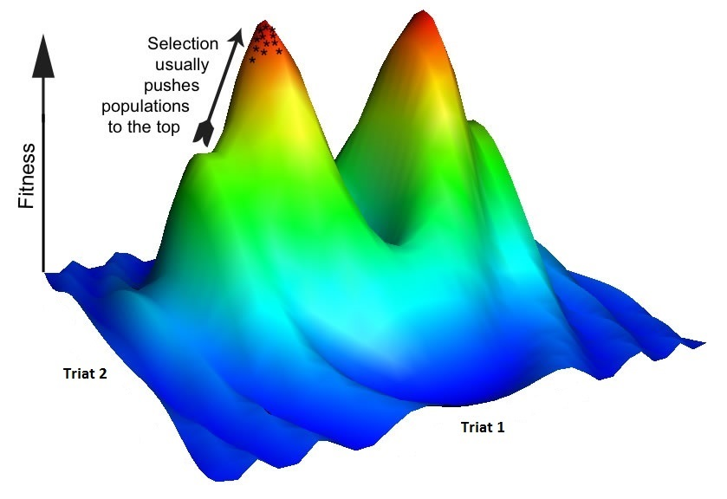

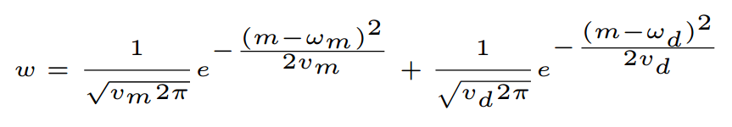
An Extensible Software Infrastructure for Testing the Evolutionary Consequences of Developmental Interactions
Elizabeth Brooks
Central Washington Univ.
Dept. of Computer Science
Ellensburg, WA 98926
brookse@cwu.edu
Alison Scoville
Central Washington Univ.
Dept. of Biological Sciences Ellensburg, WA 98926 scoville@cwu.edu
Filip Jagodzinski
Western Washington Univ.
Dept. of Computer Science
Bellingham, WA 98225 ﬁlip.jagodzinski@wwu.edu
Central Washington University
Introduction
Methods: Java/C++
Preliminary Results
Quantitative genetics is the study of traits of an organism, such as size or degree of pigmentation, that are controlled by more than one gene. Many quantitative genetic models use the genetic (co)variances of traits (the G-matrix) to predict evolution in response to selection. However, developmental interactions can cause rapid changes to the G-matrix. Because of this, traditional models may not accurately predict evolutionary dynamics.
The goal of this research is to develop a code infrastructure that implements a mathematical framework that explicitly incorporates nonlinear interactions between developmental factors of multiple traits, based on the concept of a phenotypic landscape (Rice 2002). This will allow users to test hypothesis concerning the evolutionary consequences of nonlinear developmental interactions. We have, in Java and C++, developed two models of increasing developmental complexity for testing hypothesis regarding evolutionary trajectories specific to high-alpine populations of Daphnia melanica.
As a first step, with the Java programming language we have developed a G-matrix based model and a second more advanced model that allows the user to test hypotheses about how the developmental interactions among two traits in Daphnia melanica, diel vertical migration and melanin production.
Initial parameters for model testing have been estimated using empirical data from multiple populations of Daphnia melanica in high altitude alpine lakes of Sierra Nevada.
Phenotypic landscape of melanin for an individual Daphnia as a function of average daytime depth and sensitivity to induction via UVB radiation.
The G-matrix based model (left) predicts only a slight change in the evolutionary trajectory of the modeled Daphnia population. However, the second more advanced model (right) incorporates underlying developmental factors of traits in order to project the changes from generation t to generation t+1 due to directional selection, as given by Rice (2002, 2004).
The more advanced models are also written in C++ to take advantage of the math libraries of the high level programming language. Translation to C++ will allow for the development of a generalized model module for additional programming languages, such as Python and R.
Quantitative Genetics Models
Conclusions - Future Work
*
Model One
Model Two
This software will allow users to assess the effect of developmental architecture on evolutionary trajectories. Future versions of our software will be available online as a user-friendly web tool, which will provide options to custom supply model parameters and equations specifying the relationship between developmental factors and traits of interest.
Model One: a model that predicts the evolution of mean melanin* and mean diel vertical migration (DVM)* of Daphnia over time, based on the genetic (co)variances of these traits.
Model Two: a model that predicts the evolution of mean melanin* and mean diel vertical migration (DVM)* over time, while allowing for “developmental entanglement” between these traits.
*
*
References
The individual fitness surface (w) is defined by the sum of fitness values associated with the m and d values of an individual. This describes how the trait values of an individual affect its fitness.
M. Bj¨orklund, A. Husby, and L. Gustafsson. Rapid and unpredictable changes of the G-matrix in a natural bird population over 25 years. Journal of Evolutionary Biology, 26(1):1–13, Jan. 2013.
F. Eroukhmanoﬀ. Just How Much is the G-matrix Actually Constraining Adaptation? Evolutionary Biology, 36(3):323–326, May 2009.
T. F. Hansen. The Evolution of Genetic Architecture. Annual Review of Ecology, Evolution, and Systematics, 37:123–157, Jan. 2006.
R. Lande and S. J. Arnold. The Measurement of Selection on Correlated Characters. Evolution, 37(6):1210–1226, Nov. 1983.
S. Rice. A general population genetic theory for the evolution of developmental interactions. Proceedings of the National Academy of Sciences, 99:15518–15523, 2002.
D. Schluter. Adaptive Radiation Along Genetic Lines of Least Resistance. Evolution, 50(5):1766–1774, Oct. 1996.
*
*
Developmental entanglement arises from the fact that DVM influences exposure to UV radiation, and UV radiation stimulates the production of melanin.
Acknowledgements
Selection acts on traits to push populations towards optimum fitness.
Funding provided by the National Science Foundation and the McNair Post-Baccalaureate Achievement Program, Central Washington University.
Additional funding provided by Dean Kirk Johnson, College of the Sciences, Central Washington University.

