Slide 1
An Extendable Software Package for Determining the Effects of Developmental Interactions on Evolutionary Trajectories
Elizabeth Brooks - CWU, Dept. of Computer Science
Dr. Alison Scoville - CWU, Dept. of Biological Sciences
Dr. Filip Jagodzinski - WWU, Dept. of Computer Science

Slide 2
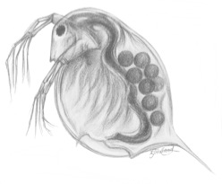
Biological Background Topics
Evolutionary Development
Fitness
Selection
Developmental Interactions

Slide 3
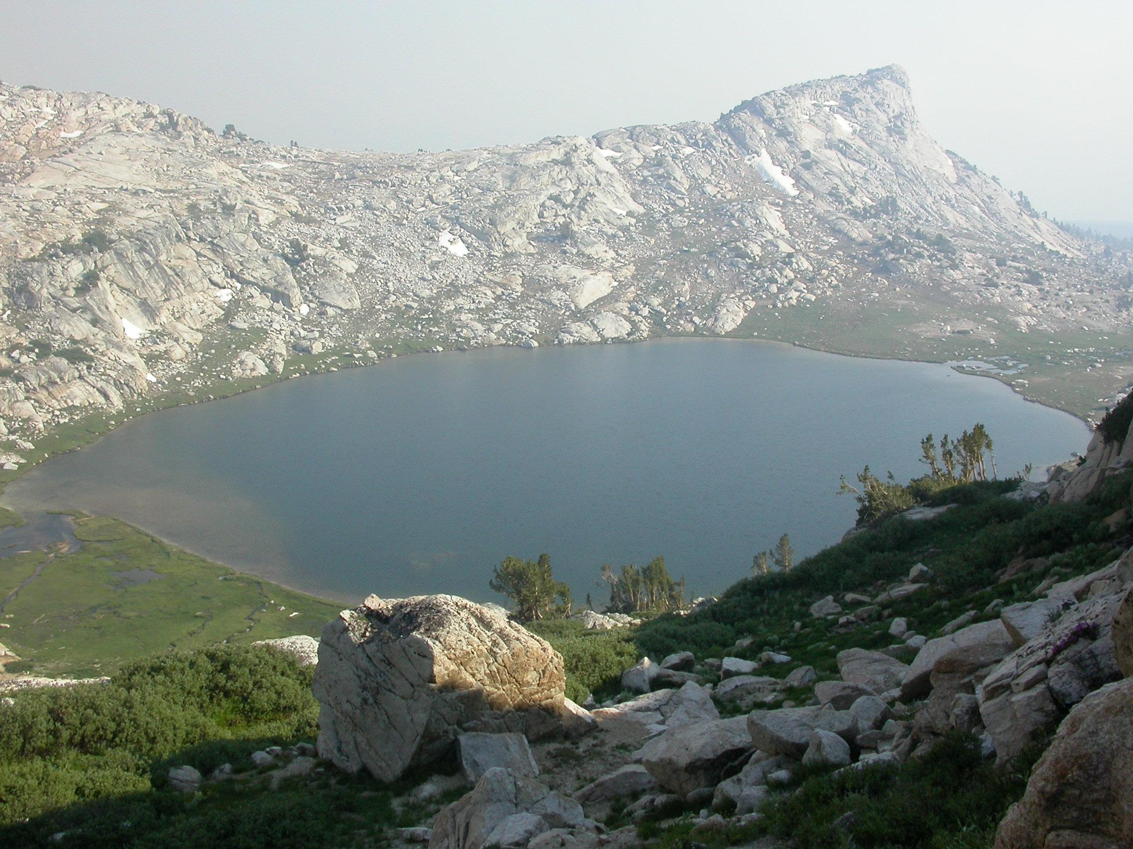
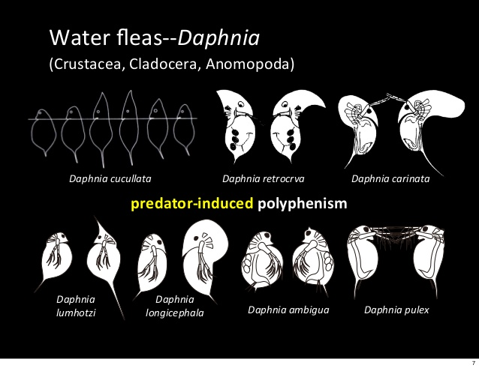
Evolutionary Development

Slide 4
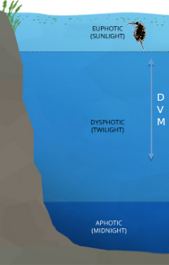
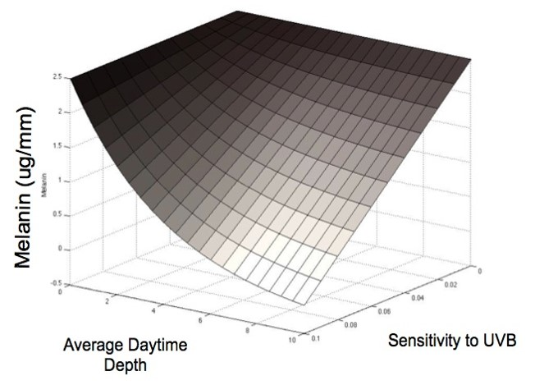
Developmental Interactions

Slide 5
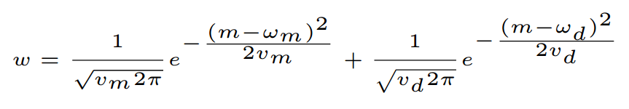
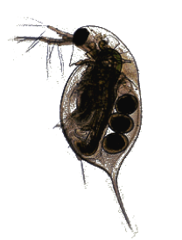
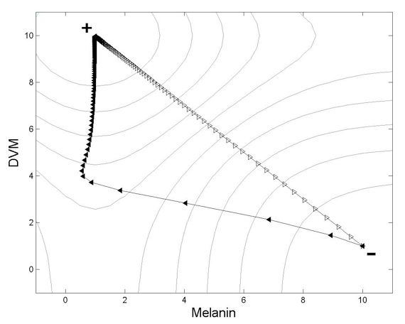
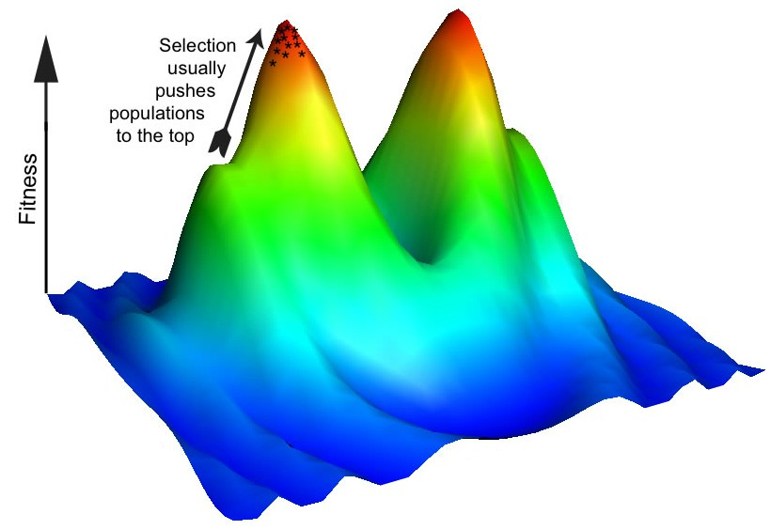
Fitness & Selection
DVM
Melanin

Slide 6
Research Motivation
Genes controlling one trait may overlap with genes influencing other traits.
Traits often result from nonlinear interactions between developmental factors.
Developmental interactions may result in large and rapid changes to trait (co)variances and the traditionally used genetic variance-covariance matrix (G-matrix).

Slide 7
Research Objectives
Program to project the evolutionary trajectories of a given species.
Implementation of traditional and updated mathematical models.
Extendable software package for future developments.
Graphical visualization of model results.

Slide 8

Software Development Topics
Object-Oriented Program Structure
Classic Mathematical Model
Updated Mathematical Models
Web User Interface
Visualization of Results

Slide 9
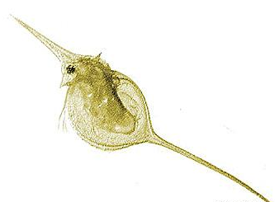
Object-Oriented Program Structure
Objects model the state and behavior of real-world systems or entities.
Daphnia melanica
Genus: Daphnia
Species: melanica
Animalia
Kingdom: Animalia
Family: Daphniidae
Daphnia lumholtzi
Genus: Daphnia
Species: lumholtzi
Real-World Domain
Model Domain

Slide 10

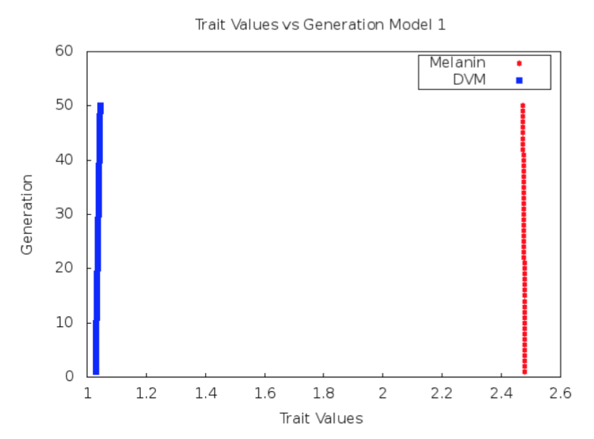

Classic Mathematical Model
Predicts the evolution of mean melanin and mean diel vertical migration (DVM) of Daphnia over time, based on the genetic (co)variances (G-matrix) of these traits.

Slide 11

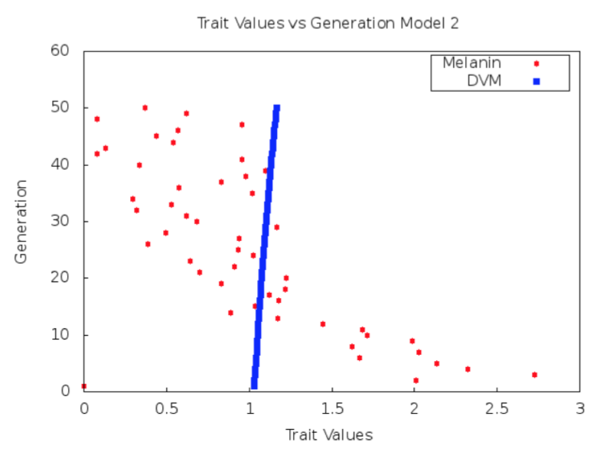
Updated Mathematical Model - Tanning
Predicts the evolution of mean melanin and mean diel vertical migration (DVM) over time, while allowing for nonlinear interactions between these traits.

Slide 12
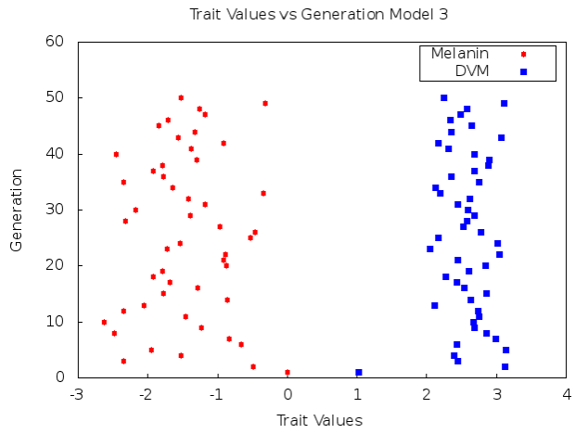
Updated Mathematical Model - Tolerance
Predicts the evolution of mean melanin and mean diel vertical migration (DVM) over time, while allowing for more complex nonlinear interactions between these traits.

Slide 13
ModEvo Web Interface

Slide 14
Research Objectives - Revisited
Program to project the evolutionary trajectories of a given species.
Implementation of traditional and updated mathematical models.
Extendable software package for future developments.
Graphical visualization of model results.

Slide 15
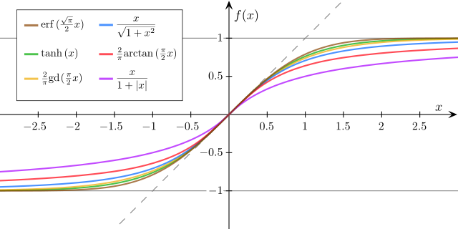
Future Work
Sigmoidal distributions
User supplied functions
Program optimization

Slide 16



References & Acknowledgements
M. Bj¨orklund, A. Husby, and L. Gustafsson. Rapid and unpredictable changes of the G-matrix in a natural bird population over 25 years. Journal of Evolutionary Biology, 26(1):1–13, Jan. 2013.
F. Eroukhmanoﬀ. Just How Much is the G-matrix Actually Constraining Adaptation? Evolutionary Biology, 36(3):323–326, May 2009.
T. F. Hansen. The Evolution of Genetic Architecture. Annual Review of Ecology, Evolution, and Systematics, 37:123–157, Jan. 2006.
R. Lande and S. J. Arnold. The Measurement of Selection on Correlated Characters. Evolution, 37(6):1210–1226, Nov. 1983.
S. Rice. A general population genetic theory for the evolution of developmental interactions. Proceedings of the National Academy of Sciences, 99:15518–15523, 2002.
D. Schluter. Adaptive Radiation Along Genetic Lines of Least Resistance. Evolution, 50(5):1766–1774, Oct. 1996.

