Slide 1
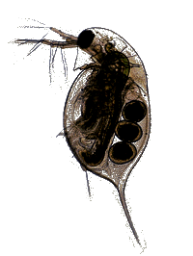
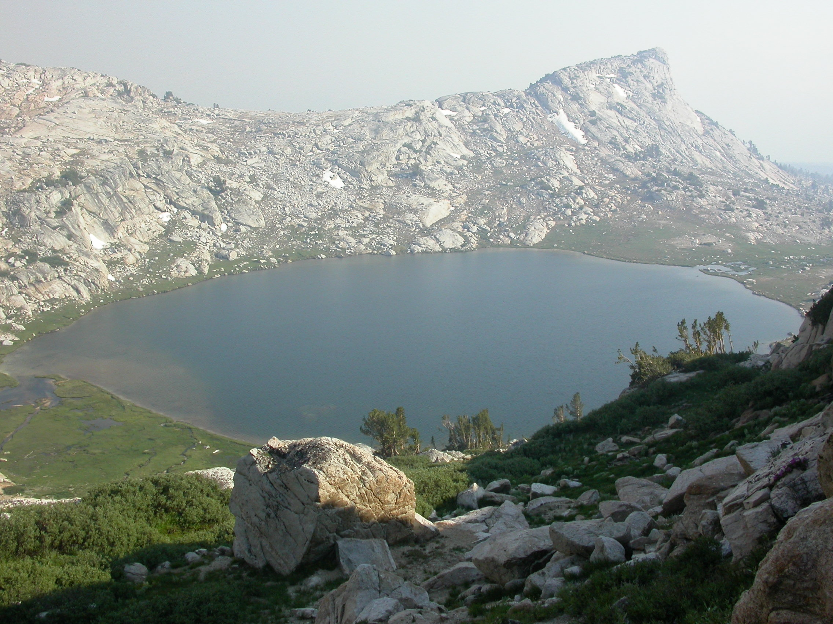
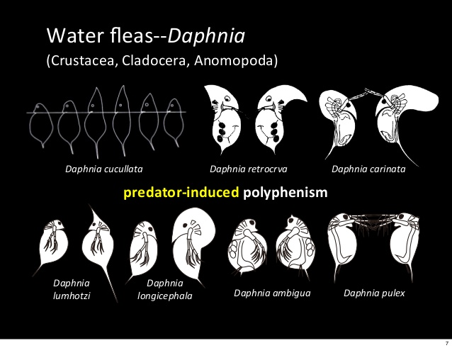
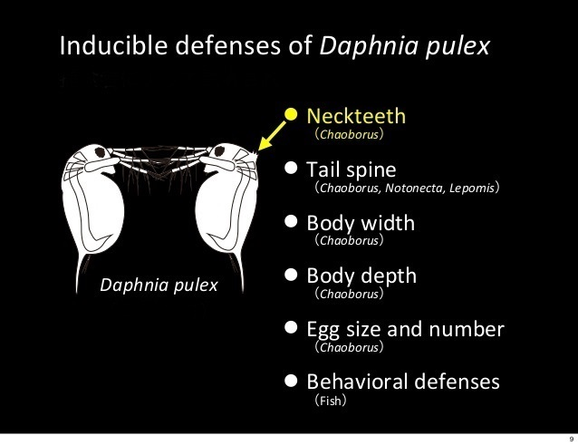
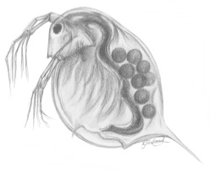
Object-Oriented Implementation of a Novel Mathematical Framework to Determine the Effects of Developmental Interactions on Evolutionary Responses
Elizabeth Brooks

Slide 2
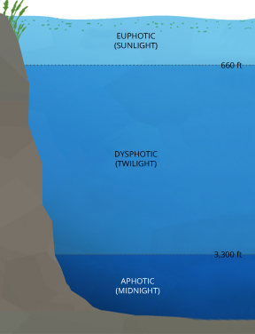
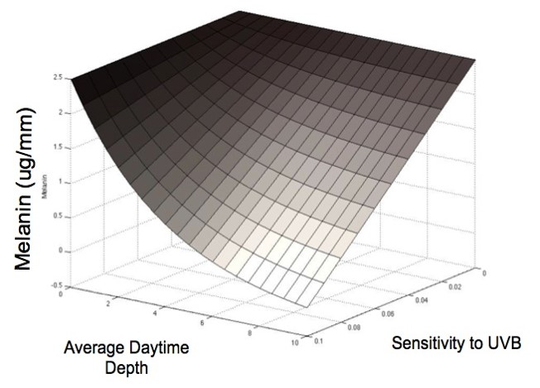
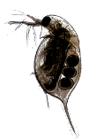

Evolutionary Developmental Biology
Traits often result from nonlinear interactions between developmental factors.
May produce large and rapid changes to trait (co)variances.
DVM

Slide 3
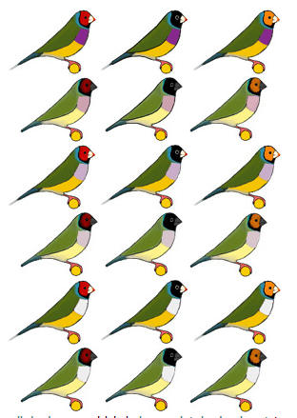
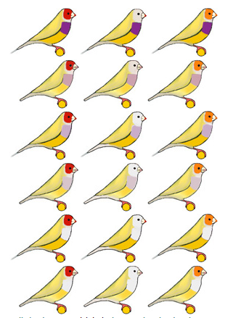
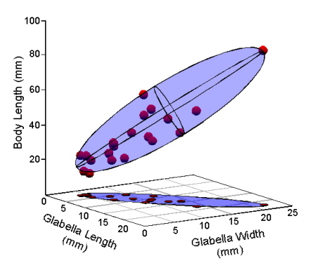
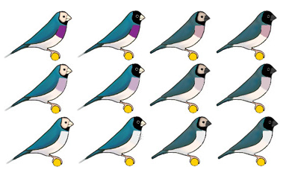
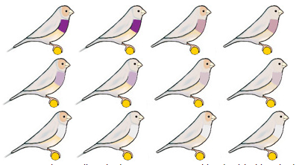


Quantitative Genetics
The study of complex biological traits.
Traits controlled by more than one gene, or epistasis.
Genes controlling one trait may overlap with genes influencing other traits.
Allows for covariation between traits.
The G-matrix describes the extent to which traits have genetic variation and whether or not different traits are genetically related.

Slide 4
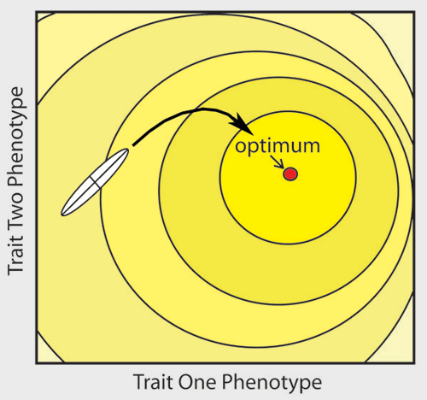
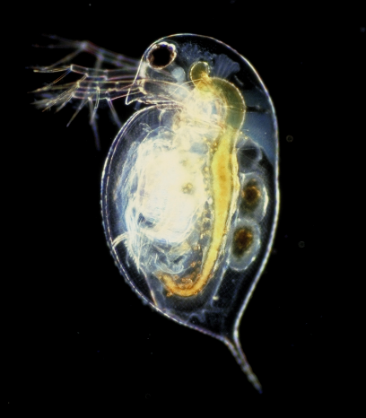
Research Motivation
Traditional quantitative genetic models rely on genetic variances and covariances (the G-matrix).
May be used to determine the short-term evolution of a species.
A fitness landscape represents how a species interacts with its environment to improve their ability to survive.
Fails to take into consideration the developmental interactions underlying traits.
The phototactic behavior of Daphnia affects multiple phenotypic traits.

Slide 5
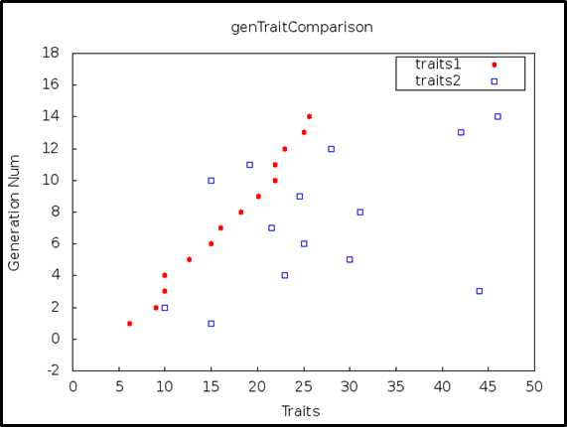
Objectives/Deliverables
The development of a program that will determine the extent to which the interactions of traits affects the evolutionary response of a given species.
Web-based tool that accepts user supplied functions.
Downloadable program packages in Java and C++.
Graphical representation of mathematical results.

Slide 6
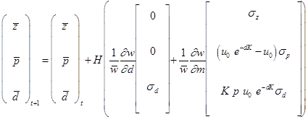
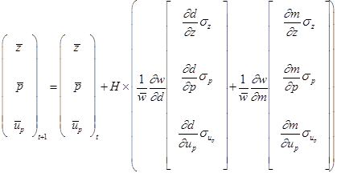





Updated Mathematical Framework
Model One
Model Two
Model Three
Relies on the genetic (co)variances of individual traits.
Allows for developmental entanglement on the first trait by the second.
Includes increasing levels of entanglement with specific, individual trait functions.

Slide 7
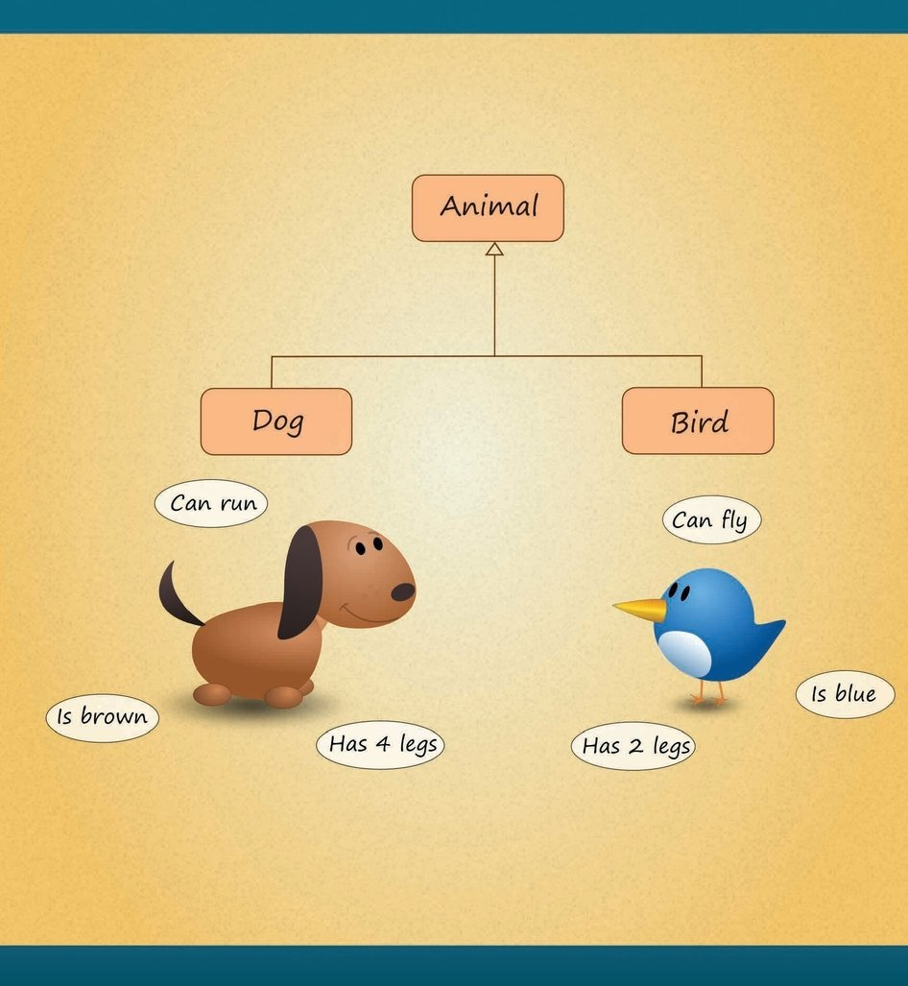
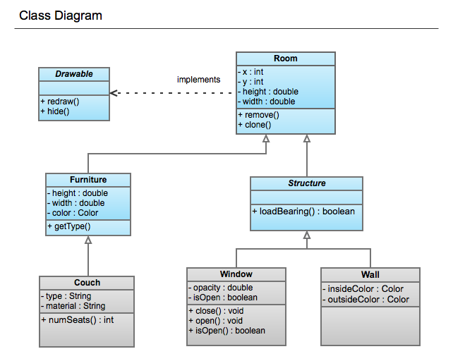
Object-Oriented Programming
Use of objects allows for increased code flexibility.
Objects are used to model the state and behavior of related systems.
Inheritance efficiently structures the code base and reduces redundancies.
Fields and methods may be shared between classes.
Interfaces provide specific classes with the necessary information for describing the state of an object in a particular instance.
A class describes the characteristics of an object through related functions.

Slide 8
Code Structure
SpeciesCharacteristics
IndividualFitness
GeneralModel
ModelOne
ModelTwo
ModelThree
IndividualTraitOneModelTwo
IndividualTraitOneModelThree
IndividualTraitTwo
ModelThree
MeanFitnessBy
SimulationModelThree
MeanFitnessBy
SimulationModelOne
MeanFitnessBy SimulationModelTwo
SpeciesCharacteristics
GeneralModel
ModelOne
ModelTwo
ModelThree
IndividualFitness
MeanFitnessBySimulationModelOne
MeanFitnessBySimulationModelTwo
MeanFitnessBySimulationModelThree
IndividualTraitOneModelTwo
IndividualTraitOneModelThree
IndividualTraitTwoModelThree
Driver

Slide 9
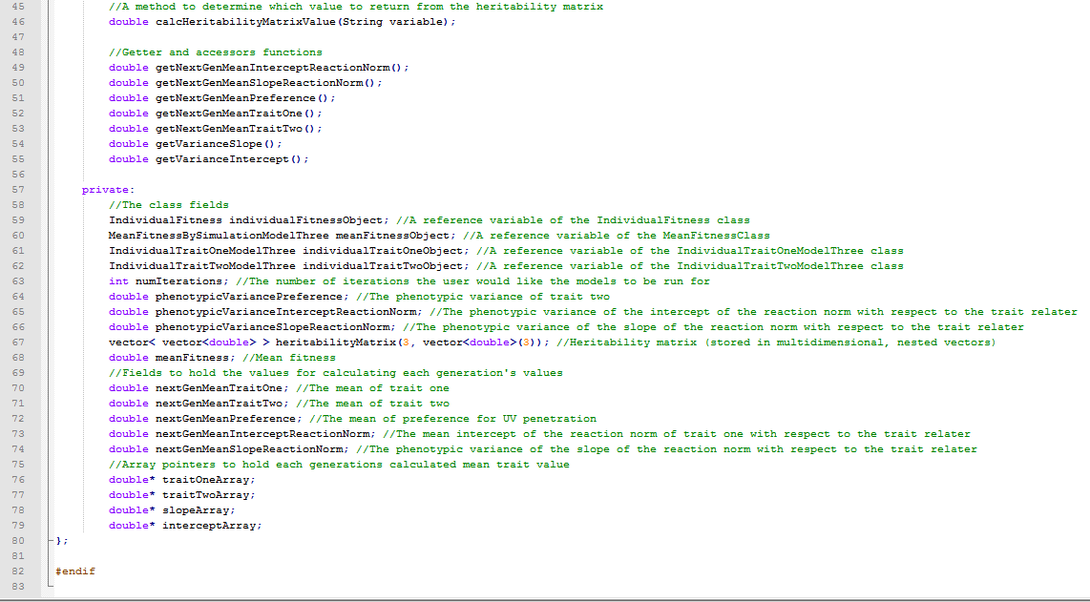
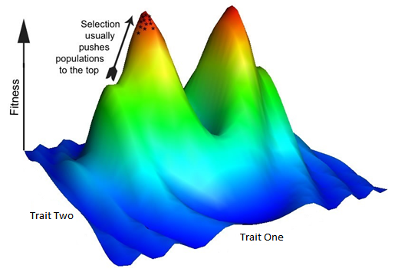

Shared Functions
SpeciesCharacteristics
IndividualFitness
GeneralModel
ModelOne
ModelTwo
ModelThree
IndividualTraitOneModelTwo
IndividualTraitOneModelThree
IndividualTraitTwo
ModelThree
MeanFitnessBy
SimulationModelThree
MeanFitnessBy
SimulationModelOne
MeanFitnessBy SimulationModelTwo
The individual fitness surface (w) is defined by the sum of fitness values associated with the trait values (m,d) of an individual.

Slide 10
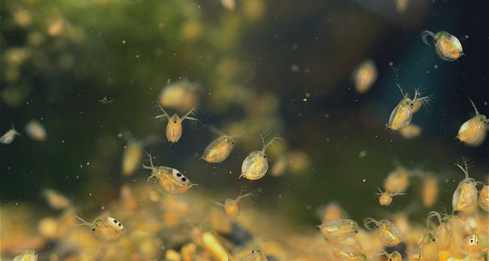
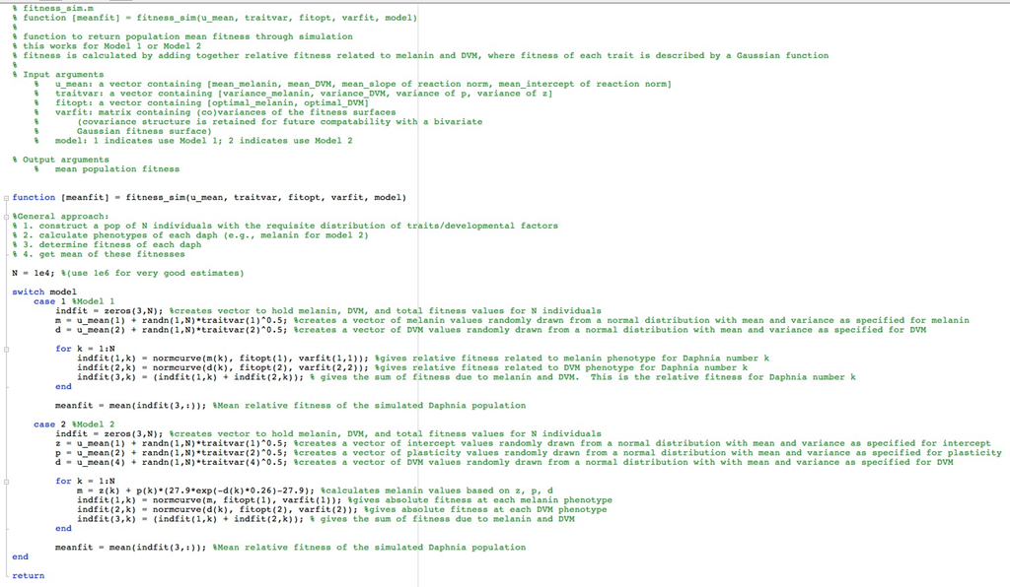
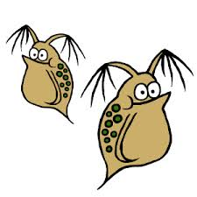

Program and Data Verification
Dr. Alison Scoville
Department of Biology, Central Washington University

Slide 11
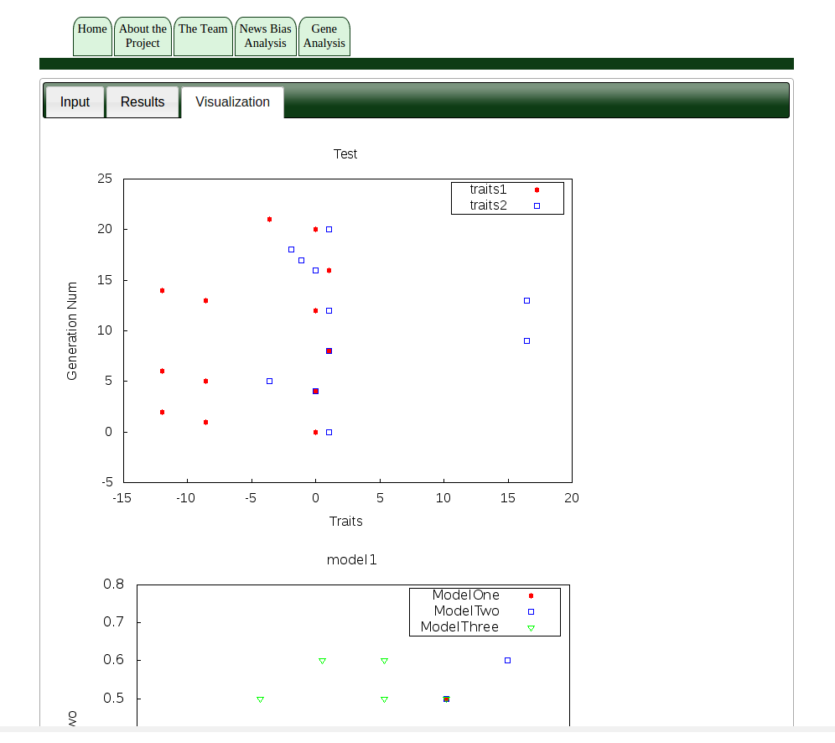
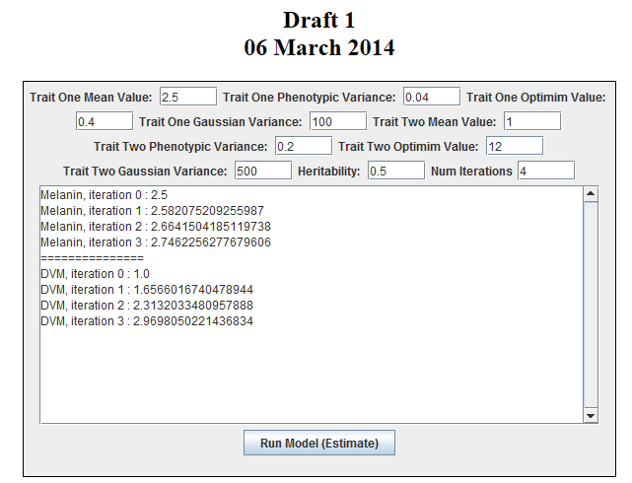
Web-Based Tool
Biologists will be able to test hypothesis about the evolutionary trajectory of a given species.
Accepts user supplied values and functions.
Displays plots of trait development.
Program packages will be available for download in multiple languages.

Slide 12
References
Bateson, W. 1894. Materials for the study of variation, treated with especial regard to discontinuity in the origin of species. London: Macmillan.
Carroll, S.B., and S.P. Klassen, 1997. Genetic differentiation of fitness-associated traits among rapidly evolving populations of the soapberry bug. Evolution 51:1182-1188.
Mohan, Permanand. 2013. Fundamentals of Object-Oriented Programming in Java. CreateSpace Independent Publishing Platform.
Parsons, K. J., and B. W. Robinson. 2006. Replicated evolution of integrated plastic responses during early adaptive divergence. Evolution 60: 801-813.
Rice, S. H. 2002. A general population genetic theory for the evolution of developmental interactions. PNAS 99: 15518-15523.
Rice, S. H. 2004a. Evolutionary Theory: Mathematical and conceptual foundations. Sinauer Associates. Sunderland MA.
Rice, S. H. 2004b. Developmental associations between traits: covariance and beyond. Genetics 166:513-526.
Streelman, J. Todd (ed). 2014. Advances in Evolutionary Developmental Biology. Wiley-Blackwell. Retrieved from http://www.eblib.com.
Wolf, J. B. 2002. The geometry of phenotypic evolution in developmental hyperspace. Proceedings of the National Academy of Sciences, USA 99:15849-15851.

