Slide 1
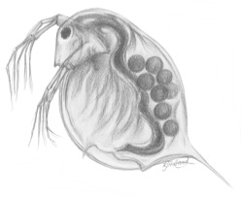
An Extensible Software Infrastructure for Testing the Evolutionary Consequences of Developmental Interactions
Elizabeth Brooks
Central Washington Univ.
Dept. of Computer Science
Ellensburg, WA 98926
brookse@cwu.edu
Alison Scoville
Central Washington Univ.
Dept. of Biological Sciences Ellensburg, WA 98926 scoville@cwu.edu
Filip Jagodzinski
Western Washington Univ.
Dept. of Computer Science
Bellingham, WA 98225 ﬁlip.jagodzinski@wwu.edu

Slide 2
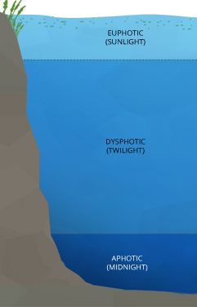

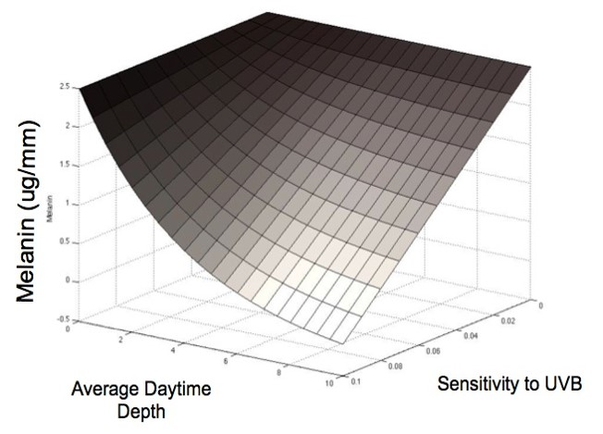

Research Motivation
Genes controlling one trait may overlap with genes influencing other traits.
The G-matrix describes the extent to which traits have genetic variation and whether or not different traits are genetically related.
Non-additive developmental interactions can alter genetic variances.
DVM
Traits often result from nonlinear interactions between developmental factors.
May produce large and rapid changes to trait (co)variances.
The G-matrix may become unstable, and may therefore not accurately predict evolutionary dynamics.

Slide 3
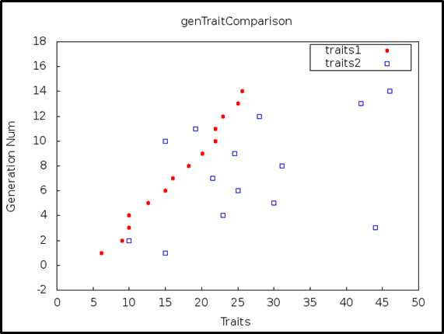
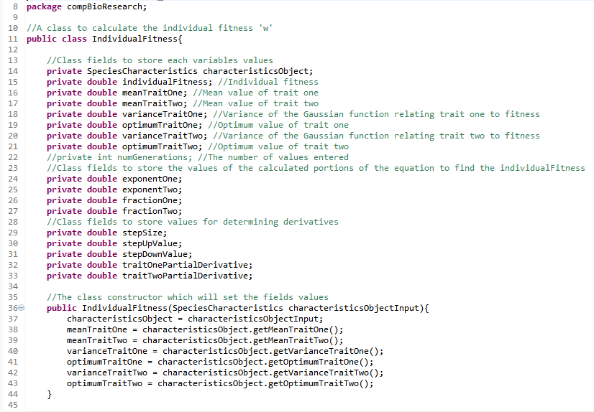
Research Objectives
The development of a program that will determine the extent to which the interactions of traits, melanin and diel vertical migration (DVM), affects the evolutionary response of Dapnia melanica.
Deliverables:
Graphical representation of numeric program results.
Extensible codebase to produce custom models for specific species of organisms.
Web-based tool that accepts user supplied functions of developmental interactions.

Slide 4

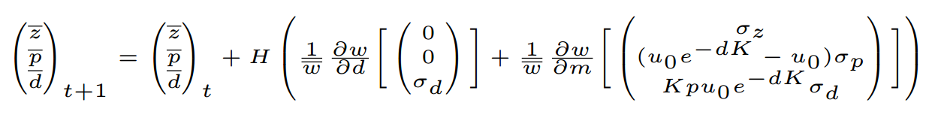


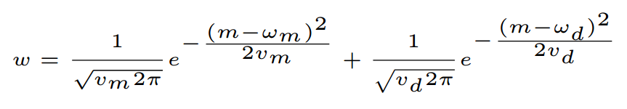
Mathematical Framework
Model One
Model Two
Predicts the evolution of mean melanin and mean diel vertical migration (DVM) of Daphnia over time, based on the genetic (co)variances of these traits.
Predicts the evolution of mean melanin and mean diel vertical migration (DVM) over time, while allowing for nonlinear interactions between these traits.
Shared Fitness Function
The individual fitness surface (w) is defined by the sum of fitness values associated with the trait values (m,d) of an individual.

Slide 5
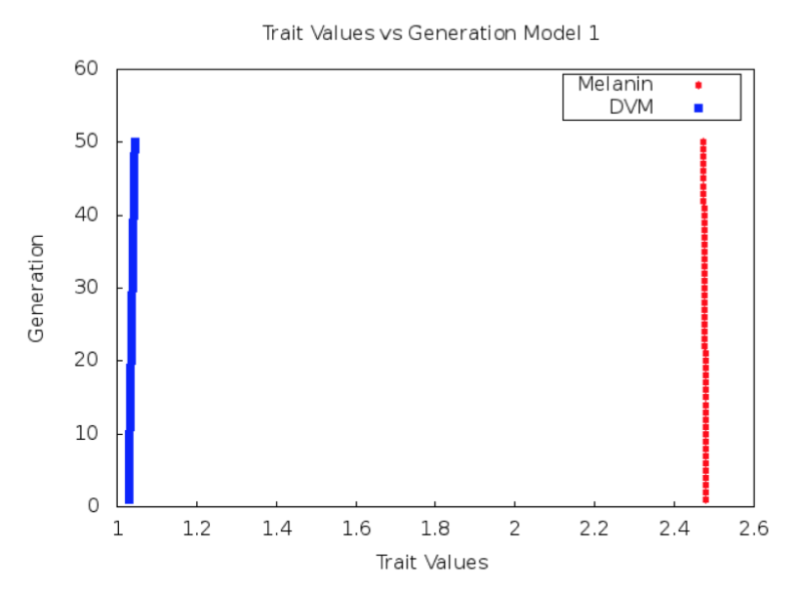
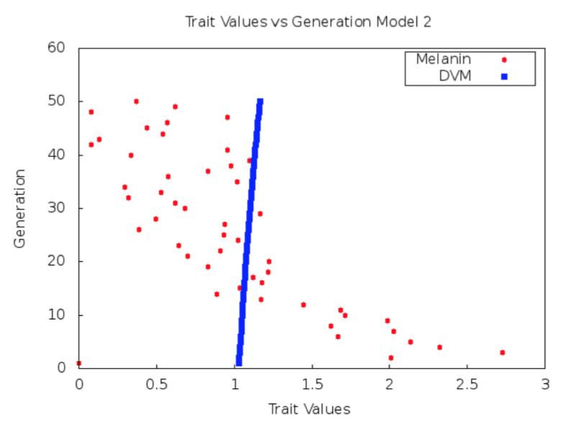
Preliminary Results
The G-matrix based model (left) predicts a small variation in the evolutionary trajectory of traits for the modeled Daphnia population. The second, more advanced model (right) incorporates underlying developmental factors of traits, resulting in an increased calculated evolutionary response.
Initial parameters for model testing have been estimated using empirical data from multiple populations of Daphnia melanica in high altitude alpine lakes of Sierra Nevada.

Slide 6
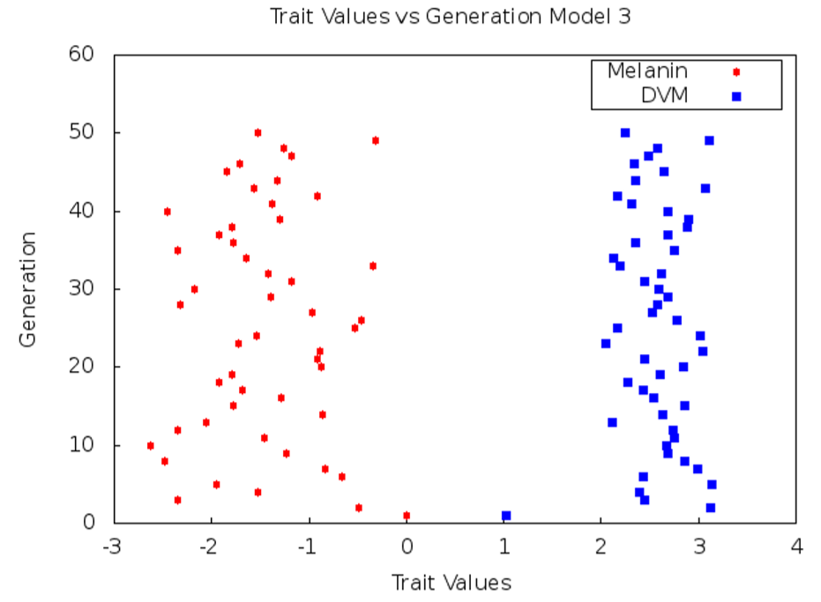
Future Work
Test and optimize model 3
C++ translation of updated models
Develop Python and/or R module
Test and compare optimized model results

Slide 7
References
M. Bj¨orklund, A. Husby, and L. Gustafsson. Rapid and unpredictable changes of the G-matrix in a natural bird population over 25 years. Journal of Evolutionary Biology, 26(1):1–13, Jan. 2013.
F. Eroukhmanoﬀ. Just How Much is the G-matrix Actually Constraining Adaptation? Evolutionary Biology, 36(3):323–326, May 2009.
T. F. Hansen. The Evolution of Genetic Architecture. Annual Review of Ecology, Evolution, and Systematics, 37:123–157, Jan. 2006.
R. Lande and S. J. Arnold. The Measurement of Selection on Correlated Characters. Evolution, 37(6):1210–1226, Nov. 1983.
S. Rice. A general population genetic theory for the evolution of developmental interactions. Proceedings of the National Academy of Sciences, 99:15518–15523, 2002.
D. Schluter. Adaptive Radiation Along Genetic Lines of Least Resistance. Evolution, 50(5):1766–1774, Oct. 1996.

