Slide 1
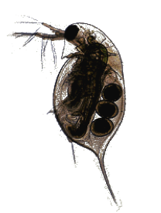

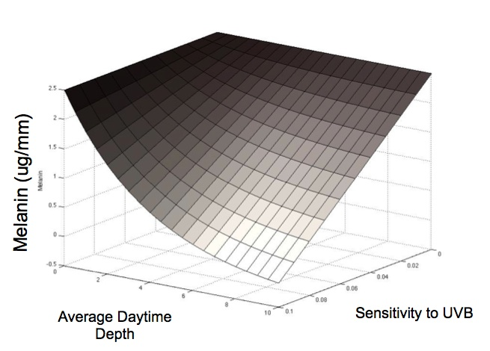





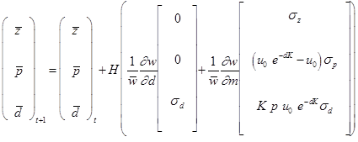
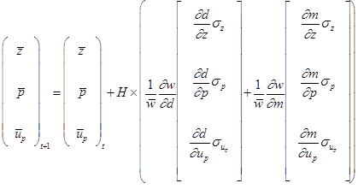
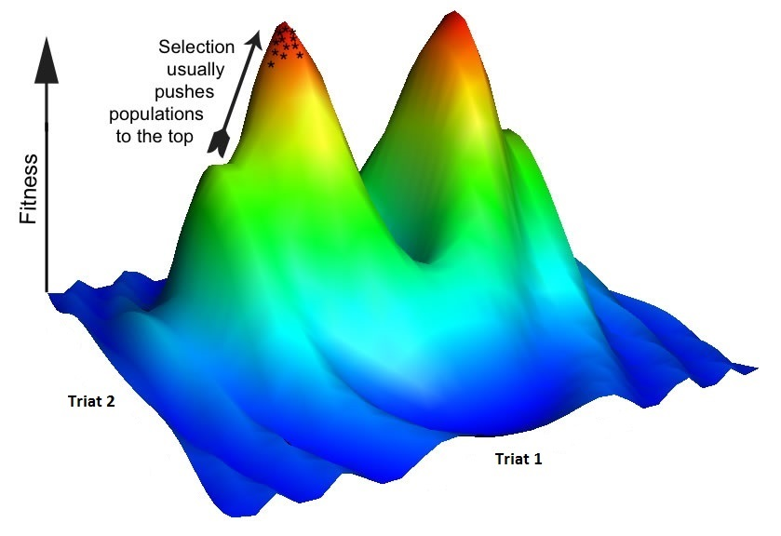


A Java and C++ Implementation of a Novel Quantitative Genetic Framework for the Evolution of Complex Biological Traits
Elizabeth Brooks† , Dr. Filip Jagodzinski† , and Dr. Alison Scoville∗
*Department of Biology, Central Washington University, Ellensburg, WA 98926 USA
scoville@cwu.edu
† Department of Computer Science, Central Washington University, Ellensburg, WA 98926 USA
brookse@cwu.edu, jagodzinski@cwu.edu
Central Washington University
Introduction
Methods: Java
Methods: C++
Quantitative genetics is the study of traits of an organism, such as size or degree of pigmentation, that are controlled by more than one gene. Many quantitative genetic models use the genetic (co)variances of traits (the G-matrix) to predict evolution in response to selection. However, developmental interactions can cause rapid changes to G-matrix. Because of this, traditional models may not accurately predict evolutionary dynamics.
The goal of this project is to determine the extent to which the developmental architecture of traits affects the evolutionary response of a given species. This may be achieved through use of a mathematical framework that explicitly incorporates nonlinear interactions between developmental factors underlying one or more traits, based on the concept of a phenotypic landscape (Rice 2002).
As a first step, with the Java programming language we have developed a G-matrix-based model as well as second model that allows the user to test hypotheses about how the developmental interactions among two traits in Daphnia melanica, diel vertical migration and melanin production, affect their (co)variances and subsequent evolutionary trajectories.
The more advanced models are written in C++ to take advantage of the math libraries of the C++ programming language. These mathematical models incorporate the underlying developmental factors of traits in order to project the changes from generation t to generation t+1 due to directional selection, as given by Rice (2002, 2004).
Phenotypic landscape of melanin as a function of average daytime depth and sensitivity to induction via UVB radiation.
The trait values for melanin and DVM are simulated for several individuals of a random population using a single set of biologically relevant roots.
Quantitative Genetics Models
Conclusions - Future Work
Model One
Model Two
Model Three
This software will allow users to assess the effect of developmental architecture on evolutionary trajectories. Future versions of our software will be available online as a user-friendly web tool, which will provide options to custom supply model parameters and equations specifying the relationship between developmental factors and traits of interest.
Model One: a model that predicts the evolution of mean melanin and mean diel vertical migration (DVM) of Daphnia over time, based on the genetic (co)variances of these traits.
Model Two: a model that predicts the evolution of mean melanin and mean diel vertical migration (DVM) over time, while allowing for “developmental entanglement” between these traits, due to the fact that DVM influences exposure to UV radiation, and UV radiation stimulates production of melanin.
Model Three: a model that predicts the evolution of mean melanin and mean diel vertical migration (DVM) over time that continues to allow for developmental entanglement between these traits. This is due to the fact that DVM is determined by behavioral avoidance of UV penetration, and UV penetration is partially determined by melanin.
The individual fitness surface (w) is defined by the sum of fitness values associated with the m and d values of an individual.
References
Rice, S. H. 2002. A general population genetic theory for the evolution of developmental interactions. PNAS 99: 15518-15523.
Arnold, S. J., R. Bürger, P. A. Hohenlohe, B. C. Ajie, A. G. Jones. 2008. Understanding the evolution and stability of the G-matrix. Evolution 62:2451-2461.
Jones, A. G., S. J. Arnold, and R. Bürger. 2003. Stability of the G-matrix in a population experiencing stabilizing selection, pleiotropic mutation, and genetic drift. Evolution 57:1747-1760.
A fitness surface describes how the trait values of an individual affect its fitness. Selection acts on traits to push populations towards optimum fitness.
Acknowledgements
Funding provided by Dean Kirk Johnson, College of the Sciences, Central Washington University.

