Slide 1


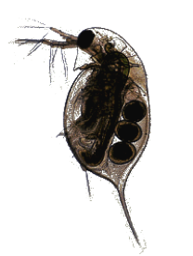
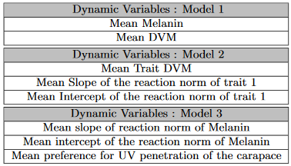
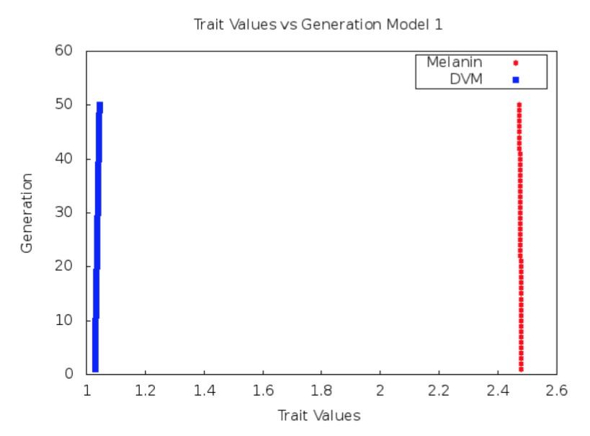
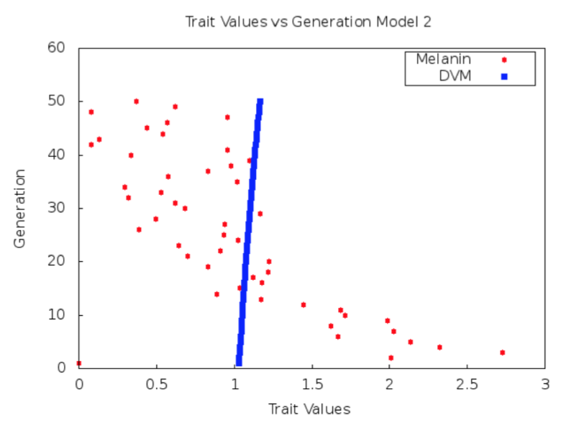
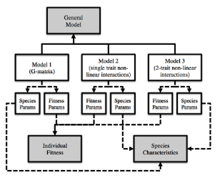

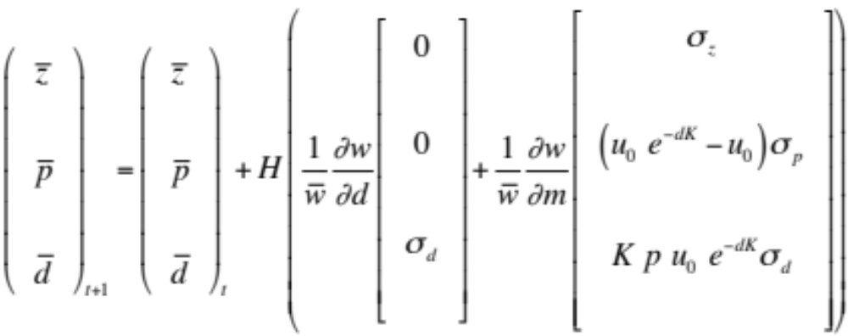
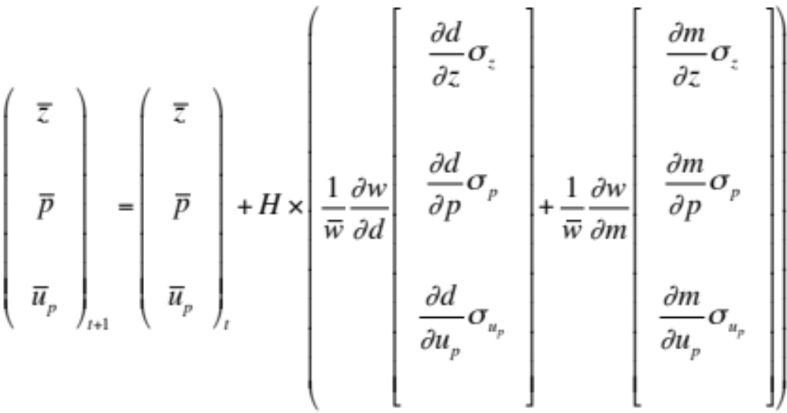

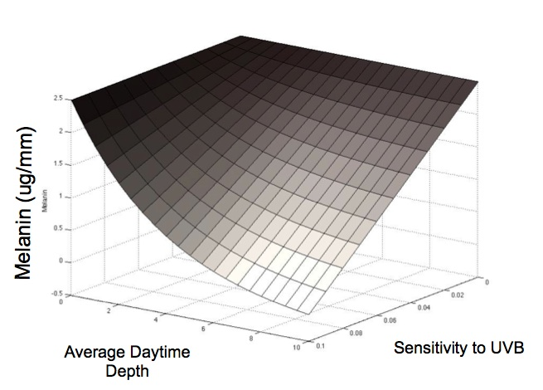
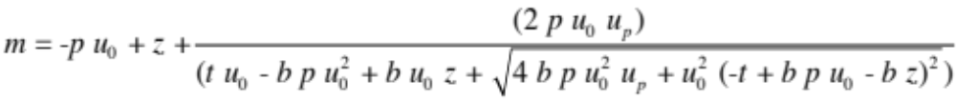
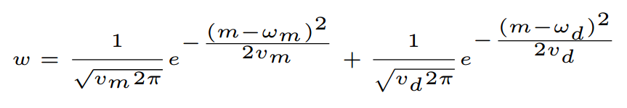
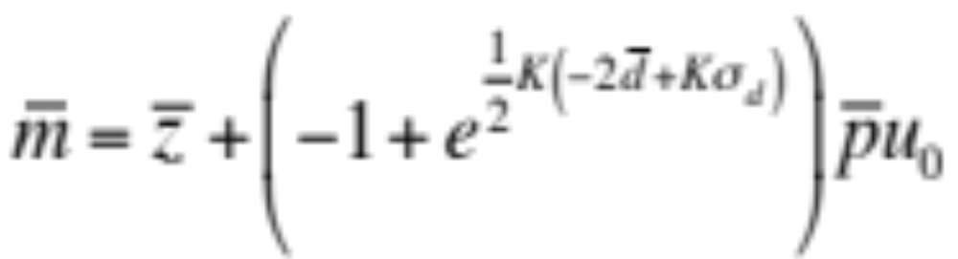
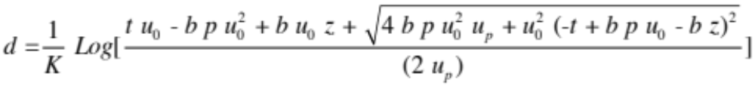
An Extendable Software Architecture for Exploring the Effects of Developmental Interactions on Evolutionary Trajectories
Elizabeth Brooks
Central Washington Univ.
Dept. of Computer Science
Ellensburg, WA 98926
brookse@cwu.edu
Alison Scoville
Central Washington Univ.
Dept. of Biological Sciences Ellensburg, WA 98926 scoville@cwu.edu
Filip Jagodzinski
Western Washington Univ.
Dept. of Computer Science
Bellingham, WA 98225 ﬁlip.jagodzinski@wwu.edu
Central Washington University
Introduction
Methods: Java/C++
Preliminary Results
Quantitative genetics is the study of traits, such as size or degree of pigmentation, that are controlled by more than one gene. Many quantitative genetic models use the genetic (co)variances of traits (the G-matrix) to predict evolution in response to selection. However, developmental interactions can cause rapid changes to the G-matrix. Because of this, traditional models may not accurately predict evolutionary dynamics.
The goal of this research is to develop a code base that implements a mathematical framework to explicitly incorporate nonlinear interactions between developmental factors of multiple traits, based on the concept of a phenotypic landscape (Rice 2002). This will allow users to test hypothesis concerning the evolutionary consequences of nonlinear developmental interactions. We have, in Java and C++, developed two models of increasing developmental complexity for testing hypotheses regarding evolutionary trajectories specific to high-alpine populations of Daphnia melanica.
We have designed our codebase with the goal that it may be extended to produce custom models for analyzing evolution of trait means and (co)variances for specific species of organisms and specific developmental interactions.
Initial parameters for model testing have been estimated using empirical data from multiple populations of Daphnia melanica in high altitude alpine lakes of Sierra Nevada.
Object-oriented programming principles and the concepts of inheritance are employed to permit a user to construct a custom code class for modeling a species of interest. The inheritance structure and use of Interfaces (left) allows for building unique models to predict the evolution of traits over time.
The G-matrix based model (left) predicts only a slight change in the evolutionary trajectory of the modeled Daphnia population. However, the second, more advanced model (right) incorporates underlying developmental interactions of traits in order to project the changes from generation t to generation t+1 due to directional selection, as given by Rice (2002, 2004).
Quantitative Genetics Models
Conclusions - Future Work
*
Model One
Model Two
Model Three
This software will allow users to assess the effect of developmental interactions on evolutionary trajectories. The program will be available online as a free web-tool that graphically displays the predicted evolutionary trajectories of a given species. Future extensions of the program will include a feature to permit a user to provide custom fitness functions via the web application.
Model One: predicts the evolution of mean melanin* and mean diel vertical migration (DVM)* of Daphnia over time, based on the genetic (co)variances of these traits.
Model Two: predicts the evolution of mean melanin* and mean DVM*, while allowing for developmental entanglement between these traits.
Model Three: predicts the evolution of mean melanin * and mean DVM* while allowing developmental entanglement to arise from the fact that DVM is determined by behavioral avoidance of UV penetration, and UV penetration is partially determined by melanin.
*
*
References
Fitness Function
*
M. Björklund, A. Husby, and L. Gustafsson. Rapid and unpredictable changes of the G-matrix in a natural bird population over 25 years. Journal of Evolutionary Biology, 26(1):1–13, Jan. 2013.
F. Eroukhmanoﬀ. Just How Much is the G-matrix Actually Constraining Adaptation? Evolutionary Biology, 36(3):323–326, May 2009.
T. F. Hansen. The Evolution of Genetic Architecture. Annual Review of Ecology, Evolution, and Systematics, 37:123–157, Jan. 2006.
R. Lande and S. J. Arnold. The Measurement of Selection on Correlated Characters. Evolution, 37(6):1210–1226, Nov. 1983.
S. Rice. A general population genetic theory for the evolution of developmental interactions. Proceedings of the National Academy of Sciences, 99:15518–15523, 2002.
D. Schluter. Adaptive Radiation Along Genetic Lines of Least Resistance. Evolution, 50(5):1766–1774, Oct. 1996.
The individual fitness surface (w) is defined by the sum of fitness values associated with the m and d values of an individual. This describes how the trait values of an individual affect its fitness.
Developmental entanglement arises from the fact that DVM influences exposure to UV radiation, and UV radiation stimulates the production of melanin.
*
Acknowledgements
*
*
Funding provided by the McNair Program at Central Washington University. Additional funding provided by Dean Kirk Johnson, College of the Sciences, Central Washington University.

