Slide 1
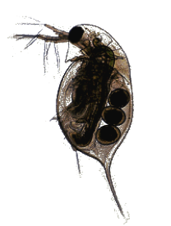

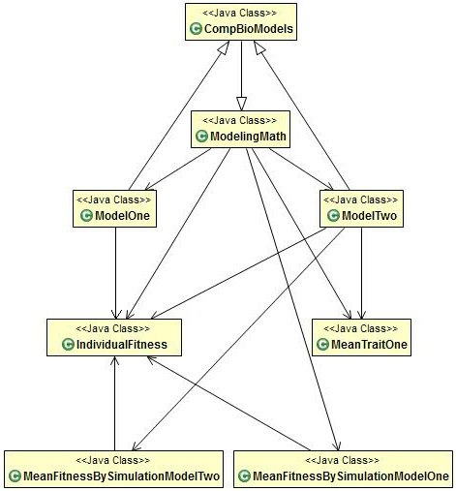
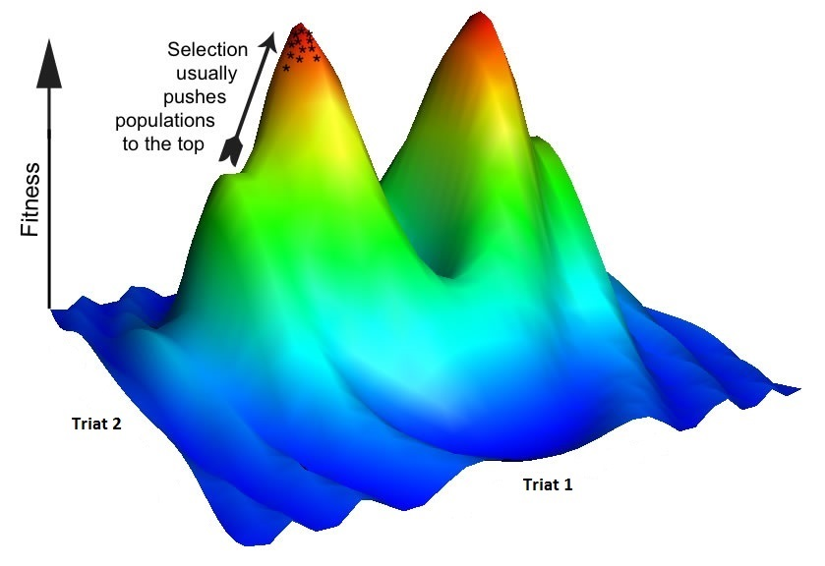
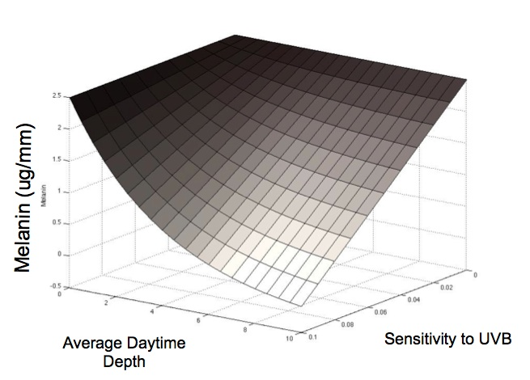
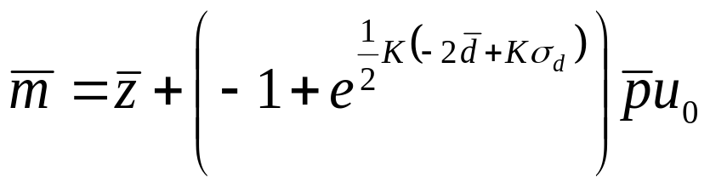
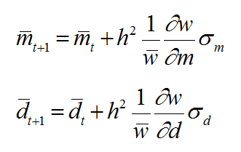
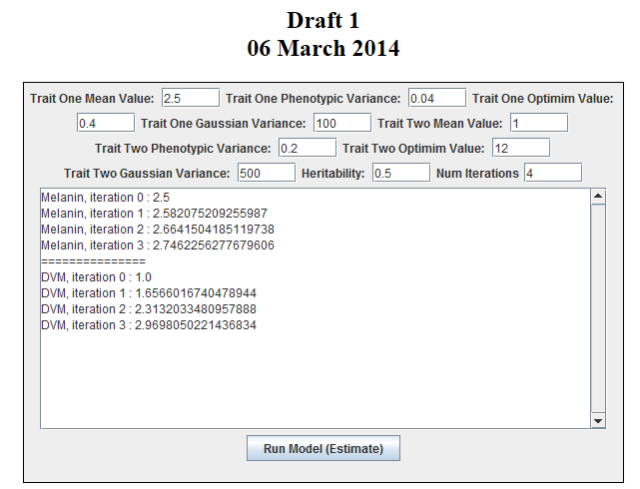
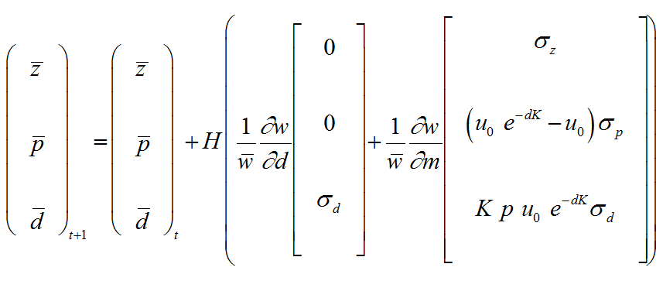
A Java Implementation of a Novel Quantitative Genetic Framework for the Evolution of Developmental Interactions
Elizabeth Brooks† , Dr. Filip Jagodzinski† , and Dr. Alison Scoville∗
*Department of Biology, Central Washington University, Ellensburg, WA 98926 USA
scoville@cwu.edu
† Department of Computer Science, Central Washington University, Ellensburg, WA 98926 USA
brookse@cwu.edu, jagodzinski@cwu.edu
Central Washington University
Introduction
Methods
Data Structure
Quantitative genetics is the study of traits of an organism, such as size or degree of pigmentation, that are controlled by more than one gene. Many quantitative genetic models use the genetic (co)variances of traits (the G-matrix) to predict evolution in response to selection. However, developmental interactions can cause rapid changes to G-matrix. Because of this, traditional models may not accurately predict evolutionary dynamics.
The goal of this project is to determine the extent to which the developmental architecture of traits affects the evolutionary response of a given species. This may be achieved through use of a mathematical framework that explicitly incorporates nonlinear interactions between developmental factors underlying one or more traits, based on the concept of a phenotypic landscape (Rice 2002).
As a first step, with the Java programming language we have developed a G-matrix-based model as well as second model that allows the user to test hypotheses about how the developmental interactions among two traits in Daphnia melanica, diel vertical migration and melanin production, affect their (co)variances and subsequent evolutionary trajectories. Additionally, our code and model framework are easily amenable to generating plots and graphs of trait relationships.
The models are implemented in a series of Java class files which interact with each other to update and predict the trait values of each new generation. By structuring the code in this manner, the program may be readily expanded to incorporate custom functions provided by the user.
Quantitative Genetics Models
Model One: a model that predicts the evolution of mean melanin and mean diel vertical migration (DVM) of Daphnia over time, based on the genetic (co)variances of these traits.
A fitness surface describes how the trait values of an individual affect its fitness. Selection acts on traits to push populations towards optimum fitness.
Phenotypic landscape of melanin as a function of average daytime depth and sensitivity to induction via UVB radiation.
Proof of Concept
Conclusions - Future Work
The provided graphical user interface will allow the user to implement specific constraints on the model. These constraints will permit the program to take into account the nonlinear interactions between developmental factors of a given species. Future versions of the interface will display results in a graphical manner.
This software will allow users to assess the effect of developmental architecture on evolutionary trajectories. Future versions of our software will be available online as a user-friendly web tool, which will provide options to custom supply model parameters and equations specifying the relationship between developmental factors and traits of interest.
Model Two: a model that predicts the evolution of mean melanin and mean diel vertical migration (DVM) over time, while allowing for “developmental entanglement” between these traits, due to the fact that DVM influences exposure to UV radiation, and UV radiation stimulates production of melanin.
References
Rice, S. H. 2002. A general population genetic theory for the evolution of developmental interactions. PNAS 99: 15518-15523.

