Slide 1
Spotify Audio Feature Analysis
Elizabeth Brooks

Slide 2
Objectives
Discover relationship between audio features and popularity
Identify most influential track attributes
Determine audience preferences for tracks and artists

Slide 3
Workflow
Get a List of Browse Categories -> Category IDs
Get a Category's playlists -> playlist IDs
Get a Playlist's Tracks -> artist IDs
Get an Artist's Related Artists -> related artist IDs
Get an Artist's Top Tracks -> track IDs
Get an Artist's Albums -> track IDs
Get Several Tracks -> track popularity
Get Audio Features for Several Tracks -> audio features

Slide 4
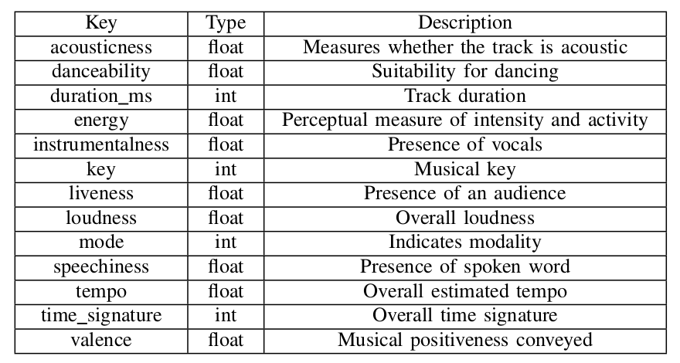
Audio Features

Slide 5
Track Feature Analysis
Visualize multidimensional data -> Python
Two-dimensional slices
Binned popularity ranges
Feature scaling -> Python
Principal Component Analysis (PCA)
Linear Discriminant Analysis (LDA)
Decision trees
Classification -> Python and R
Regression -> R
Notes:
->Before we go further, we should apply feature scaling to our dataset. In this example, I will simply rescale the data to a [0,1] range, but it is also common to standardize the data to have a zero mean and unit standard deviation.
->As with much of data science, the method you use here is dependent on your particular dataset and what information you are trying to extract from it. The PCA and LDA plots are useful for finding obvious cluster boundaries in the data, while a scatter plot matrix will show specific behavior of particular features in your dataset.

Slide 6
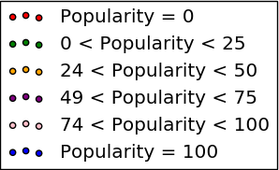
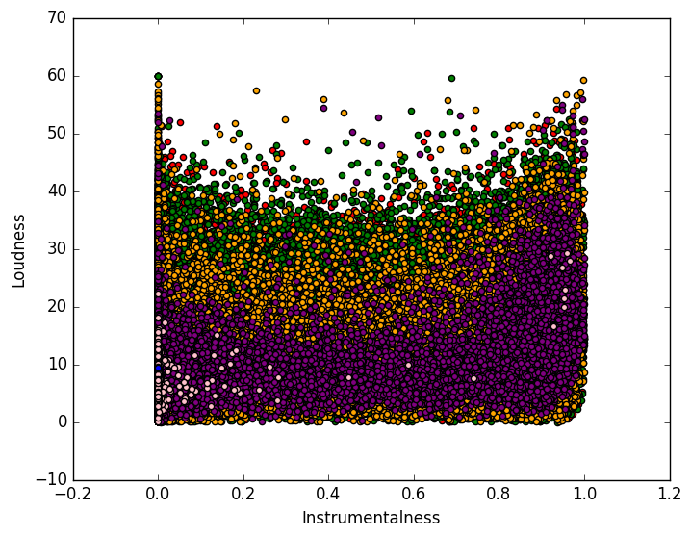
Popularity = 0
0 < Popularity < 25
24 < Popularity < 50
49 < Popularity < 75
74 < Popularity < 100
Popularity = 100

Slide 7
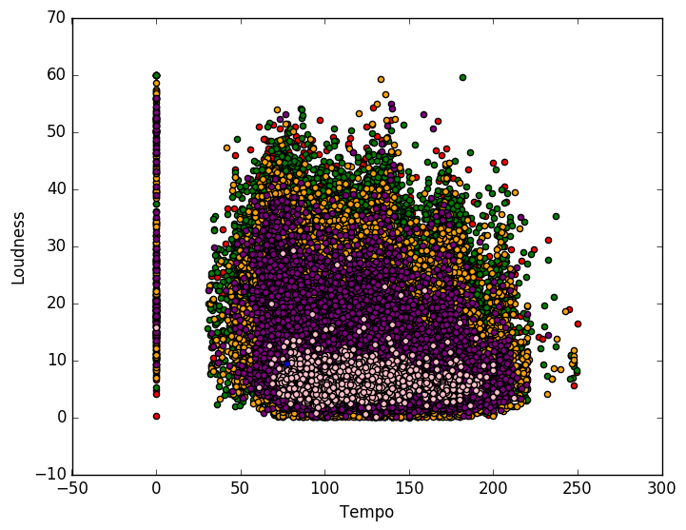
Popularity = 0
0 < Popularity < 25
24 < Popularity < 50
49 < Popularity < 75
74 < Popularity < 100
Popularity = 100

Slide 8
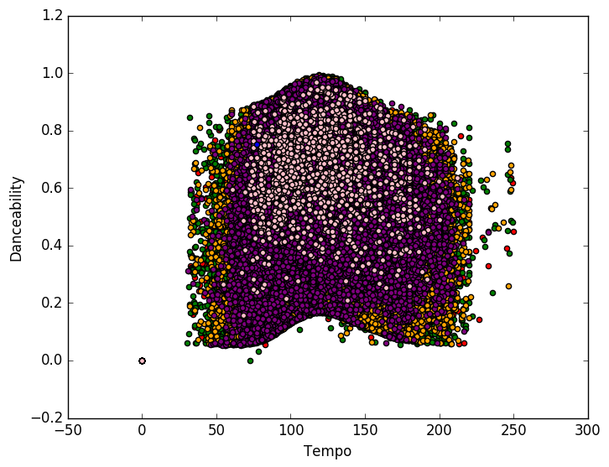
Popularity = 0
0 < Popularity < 25
24 < Popularity < 50
49 < Popularity < 75
74 < Popularity < 100
Popularity = 100

Slide 9
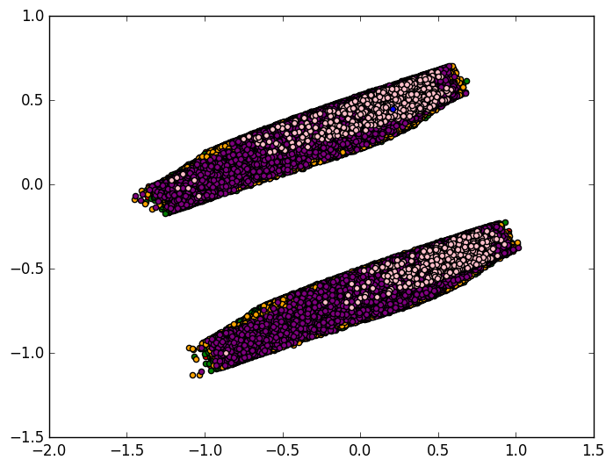
Principal Component Analysis (PCA)
Popularity = 0
0 < Popularity < 25
24 < Popularity < 50
49 < Popularity < 75
74 < Popularity < 100
Popularity = 100
Notes:
->Principle Component Analysis (PCA) is a method of dimensionality reduction. It has applications far beyond visualization, but it can also be applied here. It uses eigenvalues and eigenvectors to find new axes on which the data is most spread out. From these new axes, we can choose those with the most extreme spreading and project onto this plane. (This is an extremely hand-wavy explanation; I recommend reading more formal explanations of this.)
->A downside of PCA is that the axes no longer have meaning. Rather, they are just a projection that best “spreads” the data. However, it does show that the data naturally forms clusters in some way.

Slide 10
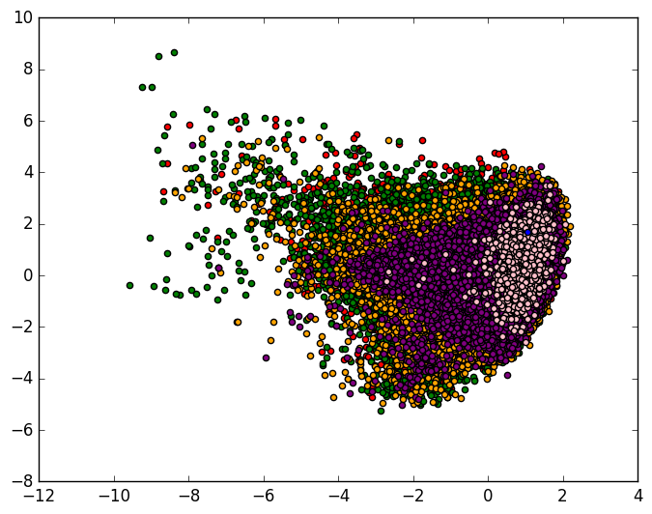
Linear Discriminant Analysis (LDA)
Popularity = 0
0 < Popularity < 25
24 < Popularity < 50
49 < Popularity < 75
74 < Popularity < 100
Popularity = 100
Notes:
->A similar approach to projecting to lower dimensions is Linear Discriminant Analysis (LDA). This is similar to PCA, but (at an intuitive level) attempts to separate the classes rather than just spread the entire dataset.

Slide 11
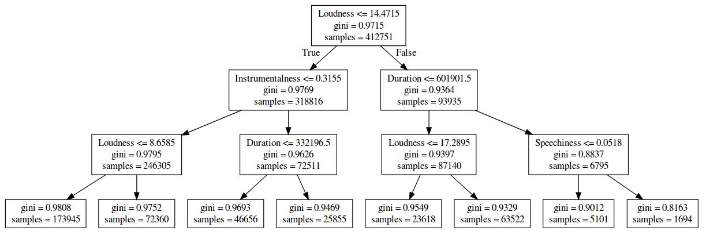
Regression Tree - Gini

Slide 12
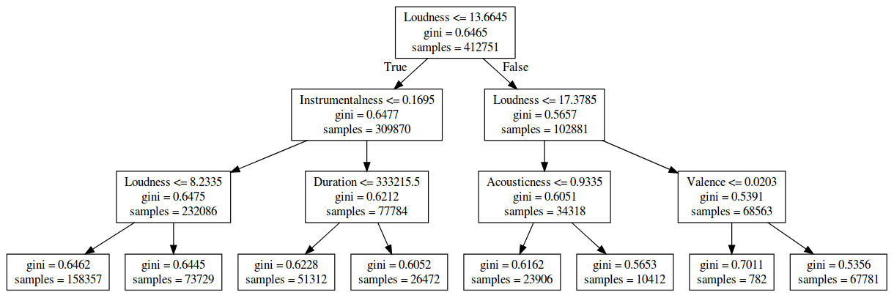
Classification Tree - Gini

Slide 13
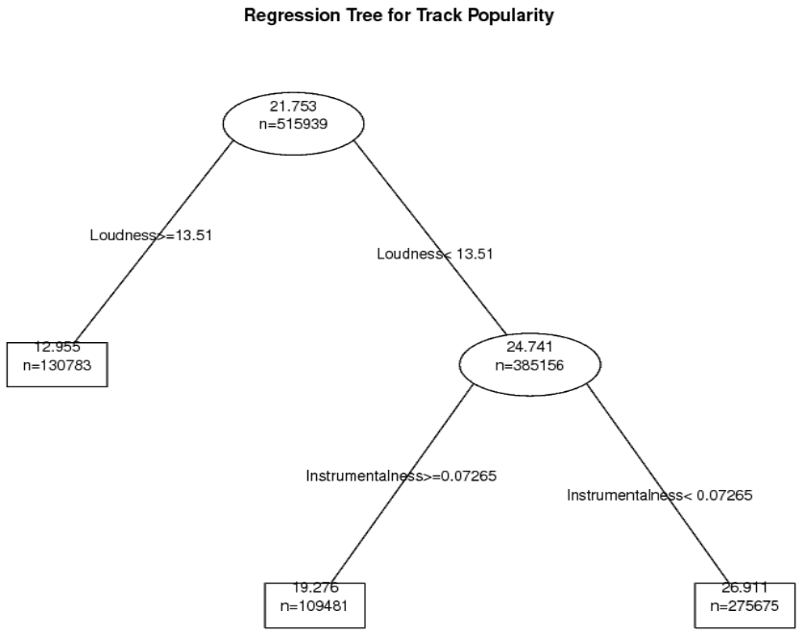

Slide 14
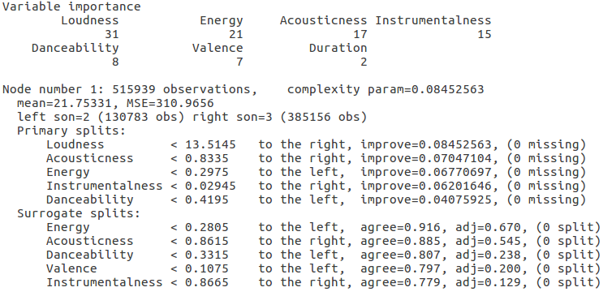
Regression Tree Analysis

Slide 15
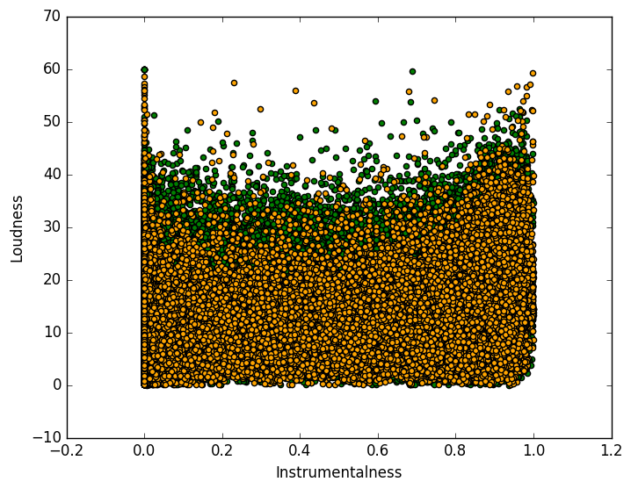
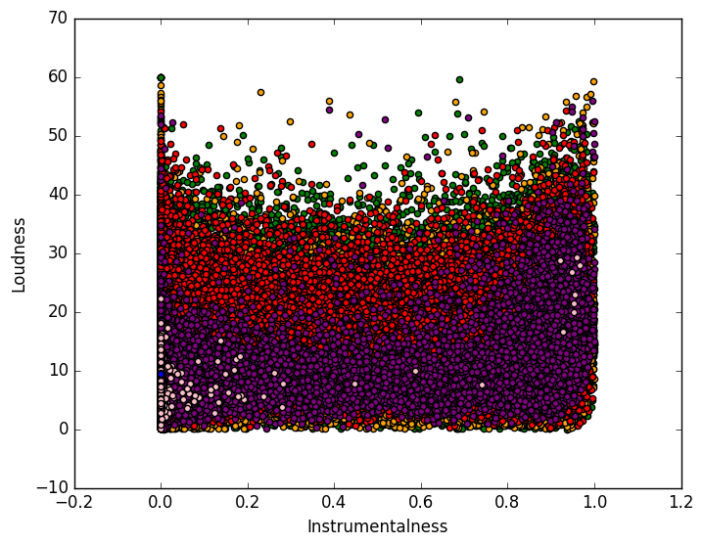
Instrumentalness vs Loudness

Slide 16
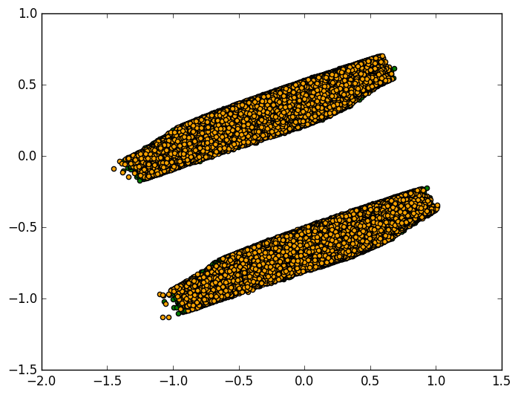
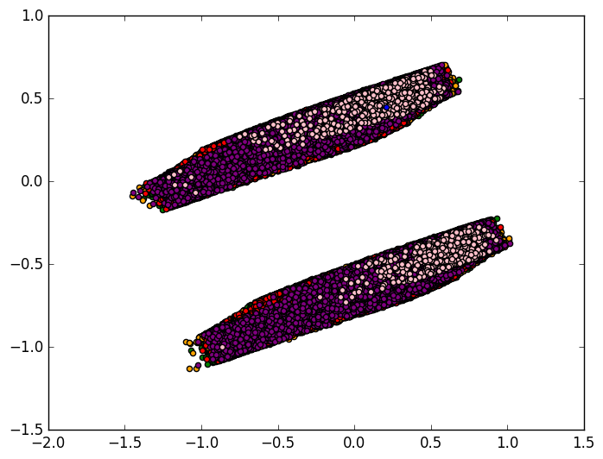
Principal Component Analysis

Slide 17
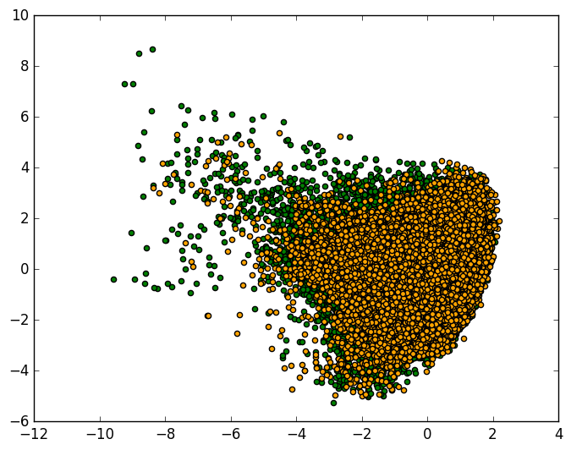
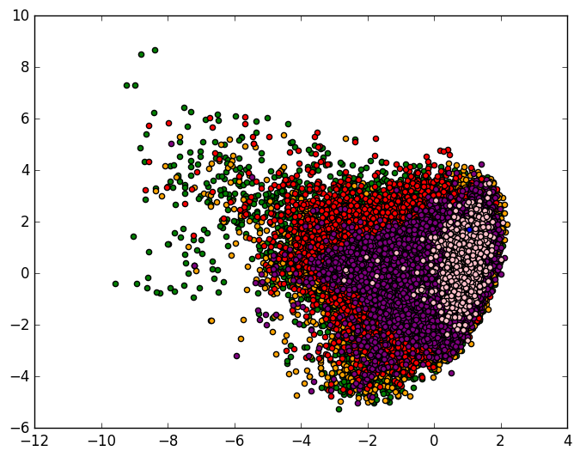
Linear Discriminant Analysis

Slide 18
Conclusions - Future Work
Key features:
Loudness
Instrumentalness
Reprocess track dataset to include genres, number of followers, and related artist popularity
Identify and remove erroneous entries

Slide 19
Questions?

