Slide 1
Lifestyle of rich and famous idols
Elizabeth Caronia

Slide 2
Motivation
celebrities
3 prongs of public appearance
Read an article that lauded miley cyrus’ diet, routine, and Instagram for making her into the success she is

Slide 3
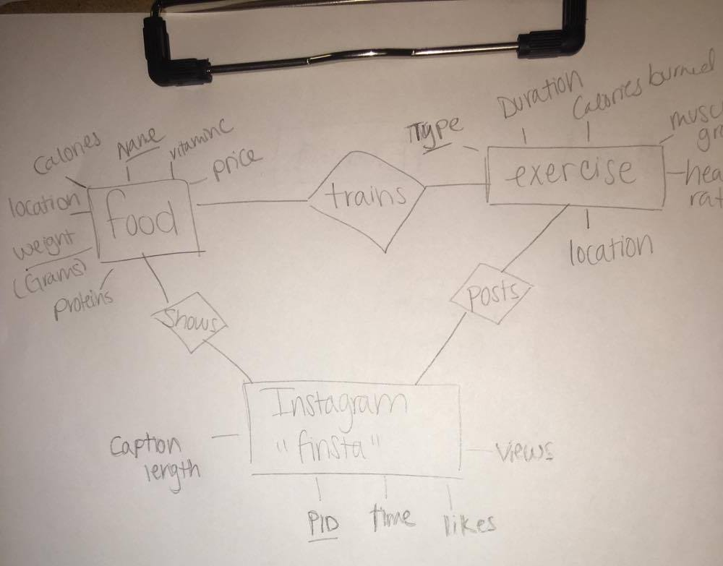
Easily Collectable Data
Stick to a Food Plan,
an Exercise Plan,
and Do a little Instagram
Stalking

Slide 4
Discover
Sponsored posts average higher likes:
Get competitive with exposure: whats the lowest view of sponsored post?
Select min(Views) from finsta where Sponsored = 1;
Choose to eat somewhere based on how much longer youll be able to work out
Select Name from trains where type Any (select Type from exercise where Duration = 90 )

Slide 5
Patterns
Healthy food is expensive: the cheaper it is calorie wise- the less it is dollarwise
query <- sprintf("select * from food where price < any( select price from food where Calories > 600) and Calories < 600")
Your average heartrate when doing aerobic exercise (skiing, suicide runs, etc) can be at minimum 65 bpm
The average likes of an unsponsored user will always be less than a sponsored user
query <- sprintf("select * from finsta where exists(select sum(l1.Likes) < sum(l2.Likes) from finsta l1, finsta l2 where group by l1.Sponsored)")

Slide 6
Foreign keys
All binary relationship tables are foreign keys
Cascade update, set null delete
Change name of food sold by Hansel & Griddle to pizza:
Update food set Name = “Pizza” where Location = “Hansel and Griddle” and Name=“Couscous”

Slide 7
Discover:
Did anyone get discovered?
Who has friends vs acquaintances
What’s more popular, food or exercise?
Do calories / proteins → exercise duration?

