Slide 1
IS651 Project
File created on: 10/16/2025 3:48:22 PM

Slide 2
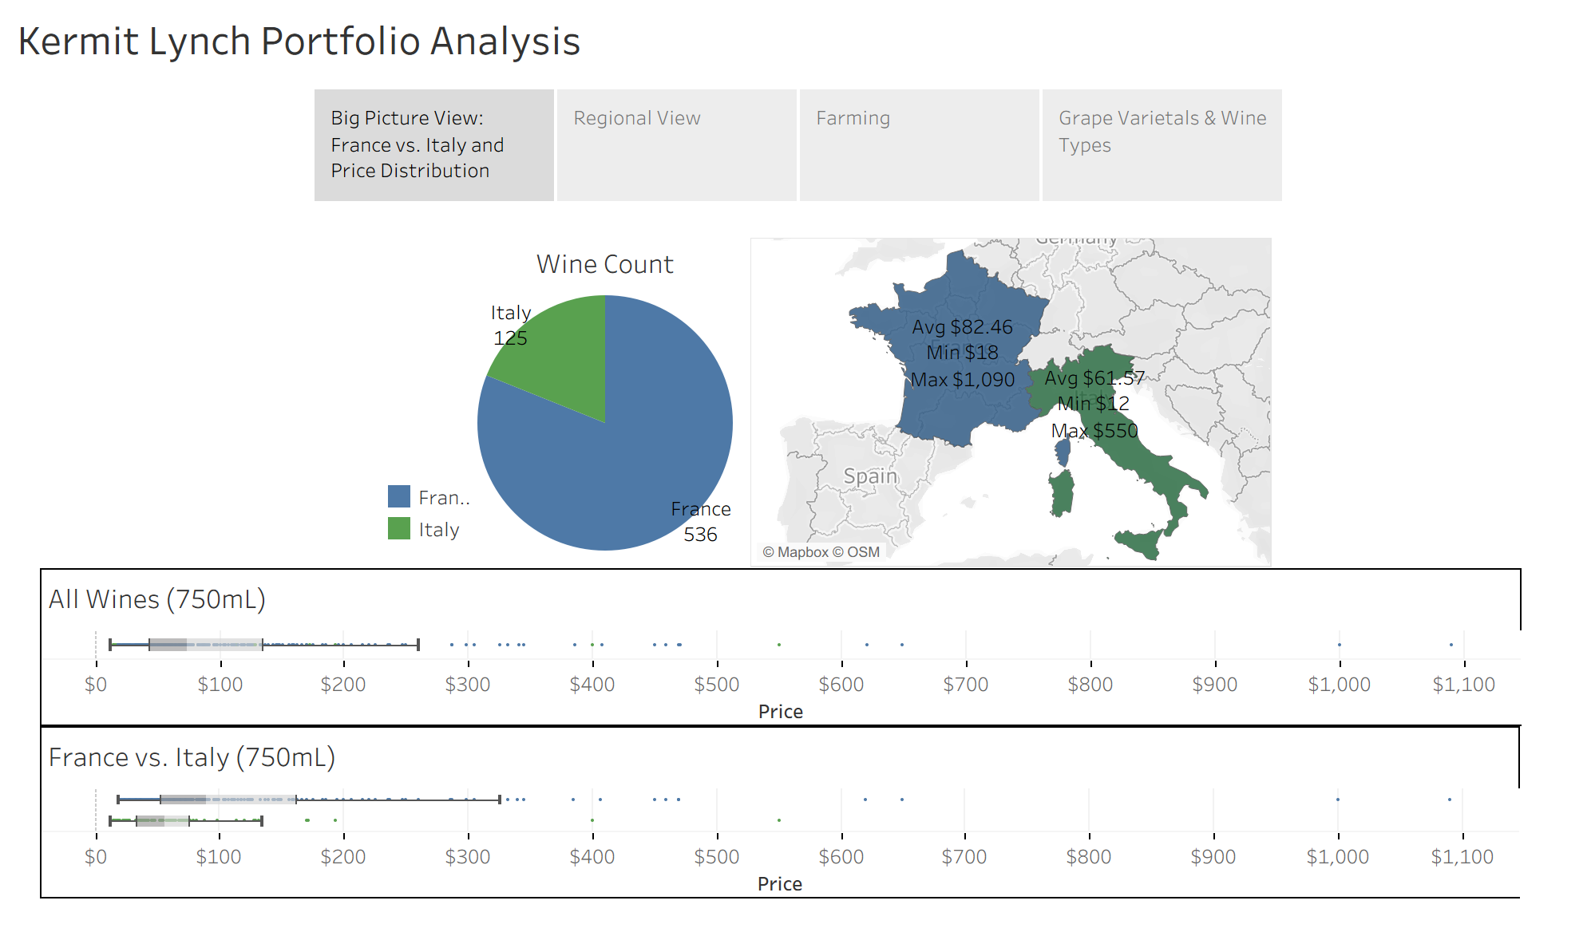

Slide 3
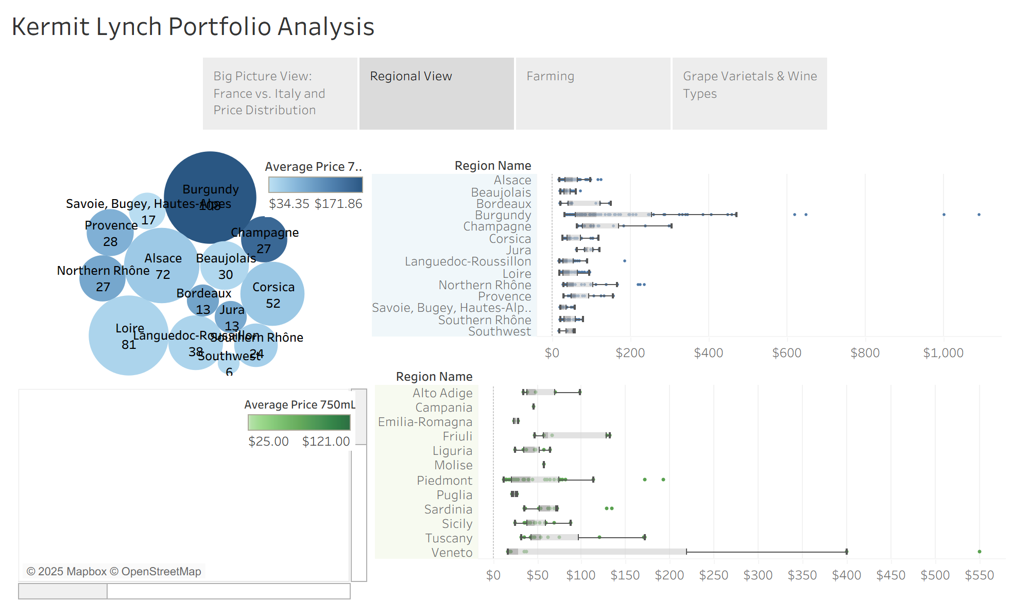

Slide 4
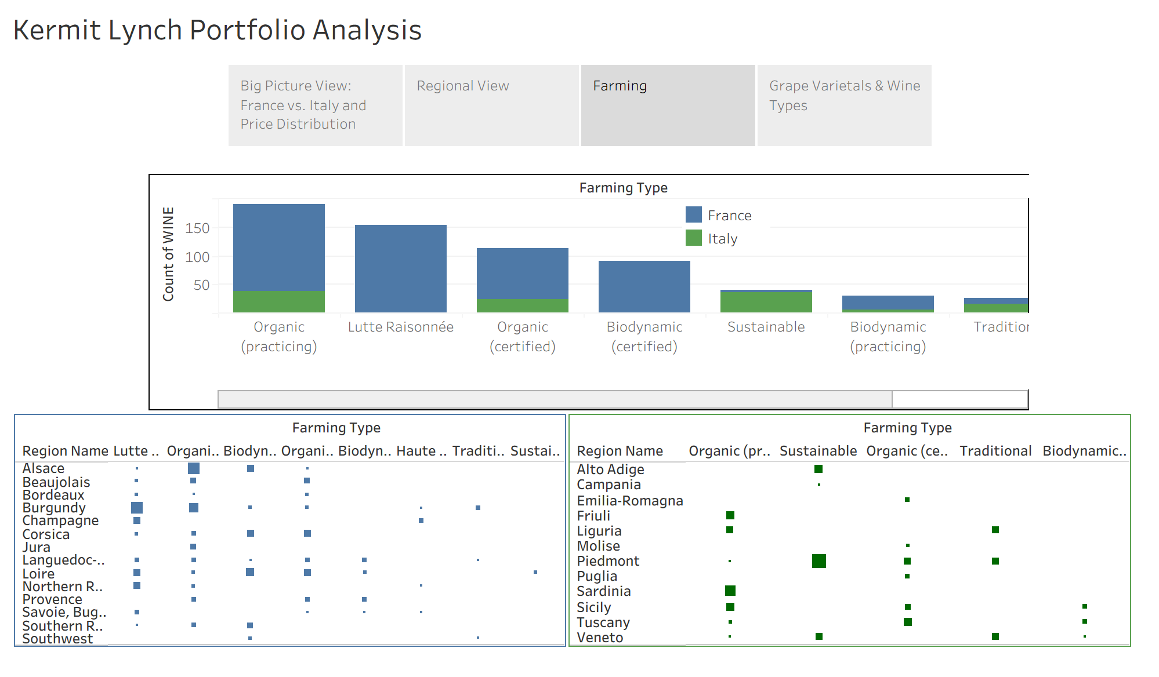

Slide 5
