Slide 1
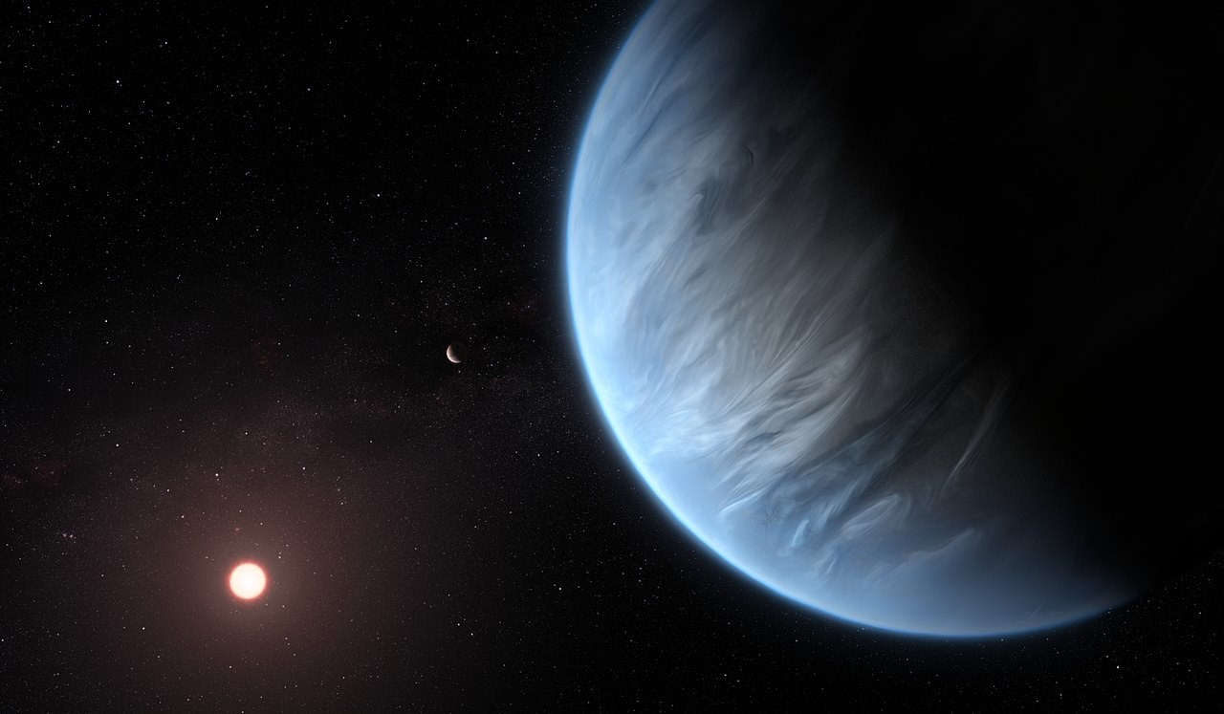
A Grid of Mini-Neptune Atmospheres for HWO Target Discrimination
By Elizabeth Pawelka, Updated 2/17/2026
By Elizabeth Pawelka, Updated 2/17/2026

Slide 2
Quick Project Overview:
Challenge: In the initial detection phase of HWO, even with current radial velocity/astrometry techniques, mass and radius will not be constrained, which means a high albedo terrestrial planet of interest might look like a low albedo mini-Neptune (that is not of interest when considering habitability).
Solution + Extra Challenge: To look at multiple (instead of just one) photometric observations across wavelength bandpasses, but we need to know which ones make it easiest to distinguish most mini-Neptunes from terrestrial planets (Alei et. al. 2025).
Project: Aims to create a grid of mini-Neptunes that range over radius, metallicity, tint, semi-major axis, ℅ ratio, and the eddy diffusion coefficient around a sun-like star for a more comprehensive exploration of parameter space and optimization of picking which multi-photometric observations would best differentiate most mini-Neptunes from terrestrial atmospheres.
Methodology/Results:
Create PT & Photochemistry grids that utilize the open-source climate model for gas giants from PICASO that assumes chemical equilibrium (balances radiative and convective energy), along with the photochemical model from photochem which accounts for chemical reactions and mass conservation to determine the composition of the atmosphere
Optimize a match in atmospheric abundances between O2-rich and H-rich mini-Neptunes and an Archean/Modern Earth, and comparing their reflected spectras

Slide 3
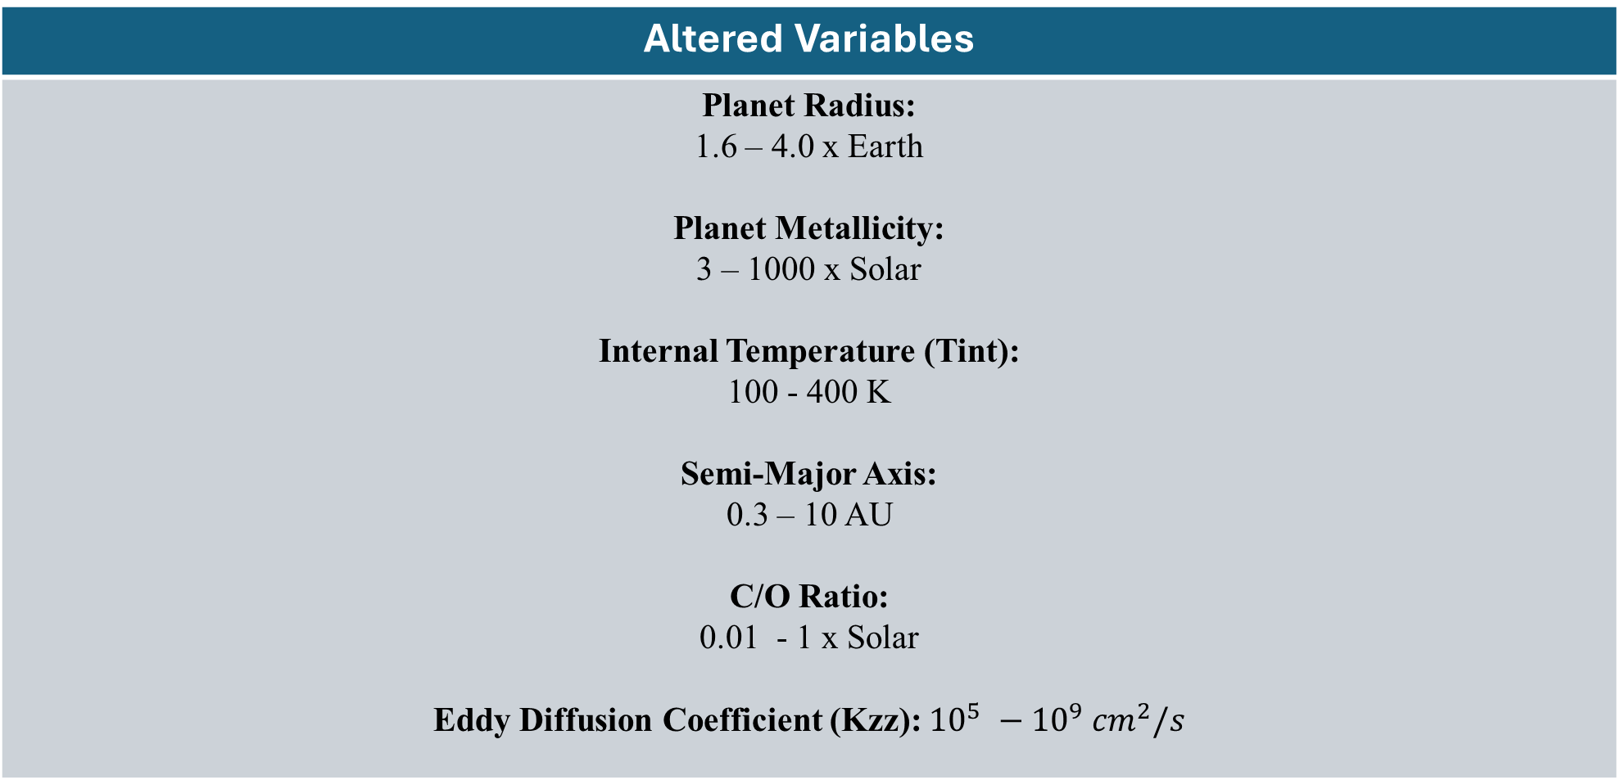
Assumptions:
Altered Variables
Planet Radius: 1.6 – 4.0 x Earth Planet Metallicity: 3 – 1000 x Solar Internal Temperature (Tint): 100 - 400 K Semi-Major Axis: 0.3 – 10 AU C/O Ratio: 0.01 - 1 x Solar Eddy Diffusion Coefficient (Kzz): ${10}^{5} −{10}^{9} {cm}^{2}/s$
Notes:
Could mention some specific examples of constant/dependent variables (also all orbit the Sun, not K & F stars), also we only include a single water cloud roughly parameterized. Important information make it the whole slide.

Slide 4
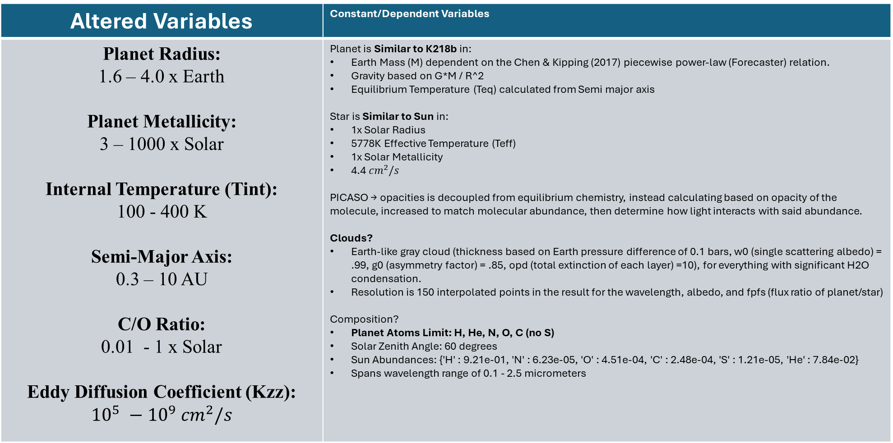
Assumptions:
Altered Variables | Constant/Dependent Variables
Planet Radius: 1.6 – 4.0 x Earth Planet Metallicity: 3 – 1000 x Solar Internal Temperature (Tint): 100 - 400 K Semi-Major Axis: 0.3 – 10 AU C/O Ratio: 0.01 - 1 x Solar Eddy Diffusion Coefficient (Kzz): ${10}^{5} −{10}^{9} {cm}^{2}/s$ | Planet is Similar to K218b in: Earth Mass (M) dependent on the Chen & Kipping (2017) piecewise power-law (Forecaster) relation. Gravity based on G*M / R^2 Equilibrium Temperature (Teq) calculated from Semi major axis Star is Similar to Sun in: 1x Solar Radius 5778K Effective Temperature (Teff) 1x Solar Metallicity 4.4 ${cm}^{2}/s$ PICASO → opacities is decoupled from equilibrium chemistry, instead calculating based on opacity of the molecule, increased to match molecular abundance, then determine how light interacts with said abundance. Clouds? Earth-like gray cloud (thickness based on Earth pressure difference of 0.1 bars, w0 (single scattering albedo) = .99, g0 (asymmetry factor) = .85, opd (total extinction of each layer) =10), for everything with significant H2O condensation. Resolution is 150 interpolated points in the result for the wavelength, albedo, and fpfs (flux ratio of planet/star) Composition? Planet Atoms Limit: H, He, N, O, C (no S) Solar Zenith Angle: 60 degrees Sun Abundances: {'H' : 9.21e-01, 'N' : 6.23e-05, 'O' : 4.51e-04, 'C' : 2.48e-04, 'S' : 1.21e-05, 'He' : 7.84e-02} Spans wavelength range of 0.1 - 2.5 micrometers
Notes:
Could mention some specific examples of constant/dependent variables (also all orbit the Sun, not K & F stars), also we only include a single water cloud roughly parameterized. Important information make it the whole slide.

Slide 5
Assumptions:
Altered Variables | Constant/Dependent Variables
Modern Composition: N2 (0.79), O2 (0.21), O3 (7e-7), H2O (3e-3), CO2 (300e-6), CH4 (1.7e-6) Archean Composition: N2 (0.945), CO2 (0.05), CO (0.0005), CH4 (0.005), H2O (0.003) | Earth: Phase angle of 0- 170 degrees Earth radius & mass Same Sun parameters used in grids Includes a grey Earth cloud (from 0.6 to 0.7 pressure, same w0, g0, opd as the one used in Mini Neptunes grid)
Notes:
The thing at the bottom needs to be its own slide and step through it one-by-one. Circle archean and cross out modern b/c more similarity and focus on more interesting calc and modern earth ones as backup slides. PICASO is missing opacities relative to modern Earth. Just 3 & 4, backup slides. Take all mini-Nep in hab zone and look closest to archean earth, similar at longer wavelengths b/c similar methane and archean has reileigh scattering and hydrogen looks much brighter. But with LUVOIR not a whole spectrum at once, we have one photometric bin. Compare point to spectra in a range. Phase 1 of LUVOIR will we be tricked? Single data point that detects planet vs. single point detects water.
Modern vs. Archean (most similar between modern & archean).

Slide 6
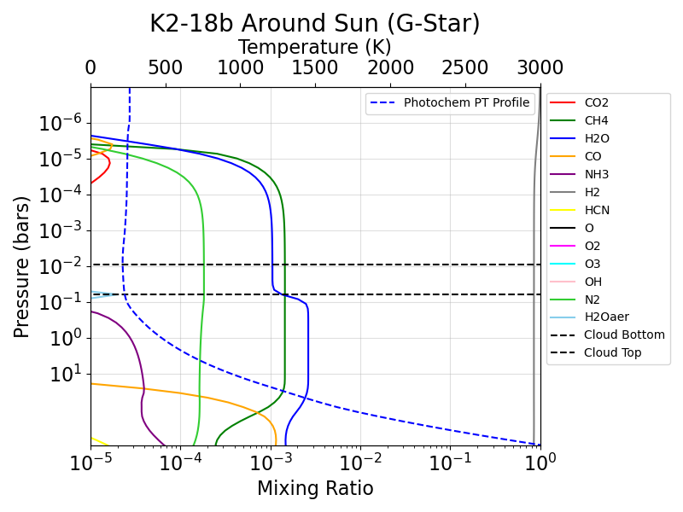
Classic H-dominated Sub-Neptune Structure for K2-18b-like Planet:
Input Parameters:
planet radius: 2.61x Earth
metallicity: ~3.16x solar
tint: 155K
semi major in AU: 1.04 AU
ctoO_solar: 1x solar c/o ratio
Kzz = 5 (10^5 cm^2/s)
Classic H-dominated mini-neptunes are Hydrogen dominated and can still have water condensation along with methane and nitrogen.
**Note: composition was limited to the molecules in the legend for each photochemistry-PT plot; atmosphere depicts most abundant molecules in this atmosphere.
Nitrogen
Methane
Hydrogen
Water Condensation
Grey Earth H2O Cloud
Notes:
Could mention some specific examples of constant/dependent variables (also all orbit the Sun, not K & F stars), also we only include a single water cloud roughly parameterized. Important information make it the whole slide.

Slide 7
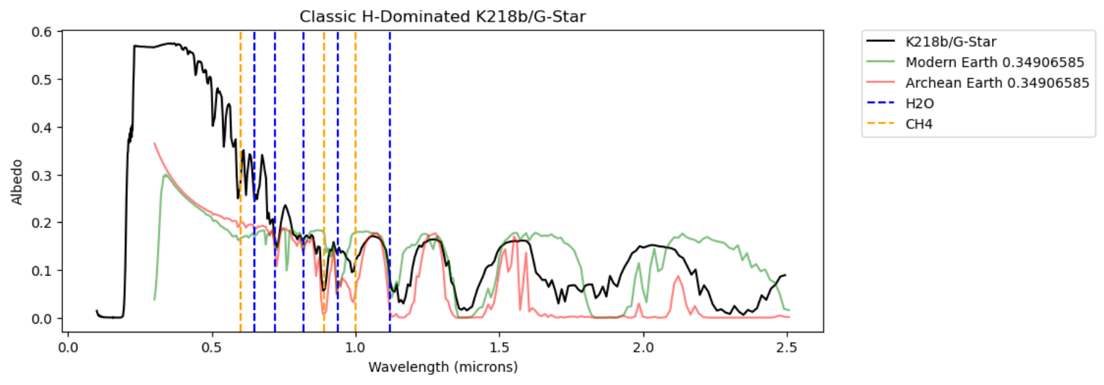
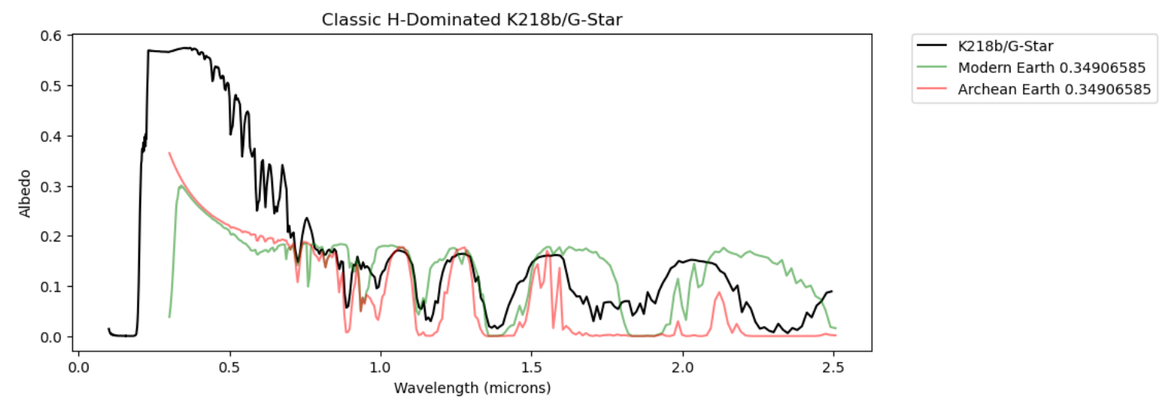
Classic H-dominated Sub-Neptune Structure for K2-18b-like Planet:
Input Parameters:
planet radius: 2.61x Earth
metallicity: ~3.16x Solar
tint: 155K
semi major in AU: 1.04 AU
ctoO_solar: 1x solar c/o
Kzz = 5 (10^5 cm^2/s)
In the reflected spectra you can see absorption features mainly of methane and water, and notice that the classical
example of a phase 0 degree mini-Neptune noticeably differs from Modern/Archean Earth at ~20 degrees.
**Note: Reflected Spectra for all cases shown had to limit PT profile to everything above temperature = 1000K due to restrictions on model for O3.
Notes:
Could mention some specific examples of constant/dependent variables (also all orbit the Sun, not K & F stars), also we only include a single water cloud roughly parameterized. Important information make it the whole slide.

Slide 8
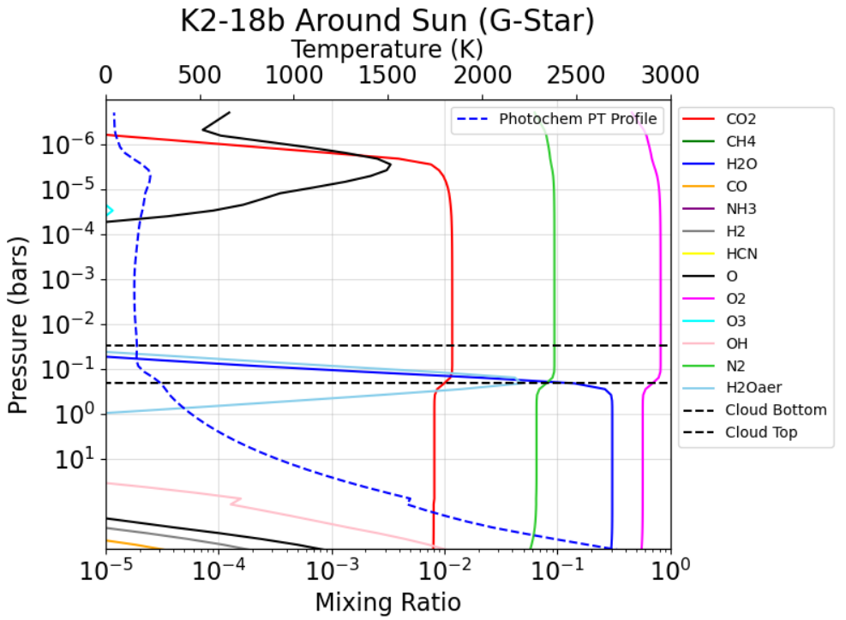
O2 Rich Sub-Neptune Structure for K2-18b-like Planet:
Input Parameters:
planet radius: 2.61x Earth
metallicity: 3162x solar
tint: 155K
semi major in AU: 1 AU
ctoO_solar: 0.01x solar c/o ratio
Kzz = 5 (10^5 cm^2/s)
Oxygen
1&2
N2
Carbon Dioxide
This higher metallicity and c/o ratio mini-Neptune is oxygen dominated, along with nitrogen, carbon dioxide, and water features.
Grey Earth (H2O) Cloud
Water Condensation
Notes:
Could mention some specific examples of constant/dependent variables (also all orbit the Sun, not K & F stars), also we only include a single water cloud roughly parameterized. Important information make it the whole slide.

Slide 9
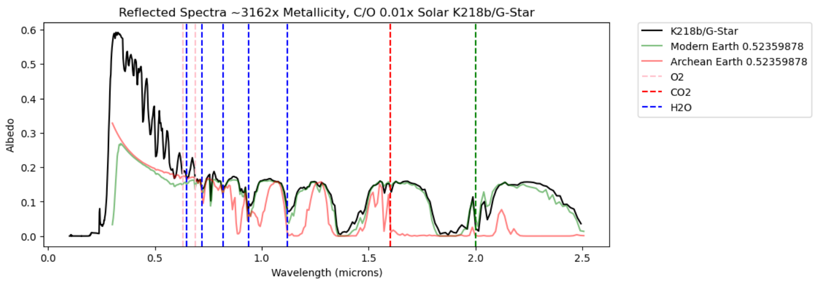
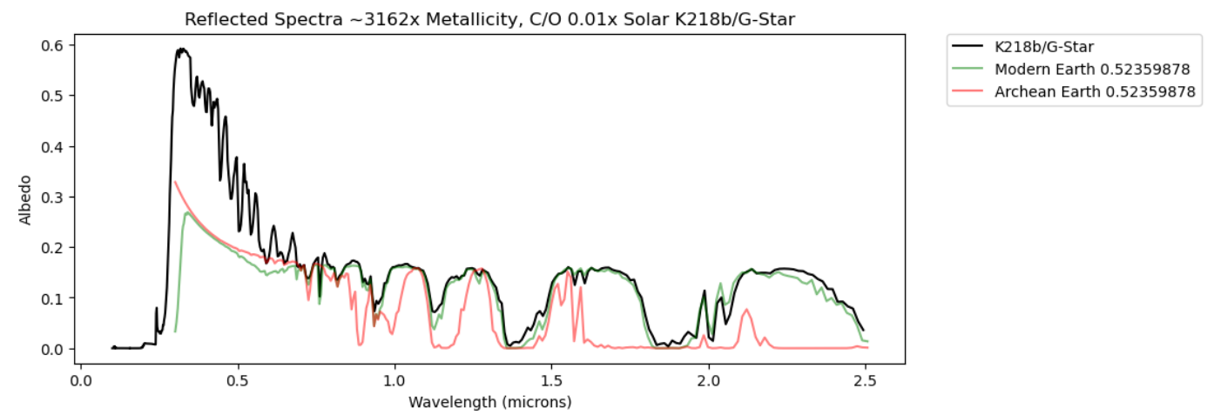
O2 Rich Sub-Neptune Structure for K2-18b-like Planet:
Input Parameters:
planet radius: 2.61x Earth
metallicity: 3162x solar
tint: 155K
semi major in AU: 1 AU
ctoO_solar: 0.01x solar c/o
Kzz = 5 (10^5 cm^2/s)
In the reflected spectra you can see absorption features mainly of water, oxygen, and carbon dioxide, but the phase 0 degrees mini-Neptune looks fairly similar between ~0.6 – 2.5 microns with Modern Earth at ~30 degrees.
Notes:
Could mention some specific examples of constant/dependent variables (also all orbit the Sun, not K & F stars), also we only include a single water cloud roughly parameterized. Important information make it the whole slide.

Slide 10
References:
Eleonora Alei et al. 2025. Multi-bandpass Photometry for Exoplanet Atmosphere Reconnaissance (MPEAR) with the Habitable Worlds Observatory (HWO) -- I. Differentiating Earth from Neptunes During Discovery. 10.48550/arXiv.2512.05279.
Notes:
Could mention some specific examples of constant/dependent variables (also all orbit the Sun, not K & F stars), also we only include a single water cloud roughly parameterized. Important information make it the whole slide.

Slide 11
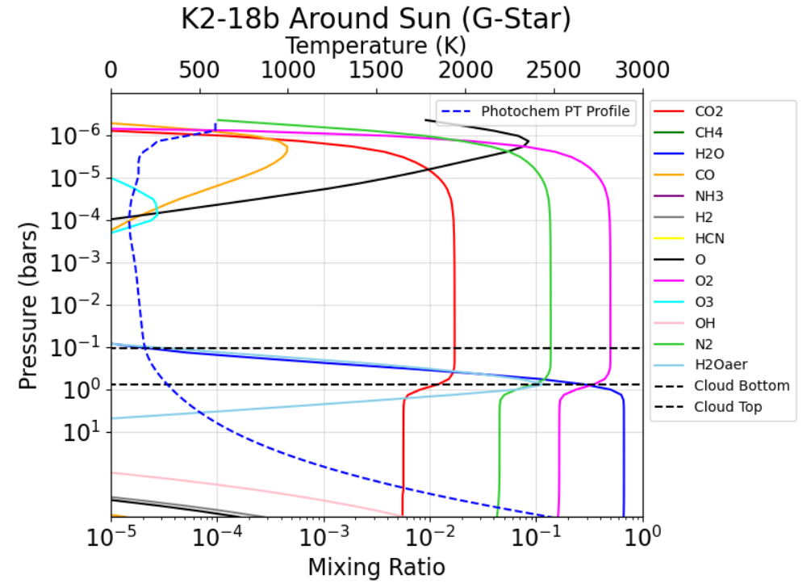
Another O2 Rich Sub-Neptune Structure for K2-18b-like Planet:
Input Parameters:
planet radius: 2.61x Earth
metallicity: 1000x solar
tint: 155K
semi major in AU: 1 AU
ctoO_solar: 0.01x solar c/o
Kzz = 5 (10^5 cm^2/s)
Oxygen
1&2
Nitrogen
Carbon Dioxide
This higher metallicity and c/o ratio mini-Neptune is oxygen dominated, along with nitrogen, carbon dioxide, and water features. There is also a little bit of carbon monoxide before UV photolysis in the upper atmosphere.
Grey Earth (H2O) Cloud
Water Condensation
Notes:
Could mention some specific examples of constant/dependent variables (also all orbit the Sun, not K & F stars), also we only include a single water cloud roughly parameterized. Important information make it the whole slide.

Slide 12
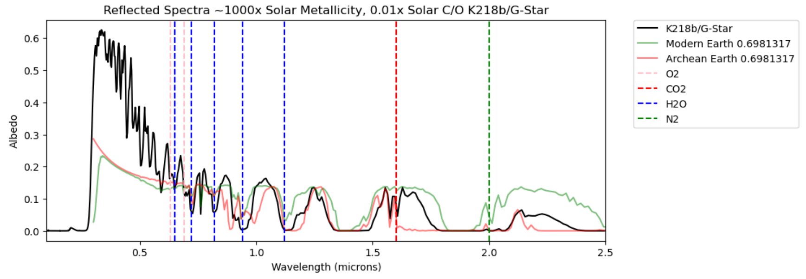
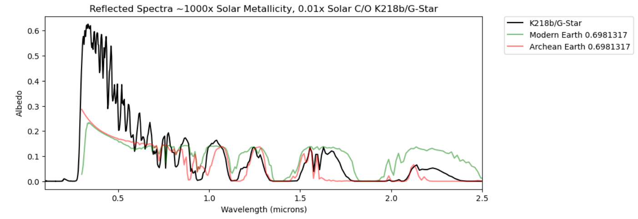
Another O2 Rich Sub-Neptune Structure for K2-18b-like Planet:
Input Parameters:
planet radius: 2.61x Earth
metallicity: 1000x solar
tint: 155K
semi major in AU: 1 AU
ctoO_solar: 0.01x solar c/o
Kzz = 5 (10^5 cm^2/s)
In the reflected spectra you can see absorption features mainly of water, oxygen, and carbon dioxide, but the phase 0 degrees mini-Neptune has some features similar to both Archean and Modern Earth at ~40 degrees, particularly at longer wavelengths.
Notes:
Could mention some specific examples of constant/dependent variables (also all orbit the Sun, not K & F stars), also we only include a single water cloud roughly parameterized. Important information make it the whole slide.

