Slide 1





Git Made Easy
A Visual Guide for Beginners
Using Visual Studio Code
Simple
Visual
Practical

Slide 2

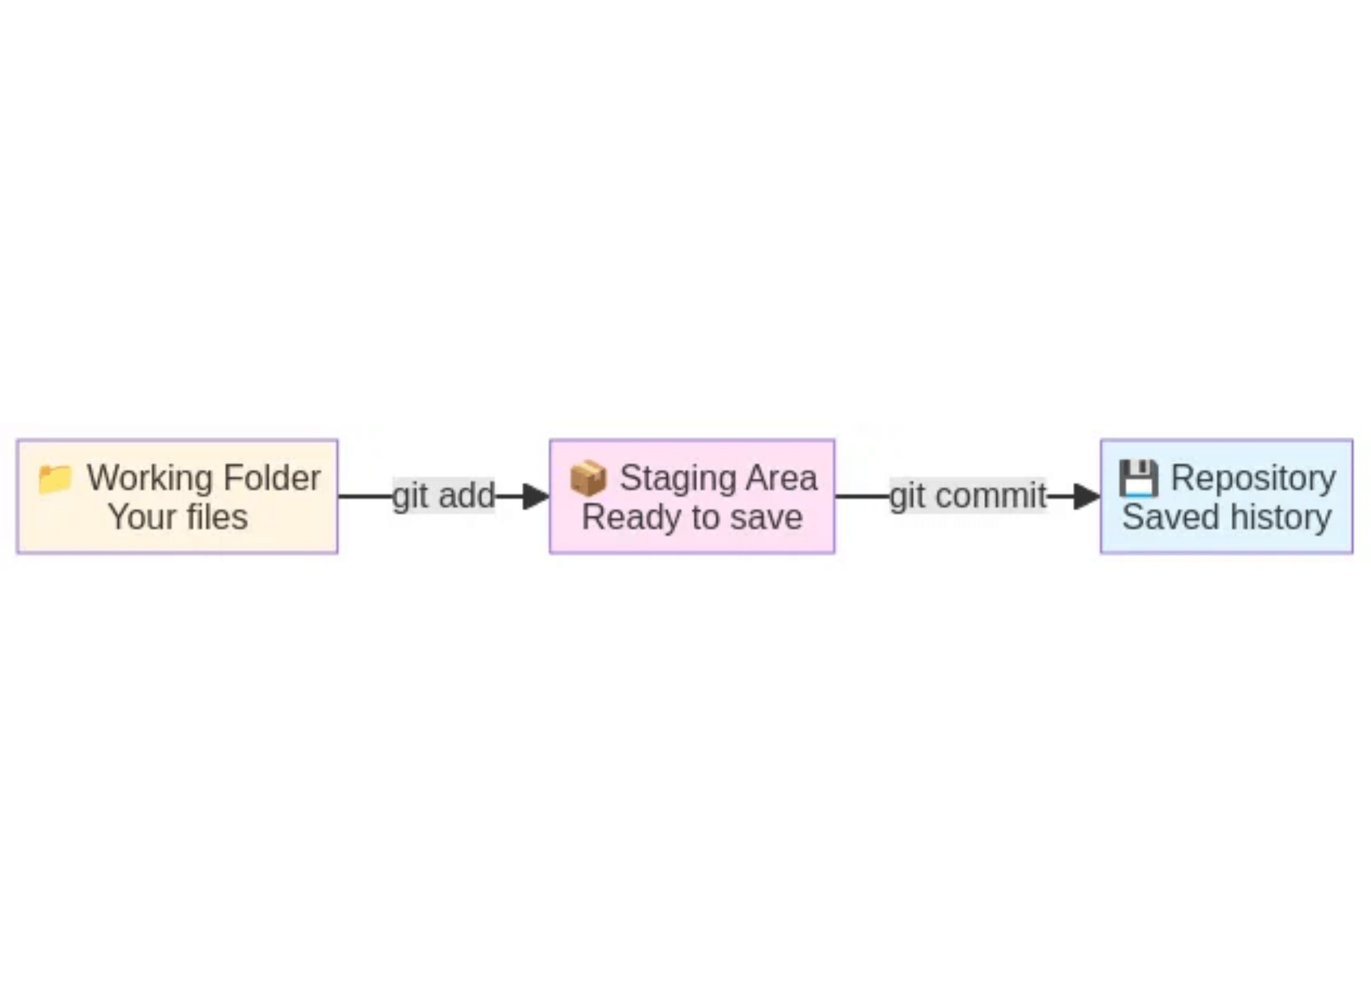



Understanding the Git Workflow
Think of Git like preparing a package to mail
1. Working Folder
Your project files where you make changes
2. Staging Area
Select which changes to include (like packing a box)
3. Repository
The final saved snapshot (package delivered and stored)

Slide 3

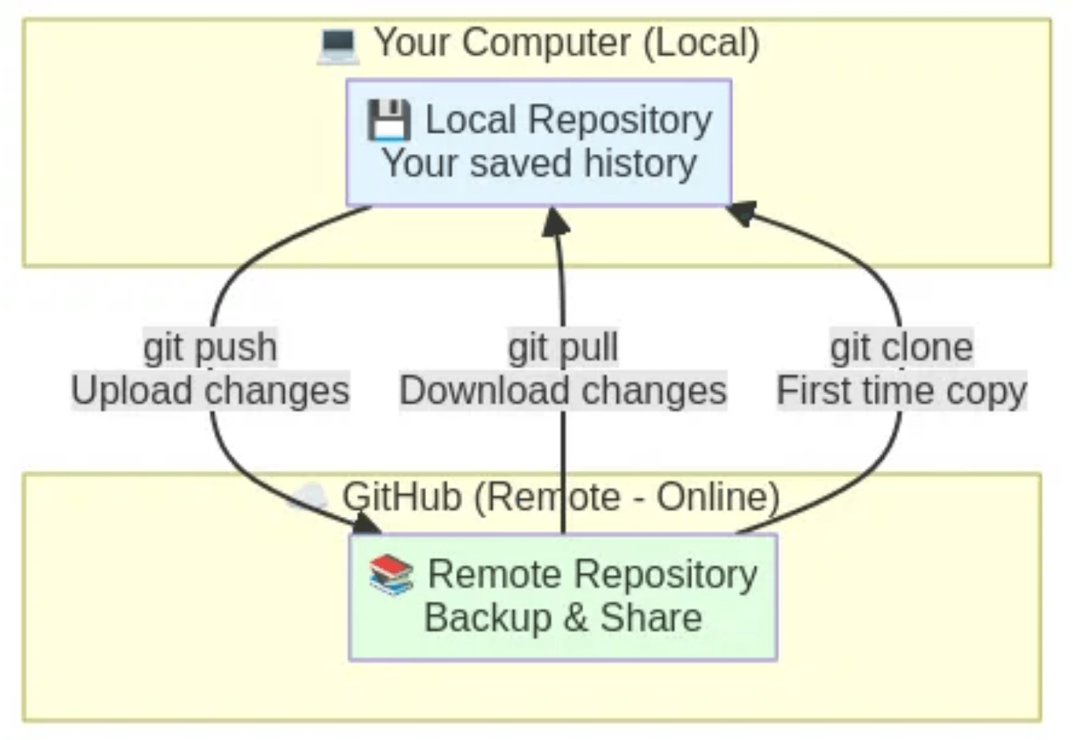






Local vs Remote Repositories
Your computer + GitHub = Perfect backup system
Local Repository
Remote Repository
Lives on your computer
Lives on GitHub (online)
Works offline
Accessible from anywhere
Fast and private
Share with others & backup
Clone
Push
Pull
Copy from GitHub (first time)
Upload to GitHub
Download from GitHub

Slide 4
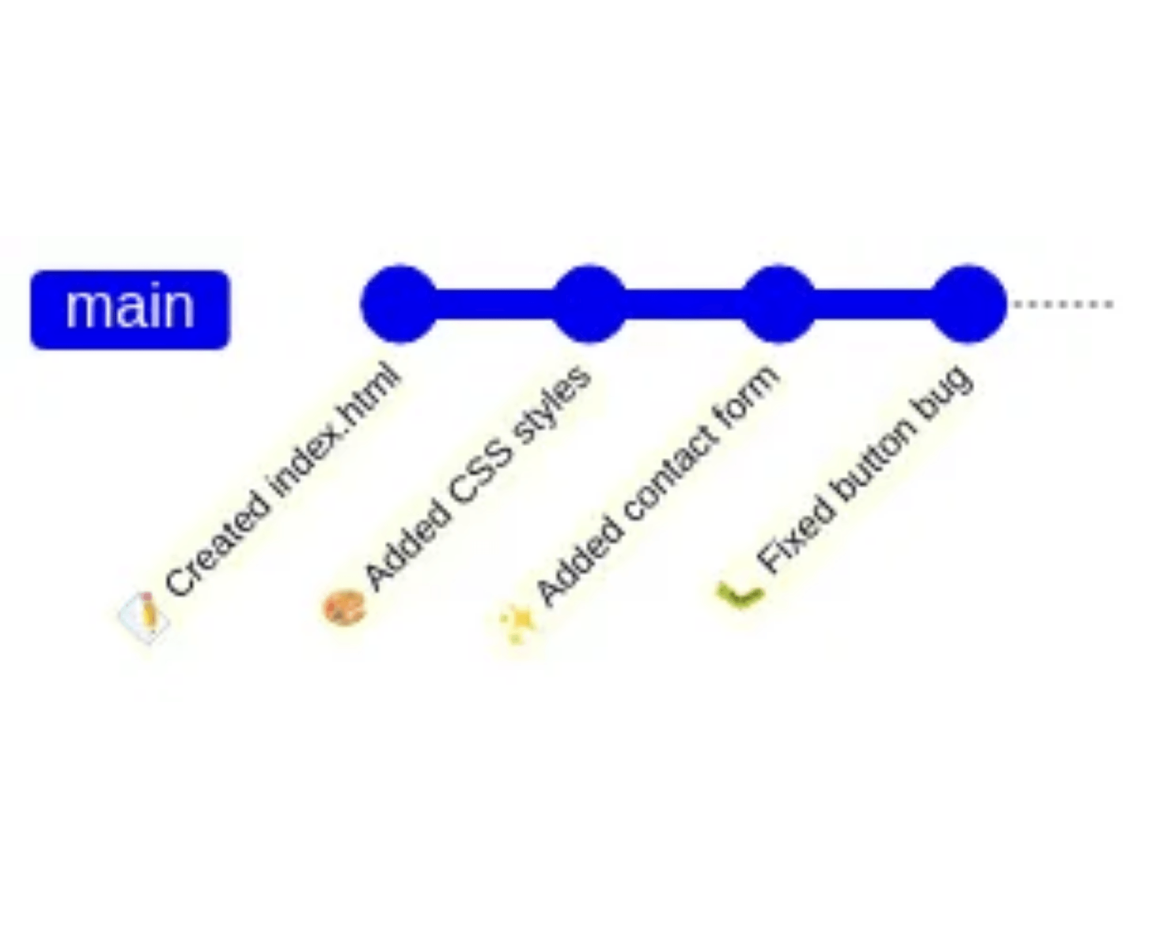





Commits Create a History Timeline
Every commit is a checkpoint you can return to
Each commit saves:
What files changed
Which files were added, modified, or deleted
Who made the change
Your name and email address
When it happened
Date and time of the commit
A message describing why
Your explanation of what you did
You can jump back to any of these points anytime!

Slide 5


Setting Up Git in VS Code
VS Code has Git built-in - no extra software needed!
1
Install Git on your computer
Windows:
Download from git-scm.com
Mac:
Already installed or use Homebrew
sudo apt install git
Linux:
2
Configure your identity (one-time setup)
Open VS Code Terminal (View → Terminal) and type:
git config --global user.name "Your Name"
git config --global user.email "your.email@example.com"
3
Sign in to GitHub in VS Code
Click the Account icon (bottom left)
Choose "Sign in to Sync Settings"
Follow the GitHub login prompts

Slide 6






Creating Your GitHub Account
Your online home for Git repositories
What is GitHub?
Create Free Account
Online platform for hosting Git repositories
1.
Go to
github.com
2.
Click "Sign up" button
Free cloud backup for your projects
3.
Enter your email address
Share code with others
4.
Create a password
Build your developer portfolio
5.
Choose a username
6.
Verify your account (check email)
7.
Select the
free plan
Important:
Use a professional username - employers may see your GitHub profile!
Next:
Connect VS Code to your GitHub account

Slide 7







Connecting VS Code to GitHub
Link your editor to your GitHub account (one-time setup)
Step-by-Step Connection
1.
Click the
Account icon
(bottom left corner of VS Code)
2.
Choose
"Sign in to Sync Settings"
3.
Select
"Sign in with GitHub"
4.
Browser opens automatically
Click
"Authorize Visual Studio Code"
VS Code ↔ GitHub
5.
Return to VS Code
Connected & Ready!
You're now connected!
Once connected, VS Code can push and pull directly to GitHub!
No need to enter your password every time - it's all automatic
Tip:
You only need to do this once per computer

Slide 8




Creating Your First Repository
Two ways to start: Create new or clone existing
Option A: Create New
Option B: Clone Existing
In VS Code:
In VS Code:
1. Open your project folder
1. Press Ctrl+Shift+P
(File → Open Folder)
(Cmd+Shift+P on Mac)
2. Click Source Control icon
2. Type "Git: Clone"
(left sidebar, branch symbol)
3. Paste GitHub repository URL
3. Click "Initialize Repository"
4. Choose where to save it
Terminal command:
Terminal command:
git init
git clone https://github.com/username/repo.git
Tip:
Use Option A for new projects, Option B to work on existing GitHub projects

Slide 9



Making Your First Commit
Save a snapshot of your work
1
Make changes to your files
Create or edit files in your project. VS Code shows changed files with colored indicators.
2
Stage your changes (choose what to save)
In VS Code:
Terminal command:
• Open Source Control panel (left sidebar)
git add filename.txt
• See changed files under "Changes"
• Click
+
icon next to each file to stage it
git add .
• Or click
+
next to "Changes" to stage all
The dot (.) stages all files
3
Commit (create the snapshot)
In VS Code:
Terminal command:
• Type a message in the text box at top
git commit -m "Added homepage"
• Example: "Added homepage"
• Click the
✓ Commit
button
The -m flag adds your message

Slide 10






Checking Your Status
See what's changed and what's staged
In VS Code
Terminal Command
Source Control Panel
git status
Click the branch icon on left sidebar
Badge Number
What you'll see:
Shows count of changed files
File List
Files in red
See all modified files with indicators
Changed but not staged
Colored Indicators:
Files in green
M
= Modified
Staged and ready to commit
U
= Untracked (new)
D
= Deleted
"Nothing to commit"
Everything is saved

Slide 11







Viewing Your Commit History
See all the snapshots you've created
In VS Code
Terminal Commands
Timeline View
Full history:
Click the clock icon in Source Control panel
git log
Git Graph Extension
Install for visual timeline (recommended)
Compact view (one line per commit):
git log --oneline
Click Any Commit
See exactly what changed in that commit
Each commit shows:
Unique ID
Author Name
Long code identifying the commit
Who made the commit
Date and Time
Commit Message
When it was created
Description of what changed

Slide 12





Connecting to GitHub
Upload your repository to the cloud
1
Create a repository on GitHub
Go to
github.com
Don't initialize with README
Click "New repository" (green button)
Click "Create repository"
Give it a name (same as your project)
2
Connect your local repository to GitHub
In VS Code:
Terminal commands:
• Click "Publish to GitHub" in Source Control panel
git remote add origin https://github.com/username/repo-name.git
• Choose public or private
git branch -M main
• Select which files to include
git push -u origin main
• Done!
Success!
Your local repository is now connected to GitHub

Slide 13






Pushing Changes to GitHub
Upload your new commits to the cloud
After making and committing changes locally, send them to GitHub:
In VS Code
Terminal Command
Click the
...
menu in Source Control panel
git push
Select
"Push"
Or click the cloud icon with up arrow in bottom status bar
First time pushing?
You may need to use:
git push -u origin main
What happens:
Your local commits
Transfer
GitHub updates
Upload to GitHub
Sent over internet
Others can see changes

Slide 14










Pulling Changes from GitHub
Download updates from the cloud
How to Pull
When to Pull
In VS Code:
Before starting work each day
• Click the
...
menu in Source Control panel
Get the latest version before making changes
• Select
"Pull"
Before making new changes
• Or click the cloud icon with down arrow in bottom status bar
Ensure you're working with current files
When working with others
Terminal command:
Stay in sync with team changes
git pull
What happens during a pull:
Downloads new commits from GitHub
Updates your local files automatically
Keeps your computer in sync with GitHub

Slide 15




Common Beginner Workflow - Part 1
Your daily Git routine in VS Code
1
Pull first
Source Control → ... → Pull
git pull
Get latest changes
2
Make changes
Code, create, modify files normally
Edit files
3
Check status
Look at Source Control panel
git status
See what changed
Continued on next slide...

Slide 16




Common Beginner Workflow - Part 2
Saving and uploading your changes
4
Stage files
Click + next to changed files
git add .
Choose what to save
5
Commit
Write message, click ✓
git commit -m "message"
Save snapshot
6
Push
Source Control → ... → Push
git push
Upload to GitHub
Repeat this workflow every time you work on your project!
This 6-step routine will become second nature with practice
Pro Tip:
Always pull before starting work to avoid conflicts!

Slide 17










Git for Python & Streamlit Projects
What to track and what to ignore
DO Commit These
DON'T Commit These
Your Python code
venv/ or env/
All .py files, including your Streamlit app
Virtual environment folder (huge and unnecessary)
requirements.txt
__pycache__/
Lists your project dependencies
Python cache files (auto-generated)
README.md
*.pyc files
Project documentation and instructions
Compiled Python files (auto-generated)
Config files
.env files
Like .streamlit/config.toml
Contains API keys and secrets (security risk!)
Next:
Learn how to create a .gitignore file to automatically ignore these files

Slide 18




Creating .gitignore for Python Projects
Tell Git what files to automatically ignore
What is .gitignore?
Example .gitignore content:
A special file that tells Git which files and folders to
never track
.
# Virtual environment
venv/
Once you create it, Git automatically ignores those files.
env/
How to create it:
# Python cache
1.
In VS Code Explorer, right-click
__pycache__/
*.pyc
2.
Select
"New File"
*.pyo
3.
Type exactly:
.gitignore
4.
Copy the example content →
# Environment variables
.env
5.
Save the file
.env.local
# IDE settings
.vscode/
.idea/
# OS files
.DS_Store
Thumbs.db
Create this BEFORE your first commit!
Prevents accidentally committing large files or secrets. If you already committed venv/ by mistake, ask for help to remove it.

Slide 19




Essential VS Code Git Operations
Quick reference for common tasks
What you want to do
VS Code Method
Terminal Command
Start tracking a project
Source Control → Initialize Repository
git init
Copy a GitHub project
Command Palette → Git: Clone
git clone <url>
See what changed
Source Control panel
git status
Prepare files to save
Click + on files
git add .
Save a snapshot
Type message, click ✓
git commit -m "message"
Upload to GitHub
... menu → Push
git push
Download from GitHub
... menu → Pull
git pull
View history
Timeline view or Git Graph
git log
Connect to GitHub
Publish to GitHub button
git remote add origin <url>
Tip:
Bookmark this slide for quick reference while working!

Slide 20








Understanding Git Messages
What VS Code is telling you
File Status Indicators
M
Modified
U
Untracked
D
Deleted
A
Added
File was changed
New file
File removed
New file staged
Common Messages
"No changes"
"Sync Changes"
Everything is committed, nothing to save
Push and pull at the same time
"Publish Branch"
"Merge conflict"
First time pushing to GitHub
Two people changed same line (advanced)
Status Bar Indicators (bottom of VS Code)
Cloud with arrow
Branch icon
Sync icon
Push/pull available
Shows current branch (usually "main")
Number of commits to push/pull

Slide 21





Best Practices for Beginners
Simple rules to avoid problems
Commit Messages
When to Commit
• Write clear, short descriptions
• After completing a small task
• Use present tense: "Add feature" not "Added feature"
• Before trying something risky
• Be specific: "Fix login button" not "Fixed stuff"
• At the end of each work session
• When something works (before breaking it!)
What to Commit
What NOT to Commit
• Your code files
• Passwords or API keys
• Documentation
• Large files (videos, datasets)
• Configuration files
• Generated files (node_modules, build folders)
• Personal settings
Golden Rule
Commit often, push regularly
Pull before you start working • Write meaningful commit messages

Slide 22









Troubleshooting Common Issues
Solutions to beginner problems
Problem: "Nothing to commit"
Problem: "Please tell me who you are"
You haven't made any changes, or you already committed them. Make some edits first!
Configure your name and email using the terminal commands from the setup slide.
Problem: Can't push to GitHub
Problem: "Repository not found"
• Make sure you're signed in to GitHub in VS Code
• Check the URL is correct when cloning
• Check internet connection
• Make sure you have access to the repository
• Verify repository exists on GitHub
Problem: Lost the Source Control panel
Problem: Don't see Git options
• Click the branch icon on the left sidebar
• Make sure Git is installed on your computer
• Or go to View → Source Control
• Restart VS Code after installing Git
Still stuck?
Search for your error message on Google or ask for help on GitHub Discussions!

Slide 23










Next Steps After Mastering Basics
Where to go from here
Once you're comfortable:
Learn about
branches
(work on features separately)
Explore
GitHub features
(Issues, Pull Requests)
Try
collaborating
with classmates
Use
.gitignore files
(tell Git what to skip)
Learn to
undo commits
(git revert, git reset)
Helpful Resources:
GitHub's Interactive Tutorial
VS Code Git Documentation
skills.github.com
code.visualstudio.com/docs/sourcecontrol
Git Visualization Tool
GitHub Learning Lab
git-school.github.io/visualizing-git
lab.github.com
Practice Projects:
Track your
homework assignments
with Git
Build a
personal website
and host on GitHub Pages
Create a
portfolio
of your projects
Contribute to
open source projects
Keep practicing!
The more you use Git, the more natural it becomes

Slide 24






You Now Know How to Use Git in VS Code!
Ready to track your projects like a pro
Key Concepts You Learned
Essential Operations
Git tracks changes and creates history
Initialize or clone a repository
Working folder → Staging → Repository workflow
Stage and commit changes
Local (computer) and Remote (GitHub) repositories
Push to and pull from GitHub
Commits are snapshots you can return to
View status and history
Remember
•
VS Code makes Git visual and easy
•
Commit often, push regularly
•
Terminal commands are there if you need them
•
Pull before starting work
You're Ready to Start Tracking Your Projects with Git!
Start small, practice often, and watch your confidence grow

