Slide 1




Week 11
Object-Oriented Programming & Project Refactoring
Software Architecture
Course
Topic
Week
CST1510
OOP & Refactoring
11 of 11

Slide 2

Week 11 Learning Objectives
1
Understand the core principles of Object-Oriented Programming (OOP) in Python, including encapsulation, abstraction, inheritance, and polymorphism
2
Identify objects and classes within the Multi-Domain Intelligence Platform project, distinguishing between entity classes and service classes
3
Create UML class diagrams to visualize the software architecture, showing class attributes, methods, and relationships
4
Refactor procedural code from previous implementation into clean, maintainable object-oriented structure following best practices
5
Prepare the final project for submission with comprehensive documentation, including README, code comments, and technical report

Slide 3







What is Object-Oriented Programming?
Object-Oriented Programming (OOP) is a programming paradigm that organizes software design around objects (data and behavior bundled together) rather than functions and logic. It models real-world entities and their interactions.
Procedural Programming
Object-Oriented Programming
Code is organized as a sequence of functions that operate on data. Data and behavior are separate.
Code is organized around objects that combine data (attributes) and behavior (methods) into cohesive units.
Example: Functions like register_user(), login_user(), get_incidents() that manipulate data stored in variables or files.
Example: A User object with attributes (username, password_hash) and methods (verify_password(), get_role()).
Why Use OOP?
Better Organization: Related data and behavior grouped together
Code Reusability: Classes can be reused across projects
Easier Maintenance: Changes localized to specific classes
Encapsulation: Hide internal details, expose only necessary interfaces
Real-World Modeling: Objects represent actual entities (users, incidents, tickets)
Scalability: Easy to add new features without breaking existing code

Slide 4
Core OOP Terminology
Object
Class
Instance
A thing or entity in your program (e.g., a user, a security incident).
A blueprint or template for creating objects.
A specific object created from a class.
Attributes
Methods
Data that belongs to an object (like variables). Describes what it is.
Functions that belong to an object. Describes what it can do.

Slide 5

Real-World Analogy: Person
Attributes (Data):
Name
Age
Address
Attributes (Data):
Walk:
Talk
Breath
Programme is composed of lots of individual objects (bundles of data). Entities are usually defined as a noun
Example of object could be a person

Slide 6
UML Class Diagram Structure UML
Blueprint of an object
Examples:
Identity/class name
State/attributes
Behavior/methods

Slide 7

The __init__ Constructor MethodConstructor Method
def __init__(self, ...):
What is it?
A special method that initializes a new object's state.
class Dog:
def__init__(self, name, age, breed):
self.name = name
self.age = age
self.breed= breed
When does it run?
Automatically, the moment you create a new instance of the class.
What does it do?
It sets up the initial values (attributes) for the object using the arguments provided.

Slide 8
Understanding 'self' in Python "self"
The Most Important Parameter
What is it?
How it works
It represents the current instance of the class. It allows the code to distinguish between "this specific user" and "any user".
Python passes the object automatically as the first argument. You don't pass it yourself when calling methods.
Why do we need it?
So each object can have its own separate data. Without self, variables would be shared across all instances!
Common Beginner Mistake
Forgetting to include self as the first parameter in every method definition.
self

Slide 9
Creating Objects
Making Instances from the Blueprint
dog1 (Instance)
# Create two different users
dog1 = Dog(”Vuk", 2 “Husky ”)
dog2 = Dog( ”Princess",5, ”Poodle”)
# Access data
print(dog1.name) # Output: Vuk
print(dog2.name) # Output: Princess
name:
”Vuk"
age:
2
breed:
“Husky”
dog2 (Instance)
name:
”Princess"
age:
5
breed
”Poodle”
Key Concept: Each instance has its own separate memory and data.

Slide 10

Complete Dog Class Example
Hands-On Code
1. Define the Class
2. Use the Class
# Create instances
vuk = Dog(”Vuk", 2 “Husky ",
princess = Dog( ”Princess",5, ”Poodle",
# Access attributes
print(vuk.breed)
# Modify attributes
vuk.breed = 7
print(vuk.breed)
class Dog:
def__init__(self, name, age, breed):
self.name = name
self.age = age
self.breed= breed
OUTPUT
Husky

Slide 11
What are Dunder Methods?
Dunder = Double UNDERscore
Special methods that Python calls automatically in specific situations. They are also known as "Magic Methods".
__init__
__str__
__len__
The Constructor Called automatically when a new object is created.
String Representation Called automatically when you print() an object.
Length Called automatically when you use len(object).

Slide 12

The __str__ Method
Making Objects Printable
print(dog1)
Console Output
Without __str__
Default Behavior
<__main__.Dog object at 0x7f8b3c>
def
__str__(self):
return
f”Dog: {self.name}, {self.age}, {self.breed}"
With __str__
Console Output
Custom Behavior
Dog: Vuk, 2, Husky
print(user1)
Result: Makes debugging and logging much easier!

Slide 13
Documenting Your Classes
Using Docstrings
class Dog:
""" Represents a dog in the system. Attributes: name (str): Dog’s age (int): Dob’s breed (str, etc.) ""”
def__init__(self, name, age, breed):
self.name = name
self.age = age
self.breed= breed
The Syntax
Use triple quotes """ to define a docstring. It can span multiple lines.
The Placement
Must be the very first thing inside a class or method definition.
The Purpose
Explains what the class does and lists its attributes for other developers (and you).

Slide 14
Adding Methods
class Dog:
""" Represents a dog in the system. Attributes: name (str): Dog’s age (int): Dog’s breed (str, etc.) ""”
def__init__(self, name, age, breed
self.name = name
self.age = age
self.breed=breed
def get_username(self):
return self. username
def set_age(self, new_age):
self. age = new_age
def is_breed(self,new_breed):
if self.breed == breed:
return True
return False
def __str__(self,):
return f‘The user id is {self.name}, name {self.name}’
Defining What Objects Can DO
Functionality
Methods are simply functions defined inside a class. They define behaviors.
The Golden Rule
Always include self as the first parameter so the method can access the object's data.
Accessing Data
Use self.attribute_name to read or modify the object's attributes.

Slide 15

Using Methods
Interacting with Objects
# 1. Create an instance
alice = User(1, "alice", "alice123vbnghgh")
# 2. Call a method that returns a value
if is_breed(‘Poodle’):
print(”It’s a Poodle”
# 3. Call a method that changes state
alice.set_name(”Alice12")
# 4. Call a method to get data
print(alice)
Dot Notation
Use object.method() to tell the object to do something.
Return Values
Methods like is_valid_hash() give back an answer (True/False) that you can use in logic.
Modifying State
Methods like set_name() change the internal data (attributes) of the object.
Encapsulation
You don't need to know how __str__() builds the string, representation of the object

Slide 16




Hands-On Activity
Create a Class of a Car as the UML diagram below and three object of the class.
Object:
Audi
Object:
Volvo
Object:
Volvo
Class:
car
Change the make year, model, and fuel type into private attributes and create accessor methods to be able to get the data

Slide 17
Inheritance Basics
Object-oriented programming (OOP) allows you to define new classes from existing classes.
Inheritance enables you to define a general class (a superclass) and later extend it to more specialized classes (subclasses).
A subclass inherits accessible data fields and methods from its superclass, but it can also have other data fields and methods.

Slide 18
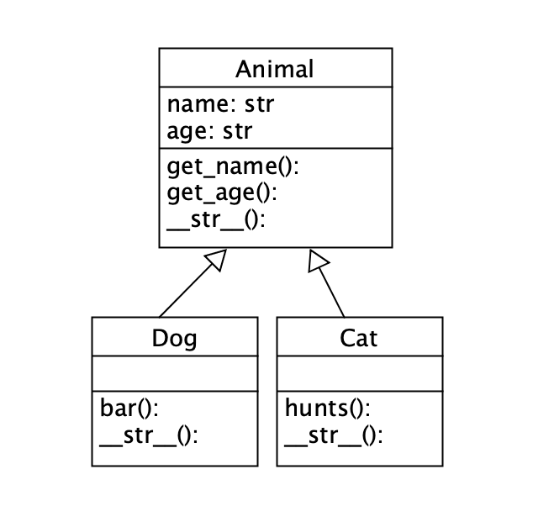
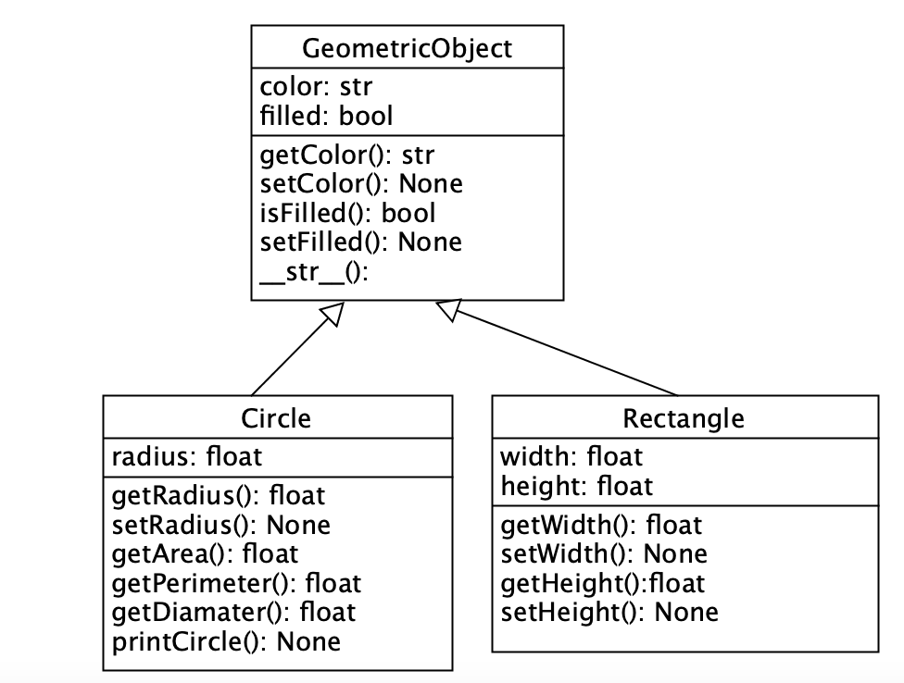
Inheritance Examples
Example 1
Example 2
superclass
subclass
subclass
superclass
class Dog(Animal):
class Circle(GeometricObject):
Liang book p.401

Slide 19
Using super() in Subclasses
class Animal: def __init__(self, name, age,breed): self.__name = name self.__age = age
self.__breed = breed
class Dog(Animal):
def __init__(self, name, age, breed), super().__init__(name, age, breed)
self.__id = id
super ()
calls constructor from the superclass

Slide 20
Overriding Methods
To override a method, the method must be defined in the subclass using the same header as in its superclass.
class Animal: def __init__(self, name, age): self.__name = name self.__age = age
def get_name(self): return self.__name def get_age(self): return self.__age def __str__(self): return f'the Animal name is: {self.__name} and he is: {self.__age} years old'
class Cat(Animal):
def __init__(self, name, age, id): super().__init__(name, age)
self.__id = id def hunts(self): return f' it is: {True} cuts are hunting ' def __str__(self): return super().__str__() + self.hunts()

Slide 21
The Python Object Class
Every class in Python is descended from the object class.
The object class is defined in the Python library. If no inheritance is specified when a class is defined, its superclass is object by default.
The __new__() method is automatically invoked when an object is constructed.
This method then invokes the __init__() method to initialize the object. Normally we only override the __init__() method to initialize the data fields defined in the new class.
The __str__() method returns a string description/representation for the object

Slide 22
Using isinstance()
The isinstance function can be used to determine whether an object is an instance of a class.
def main(): vuk = Dog('Vuk', 5,Hasky') princess = Dog('Princess', 2, Poodle') bark = Dog('Bark', 4, Hasky') piko = Cat('Piko’,2,Ragdool') poko = Cat('Poko',1, Ragdool’)
dogs_list = [vuk, princess, bark] cats_list = [piko, poko] animals = dogs_list +cats_list for i in animals: if isinstance(i, Cat): print(i.hunts()) if __name__=='__main__': main()
Is instance
Check if instance for the specific class

Slide 23
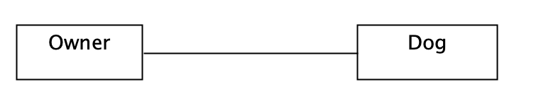
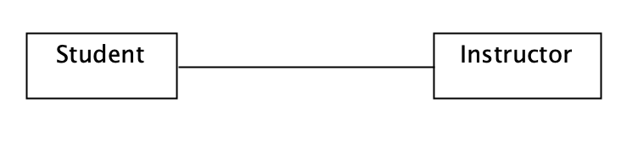
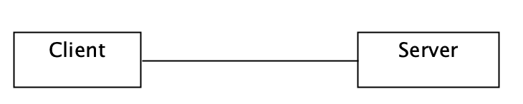
Class Association Relationships
If two classes in a model need to communicate with each other, there must be a link between them, and that can be represented by an association (connector).
Examples:
owner association with dog
student associate with instructor
client associate with server etc

Slide 24
Composition in OOP
class Address: def __init__(self, number, street, postcode, country): self.number = number self.street = street self.postcode = postcode self.country = country def __str__(self): return f'The address is:\n{self.number} {self.street}
\n{self.postcode} \n{self.country}'
class Animal: def __init__(self, name, age, address): self.__name = name self.__age = age self.address= address def get_name(self): return self.__name def get_age(self): return self.__age def get_Address(self): return self. address def __str__(self): return f'the Animal name is: {self.__name} and he is: {self.__age} years old\n{self.address}'
def main(): vuk = Dog('Vuk', 5, Address(1, 'Station Road', ‘ES4', 'UK')) princess = Dog('Princess', 2, Address(2, 'Hendon Lane', 'N4', 'UK')) poko = Cat('Poko',1, Address(1, ‘Dog lane', ‘NW1', 'UK')) animals = [vuk, princess, poko] for i in animals: print(i) print('----------------------') if __name__=='__main__': main()

Slide 25
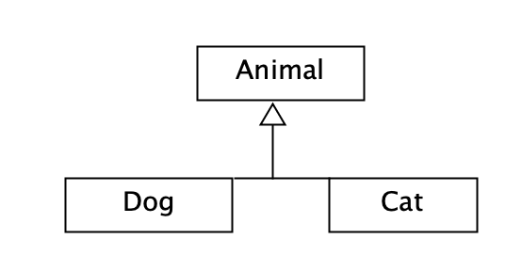
Inheritance vs Composition
Inheritance models what is called an is a relationship. This means that when you have a Derived class that inherits from a Base class, you created a relationship where Derived is a specialized version of Base.
Example: a cat is a animal (inheritance / generalization)

Slide 26

Identifying Project Domain Objects
Identifying Domain Entity Objects
Domain entities represent the core data objects in our application. Each entity corresponds to a real-world concept and encapsulates related data and behavior.
User
SecurityIncident
Authentication
Cybersecurity Domain
Attributes
Attributes
username: str
•
•
id: int
•
password_hash: str
incident_type: str
•
role: str
•
severity: str
•
Methods
Methods
•
verify_password(password)
update_status(new_status)
•
get_role()
•
get_severity_level()
•
Dataset
ITTicket
Data Science Domain
IT Operations Domain
Attributes
Attributes
•
id: int
•
id: int
name: str
•
•
title: str
•
size: int
priority: str
•
Methods
Methods
•
calculate_size_mb()
assign_to(staff)
•
get_source()
•
close_ticket()
•

Slide 27
Identifying Service Classes
Identifying Service Classes
Service classes coordinate application operations, encapsulate business logic, and manage shared resources.
DatabaseManager
Key Methods
Data Access Layer
•
connect() - Open connection
•
execute_query(sql, params)
Centralizes DB connections, queries, and transactions.
•
fetch_one()/fetch_all()
•
close() - Close connection
AuthManager
Key Methods
Authentication Service
•
register_user(...)
•
login_user(...)
Manages authentication, registration, sessions, and roles.
•
hash/verify_password(...)
•
get_user_role(...)
AIAssistant
Key Methods
AI Integration Service
•
set_system_prompt(...)
•
send_message()/stream_response()
Integrates ChatGPT for domain-specific assistance.
•
clear_history()
•
analyze_incident(...)

Slide 28

Benefits of OOP Refactoring
1
Better Organization
Related data and behavior are grouped together in classes. Code is organized by domain entities (User, SecurityIncident, Dataset, ITTicket) and services (DatabaseManager, AuthManager, AIAssistant), making the codebase more intuitive and easier to navigate.
2
Code Reusability
Classes can be reused across different parts of the application and even in future projects. Inheritance allows you to extend existing classes without modifying them. Common functionality is defined once and shared through inheritance or composition.
3
Easier Maintenance
Changes are localized to specific classes rather than scattered across multiple functions. Adding a new field to SecurityIncident only requires updating the SecurityIncident class. Bug fixes are contained within the relevant class, reducing the risk of breaking unrelated functionality.
4
Improved Testability
Classes can be tested independently with unit tests. Mock objects can replace dependencies (e.g., mock DatabaseManager for testing AuthManager). Clear interfaces make it easy to write comprehensive test suites, ensuring code quality and reliability.
5
Scalability
Easy to add new features without breaking existing code. New domain entities can be added by creating new classes that follow the same patterns. The system can grow organically as requirements evolve, with minimal refactoring of existing code.

Slide 29

OOP Design Principles (SOLID)
SR
Single Responsibility
DRY
Don't Repeat Yourself
Each class should have one, and only one, reason to change. A class should focus on a single responsibility or concern, making it easier to understand, test, and maintain.
Avoid code duplication by extracting common functionality into reusable classes or methods. Every piece of knowledge should have a single, authoritative representation.
Example: DatabaseManager handles only database operations, not authentication or business logic.
Example: Instead of repeating CRUD code for each domain, use a base class or shared methods.
EN
Encapsulation
CI
Composition over Inheritance
Hide internal implementation details and expose only necessary interfaces. Use private attributes and provide public methods for controlled access to data.
Favor object composition (has-a relationship) over class inheritance (is-a relationship) when possible. Composition provides more flexibility and reduces tight coupling between classes.
Example: User class has private __password_hash and public verify_password() method.
Example: AuthManager has-a DatabaseManager rather than inheriting from it.
IF
Clear Interfaces
Design simple, intuitive interfaces for your classes. Method names should be descriptive, parameters should be clear, and the class's purpose should be obvious from its public methods.
Example: DatabaseManager.execute_query(sql, params) is clear and self-documenting.

Slide 30
UML Class Diagram Basics
UML (Unified Modeling Language) class diagrams visualize the structure of object-oriented systems. They show classes, their attributes, methods, and relationships.
Visibility Symbols
+
Public: Accessible from anywhere
-
Private: Only accessible within the class
#
Protected: Accessible within class and subclasses
Class Box Structure
Relationship Types
User
───▷
Inheritance: Subclass inherits from superclass (is-a relationship)
Attributes
- username: str
───◆
Composition: Strong ownership, part cannot exist without whole (has-a)
- password_hash: str
+ role: str
───◇
Aggregation: Weak ownership, part can exist independently
Methods
───→
Association: General relationship, objects interact but neither owns the other
+ verify_password(pwd): bool
+ get_role(): str
- hash_password(pwd): str

Slide 31
UML Diagram Example: Domain Classes
UML Diagram: Domain Entity Classes
User
SecurityIncident
- username: str
- id: int
- password_hash: str
- incident_type: str
- role: str
- severity: str
+ __init__(username, password_hash, role)
- status: str
+ verify_password(password): bool
- description: str
+ get_role(): str
+ __init__(id, type, severity, status, desc)
+ __str__(): str
+ update_status(new_status): void
+ get_severity_level(): int
+ __str__(): str
Dataset
ITTicket
- id: int
- id: int
- name: str
- title: str
- size: int
- priority: str
- rows: int
- status: str
- source: str
- assigned_to: str
+ __init__(id, name, size, rows, source)
+ __init__(id, title, priority, status, assigned)
+ calculate_size_mb(): float
+ assign_to(staff): void
+ get_source(): str
+ close_ticket(): void
+ __str__(): str
+ __str__(): str

Slide 32
Final Project Structure
Project Structure After Refactoring
New Folder Structure
📁 models/
📁 multi_domain_platform/
Contains all entity classes representing domain objects. Each file defines a class with attributes, constructor, and methods for data manipulation.
📁 models/
📄 __init__.py
📄 user.py
📁 services/
📄 security_incident.py
📄 dataset.py
Houses service classes that provide business logic and coordinate operations. These classes use composition to work with DatabaseManager and entity objects.
📄 it_ticket.py
📁 services/
📄 __init__.py
📄 database_manager.py
📁 database/
📄 auth_manager.py
Contains database connection utilities and the SQLite database file. Keeps data persistence layer separate from business logic.
📄 ai_assistant.py
📁 database/
📄 db.py
📄 platform.db
📁 pages/
📁 pages/
Streamlit multi-page application pages. Each page imports and uses service classes and entity objects for clean, readable code.
📄 1_🔐_Login.py
📄 2_🛡️_Cybersecurity.py
📄 3_📊_Data_Science.py
Key Benefits
📄 4_💻_IT_Operations.py
📄 5_🤖_AI_Assistant.py
✓ Clear separation of concerns
📁 .streamlit/
✓ Easy to navigate and understand
📄 secrets.toml
✓ Scalable architecture
📄 Home.py
✓ Reusable components
📄 requirements.txt
✓ Testable modules
📄 README.md
📄 .gitignore

