Slide 1

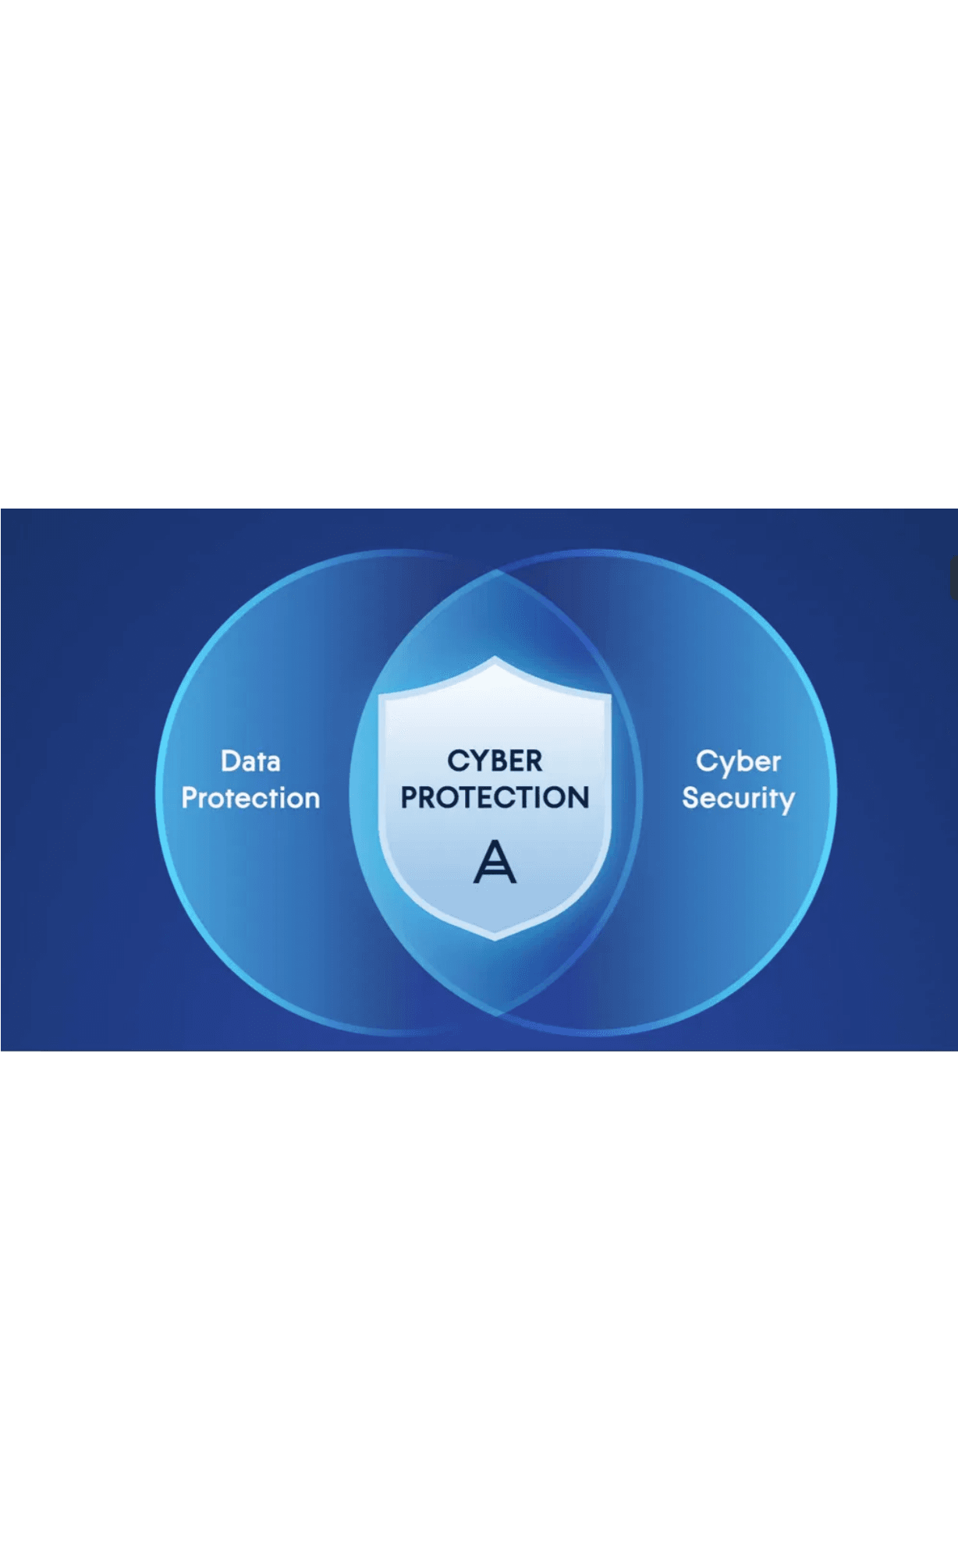
Week 7
Secure Authentication & File Persistence
Building the Foundation of System Security
CST1510 Multi-Domain Intelligence Platform

Slide 2

01
Explain the critical difference between encryption and hashing
Learning Objectives
02
Describe why passwords must be hashed, not encrypted or stored in plaintext
03
Justify the use of bcrypt over faster hashing algorithms
04
Implement a secure registration and login system in Python
05
Persist user credentials to the file system using basic file I/O

Slide 3

The Problem: Why Plaintext Storage Fails
Storing passwords in their original, human-readable form (plaintext) is a critical security vulnerability. If an attacker gains access to your user database, they instantly have credentials for every single user.
12B+
#1
Compromised Accounts
Primary Breach Vector
Tracked by "Have I Been Pwned" database, demonstrating the massive scale of credential breaches worldwide
Verizon DBIR 2024 identifies stolen credentials as a leading cause of data breaches across industries
Our Security Goal
Even if our user data file is stolen, the attacker must not be able to recover the original passwords.

Slide 4

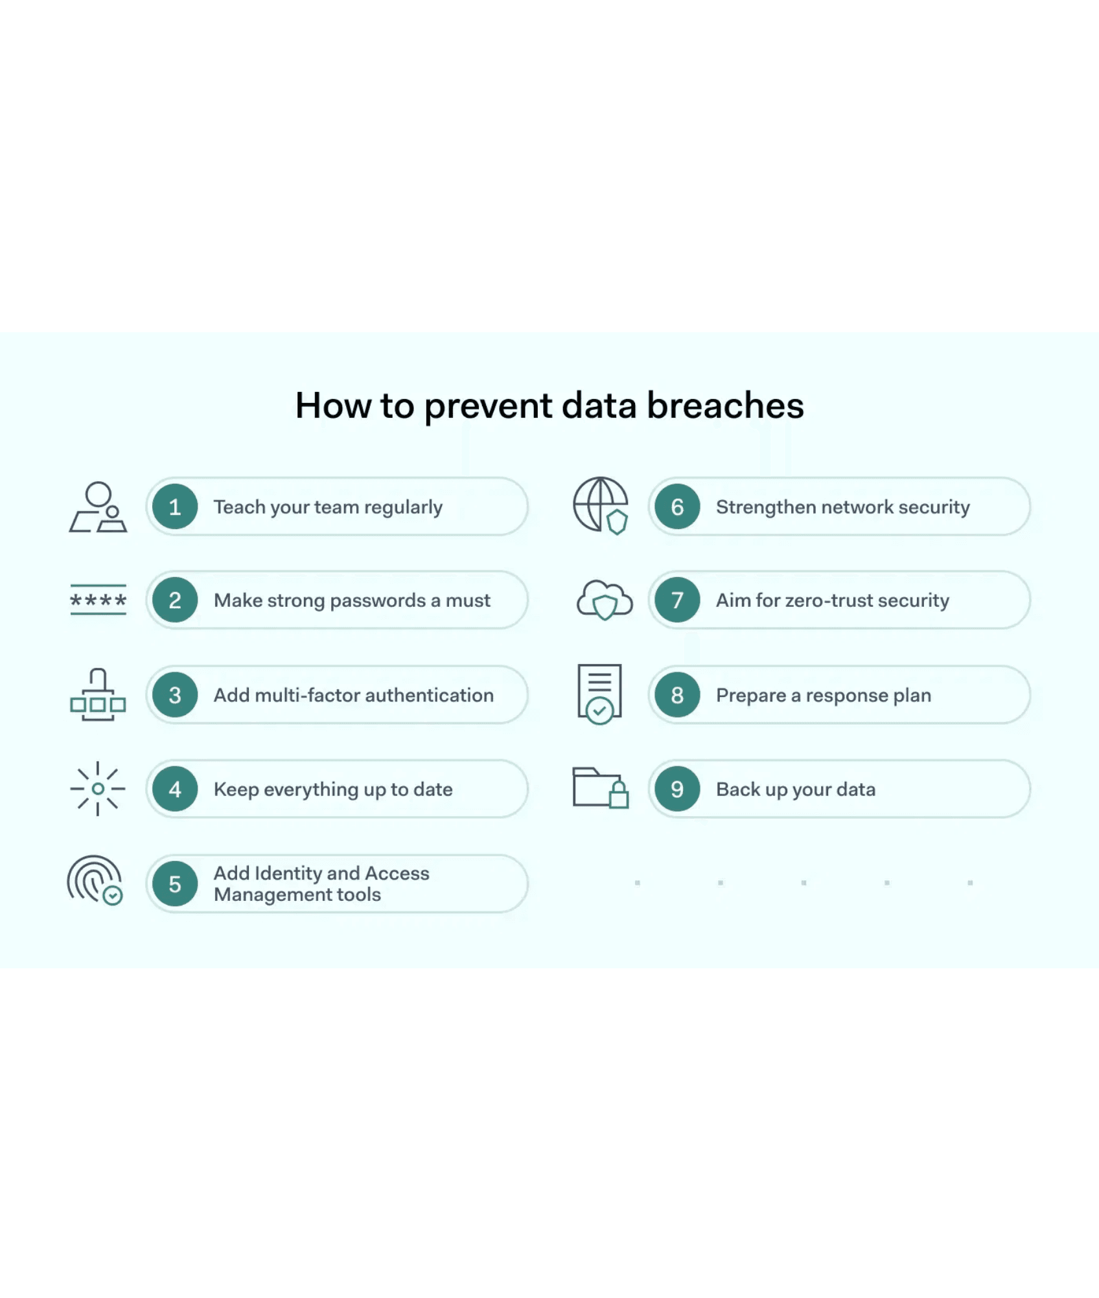
Hashing: The One-Way Street to Security
Cryptographic hashing is a mathematical algorithm that transforms an input into a fixed-size string of characters (the "hash"). The process is one-way—you cannot reverse it to get the original input.
One-Way
Computationally infeasible to reverse the hash back to the original input
Deterministic
The same input will always produce the same output hash
Avalanche Effect
A tiny change in input (even one character) drastically changes the entire hash output
Why hashing beats encryption: Encryption is two-way. If an attacker steals the encryption key, they can decrypt all passwords. With hashing, there is no key to steal.

Slide 5

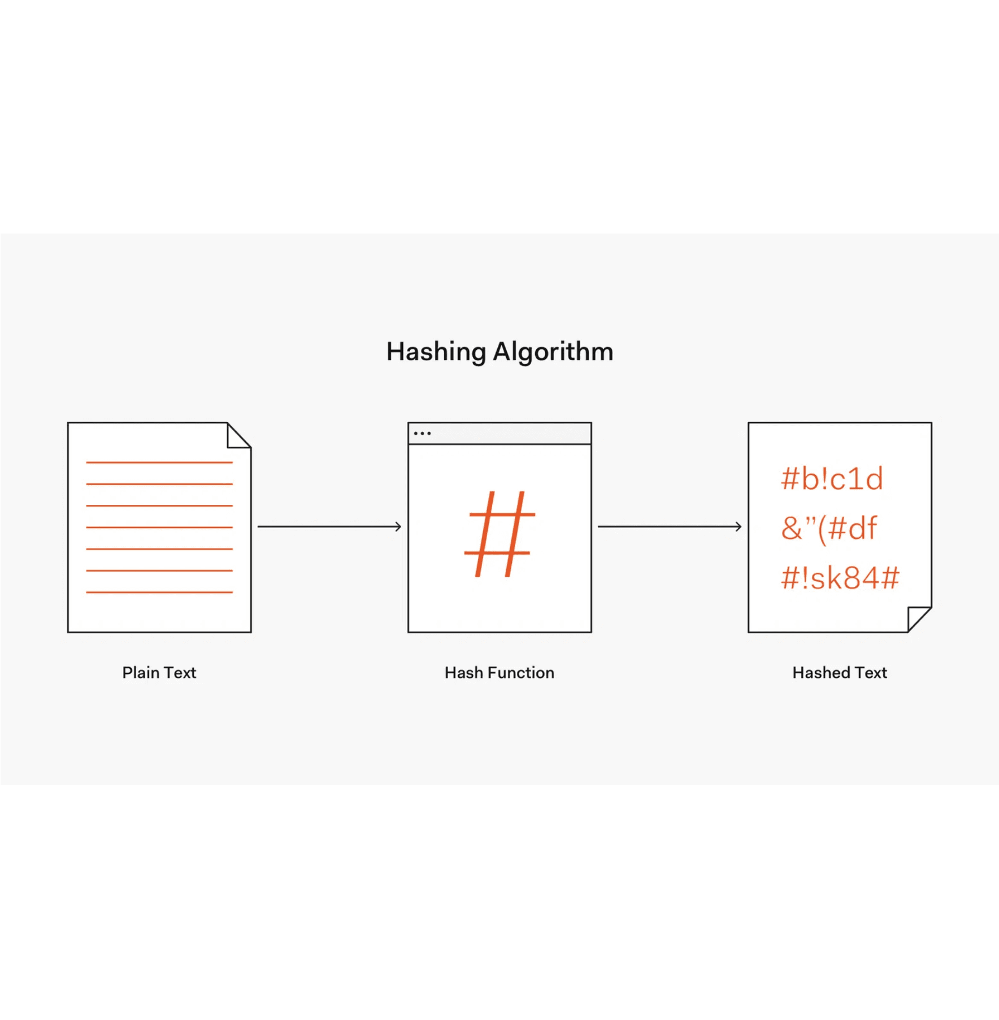
Hashing vs. Encryption: A Critical Distinction
Feature
Hashing
Encryption
Direction
One-way only
Two-way (encrypt & decrypt)
Reversible?
No
Yes (with the key)
Use Case
Password verification
Protecting data in transit/storage
Key Required?
No
Yes
Example
bcrypt, SHA-256
AES, RSA
For Passwords
We verify by hashing the user's input and comparing it to the stored hash. We never need to "decrypt" the password.

Slide 6

The Rainbow Table Attack
Example: Pre-Computed Hash Table
Password
MD5 Hash
Since the same password always produces the same hash, attackers can pre-compute hashes of common passwords and store them in a massive lookup table called a rainbow table.
password
5f4dcc3b5aa765d61d8327deb882cf99
123456
e10adc3949ba59abbe56e057f20f883e
By comparing the hashes in a stolen database to their rainbow table, they can quickly find matches and recover weak passwords.
qwerty
d8578edf8458ce06fbc5bb76a58c5ca4
admin
21232f297a57a5a743894a0e4a801fc3
letmein
0d107d09f5bbe40cade3de5c71e9e9b7
The Vulnerability
An attacker compares stolen hashes to their rainbow table and instantly finds matches for weak passwords.
Without additional protection, simple hashing is vulnerable to pre-computed attacks.

Slide 7

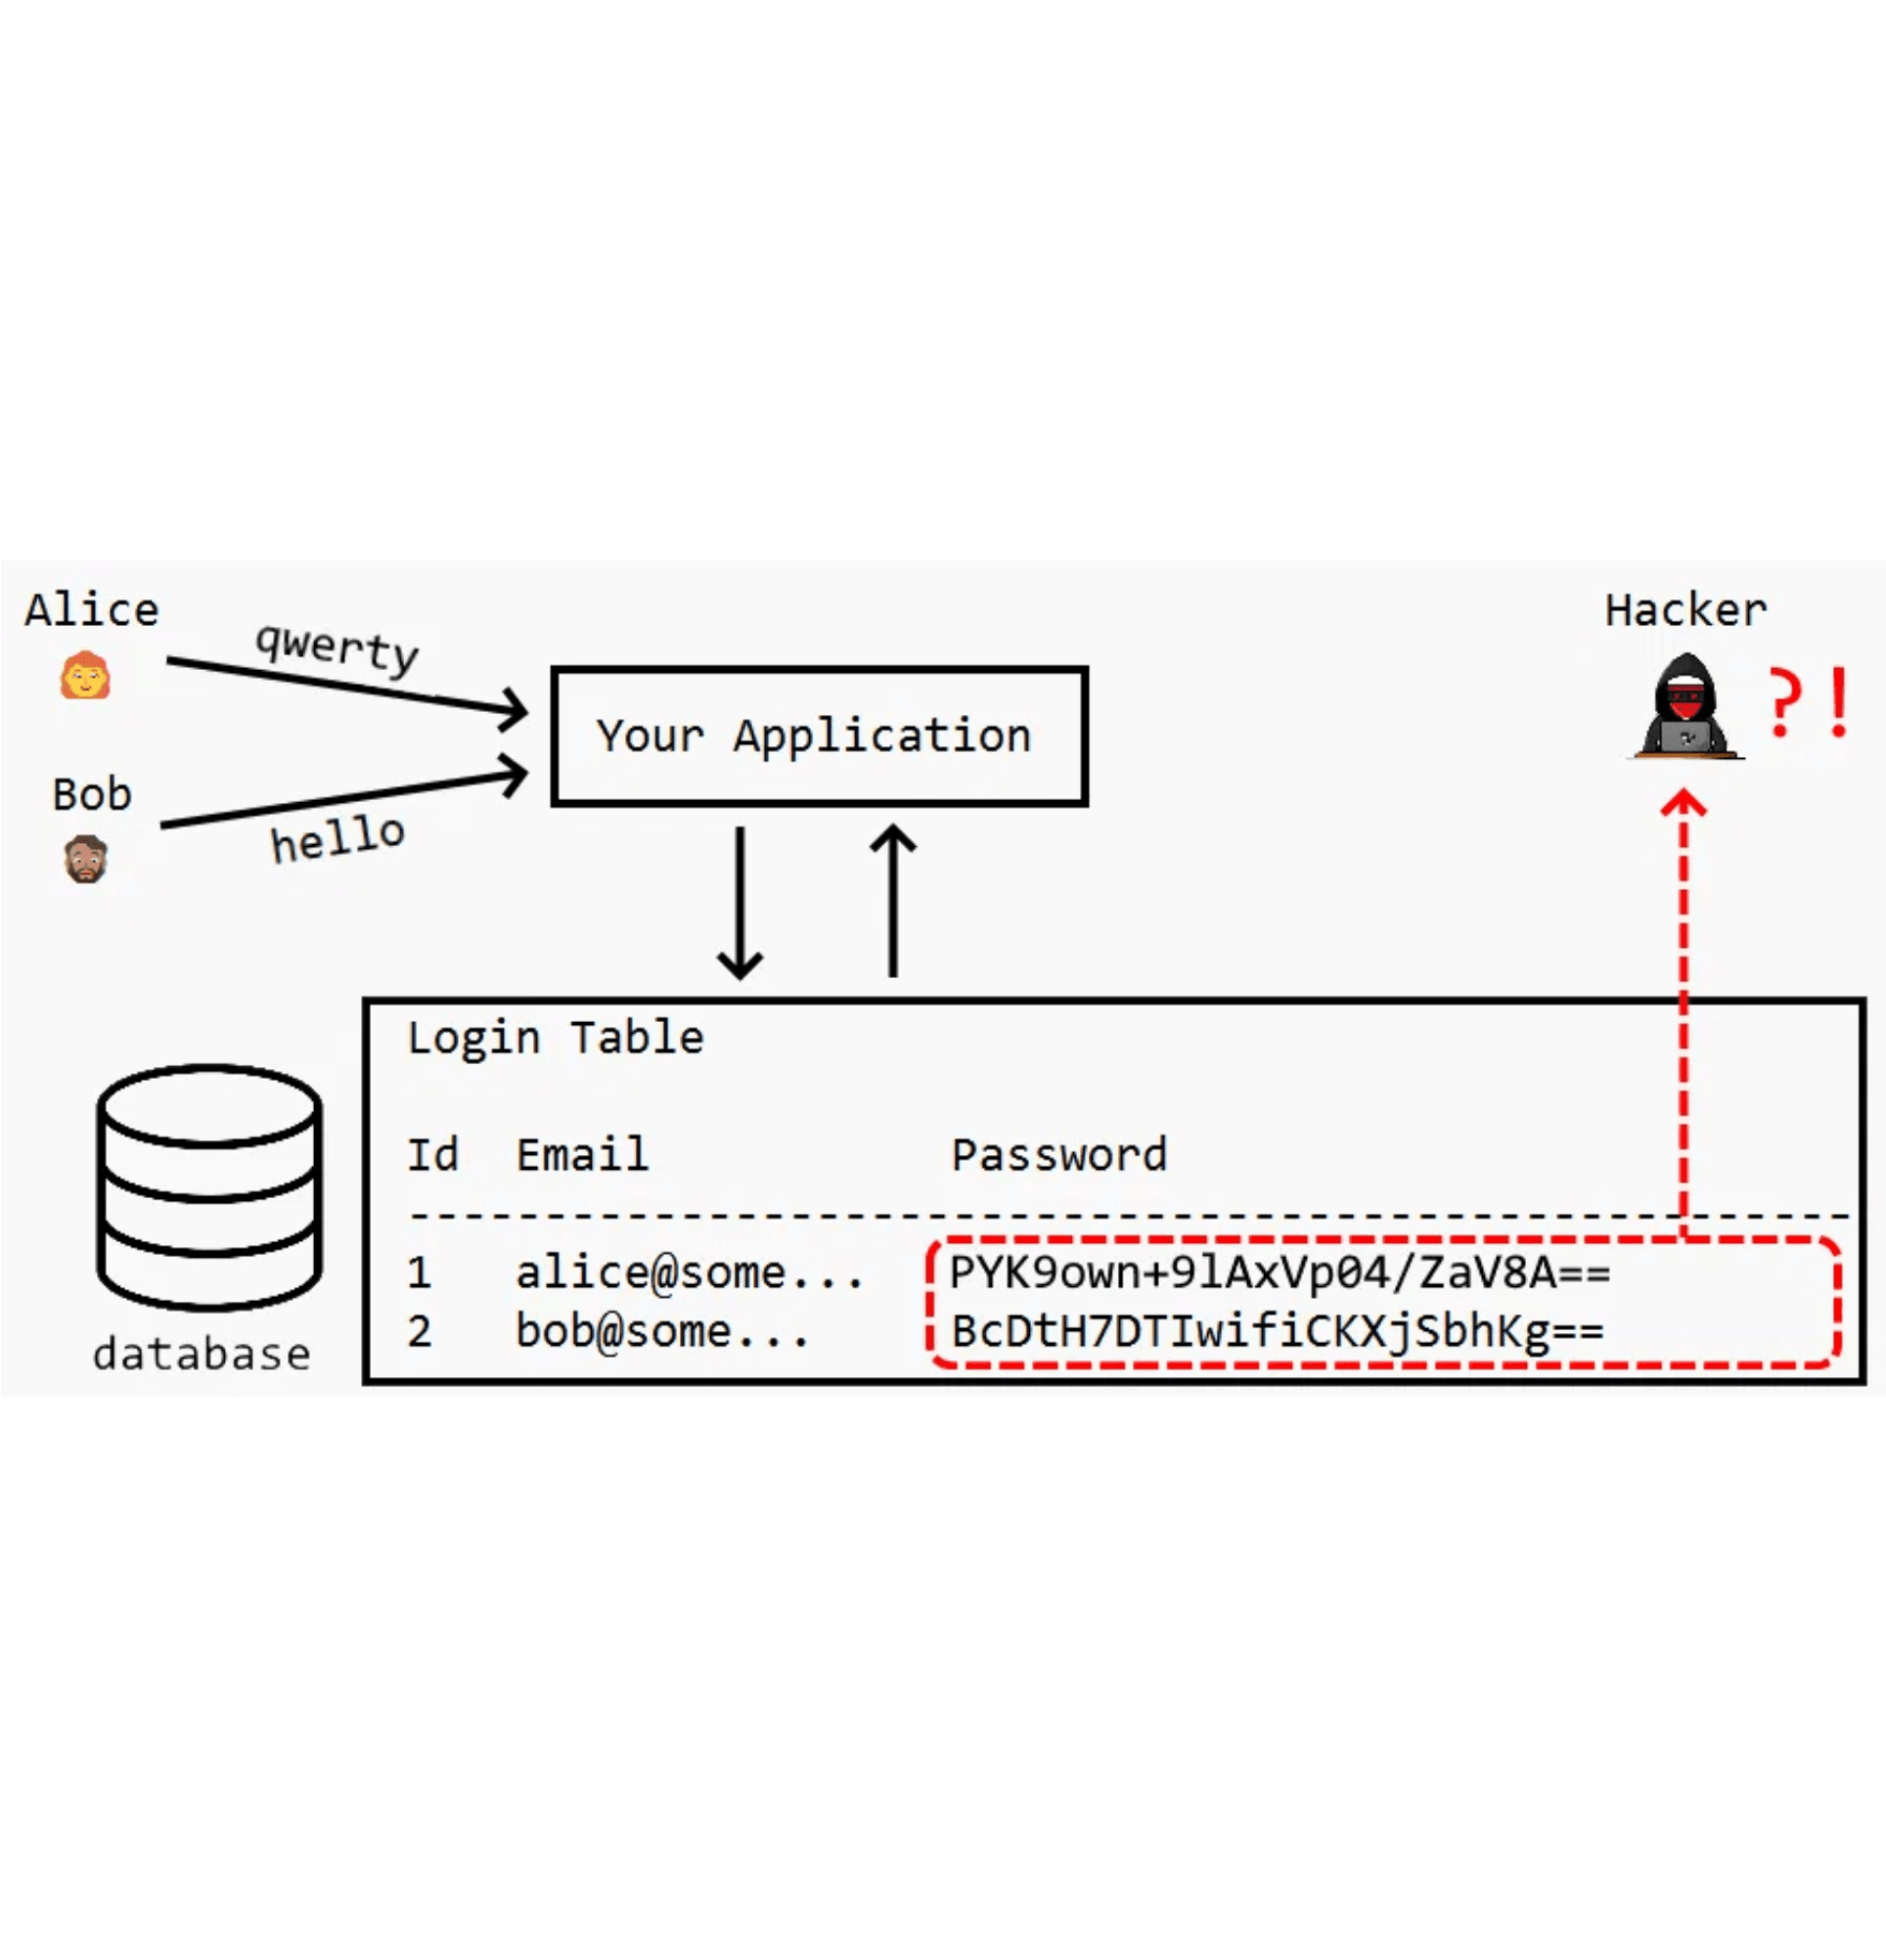
Salting: Defeating Pre-Computed Attacks
A salt is a unique, random string added to each password before hashing. The salt is stored alongside the hashed password, making each hash unique even for identical passwords.
Username
Salt
Hashed Password
alice
salt_1
hash("password123" + "salt_1")
bob
salt_2
hash("password123" + "salt_2")
Result
Even though Alice and Bob have the same password, their stored hashes are completely different. The rainbow table is useless because the attacker would need a separate table for every possible salt.

Slide 8

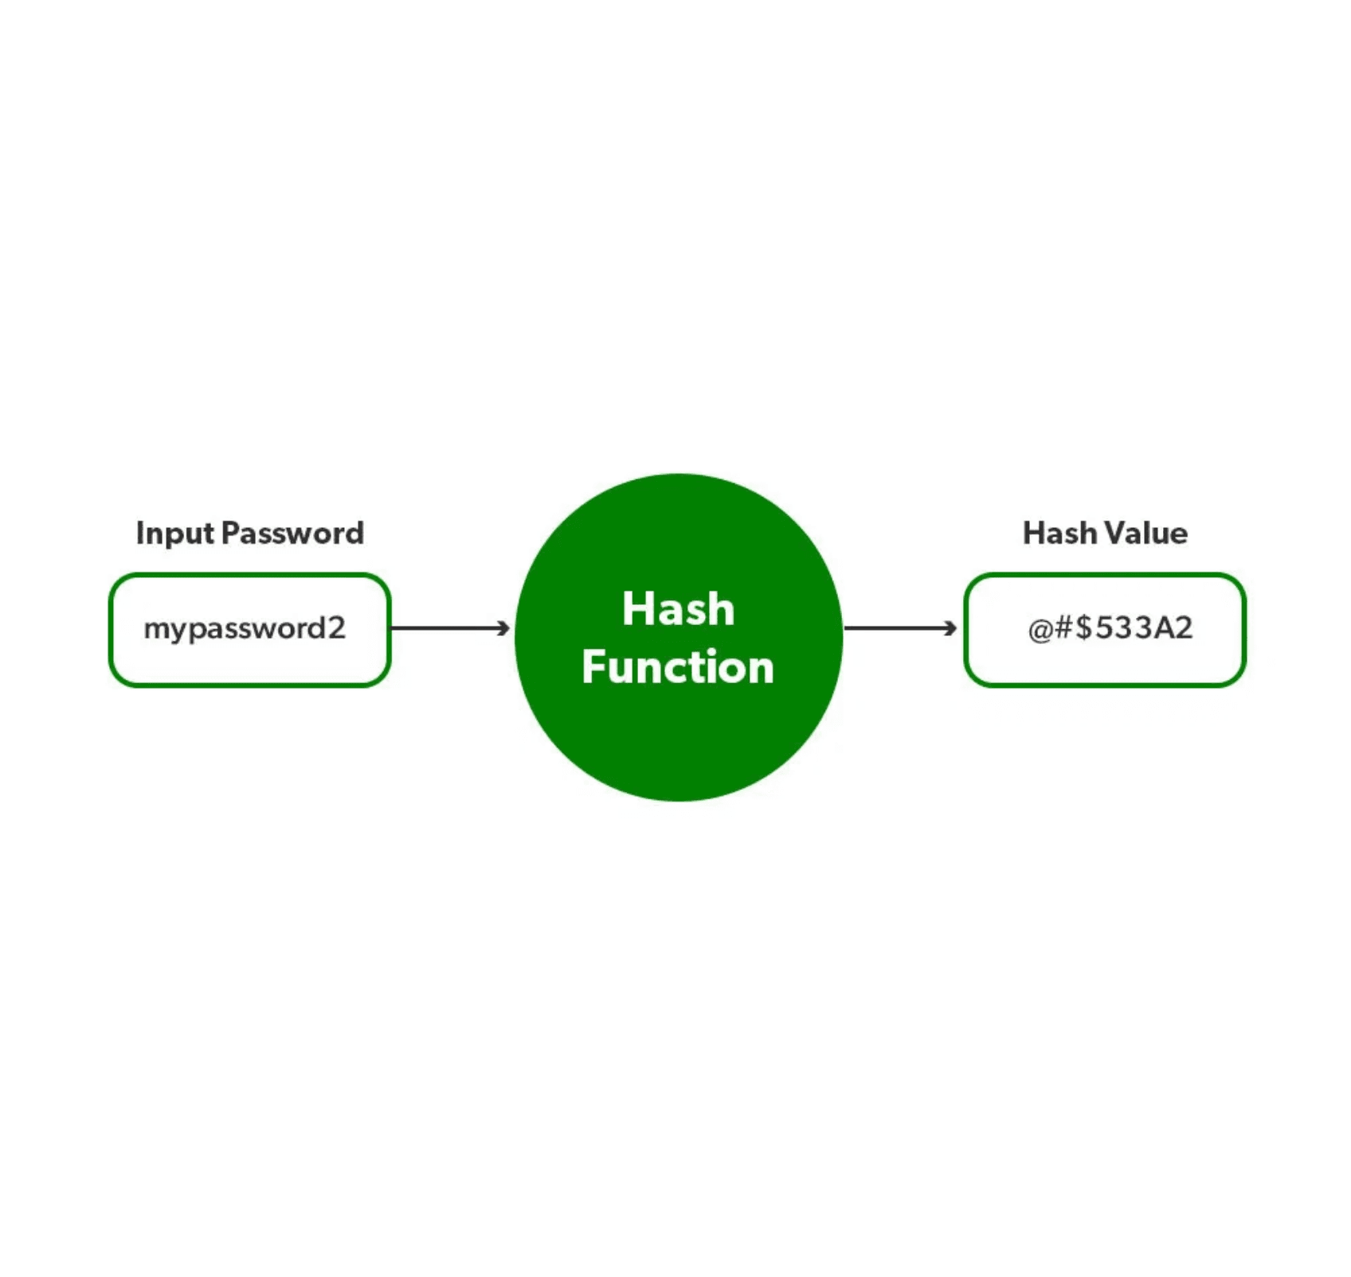
Why bcrypt is the Industry Standard
01
It is slow
bcrypt has a configurable "cost factor" that determines how long it takes to compute a hash. You can increase this factor as computers get faster, ensuring hashing remains computationally expensive for attackers.
02
It includes the salt
bcrypt automatically generates a cryptographically secure salt and embeds it within the final hash string. This simplifies implementation and eliminates the risk of using an insecure salt.
"Passwords MUST be hashed using a strong one-way key derivation function... such as bcrypt..."
— OWASP Password Storage Cheat Sheet, 2024

Slide 9

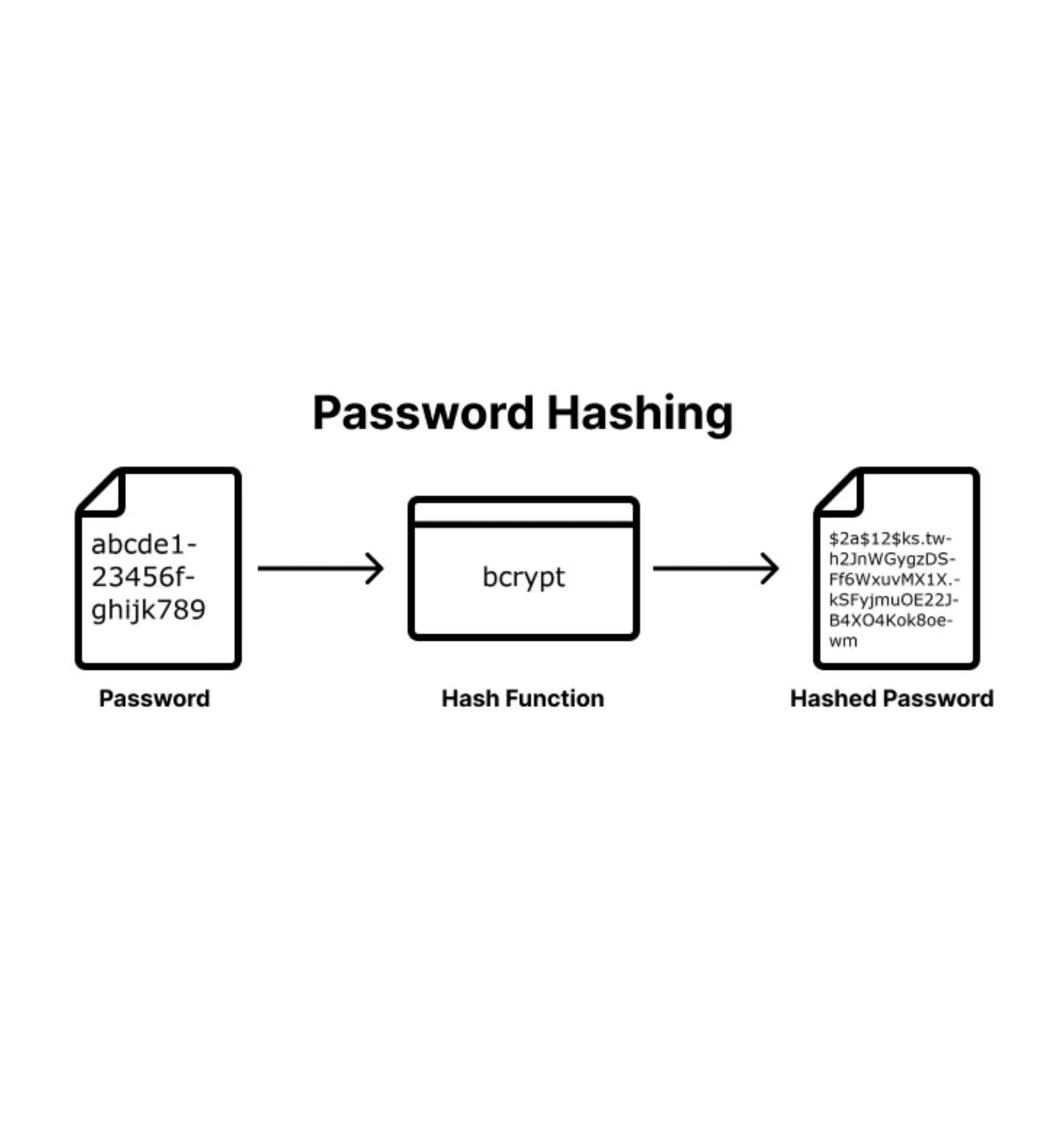
bcrypt: Adaptive Security Over Time
The "cost factor" in bcrypt determines how many iterations the algorithm performs. As computers get faster, you can increase the cost factor to maintain security.
Cost Factor
Time per Hash
10
~0.1 seconds
12
~0.4 seconds
14
~1.6 seconds
Legitimate User
Attacker
A 0.4-second delay during login is imperceptible
Trying 1 million passwords would take 4.6 days instead of seconds

Slide 10

Implementing bcrypt in Python
Installation
pip3 install bcrypt
Function 1: Hashing a Password
import bcrypt def hash_password(plain_text_password): # Encode the password to bytes, required by bcrypt password_bytes = plain_text_password.encode('utf-8’) # Generate a salt and hash the password salt = bcrypt.gensalt() hashed_password = bcrypt.hashpw(password_bytes, salt) # Decode the hash back to a string to store in a text file return hashed_ password
Function 2: Verifying a Password
def verify_password(plain_text_password, hashed_password): # Encode both the plaintext password and stored hash to bytes password_bytes = plain_text_password.encode('utf-8’) hashed_password_bytes = hashed_password.encode('utf-8’) # bcrypt.checkpw handles extracting the salt and comparing return bcrypt.checkpw(password_bytes, hashed_password_bytes)

Slide 11

File Persistence: Storing User Data
For Week 7, we use a simple text file users.txt to store user credentials. This introduces basic file I/O operations in Python before upgrading to SQL in Week 8.
Format: username,hashed_password
User Registration
User Login
def register_user(username, password):
"""Register a new user."""
hashed_password = hash_password(password)
with open("users.txt", "a") as f:
f.write(f"{username},{hashed_password}\n")
print(f"User '{username}' registered.")
def login_user(username, password):
"""Log in an existing user.""”
with open("users.txt", "r") as f:
for line in f.readlines():
user, hash = line.strip().split(',', 1)
if user == username:
return verify_password(password, hash)
return False
Key Points
# Mode "a" appends to file without overwriting existing users
# Mode "r" reads the file to search for matching username
# split(',', 1) handles usernames or hashes that might contain commas

Slide 12

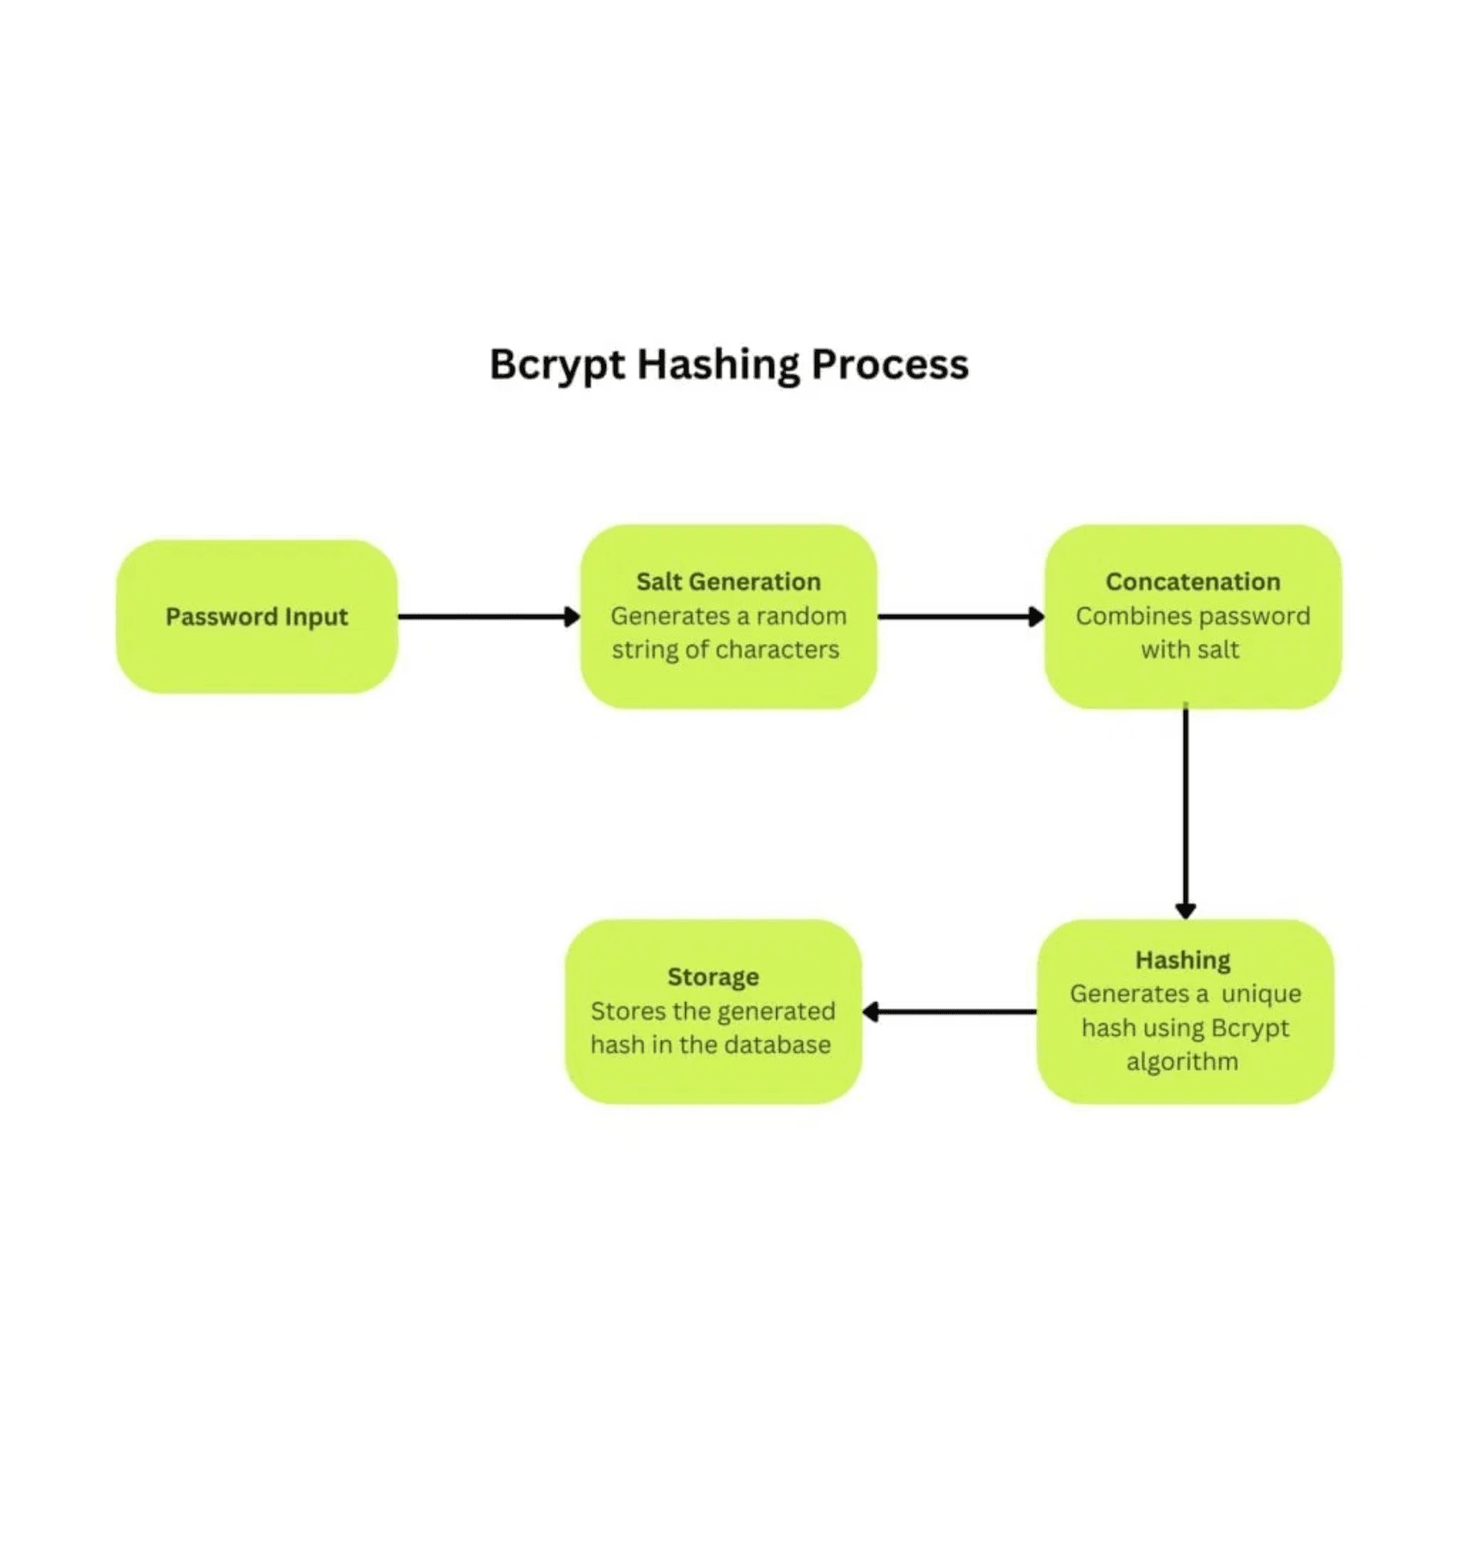
Summary: Key Takeaways
01
Plaintext storage is a critical vulnerability — even a single breach exposes all users
02
Hashing is one-way — you cannot reverse a hash to get the original password
03
Salting defeats rainbow tables — unique salts make pre-computed attacks impossible
04
bcrypt is the industry standard — slow, adaptive, and includes automatic salting
05
File I/O is a stepping stone — we will upgrade to SQL databases in Week 8
You have now built the first essential security layer for your Multi-Domain Intelligence Platform.

Slide 13
References:
[1] National Institute of Standards and Technology (NIST). (2023). NIST Special Publication 800-63B: Digital Identity Guidelines. https://doi.org/10.6028/NIST.SP.800-63b
[2] OWASP Foundation. (2024). OWASP Authentication Cheat Sheet. https://cheatsheetseries.owasp.org/cheatsheets/Authentication_Cheat_Sheet.html
[3] OWASP Foundation. (2024). OWASP Password Storage Cheat Sheet. https://cheatsheetseries.owasp.org/cheatsheets/Password_Storage_Cheat_Sheet.html
[4] Verizon Business. (2024). Data Breach Investigations Report (DBIR). https://www.verizon.com/business/resources/reports/dbir/
[5] Hunt, T. (ongoing). Have I Been Pwned. https://haveibeenpwned.com/
[6] Provos, N., & Mazières, D. (1999). A Future-Adaptable Password Scheme. USENIX Annual Technical Conference. https://www.usenix.org/legacy/events/lisa99/provos/provos_html/
[7] PyPI. bcrypt documentation. https://pypi.org/project/bcrypt/
[8] Python Software Foundation. Reading and Writing Files in Python. https://docs.python.org/3/tutorial/inputoutput.html#reading-and-writing-files

