Slide 1
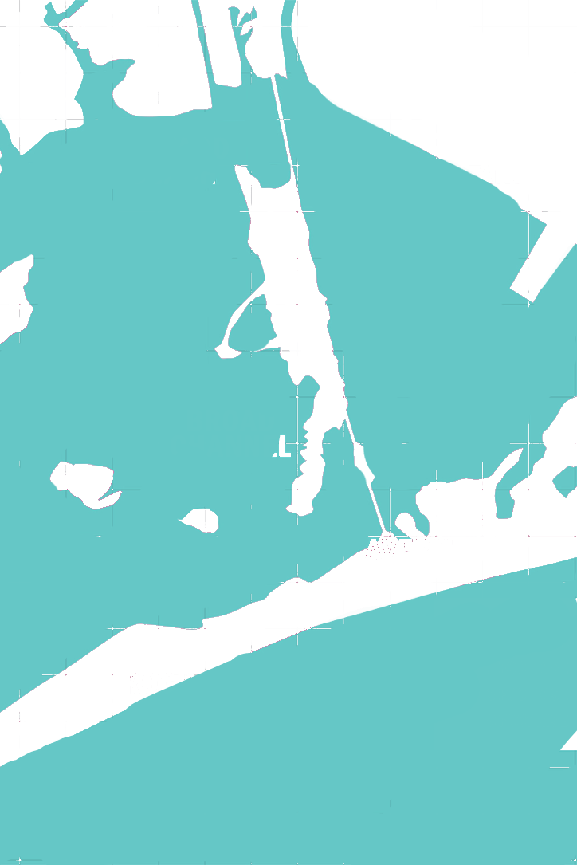
WILL NOT PRINT
WILL NOT PRINT
JAMAICA BAY
ROCKAWAYS
WILL NOT PRINT
LOST TO SEA
WILL NOT PRINT
WILL NOT PRINT

Slide 2
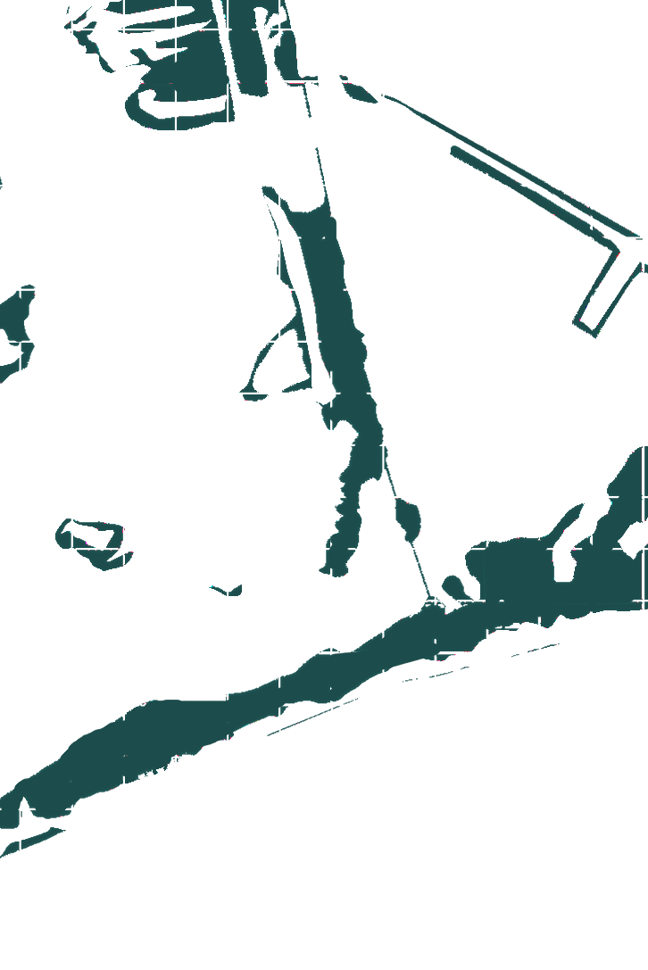

WILL NOT PRINT
WILL NOT PRINT
FLOODING PROBLEMS
Jamaica Bay’s low elevation with rising seas makes this highly urbanized area vulnerable to floods
Major flooding from Hurricane Sandy devasted local communities and breached narrow lands in the bay.
The bay acts as a barrier to floods for NYC.
However, we are losing this natural barrier due to:
Sea level rise
Dredging
Sewage dumping
SEWAGE RUNOFF causes major erosion of the marshes by destabilizing the root structures of vegetation which holds the soil together.
WILL NOT PRINT
WILL NOT PRINT

Slide 3
WILL NOT PRINT
WILL NOT PRINT
3rd page
WILL NOT PRINT
WILL NOT PRINT

Slide 4

WILL NOT PRINT
WILL NOT PRINT
Visit Jamaica Bay’s Wildlife Refuge
subway stop
Broad Channel
WILL NOT PRINT
Land lost
to 6 feet of sea level rise
WILL NOT PRINT

