Slide 1
CourseSeek
Group members: Jenny Huang, Elizabeth Celedon-Jasso, Howard King, Chrishaun Mitchell and Shawn Lee

Slide 2
About CourseSeek
Online course search engine for Android devices
Users can search for hundreds of FREE educational materials
Bookmark and save current courses
Notes:
Users will be able to use the android CourseSeek App to search for online courses under any category. The search will generate a list displaying all available courses that meets your criteria that are free. A user account system will be created to allow users to save courses and access at a later time. A filter will be designed to allow users to further select specific course details such as sub categories , time and date, and course length.

Slide 3
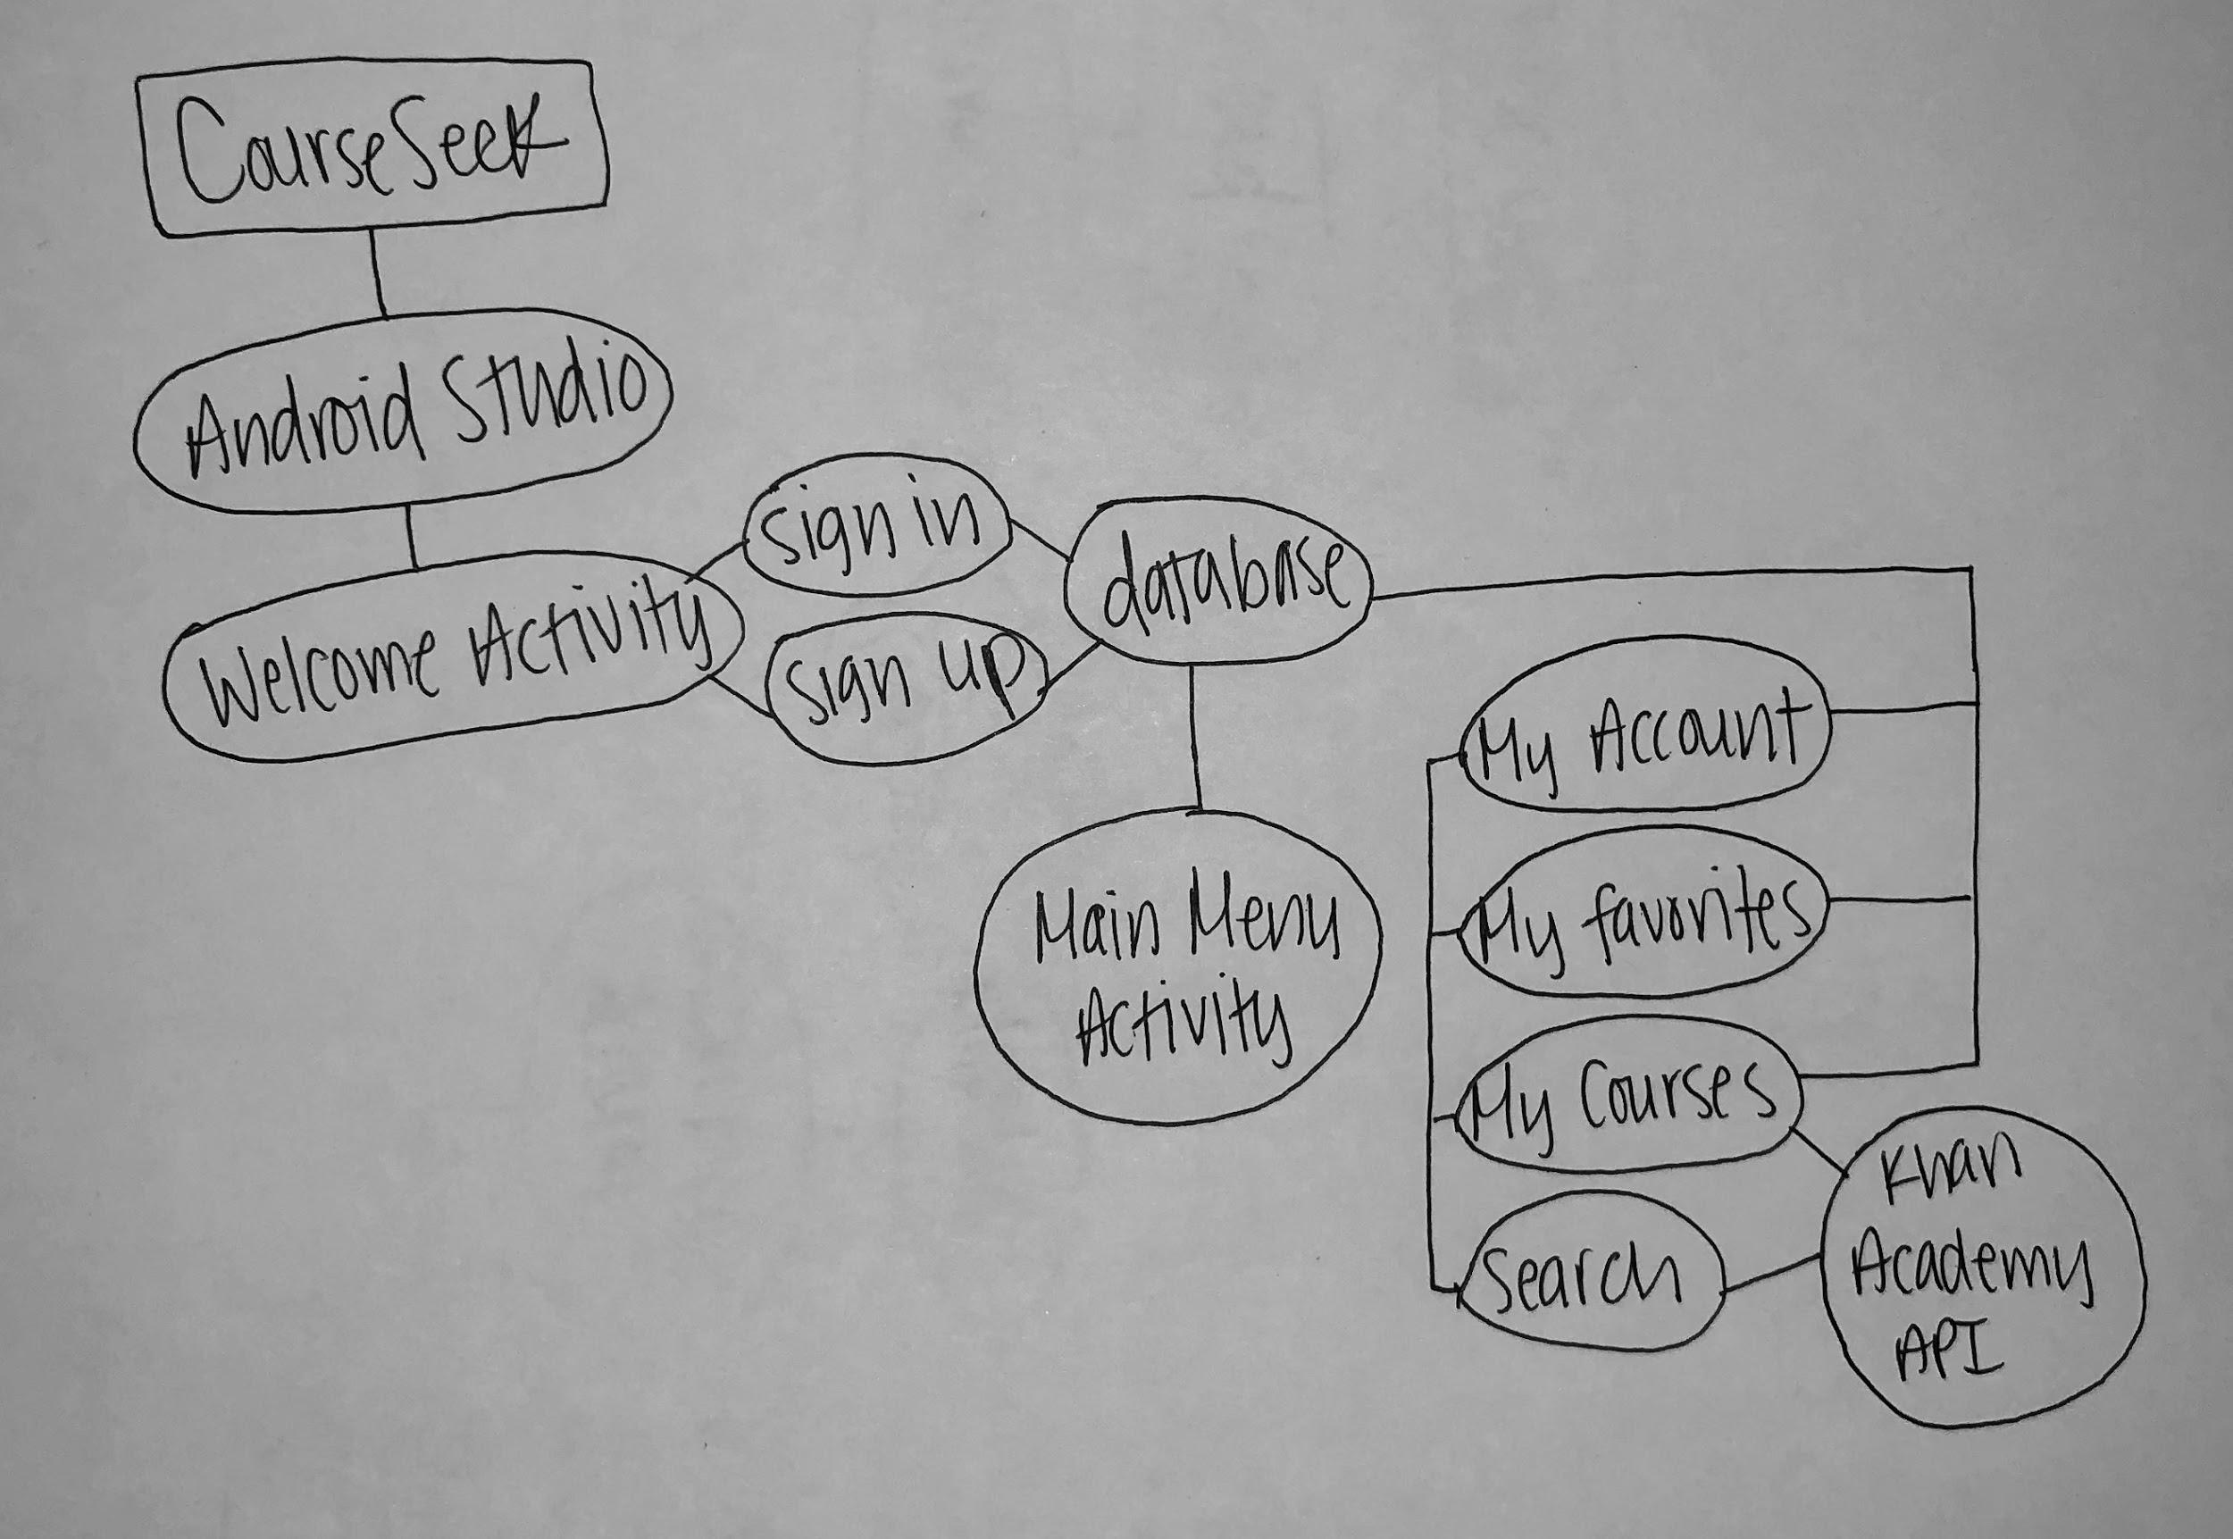
Conceptual Map

Slide 4

IDE
Android Studio
Language: Java

Slide 5

API
Khan Academy API
All materials will be provided by Khan Academy
Videos, exercises, etc.
CoboCards API
Flashcards
Notes:
To do all of this an API is needed. We’ll be using the Khan Academy API. which will allow users to search though any khan academy materials
Might use CoboCards as well to integrate it with khan academy but the material might be off

Slide 6

Database
MySQL
Connecting to database by using a MAMP server
Store user account information and track saved courses
SQLite
Using databaseHandler
Notes:
Choose mysql rather than sqlite because sqlite is just a file locally stored so other devices wouldn’t be able to have access to that file but with mysql it can
MAMP server will connect us to the database to send and receive data
Will consider using sqlite depending how complex connecting to mysql will be.

Slide 7
Backlog/Stories
Set up gmail, Slack, GitHub and Zenhub
Choose an IDE, API, and database
Create conceptual map
Design and plan out layouts
Plan out tables for database
Install and set up Android Studio
Create MySQL database
Integrate API
Notes:
Design the layouts, figure out how many activities will be needed, what features, color theme, and the general look of the app
Sketch out the database and found out how many tables will be needed and what will be the primary key and the foreign keys for each table. Find out how many fields and the type of data to store
Install and set up android studio then upload project on to github. Install the emulator.
Set up mysql and find a server to connect to the database
Integrate khan academy API, get the API key and

Slide 8
SPRINT 1
Creating Android Studio Project
-create the frontend design
-create main activities
Create database
- plan out database tables
- connect database to web server
Notes:
For sprint 1, we will begin making the android project and create blueprint layouts of the necessary activities as well as implementing the API

Slide 9
Project Challenges
Communication
Learning how to work with a new IDE
Khan Academy API is no longer monitored
Deciding on a platform
Notes:
API hasnt been updated so there may be issued in the futured

