Slide 1
Airless tires
By: Eliza Bullen

Slide 2
Overview
History (slide 3)
Plan and implementation (slide 5)
Upsides/Pros (slide 7)
Downsides/Cons (slide 8)
Summary (slide 9)
References (slide 10)

Slide 3

History
In the 1930’s James vernon martin invented the idea of airless tires.
He started with lightweight resilient tires, then the east biding tire, the elastic tire, and finally the airless tire.
People think that they are some new great idea but the idea came up a while ago
Notes:
Airless tires have been getting a ton of media attention recently with Michelin’s “Tweel” being praised as the most amazing bit of tire technology since the invention of the radial tire. People think this is some new-fangled invention, but in actuality airless tires have been under development since the 1930s and 1940s. James Vernon Martin was a well-known aircraft and automobile innovator in the early 20th Century, inventing things like airless elastic tires. He named them initially the Lightweight Resilient Tire, then the East Biding Tire, and finally the Elastic Tire.
Martin's goal with all of the versions of the airless tire was to create a lightweight, easy-to-make, “easy riding” tire that would not puncture, could conform to tough road conditions, and provide a vehicle with better control at high speeds over different terrain.
James Vernon Martin was a well-known aircraft and automobile innovator in the early 20th Century, inventing things like airless elastic tires. He named them initially the Lightweight Resilient Tire, then the East Biding Tire, and finally the Elastic Tire.
Martin's goal with all of the versions of the airless tire was to create a lightweight, easy-to-make, “easy riding” tire that would not puncture, could conform to tough road conditions, and provide a vehicle with better control at high speeds over different terrain.

Slide 4
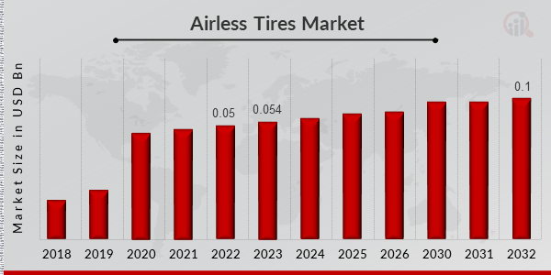
Graph

Slide 5
Plan and implementation
This plan of airless tires continues today
Multiple layers of material including: protector fly, working fly, transition fly, zero degree belt, and poly resin spokes
Many farmers are starting to use these tires on surfaces that would most likely pop an air pressured tire
Notes:
Conventional pneumatic (air-inflated) tires have dominated the tire market for over a century. However, several tire manufacturers have presented concepts or prototypes for airless tires which use rubber only in the treads, while the load-carrying structure is made of composite materials such as polyurethane, thermoplastics, fiberglass and epoxy laminates, but also eco-friendlier and bio-degradable materials have been proposed.
First, some early projects are described in which a Swedish innovative airless tire concept was tested, resulting in so-called Composite Wheel prototypes. This reduced noise emission and rolling resistance substantially and had excellent wet skid resistance properties while also providing acceptable vehicle handling. However, in full-scale testing, it did not endure an extreme test on a “pot-hole” test track due to a design lapse.
Then, a number of concept or prototype airless tires suggested by tire manufacturers in the last 15 years are reviewed. In general, very sparse information have been provided, but they all promise (without scientific proof) significant improvements over pneumatic tires. Advantages are foreseen especially in terms of dramatic reduction in global use of raw materials, use of more eco-friendly materials and much less complicated production. Even 3D-printing can be used in some cases. One of the prototypes is currently tested for use on an electric vehicle in service, with a possible market introduction targeted in 2024.
It is concluded that airless tires have substantial potential for initiating a revolution in terms of use of raw materials of which many may be eco-friendly, in addition to significant advantages over pneumatic tires in the environmental footprint during operation. However, a wide use of airless tires will have dramatic consequences for the tire manufacturing plants, and significantly influence the vehicle industry, with a risk of recent investments not being fully paid-off. Therefore, a wide introduction of airless tires on the market might take a longer time than what is technically needed, regardless of all benefits.

Slide 6
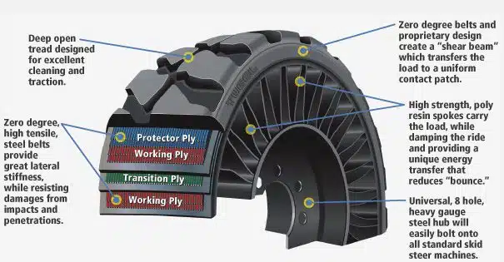

Slide 7
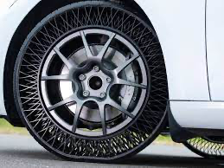
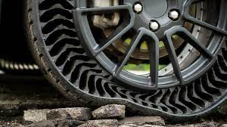
Upsides/Pros
The problem of popped tires would be eliminated once and for all
Crashes caused from popped tires would be reduced greatly/save lives
These tires are heavier so they provide more uniform tread surface especially during turns and at a low speed
Less deformation while tires are rolling so it uses less fuel
Less tire failure so you wouldn’t have to spend hundreds of dollars replacing/fixing your tires and would benefit farming and the economy greatly
Notes:
Anyone who’s ever changed tires on a busy highway knows how awful of an experience it is. One minute, you’re driving through a neighborhood where a few careless roofers dropped some nails. Five minutes later, you’re muttering curses as cars zip past you at 60 mph.
Airless tires would eliminate this problem once and for all. While no one would relish the idea of having metal hardware puncturing their tread, they would never have to worry about more dangerous consequences should they ignore it.
Speaking of dangerous consequences, flat tires and blowouts are a huge cause of serious incidents on the road. The NHTSA reported in 2003 that tire troubles caused 78,392 crashes, 10,275 non-fatal injuries and 414 fatalities a year.
Airless tires are therefore not just convenient but also lifesaving.
Airless tires are heavier than pneumatic radials and have a more uniform tread surface. Both factors improve their traction at low speeds, especially in turns.
For industrial vehicles, like forklifts, or off-road vehicles, like ATVs, this low-speed maneuverability will provide notable performance benefits.
Because they have a stiffer structure, airless tires would be less prone to deformation while rolling. Since around 2-7% of energy for common gas-powered cars is spent overcoming tire deformation, airless tires would automatically provide fuel economy benefits.
Add that to the lower rate of replacement due to punctures, and you have a much greener world to live in thanks to non-pneumatic tires.
In their airless tire information page, Bridgestone notes how tire failure causes huge losses to productivity and efficiency in industries like farming, mining and construction. Just one mishap can lead to a vehicle getting put out of commission for hours — maybe even weeks. Constant tire replacement costs also add up.
Because airless tires are much less likely to have a complete failure, they would likely be replaced less frequently. These saved replacement costs could add up quickly for truckers, contractors and anyone who owns a vehicle fleet.

Slide 8
Downsides/Cons
They are a lot more expensive than pneumatic tires
They are a much harsher ride and you can feel a lot more bumps in the road
The faster the speed the more shaky the car is and louder because of the stiffness of the tires
No air pressure means no adjustability
Notes:
The most obvious trade-off a tire shopper would face in an airless future would be cost.
Airless tires haven’t made it to market yet for a variety of reasons, but the biggest one is that they would cost far more than the average consumer would be willing to pay.
On top of that, we don’t have any data yet for how long these tires last compared to their air-filled radial counterparts. There’s a good chance that, for the average consumer, the total ownership cost of a vehicle could dramatically rise if its owner chooses to go airless all the time.
The stiffness of airless tires transmits more road irregularities into the suspension, which in turn sends vibrations to vehicle occupants. For bumpy roads, this can turn what is usually an okay ride into a bumpy nightmare.
At higher speeds, these problems become even more noticeable. Above 50 mph, the road noise and vehicle shaking is enough to call attention to the tires.
Those who have intense driving needs off-road or in industrial situations know the benefits provided by a giant cushion of air in your tires. By letting out some of the tire pressure, you can create a softer ride and better traction over loose surfaces or rocky boulders.
People who track their sports cars find tire pressure to be even more important. Subtle tweaks in pressure can translate to performance advantages depending on track conditions, weather and intended driving lines.
Airless tires lack this ability, making them less versatile in certain situations. The average person may not miss this feature, but anyone who loves driving onto the beach or who has to load their pickup on dirty job sites will certainly feel the effects.

Slide 9
Summary
I thought that airless tires were a good idea but after the research i’ve done I’ve found that they might not be that good of an idea. They are so much more expensive and they affect the ride of your whole car. I am honestly against this idea.

Slide 10
References
Airless tires were invented in the 1930’s
Airless tires pros and cons

