Slide 1

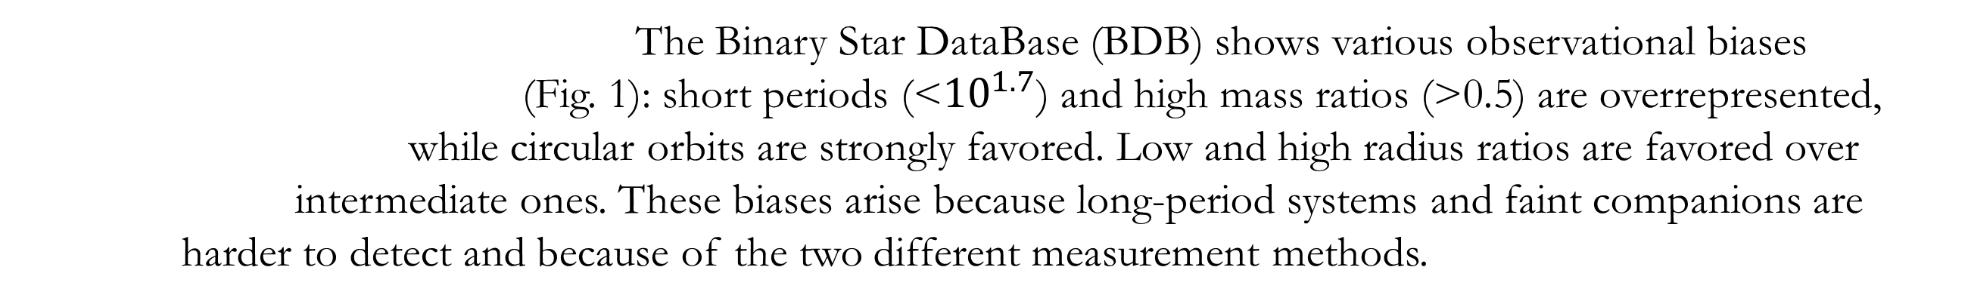
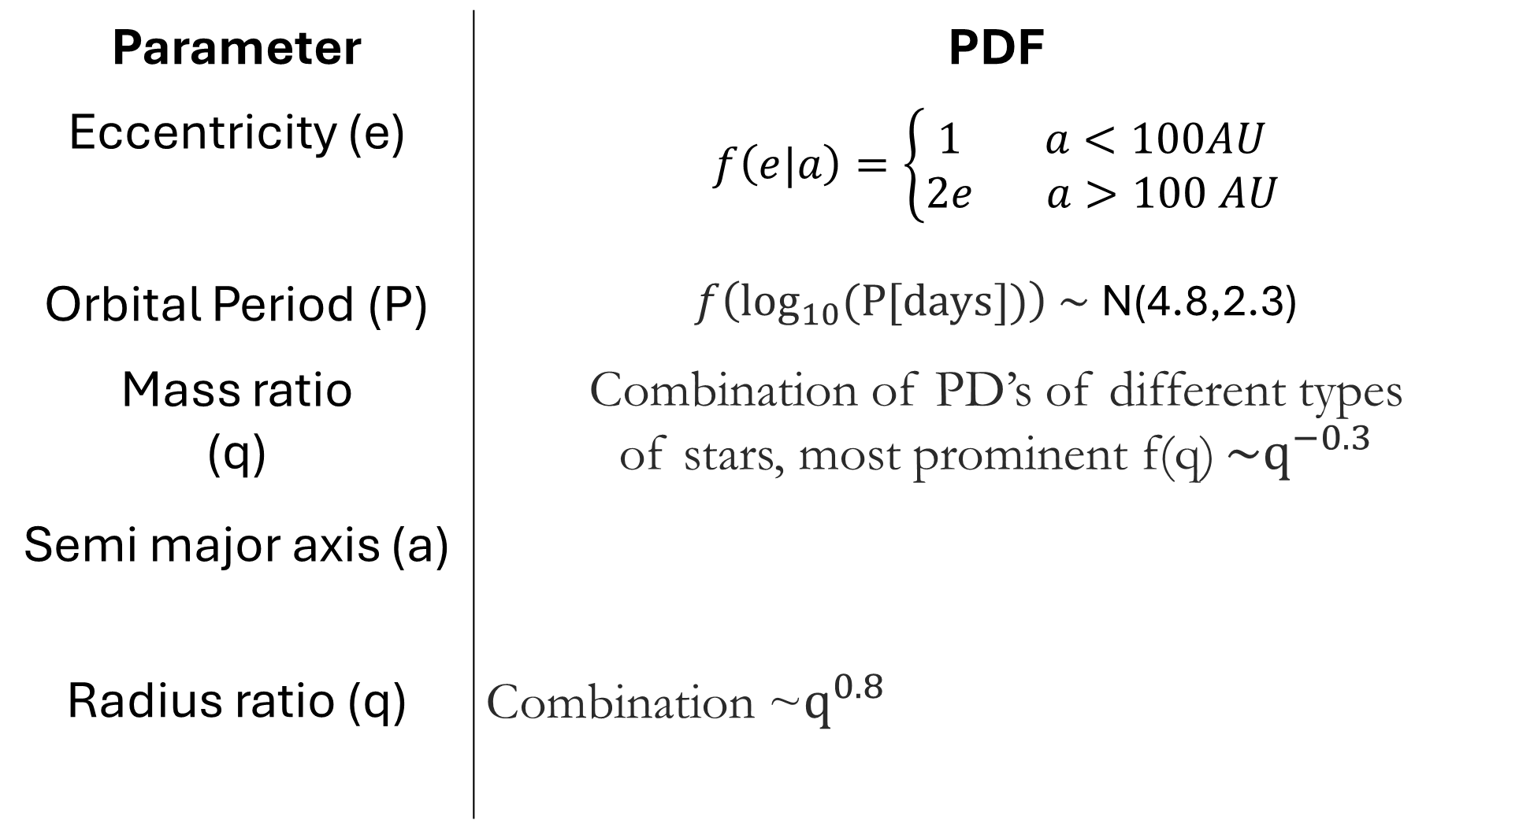
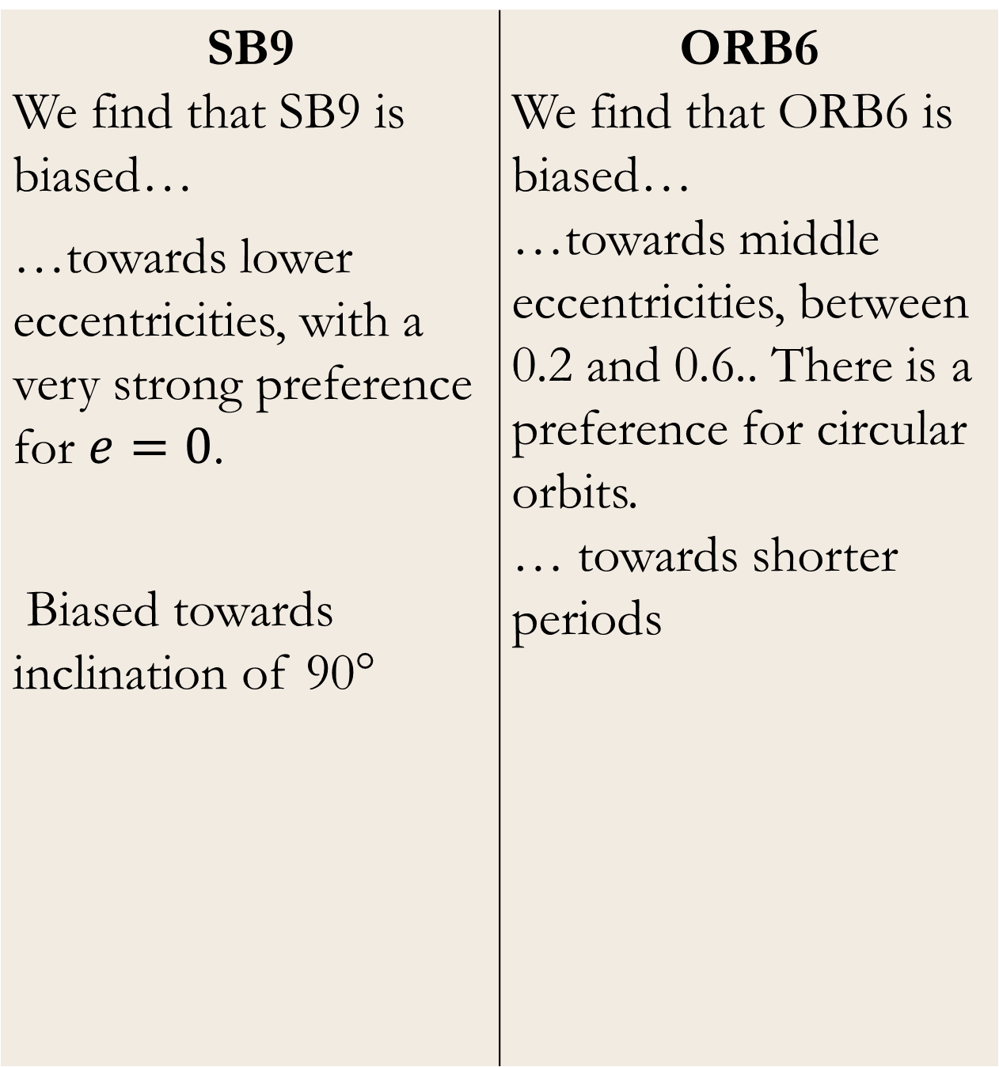
Bias in the Sky
Observational Bias in Binary Star Catalogues
Authors: Tobias de Cock (s4438361) , Elja Meuter (s4500229), Damian Sloos (s4406435), Wouter de Wit (s3519767)
Aim
We aim to answer the research question below.
Introduction
When observing stars, we only find those that are significantly detectible with our current detection methods. This introduces a bias in the acquired data. The goal of this research project is
to quantify that bias.
What observational biases are present in the binary star catalogues of the binary star database, when compared to theoretically expected binary star populations?
Method
We find the theoretical PDF’s of each parameter and compare its prediction to the data from the database. This is then plotted as the difference and represents the bias.
A4 for reference, make sure everything can be read from 2m away
Specifically, we will analyse the differences between observed and theoretical distributions of eccentricity, mass ratio, radius ratio, orbital period, and semi-major axis and the observational biases expected from the detection methods used in these catalogues.
Table 1. Theoretical distributions of binary star systems based on theory.
Parameter | PDF
Eccentricity (e) | $$f\left(e|a\right)=\left\{\begin{aligned}1 a<100AU \\ 2e a>100 AU\end{aligned}\right.$$
Orbital Period (P) | $$f\left(\log_{10}(P[days])\right) \sim \text{N}\text{(4.8,2.3)}$$
Mass ratio (q) | Combination of PD’s of different types of stars, most prominent f(q) $\sim q^{−0.3}$
Semi major axis (a)
Radius ratio (q) | Combination ~$q^{0.8}$
Results
Choose between table or plain text for results
The Binary Star DataBase (BDB) shows various observational biases
(Fig. 1): short periods (<${10}^{1.7}$) and high mass ratios (>0.5) are overrepresented, while circular orbits are strongly favored. Low and high radius ratios are favored over intermediate ones. These biases arise because long-period systems and faint companions are harder to detect and because of the two different measurement methods.
A4
Semi major axis plot
SB9 We find that SB9 is biased… …towards lower eccentricities, with a very strong preference for $e=0$. Biased towards inclination of 90° | ORB6 We find that ORB6 is biased… …towards middle eccentricities, between 0.2 and 0.6.. There is a preference for circular orbits. … towards shorter periods
Figure 1. Observational and theoretical distributions for the BDB. The upper plot shows the expected and the theoretical distribution. The residual probabilities is the observational bias for each parameter. The x-axis indicates which parameter is evaluated.
Conclusion & Discussion
For spectroscopic binaries we find more circular orbits, as their RV curve is easiest to detect. The eccentricity bias for visual binaries are strongly dependent on the period bias. This bias was confirmed by Ruymaekers G., Cuypers J., Boffin H. M. J.. We see fewer long period systems, as they either have not been observed for long enough, or because their RV signals are too weak. For mass ratios we need RV data of both stars, however one of the two might be too bright or be so massive that RV signals are too weak. For visual binaries we have a bias towards high radius ratios, while for spectroscopic binaries there is a bias for low radius ratios.
Acknowledgements & References
We thank Oleg Malkov for his continued support to provide us with all the data from the Binary Star Database BDB (Kovaleva et al, 2015), available from Institute of Astronomy (Russian Academy of Sciences), used in this project and
Susana Monteiro Carneiro for her
support and feedback throughout the
entire duration of the project.
Notes:
Results
We find that SB9 is biased towards lower eccentricities,
with a very strong preference for $e=0$. ORB6 is biased
We find that ORB6 is biased towards middle eccentricities, between 0.2 and 0.6.. There is a preference for circular orbits. It is also biased towards shorter periods

