Slide 1
Intro to JavaScript and jQuery
James Xue
COMS 4170
Thurs. Sept. 21, 2017

Slide 2
Agenda
JavaScript
jQuery
Build a weather app
Assignment 1

Slide 3
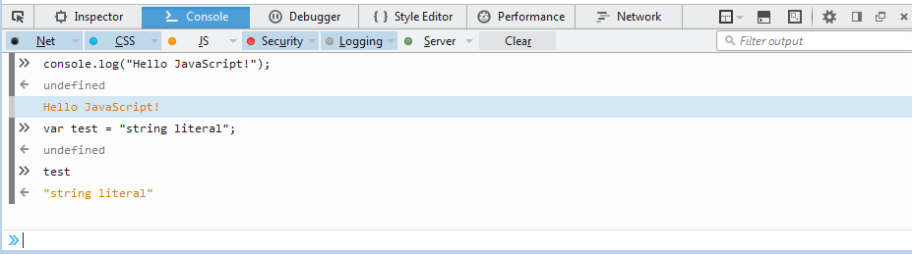
JavaScript
Programming language to make responsive web pages
You can write JavaScript in a browser’s developer tools!

Slide 4
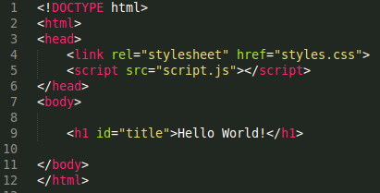

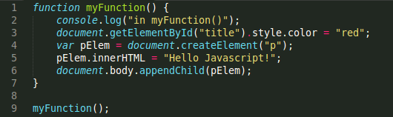
HTML + CSS + JavaScript
index.html
styles.css
script.js

Slide 5
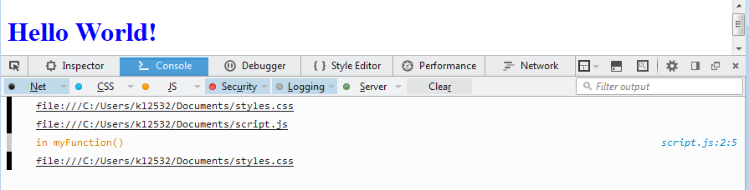
What happened?
index.html

Slide 6
What happened?
index.html
Order matters!

Slide 7
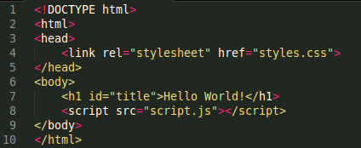
HTML + CSS + JavaScript
index.html
styles.css
script.js

Slide 8
Objects
What’s the output of the following lines?
var person = {
firstName:"John",
lastName:"Doe",
age:20,
eyeColor:"brown"
};
>> person.firstName
>> person.lastName
>> person["age"]
Objects are mutable
How would we change the person’s eyeColor to "blue"?

Slide 9
Objects
What’s the output of the following lines?
var person = {
firstName:"John",
lastName:"Doe",
age:20,
eyeColor:"brown"
};
>> person.firstName
>> person.lastName
>> person["age"]
Objects are mutable
How would we change the person’s eyeColor to "blue"?
>> person.eyeColor = "blue"

Slide 10
jQuery
A JavaScript library that simplifies
with an easy-to-use API
HTML document traversal and manipulation
Event handling
Animation
AJAX (Asynchronous JavaScript and XML)
http://api.jquery.com/

Slide 11
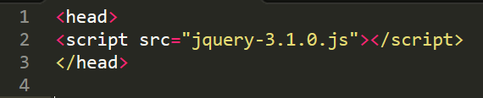
Adding jQuery
Within your directory
With a CDN (content delivery network)

Slide 12

DOM Traversal and Manipulation

Slide 13
Hello World (revisited)
Let’s rewrite this using jQuery!
Hint: check out http://api.jquery.com/
index.html
styles.css
script.js

Slide 14
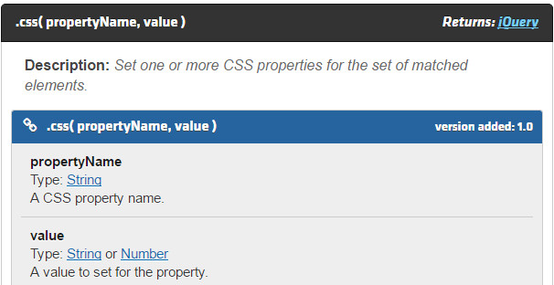
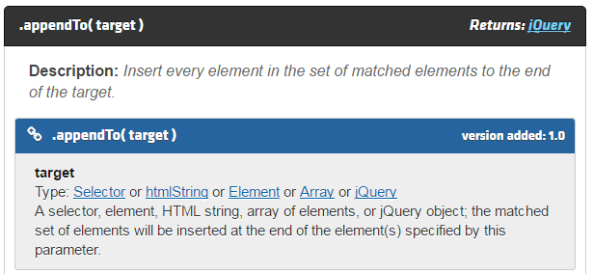
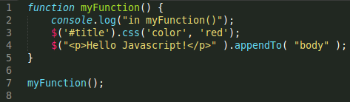
Hello World (revisited)
(old) script.js
(with jQuery) script.js

Slide 15
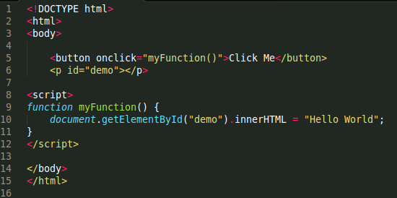
Event Handling

Slide 16
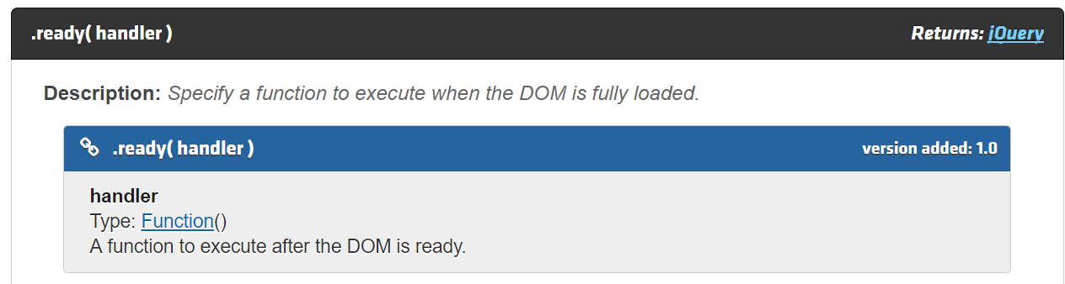
Event Handling
$(document).ready(function())

Slide 17
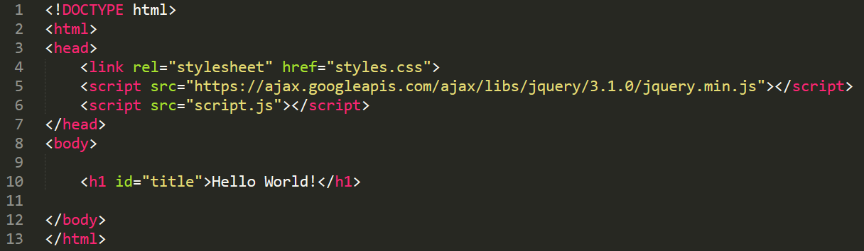
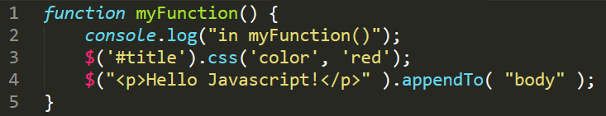
Hello World (with Event Handling)
How can we use the $(document).ready(function())?
index.html
script.js

Slide 18
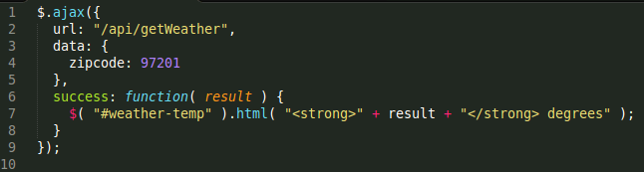
AJAX
Asynchronous JavaScript and XML
Two major features:
Make requests to server without reloading the page
Receive and work with data from the server

Slide 19
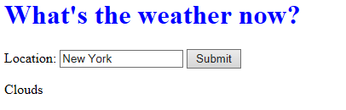
Let’s build a weather app!
API Documentation
http://openweathermap.org/current
Get an API key
https://home.openweathermap.org/users/sign_in

Slide 20
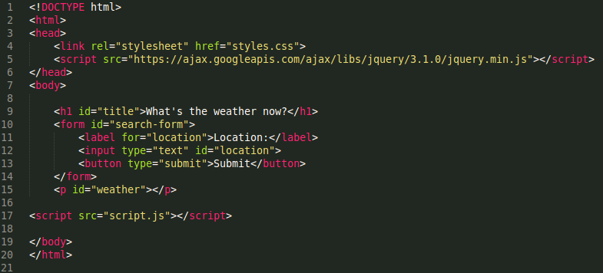
API Documentation
http://openweathermap.org/current
Get an API key
https://home.openweathermap.org/users/sign_in
index.html

