Slide 1
Intro to HTML and CSS
James Xue
COMS 4170
Sept. 21, 2017

Slide 2
Agenda
HTML
The skeleton
CSS
The skin
HTML/CSS Demo
Next Time: JavaScript, jQuery (the muscle)

Slide 3
HTML
HyperText Markup Language
HyperText → the method by which you move around on the web (clicking hyperlinks)
Markup → HTML tags mark the text inside them
Used for describing web documents
“The skeleton”

Slide 4
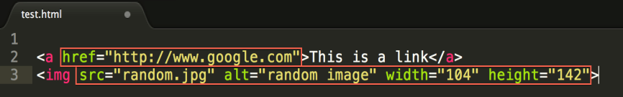
HTML Components
HTML elements
The extent of an element is shown by a tag pair: a 'start tag' (e.g., <p>) and an 'end tag' (e.g., </p>)
Nested together to form an HTML document
Can have attributes, which provide more information

Slide 5
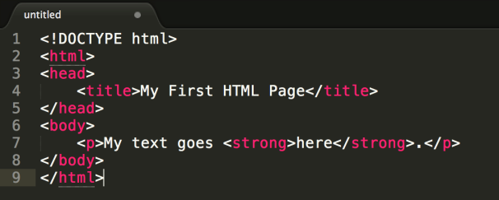
Basic HTML Document Structure
Tags:
DOCTYPE
HTML
Head
Body

Slide 6
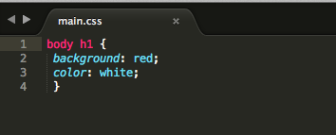
CSS
Cascading Style Sheets
Used to describe the presentation of elements within an HTML document
Adds style, such as:
Fonts
Colors
Spacing
“The skin”

Slide 7
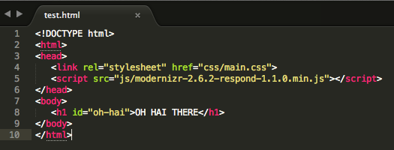
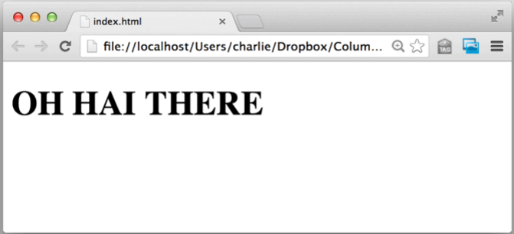
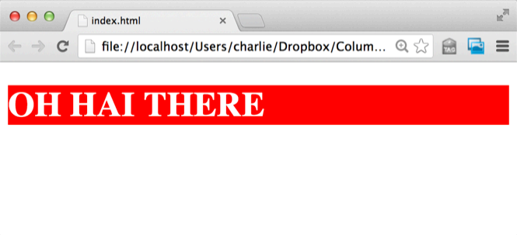
HTML and CSS
A skeleton with skin

Slide 8
Additional Resources
Codecademy Tutorial on HTML & CSS
HTML Reference
YouTube CSS Tutorial Series
CSS Reference
W3Schools

