Slide 1
Aviation Incident Analysis: Key Insights for Safer Operations
Presentation by:
Eliud Kibet

Slide 2
Outline
Business context
Data description
Data process steps
Results
Conclusion
Recommendations

Slide 3
Business context
Aviation incidents carry high human and financial costs. A such, regulators and operators require clear, data‑driven insights to target safety improvements where they matter most.
This analysis thus highlights patterns in aircraft types, operator fatalities and damage severity to guide effective interventions.

Slide 4
Data description
Our dataset comprised 1,250 aviation incident records 1,250 aviation incident records
Cleaning steps were applied:
Damage codes were standardized into clear categories (Write‑Off, Substantial, Minor, No Damage).
Duplicate records and redundant columns were removed.
Key fields were renamed for clarity.
Dates and fatalities were converted to correct formats.

Slide 5
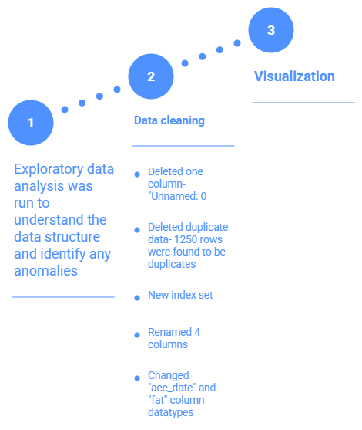
Data processing steps
The process followed three steps

Slide 6
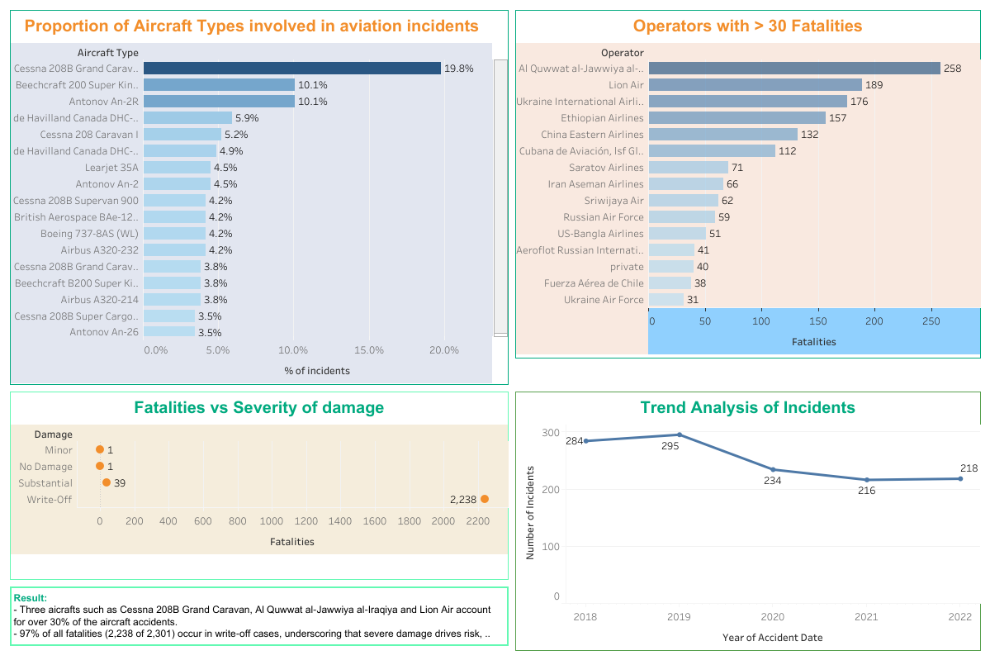
Result

Slide 7
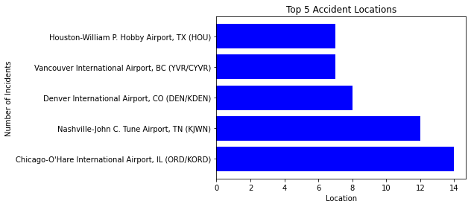
Result
Only five aircraft types account for the majority of incidents, suggesting that widely used models concentrate risk exposure.

Slide 8
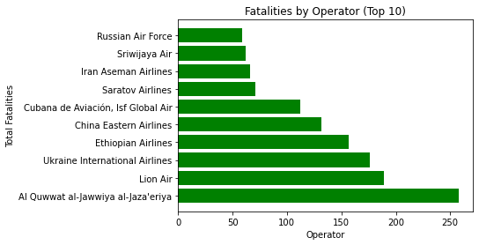
Result
Fatalities are disproportionately concentrated among a small number of operators. This indicates that targeted safety audits and operator‑specific interventions could significantly reduce overall risk

Slide 9
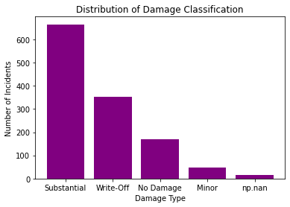
Result
Severe damage categories (Write‑Off and Substantial) dominate the dataset. Critically, 97% of fatalities occur in write‑off incidents

Slide 10
Conclusion
From the analysis it is observed that;
Incident reporting is concentrated among a handful of aircraft types.
A few operators account for most fatalities.
Severe damage categories drive nearly all fatal outcomes.
Missing or inconsistent data highlights the need for stronger reporting standards.

Slide 11
Recommendations
There is need to investigate high‑incident aircraft types to distinguish between usage volume and design vulnerabilities.
Conduct operator specific audits targeting those with disproportionate fatalities.
Strengthen reporting standards to reduce missing or unknown classifications.

Slide 12
Questions

Slide 13
Thank you
Connect with me on:
LinkeIn: www.linkedin.com/in/elkybett

