Slide 1

The “Handmonizer”
Project Course
L28
Davide Lionetti, Antonios Pappas

Slide 2
What is the «Handmonizer»?
Artist-oriented vocal improvisation tool
Tailored to the needs of jazz singer Maria Pia De Vito
Goal: enhance the singer’s live One-Woman-Band performance

Slide 3
Artistic needs
Previous setup:
Eventide guitar harmonizer (used for vocals)
Echoplex looping machine
Issues:
Unnatural/mechanical interaction
Too many physical switches/knobs
Clicking noises

Slide 4
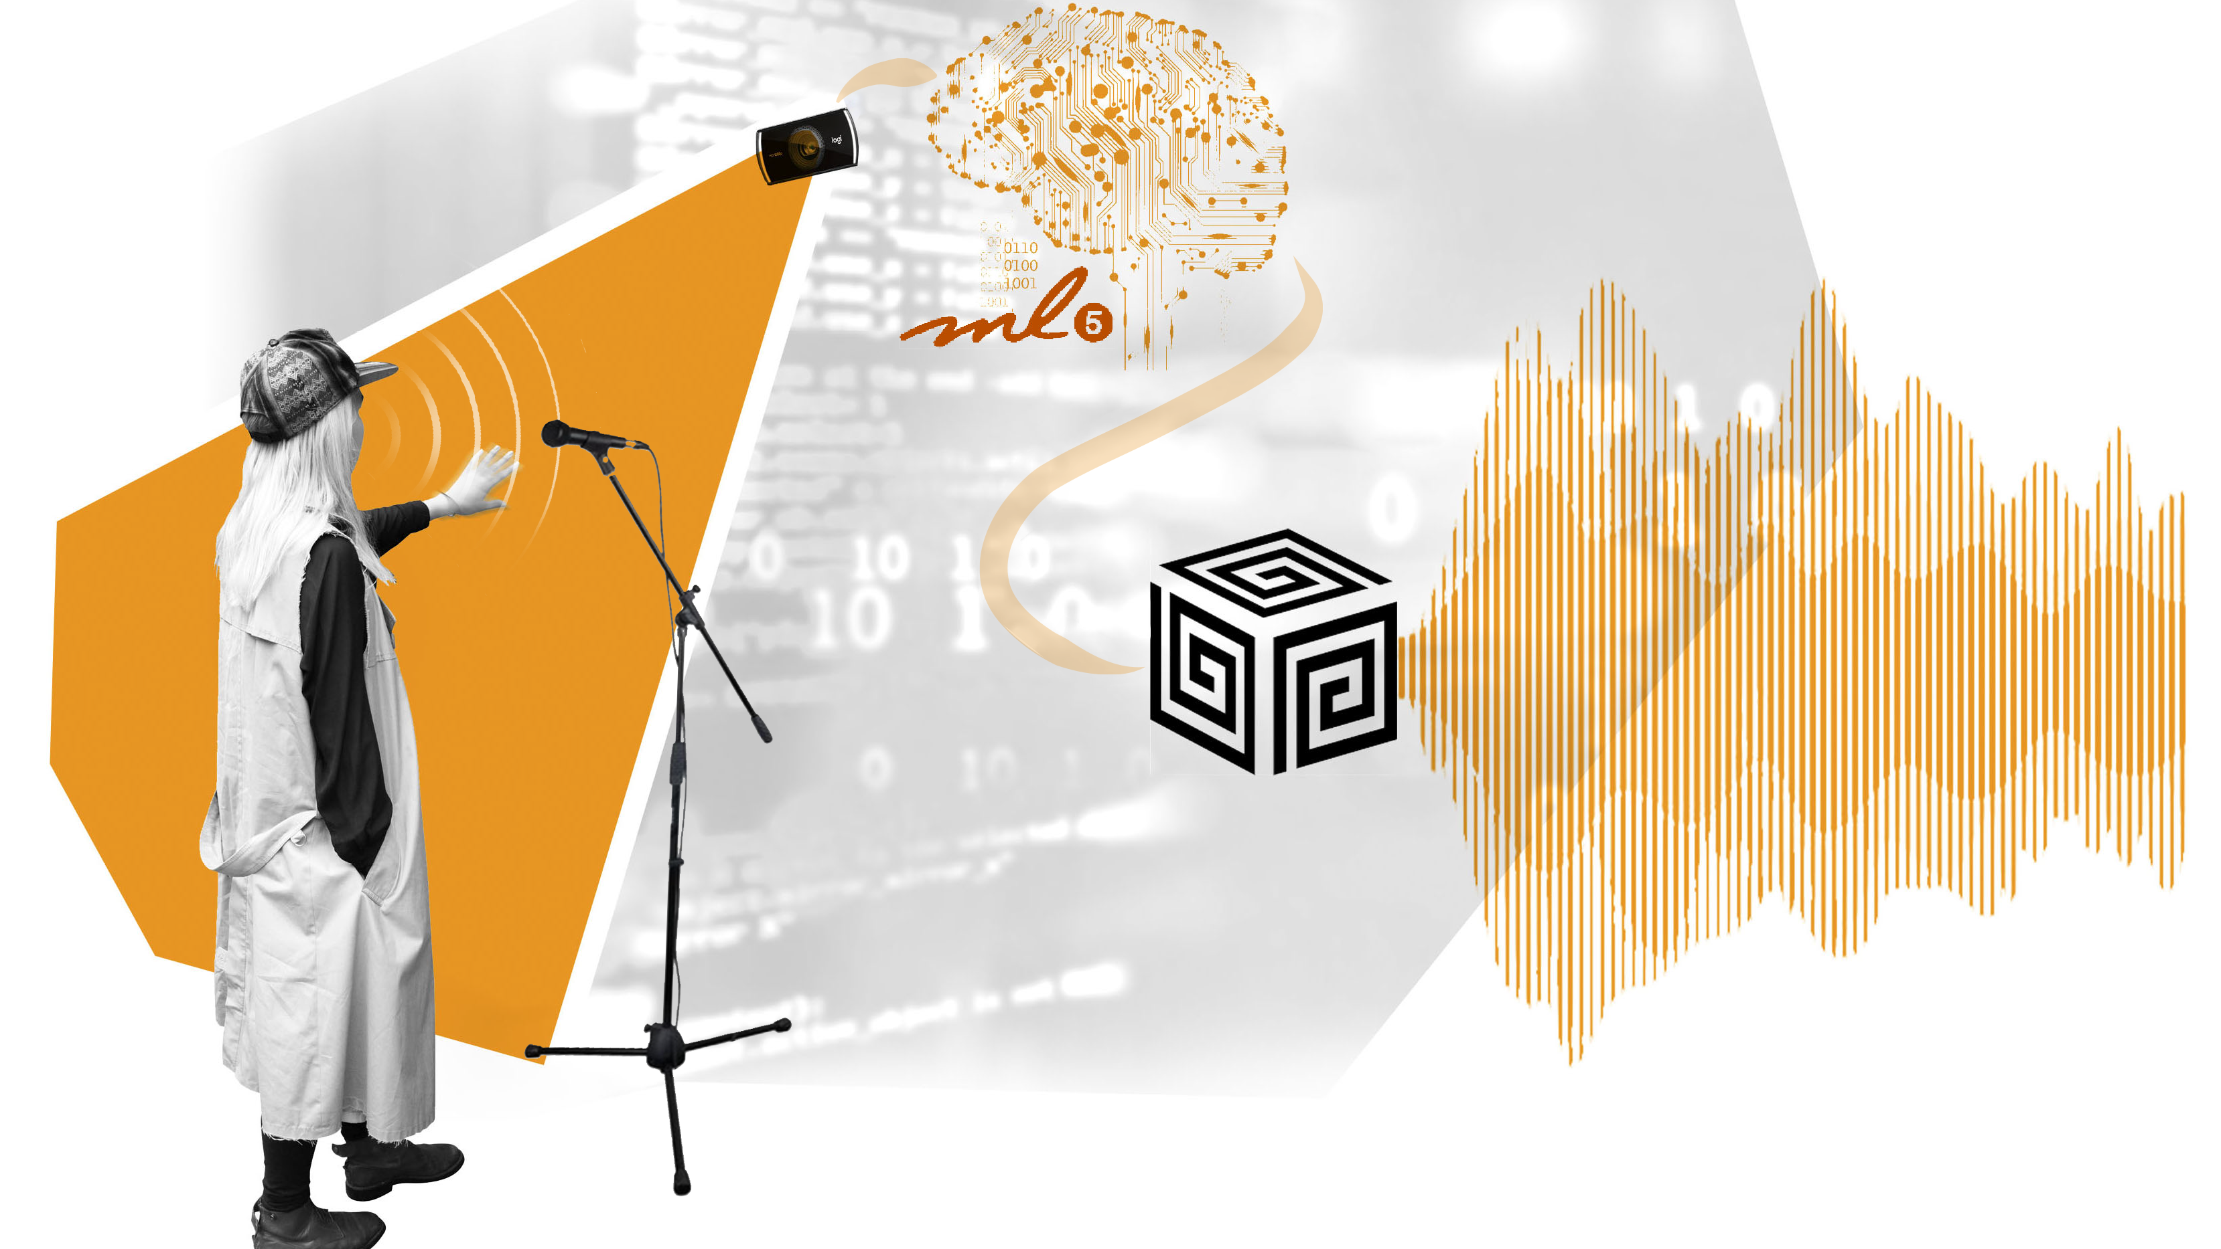
Introduction

Slide 5
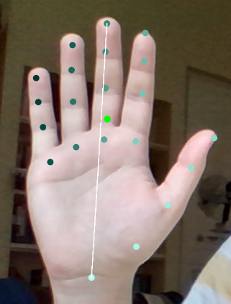
Hand motion recognition
ML5.js interface, Handpose model
Returns the coordinates of 21 points
Features:
Palm center coordinates
Palm length (white line)
Palm slope (slope of the white line)

Slide 6

Supercollider algorithm

Slide 7
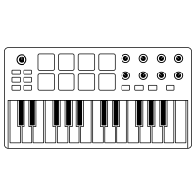




Architecture

Slide 8
Evaluation
Questionnaire covering different aspects of the performance
Answers: grade from 1 to 10 and a short comment
Can be used to evaluate similar future projects

Slide 9
Demo

Slide 10
Results and improvements

