Slide 1
The “Handmonizer”
Project Course
L28
Davide Lionetti, Antonios Pappas

Slide 2
What is the «Handmonizer»?
Artist-oriented improvisation tool
Tailored to the needs of jazz singer Maria Pia De Vito
Goal: enhance the singer’s live One-Woman-Band performance

Slide 3
Artist-oriented design
Artist need
Artist presentation
Previus setup
Initial contraints

Slide 4

Introduction

Slide 5
Hand pose model

Slide 6
Supercollider algorith
Tartiti
pitchshiftPa
MYK classes
Osc/ midi mappig

Slide 7
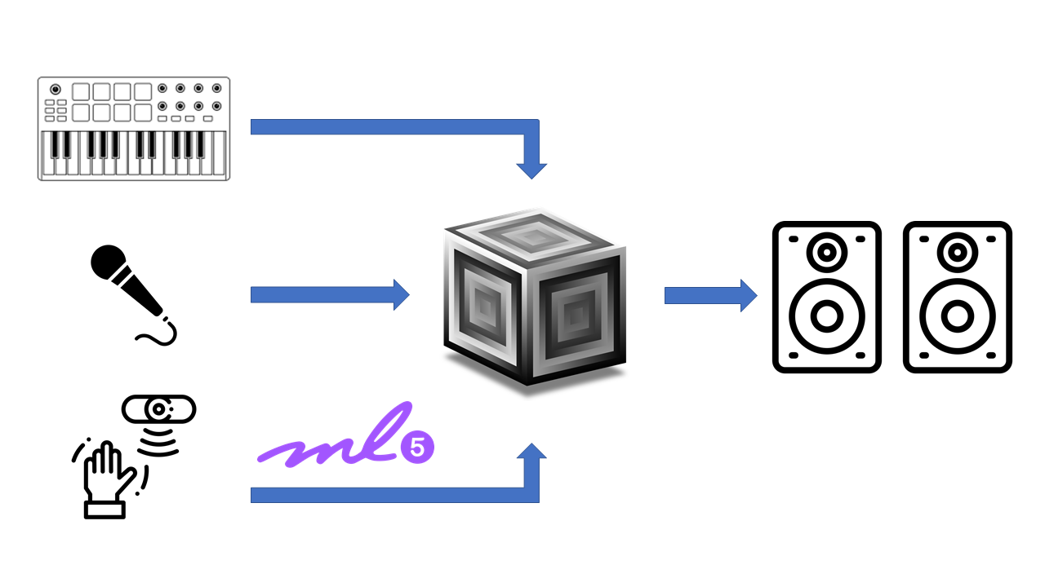
Final architecture

Slide 8
Evaluation Questionnaire
A new way to evaluate based to the artist
Made for the developers for the artistic evaluation

Slide 9
Demo

Slide 10
Results and improvements

