Slide 1

itroduction

Slide 2
Artist-oriented design
Artist need
Artist presentation
Previus setup
Initial contraints

Slide 3
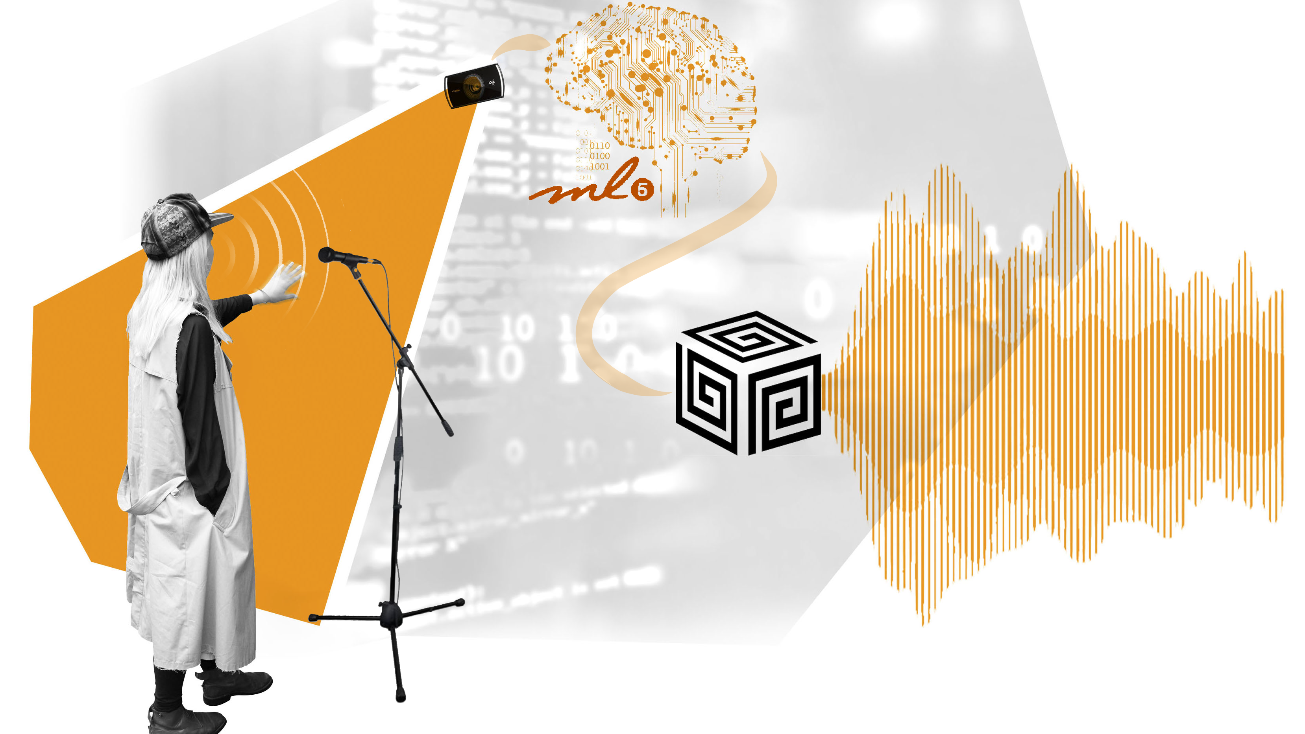
Introduction

Slide 4
Hand pose model

Slide 5
Supercollider algorith
Tartiti
pitchshiftPa
MYK classes
Osc/ midi mappig

Slide 6
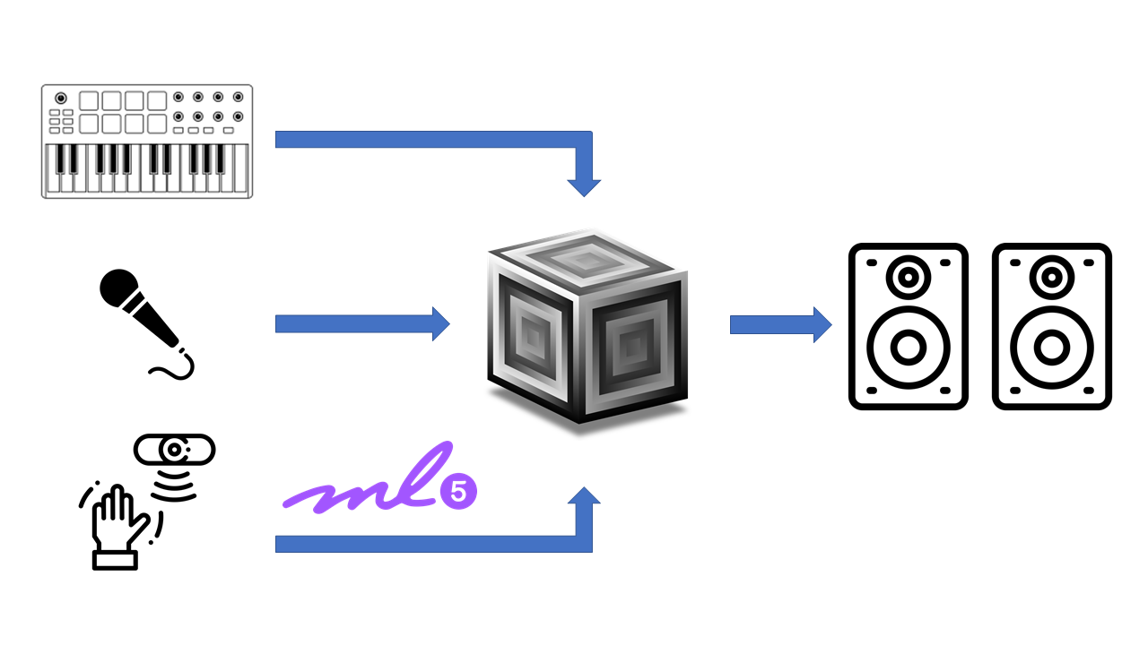
Final architecture

Slide 7
Evaluation Questionnaire
A new way to evaluate based to the artist
Made for the developers for the artistic evaluation

Slide 8
Demo

Slide 9
Results and improvements

