Slide 1

The “Handmonizer”
Project Course
L28
Davide Lionetti, Antonios Pappas

Slide 2
What is the «Handmonizer»?
Artist-oriented vocal improvisation tool
Tailored to the needs of jazz singer Maria Pia De Vito
Goal: enhance the singer’s live One-Woman-Band performance

Slide 3
Artistic needs
Previous setup:
Eventide guitar harmonizer (used for vocals)
Echoplex looping machine
Issues:
Unnatural/mechanical interaction
Too many physical switches/knobs
Clicking noises

Slide 4
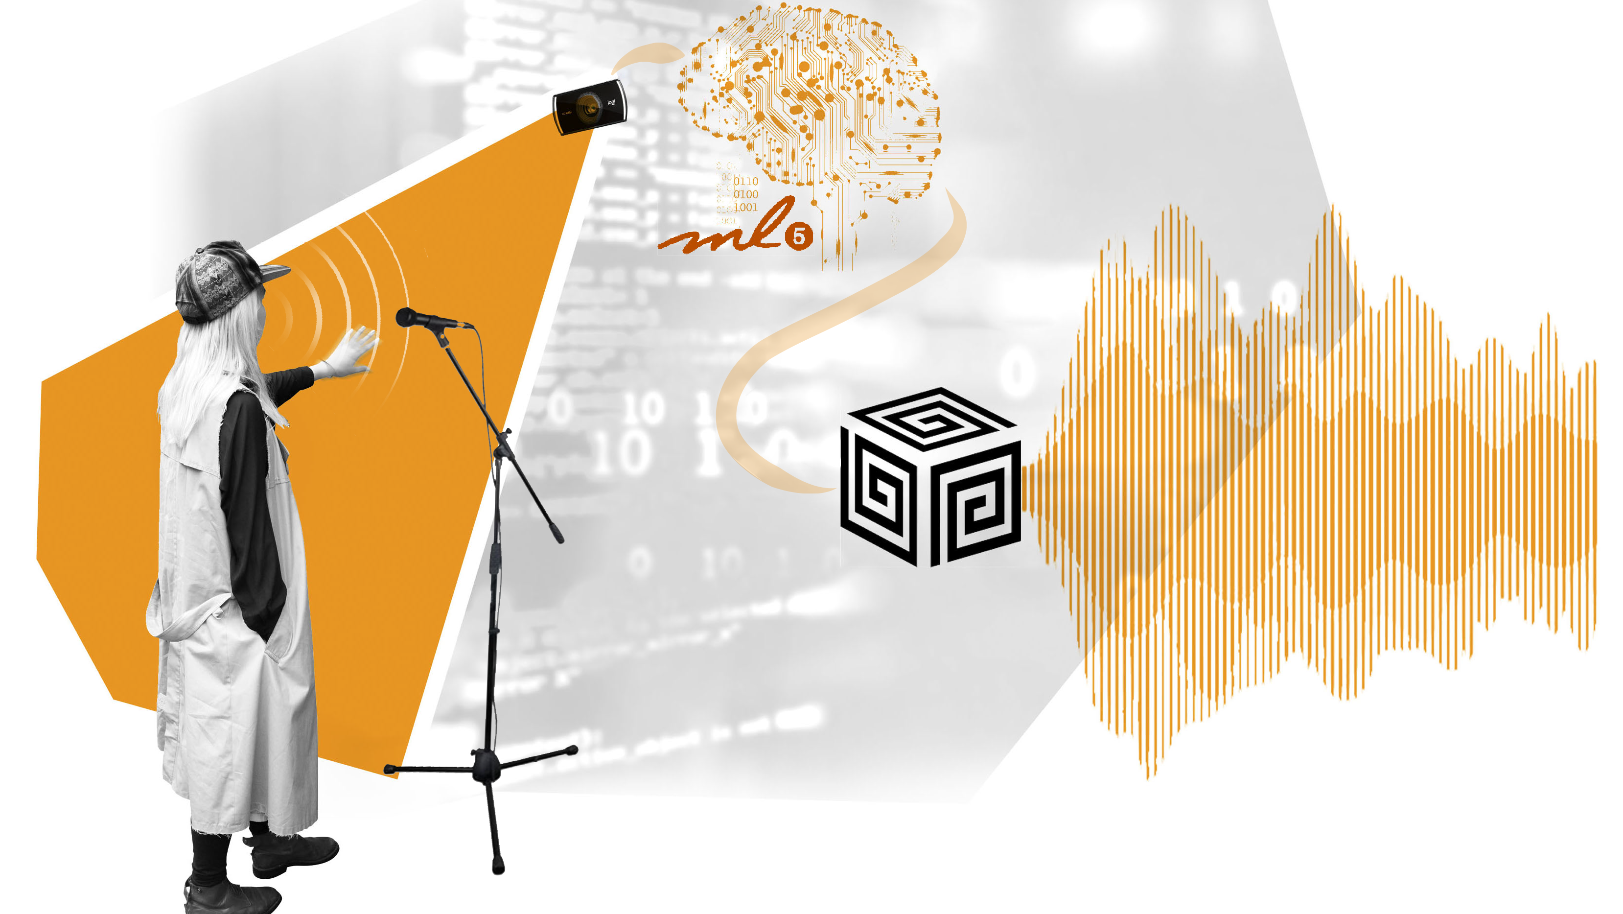
Introduction

Slide 5
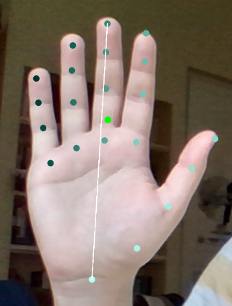
Hand motion recognition
ML5.js interface, Handpose model
Returns the coordinates of 21 points
Features:
Palm center coordinates
Palm length (white line)
Palm slope (slope of the white line)

Slide 6

Supercollider algorithm
Pitch tracker: Tartini
Pitch shifter: PitchShiftPA (PSOLA)
Effects: Rerverb / Delay
Hand motion/gesture controls:
Palm length: harmonies ON/OFF (dB mapping)
Palm center coordinates: number of voices + high/low harmonics
Palm slope: effect dry/wet knob

Slide 7
Supercollider algorithm
Version 1
Version 2
MIDI controlled patch switch
Fixed interval harmonies in each patch
Two patches with effects only (reverb/delay)
No patches
Set a scale and the “Handmonizer” will follow it
Disclaimer: two SuperCollider classes by Matthew Yee King were used

Slide 8
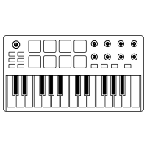




Architecture

Slide 9
Evaluation
Questionnaire covering different aspects of the performance
Answers: grade from 1 to 10 and a short comment
Can be used to evaluate similar future projects

Slide 10
Demo

Slide 11
Results and improvements

