Slide 1
Causal Inference
Case Study
Restaurant Rating Attribution Analysis
Ella Ndala | Portfolio Project

Slide 2



The Business Question
What factors causally drive restaurant ratings,
and through which pathways do they operate?
Beyond Correlation
Attribution at Scale
Heterogeneous Effects
Identifying true causal drivers — not just associations — to enable actionable business decisions
Decomposing effects through mediation pathways using Shapley values and DoWhy
Understanding how causal impacts vary across customer segments for targeted strategy

Slide 3
Project Phase Map
4 analytical phases — from raw data to causal insights and actionable recommendations
Phase 1: Data Pipeline & Feature Engineering
Phase 2-3: Causal Graph & Attribution
Phase 4: Mediation Analysis & HTE
Load 9 relational CSVs, merge patrons and restaurants, clean features, engineer distance and match scores
Construct 16-edge strict DAG, identify 3 direct treatments; dual attribution via Shapley values and DoWhy backdoor identification
Decompose treatment effects through food and service mediators; analyse 8 HTE pathways for hijos via IPW and propensity scoring

Slide 4
Phase 1-2: Data Analysis & Preprocessing
Phase 1: EDA
Phase 2: Preprocessing
Load 9 relational CSV files from 00_Raw_Data
Collapse one-to-many tables, then merge on userID and placeID
Profile distributions with ydata-profiling
Save EDA report: Reports/EDA_Reports/eda_report.html
Replace ? sentinel values with NaN
Parse business hours: Morning/Afternoon/Evening/24H
Impute missing values (most-frequent strategy)
Output: final_data.pkl — 1,161 rows × 52 features (one per rating)
Feature Engineering
Data Pipeline
Patron-restaurant distance (Haversine km)
Location clusters — KMeans k=5 on lat/long
Age groups — 18-25, 26-35, 36-50, 50+
Cuisine match score — Jaccard similarity (0-1)
Orchestrated via data_pipeline.py
Phases: Ingest → Merge → Clean → Engineer → Impute
All 9 source tables joined in sequence
Modular, rerunnable, extensible

Slide 5


Data Pipeline & Feature Engineering
9 Relational Data Sources
Engineered Features
userprofile — Demographics & preferences
usercuisine — Cuisine preferences
userpayment — Payment methods
rating_final — User ratings (target)
geoplaces2 — Restaurant profiles
chefmozcuisine — Restaurant cuisines
chefmozparking — Parking info
chefmozaccepts — Accepted payments
chefmozhours4 — Operating hours
Patron-Restaurant Distance
Geodesic (km) via Haversine
Location Clusters
KMeans (k=5) on lat/long
Age Groups
4 bins from birth year
Cuisine Match Score
Jaccard similarity (0-1)
Business Hours Category
Morning/Afternoon/Evening/24H

Slide 6
Phase 2: Correlation Analysis
Associations flagged by ydata-profiling on the CORRECTED 1,161-row table — bias-corrected, layered, and encoded as 16 causal edges
EDA → Correlation → Causal Edge
Graph Outputs
16
14
1 — Automated EDA Profiling
ydata-profiling re-run on the corrected table; alerts now name food_rating and service_rating against rating, and nothing else
Alerts extracted via BeautifulSoup HTML parsing
Causal Edges
Nodes (Variables)
3
0
2 — Correlation Review & Direction
Bias-corrected Cramér's V (Bergsma) + cardinality guard, so collapsed set-columns cannot become spurious hubs
Direction by fixed layering: exogenous → dyadic → mediators → rating; within-layer pairs omitted (selection, not causation)
Direct Treatments
Cycles (strict DAG)
3 — Edge Formalization
Key Hub Variables
Validated pairs encoded as (cause, effect) tuples in correlation_edges — see docs/edge_derivation.md
16 edges passed to networkx DiGraph → strict DAG, 0 cycles
food_rating, service_rating — the only edges clearing ydata's 0.50 alert level
Upayment, color, drink_level — 3 outgoing edges each (most influential)
42 of 75 prior edges lost their justification on the corrected data

Slide 7
Phase 2: Causal Graph (DAG)
14 nodes · 16 directed edges · 3 direct treatment variables · 0 cycles (strict DAG)

Slide 8
Phase 3: Treatment Attribution Results
60.15%
7
54.71%
R² Score
Treatments
Top Driver
food_rating Dominates
service_rating Nearly Equal
54.71% relative importance | Direct effect: +0.3597 | Shapley: 52.50% | Largest single driver of overall rating
44.75% relative importance | Direct effect: +0.3045 | Shapley: 46.84% | Food and service together explain 99.5% of treatment attribution
color — Marginal
Demographics Eliminated
0.53% relative importance | Direct effect: +0.0239 | Shapley: 0.67% | Survives the 0.20 screen at 0.223 but contributes almost nothing — on the edge of not earning its place
personality, hijos, interest and height no longer reach the screen on the corrected data (0.017–0.198). Their apparent effects were artifacts of the 27.2x duplication.

Slide 9
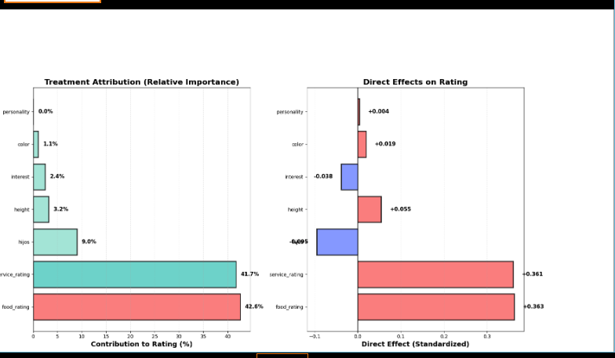
Phase 3: Treatment Attribution — Visualisations
Note: Shapley value decomposition and OLS relative importance across the 3 graph-identified treatments. Food rating (54.7%) and service rating (44.8%) account for 99.5% of attribution (R² = 60.2%).
Notes:
Attribution Analysis by treatment (direct Effect and Relative Importantce

Slide 10
Phase 4: Mediation Analysis
152.9%
133.2%
0.45
Max
Mediated
Avg
Mediated
Food
Path β
drink_level — Fully Mediated
color — Significantly Mediated
152.9% of effect flows through mediators | Food: 31.4% | Service: 68.6% | Direct effect: −0.019 | p = 0.21 — fully mediated via service (68.6%); total effect is small and non-significant
129.7% of effect flows through mediators | Food: 59.8% | Service: 40.2% | Direct effect: +0.010 | p = 0.0004 — the only treatment with a significant total effect; food-dominant mediation
Upayment — Fully Mediated
116.9% of effect flows through mediators | Food: 81.9% | Service: 18.1% | Direct effect: +0.002 | p = 0.27 — fully mediated; payment method affects ratings almost entirely via food quality

Slide 11
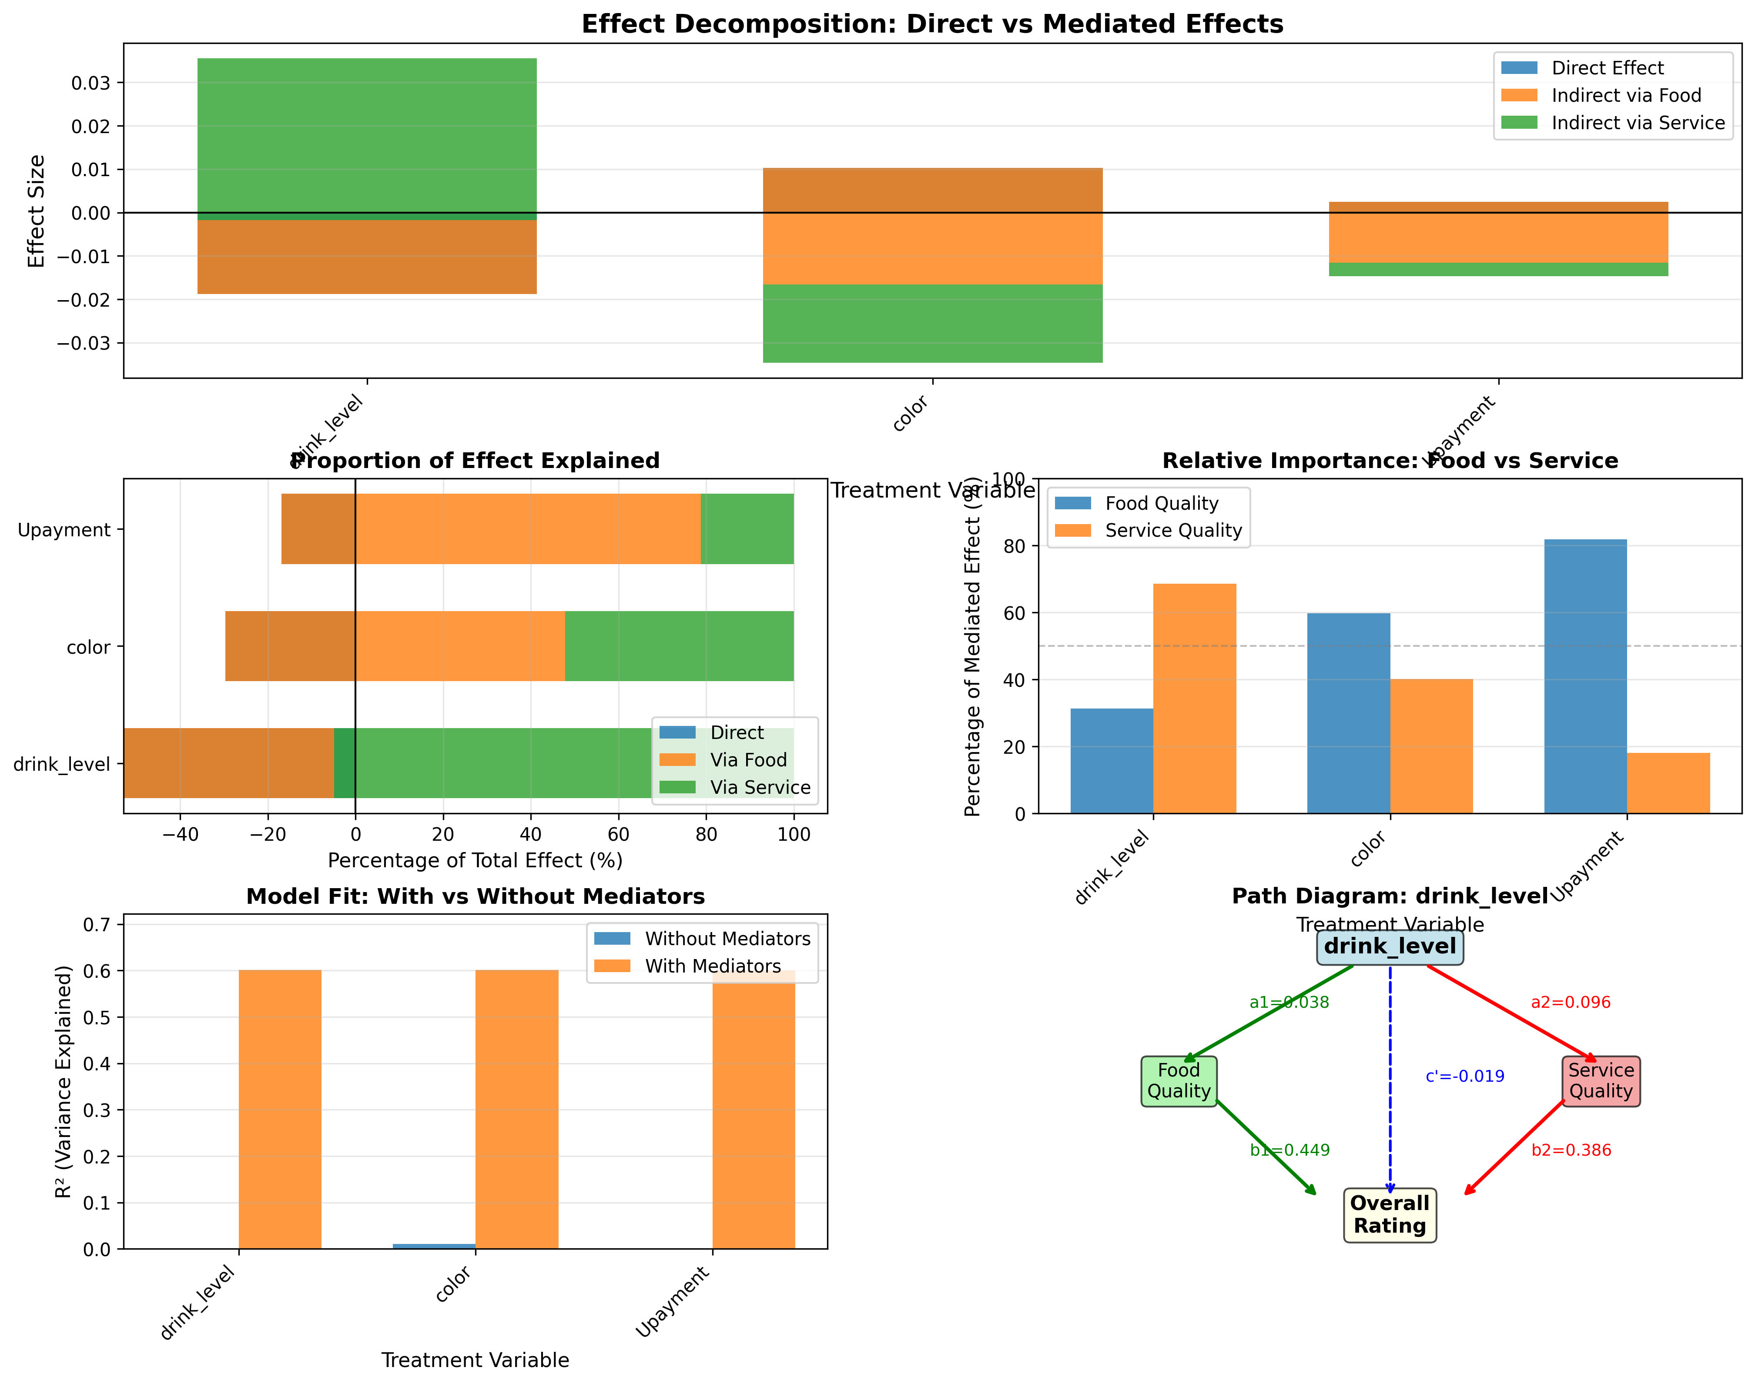
Phase 4: Mediation Analysis — Output Charts
Note: drink_level (152.9% mediated, p = 0.21), color (129.7% mediated, p = 0.0004 — only significant total effect), and Upayment (116.9% mediated, p = 0.27). All three treatments are fully mediated — the mediators absorb and reverse the small direct effects. Adding mediators lifts R² from ≈0.001 to 0.60 for each treatment.
Notes:
Mediation analysis for

Slide 12
Phase 4: Hijos — HTE Analysis
Business Question: Why do families with children rate restaurants differently?
+0.382
1.180
8
IPW ATE
ATE Range
Pathways
Causal Effect of Having Children
Pathway Decomposition (8 Paths)
IPW ATE: +0.382 (95% CI: [+0.043, +0.667]) | Adjusted ATE: +0.146 (95% CI: [−0.049, +0.327]) — not significant | Unadjusted: +0.385 (n=19 treated, 1,142 control) | Only 19 treated observations
Via Service: +0.211 (54.6%) | Via Food: +0.178 (46.1%) | Via Color: −0.003 (−0.7%)
HTE by Business Hours
What This Can and Cannot Support
Morning: +0.955 (n=2, p=0.10) | Evening: +0.664 (n=7, p=0.026) ★ only significant subgroup | Full Day: +0.234 (n=5, p=0.51) | Afternoon: +0.222 (n=2, p=0.68) | Night: −0.226 (n=3, p=0.60) | Range: 1.180 points
19 treated households split across five time windows (2–7 each) — only Evening reaches significance. The direction (families rate higher, via service 54.6% and food 46.1%) is plausible but underpowered. The next step is a larger sample, not a business decision.

Slide 13
Analytical Methodology
Graph-Informed Analysis
Causal Attribution
Path enumeration (treatment → outcome)
Mediator identification
Confounder detection (backdoor)
Dominance analysis
Relative importance weighting
Naive correlation baseline
Direct effects (OLS, standardized)
Unique R² (drop-one)
Shapley value decomposition
DoWhy backdoor estimation
Mediation Analysis
Heterogeneous Treatment Effects
Direct effect (c’): Treatment → Rating
Indirect via food (a₁×b₁)
Indirect via service (a₂×b₂)
Proportion mediated
R² comparison
8 causal pathways for hijos
IPW with stabilized weights
Bootstrap 95% confidence intervals
Subgroup-specific ATE
Propensity score overlap

Slide 14
Technical Stack
Causal Inference
Python & Data Science
DoWhy, DAGs, Backdoor Criterion, Propensity Scores, Mediation, IPW
pandas, numpy, scikit-learn, scipy, statsmodels, networkx
Visualization
Data Engineering
matplotlib, seaborn, networkx graph viz, path diagrams
Multi-source merging (9 tables), feature engineering, geodesic distance, KMeans clustering
Statistical Methods
SQL-Adjacent
OLS, Logistic Regression, Bootstrap CI, Shapley Values, F-tests, ATE estimation
Complex LEFT JOINs across relational tables (users, restaurants, ratings, cuisines, payments)

Slide 15

Thank You
Ella Ndalla
ndallaella@gmail.com
GitHub: Causal_inference-Case_study

