Slide 1
Customer Churn Prediction
& Causal Analysis
Machine Learning · Bayesian Inference · Experimental Design
Ella Ndalla | Senior Data Scientist
Telco Customer Retention · Google GBS&O Alignment

Slide 2
The Business Challenge
Customer Churn Problem
Project Objectives
Telecommunications companies lose significant revenue when customers switch providers.
Identifying at-risk customers early enables proactive retention strategies before churn occurs.
This project goes beyond standard churn prediction — it applies rigorous causal inference to distinguish correlation from causation, ensuring business recommendations rest on defensible evidence.
1. Predict customer churn accurately using ML models
2. Identify and rank key churn drivers
3. Apply causal inference to correct methodological biases
4. Design statistically powered retention experiment
5. Enable targeted, evidence-based retention strategies

Slide 3
Data Overview
7,043
21
26.5%
Kaggle
Customers in Dataset
Features per Customer
Overall Churn Rate
Data Source
Demographics
Account & Contract
Services
Gender · Senior Citizen · Partner · Dependents
Pre-treatment exogenous variables — valid causal controls
Tenure · Contract Type · Payment Method · Monthly Charges · Total Charges
Endogenous or downstream — require causal treatment
Phone · Internet · Streaming · Online Security · Device Protection · Tech Support · Online Backup
Service add-ons are the primary treatment variable

Slide 4
Multi-Phase Technical Approach
01
Data Pipeline
02
ML Modeling
03
Causal Inference
04
Experiment Design
PySpark & SQL
Decision Tree (PySpark)
Variable role classification
2×2×2 factorial design
Missing value imputation
H2O AutoML
Collider bias correction
Power analysis
Outlier removal
Stacked Ensemble
Bayesian regression (PyMC)
Sample size sensitivity
Feature engineering
MLflow tracking
MCMC sampling
Week-by-week monitoring

Slide 5
Phase 1 & 2: Machine Learning Results

Slide 6
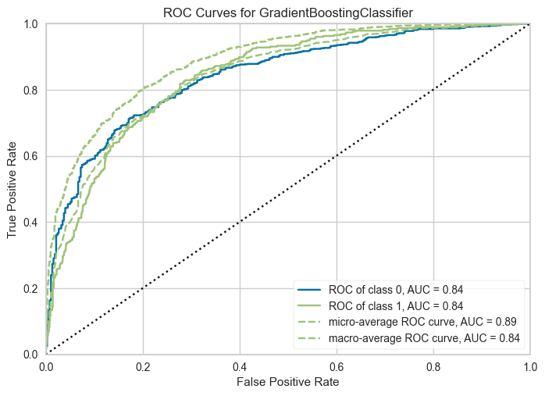
Model Performance Comparison
Metric Comparison
ROC Curve — H2O Stacked Ensemble
Metric | Decision Tree | H2O Stacked
AUC-ROC | 72.0% | 87.0% ✓
AUC-PR | 52.6% | 65.0% ✓
F1 Score | 78.5% | 64.0%
Recall | ~65% | ~80% ✓
Precision | ~72% | ~68%
Metric Decision Tree H2O Stacked
Selected Model
H2O AutoML — Stacked Ensemble
87% AUC-ROC | Best overall performance

Slide 7
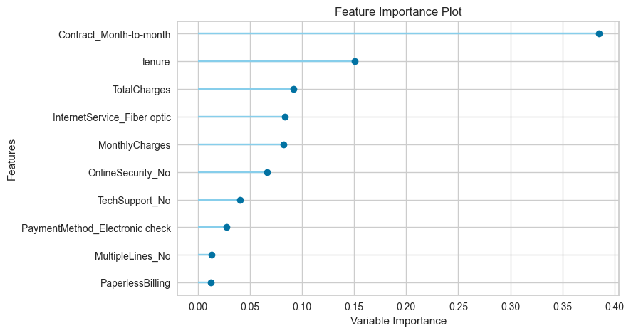
Feature Importance Analysis
Key Insights
Tenure
35%
Contract Type
22%
Device Protection
15%
Online Security
12%
Tech Support
9%
Payment Method
7%
Tenure + Contract Type account for
over 57% of predictive power.

Slide 8
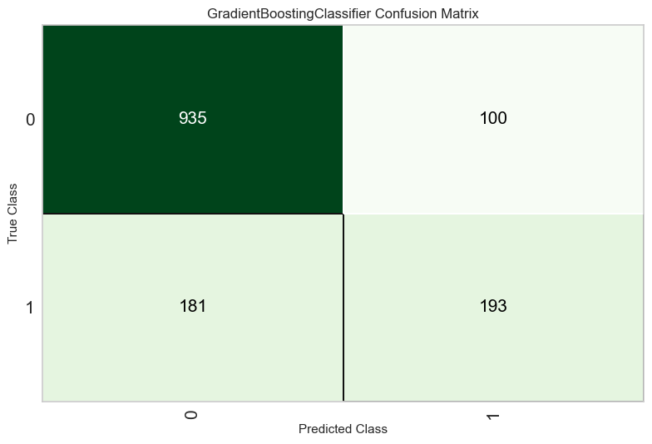
Model Evaluation: Confusion Matrix
Interpretation
True Positive Rate
Model correctly identifies ~80% of actual churners — strong recall for targeting at-risk customers.
False Positive Rate
~20% of predicted churners are non-churners — acceptable for outreach campaigns where false positives have low cost.
Class Imbalance Note
Dataset has 26.5% churn rate. Future iterations should evaluate SMOTE or class-weighted training.

Slide 9
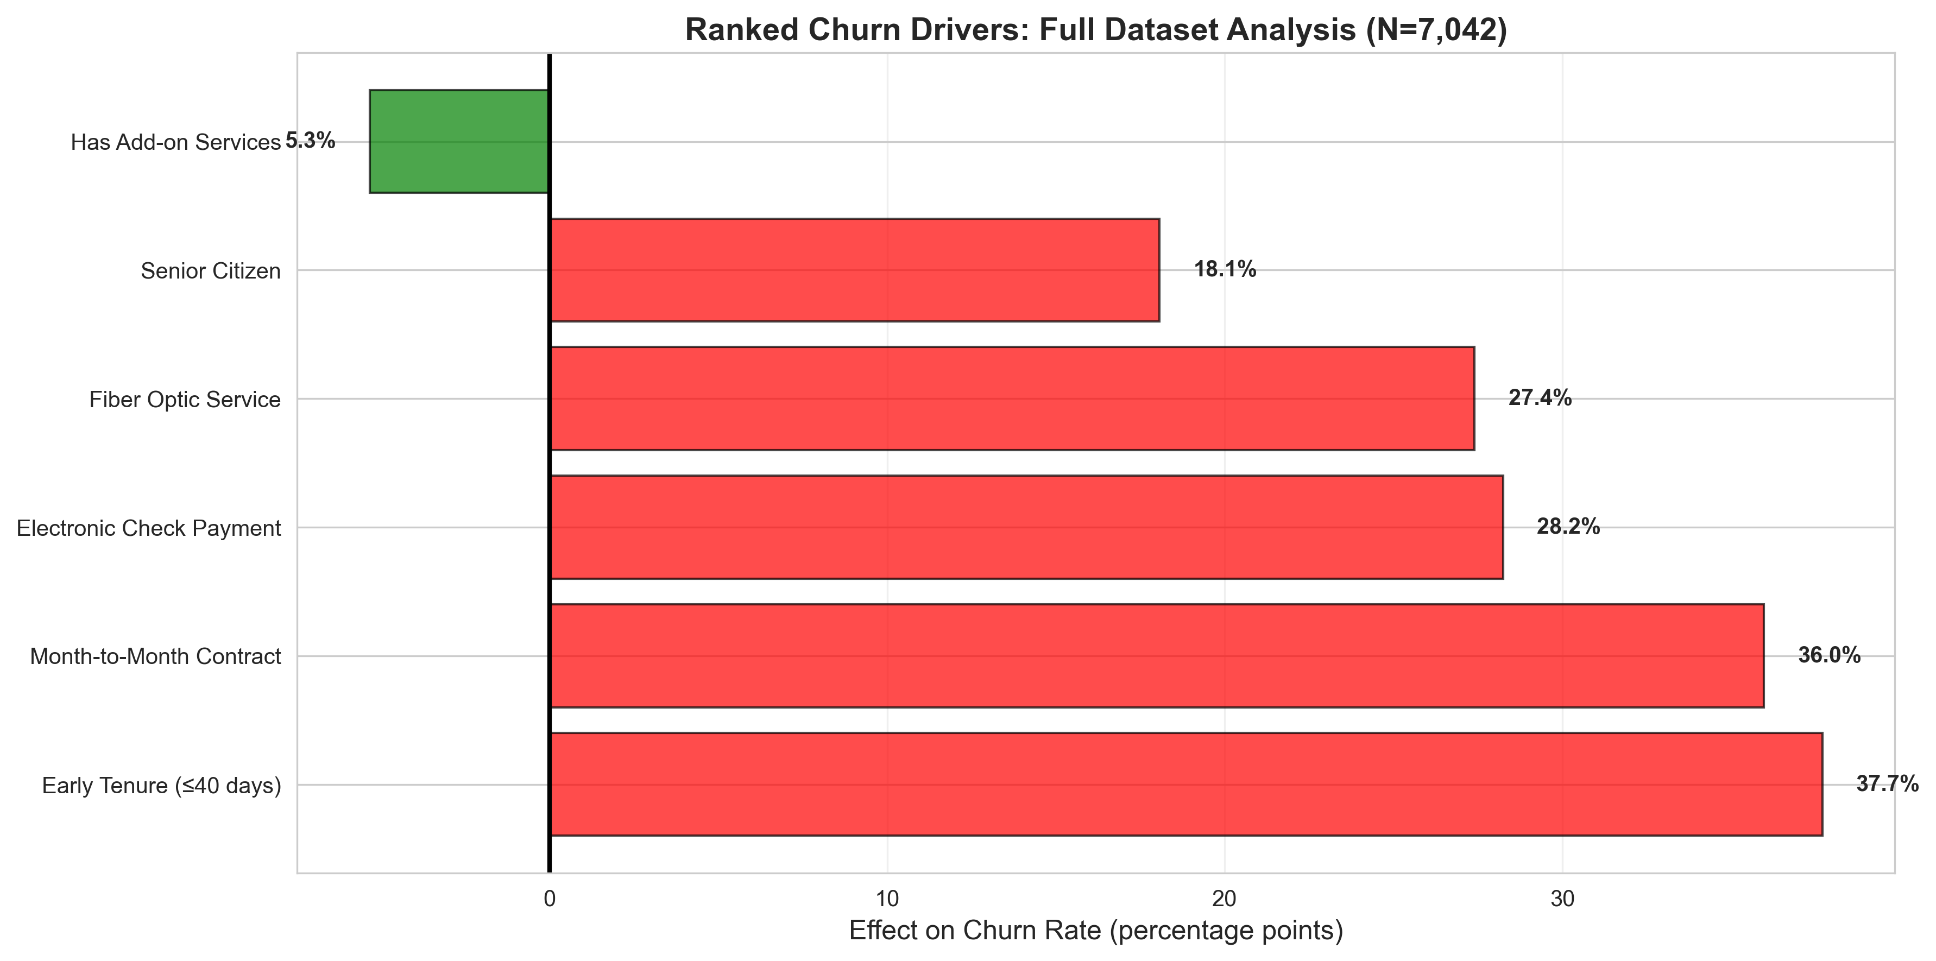
Key Churn Drivers — Ranked Analysis

Slide 10
Phase 3: Causal Inference & Methodology Correction

Slide 11
Why Predictive ML Is Not Enough
The original analysis treated tenure, contract type, and payment method as confounders — methodologically incorrect. Two-stage causal testing (initial validation → G-computation correction) revealed biases up to +9.7pp. Add-on protection was understated by 158%. These variables are colliders, co-treatments, or mediators — not pre-treatment controls.
COLLIDER — Tenure
Caused by BOTH add-on adoption AND survival/churn — controlling for tenure induces survivorship bias. Empirically validated: early tenure effect shifted only −1.5pp after G-computation correction (naive +37.7pp → adjusted +39.2pp), confirming a genuine causal signal with minimal confounding.
OTHER TREATMENT — Contract / Payment
Endogenous customer choices correlated with loyalty, each requiring a separate identification strategy — not controls. G-computation exposed material overstatement: Month-to-Month +36.0pp naive → +30.6pp adjusted (−5.3pp bias); Electronic check +28.2pp naive → +18.6pp adjusted (−9.7pp bias, 35% overstatement of true effect).
MEDIATOR — Monthly / Total Charges
Charges sit on the causal path Add-ons → Charges → Churn; controlling for them blocks the very effect being estimated. Most striking consequence: add-on protection naive −5.3pp → adjusted −13.7pp. The naive model understated true protective effect by 158% due to mediator bias.

Slide 12
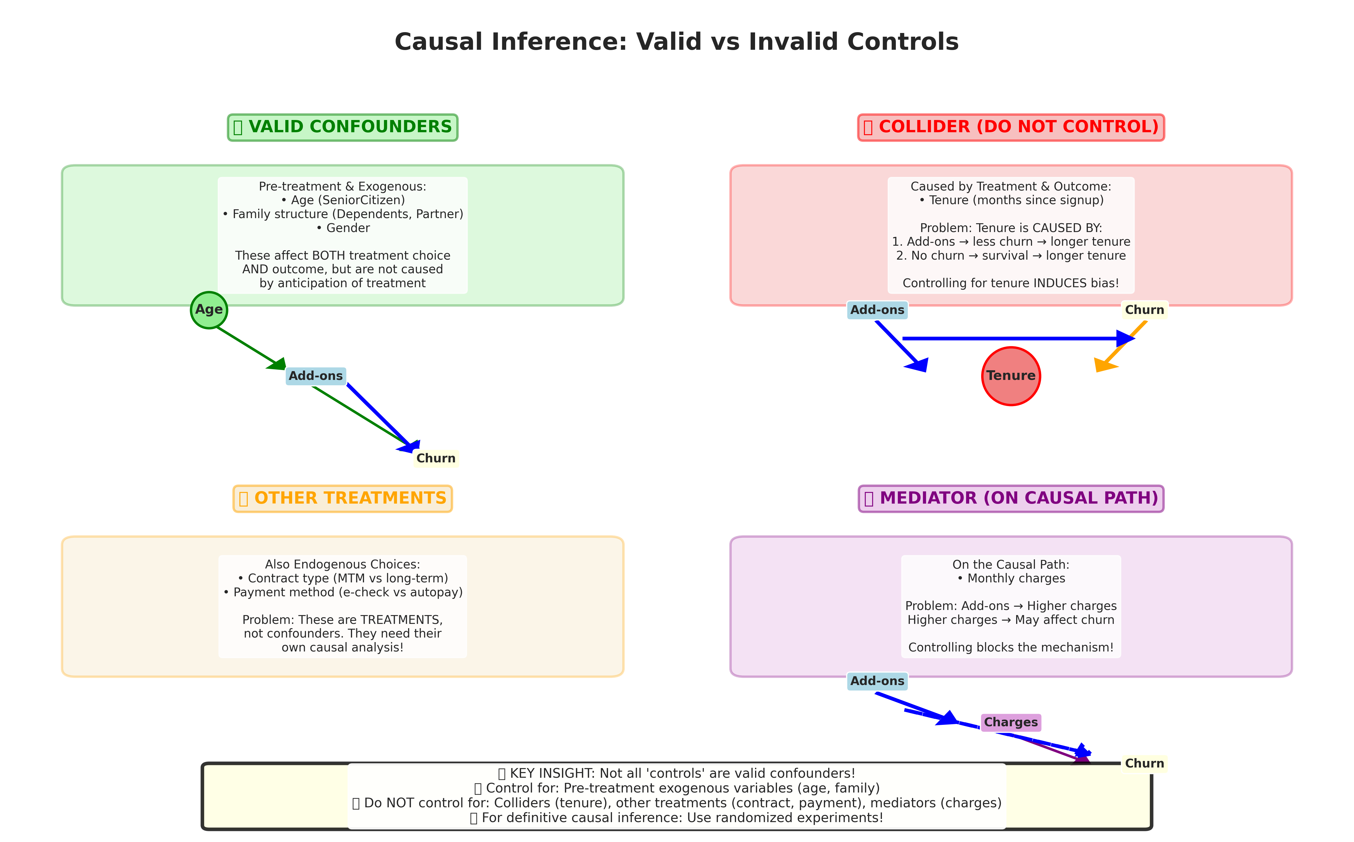
Causal Variable Classification
Decision Rule
A variable is a valid confounder if and only if:
(1) Measured BEFORE treatment
(2) EXOGENOUS — not a customer choice
(3) Common cause of both treatment & outcome
VALID Controls
SeniorCitizen · Dependents · Partner · Gender
INVALID — Remove
Tenure (collider) · Contract, Payment Method (other treatments) · Monthly/Total Charges (mediators)

Slide 13
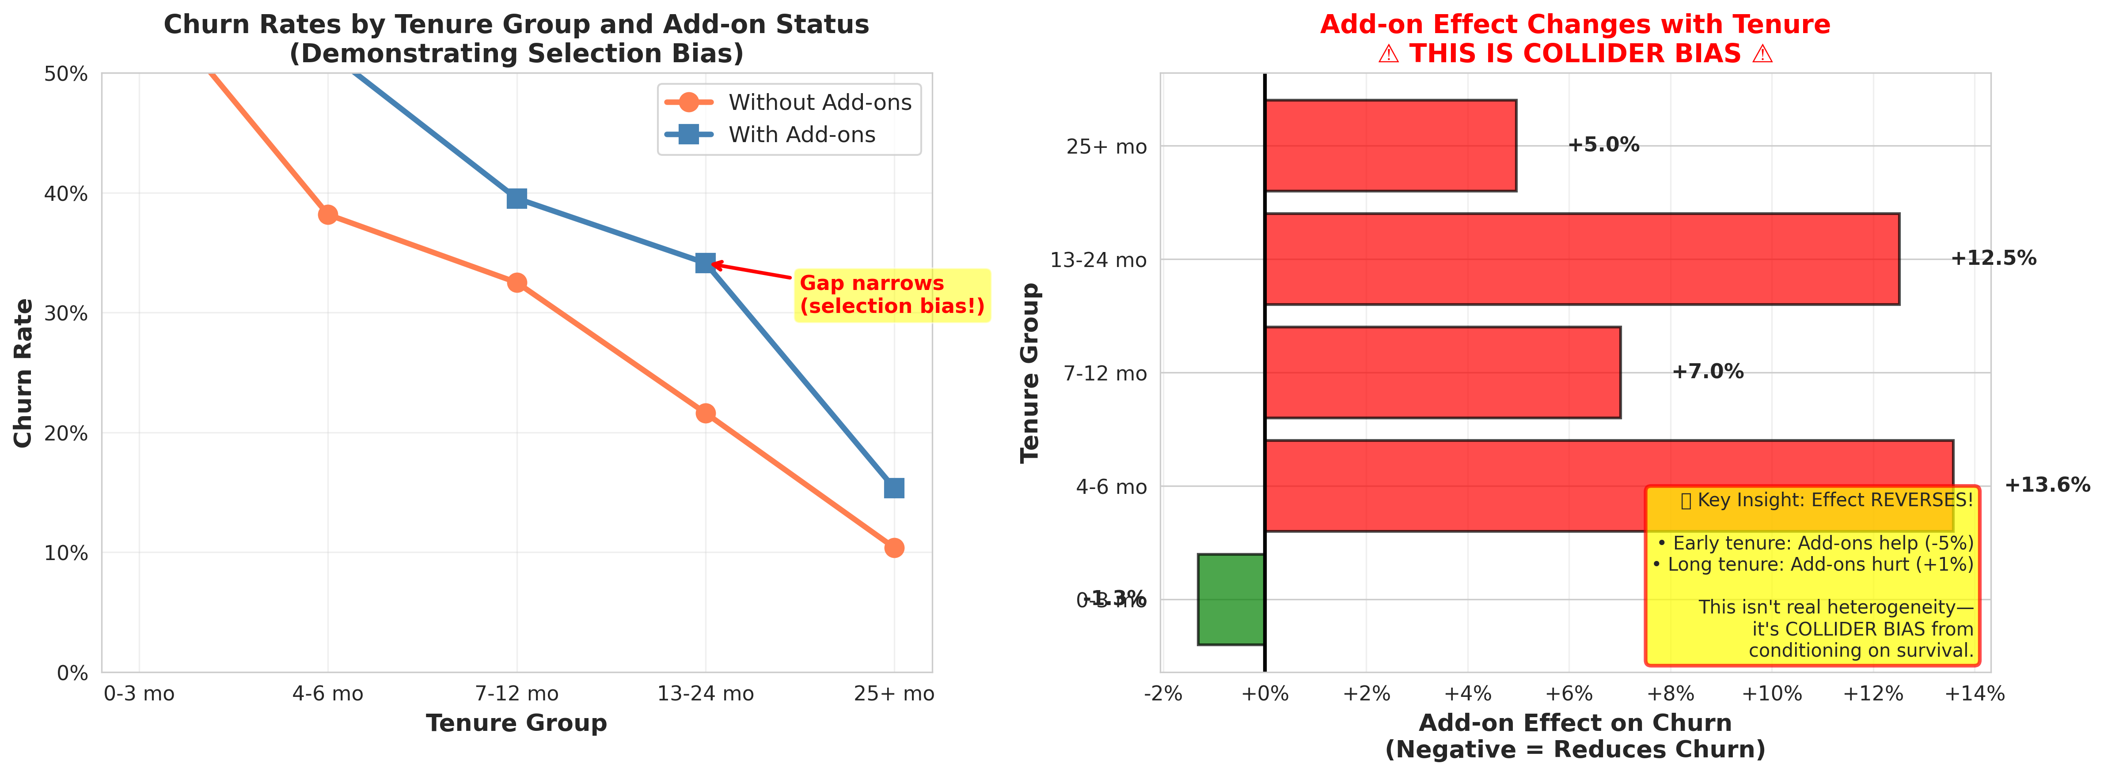
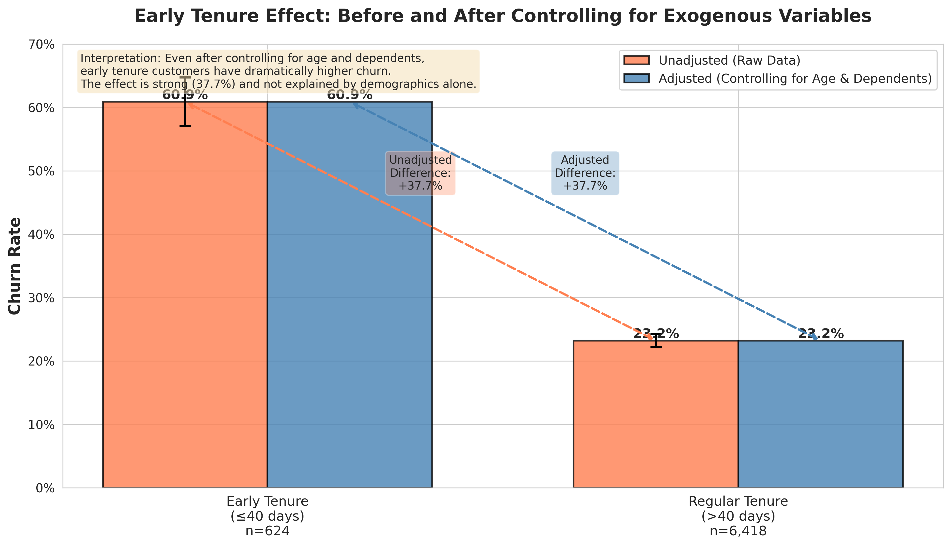
Collider Bias: Empirical Demonstration
Collider Stratification Effect
Early Tenure Effect
Controlling for tenure artificially reverses or masks the true service add-on effect — a classic symptom of collider bias. The corrected model excludes tenure from confounders.

Slide 14
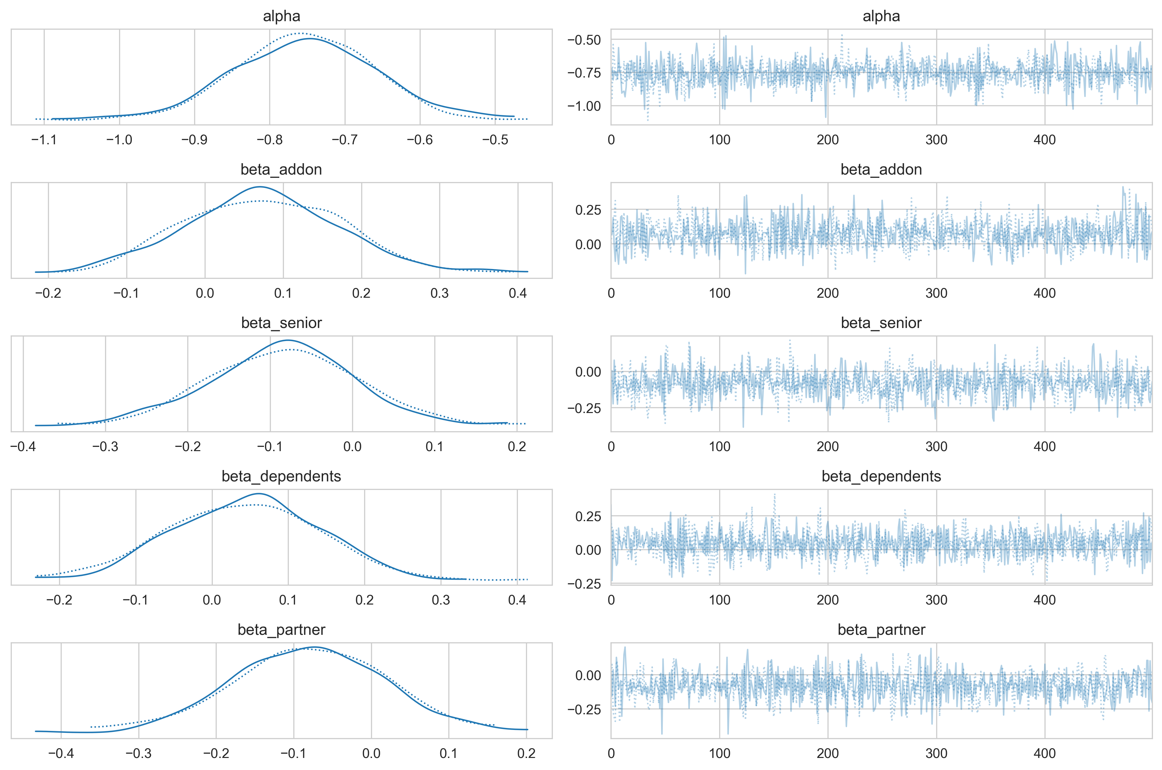
Bayesian Causal Validation — PyMC
Bayesian Approach
Model:
Bayesian logistic regression using PyMC with MCMC sampling (NUTS sampler)
Confounders:
Only exogenous demographics: SeniorCitizen, Dependents, Partner, Gender
Treatment:
Service add-on bundle (Device Protection, Online Security, Tech Support)
Convergence:
Trace plots confirm MCMC chain convergence (R-hat ≈ 1.0, effective samples > 400)

Slide 15
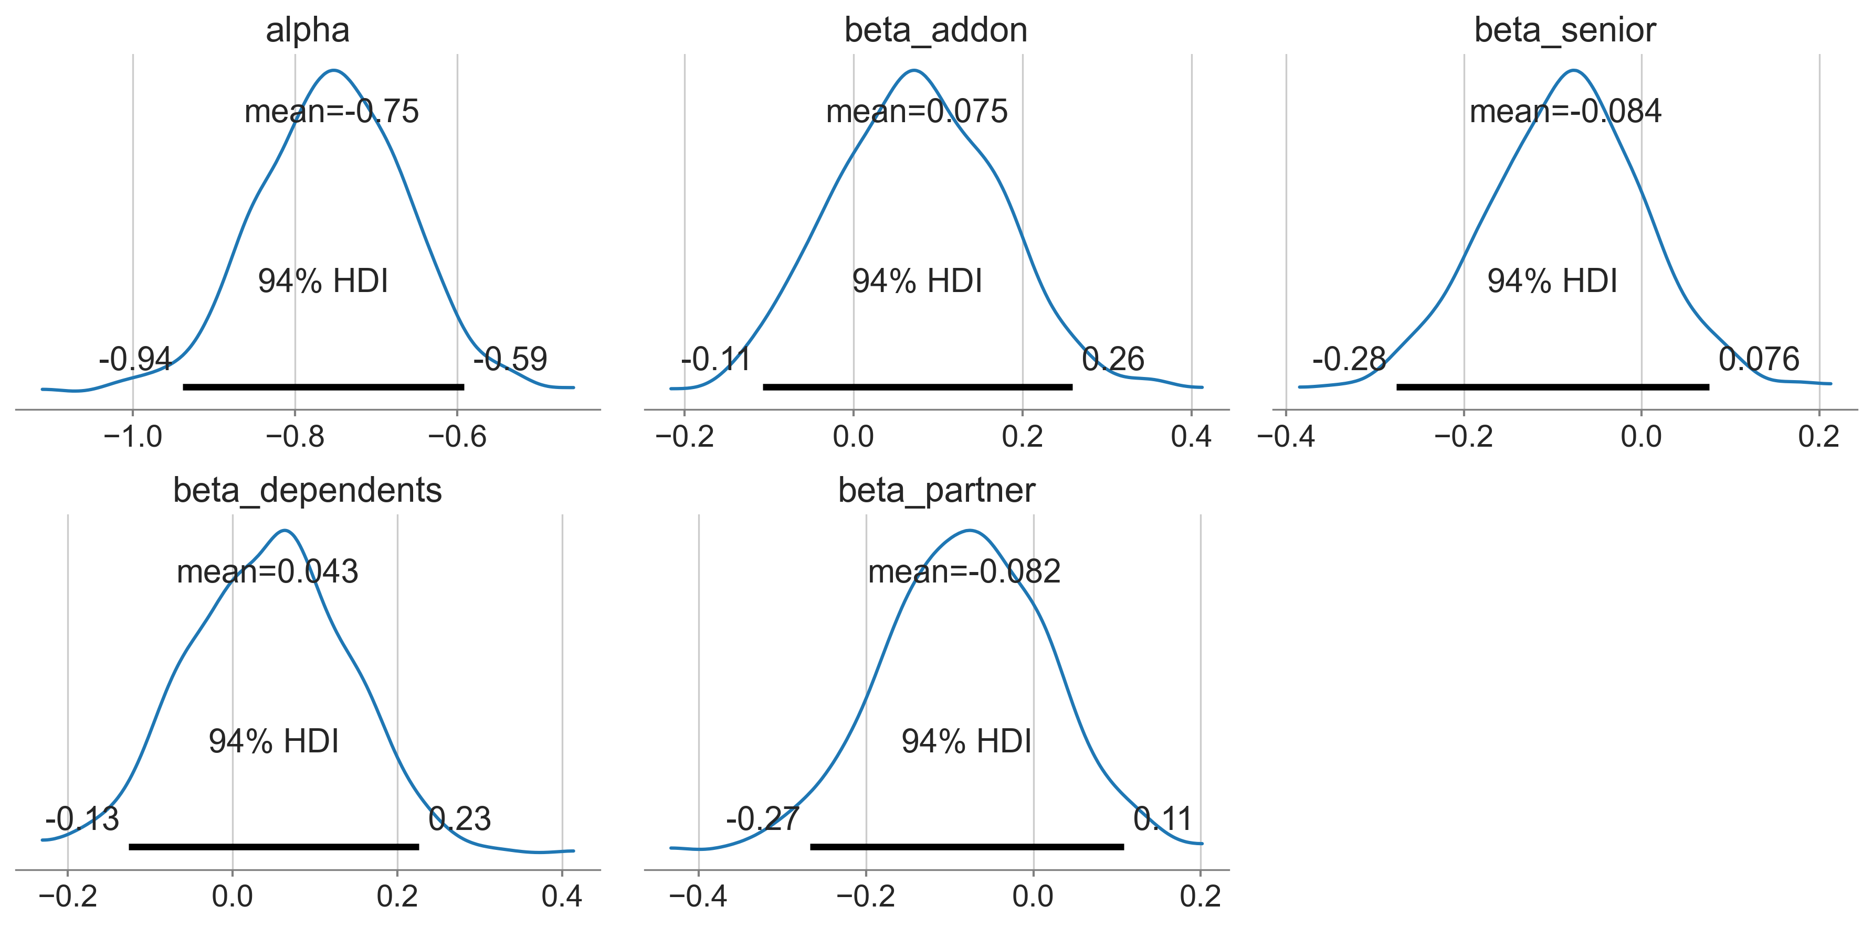
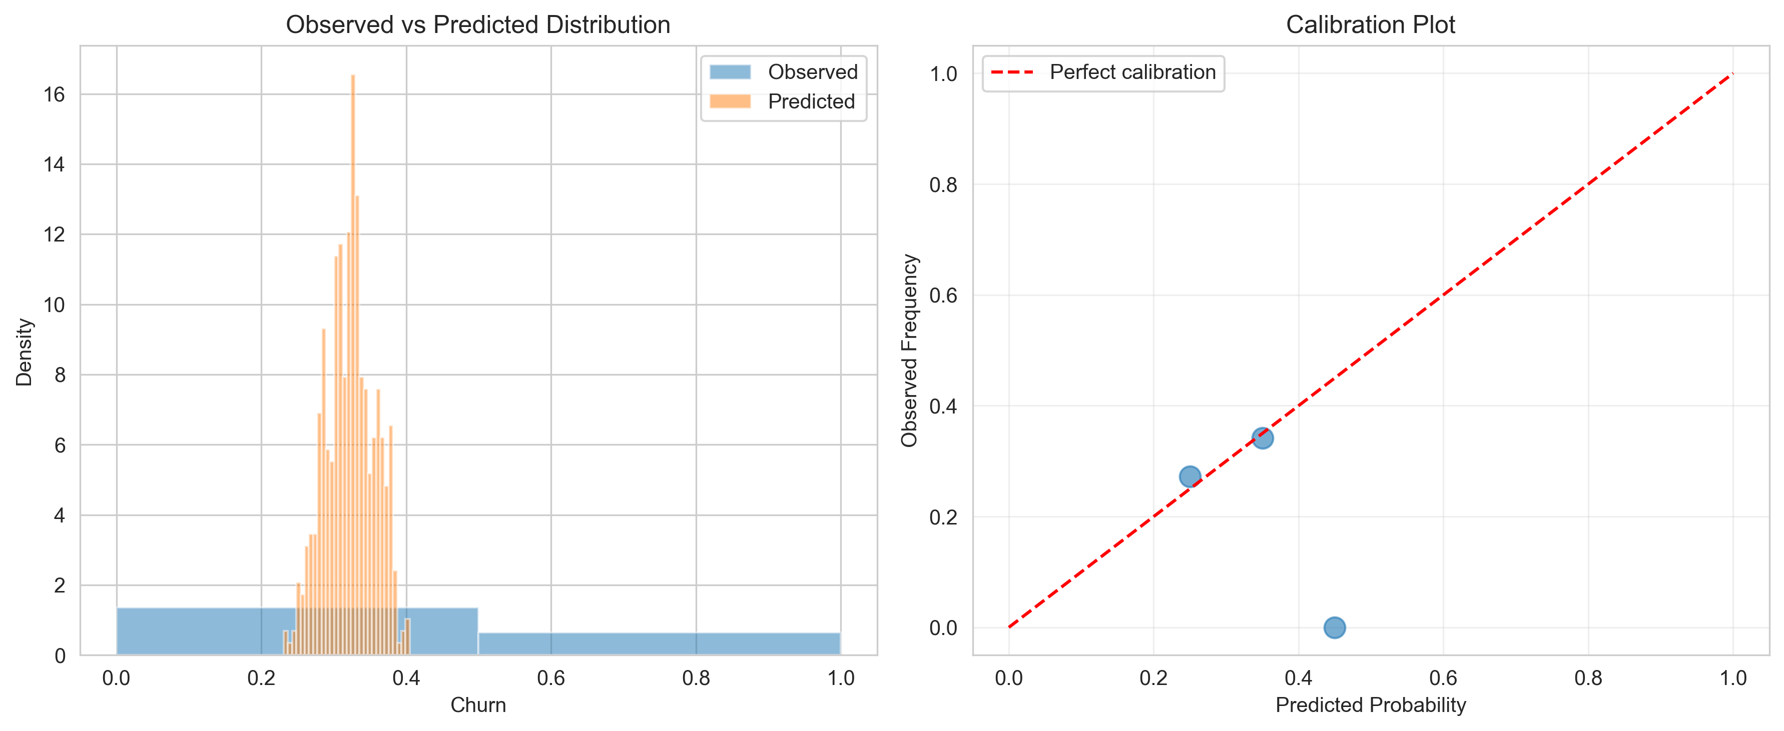
Posterior Distributions & Predictive Check

Slide 16
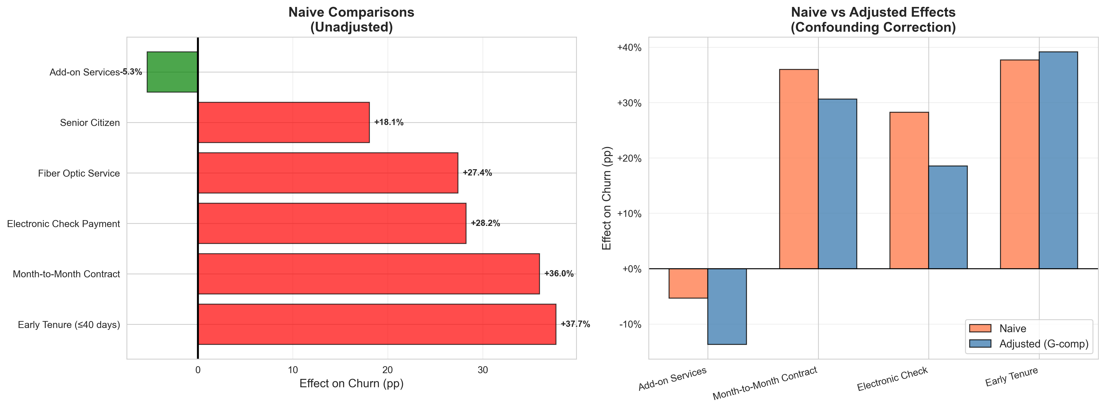
Causal Comparison: Before vs After Correction

Slide 17
Phase 4: Experimental Design & Monitoring

Slide 18
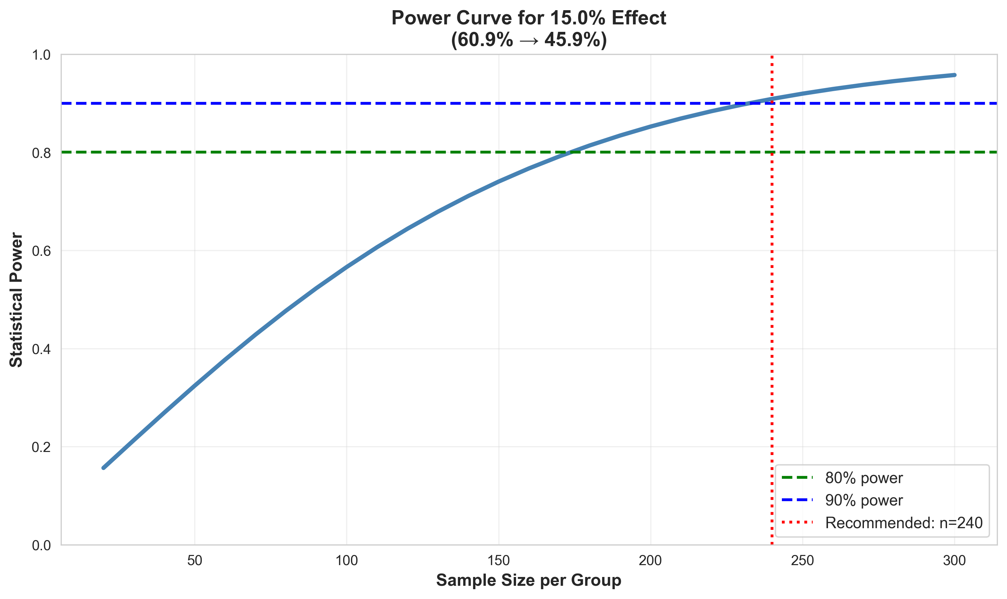
Statistical Power Analysis
Experiment Design: 2×2×2 Factorial
Three binary factors creating 8 treatment arms:
Factor A:
Device Protection bundle (on / off)
Factor B:
Proactive support outreach (on / off)
Factor C:
Early intervention timing (≤40 days / later)
~200
80%
Min. Customers/Arm
Target Power (β)

Slide 19
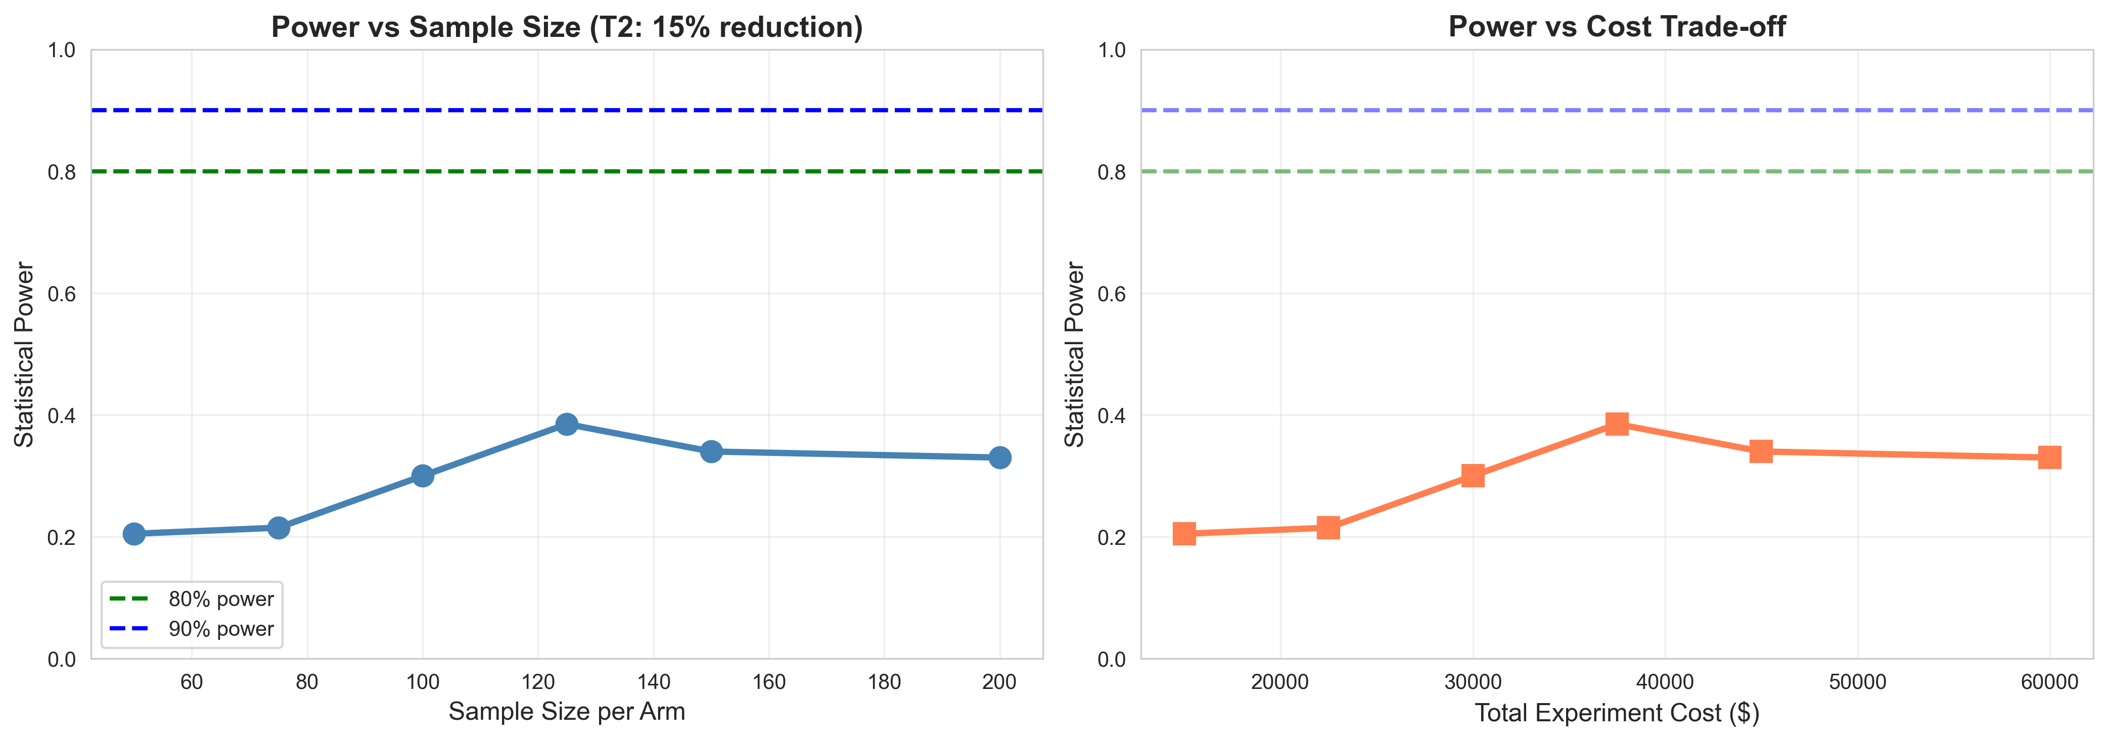
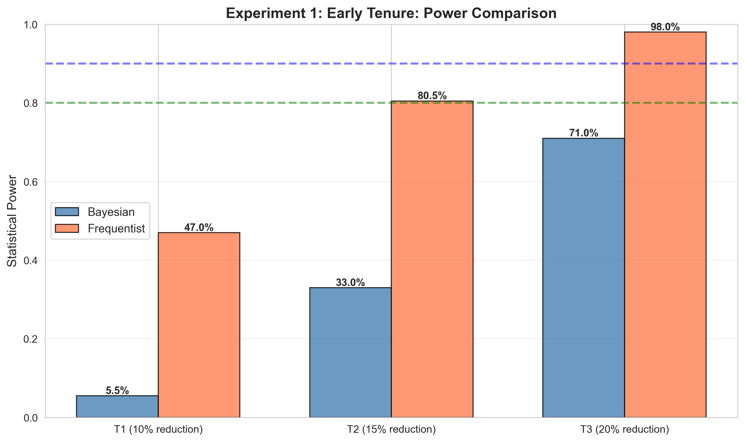
Sample Size Sensitivity & Power Comparison

Slide 20
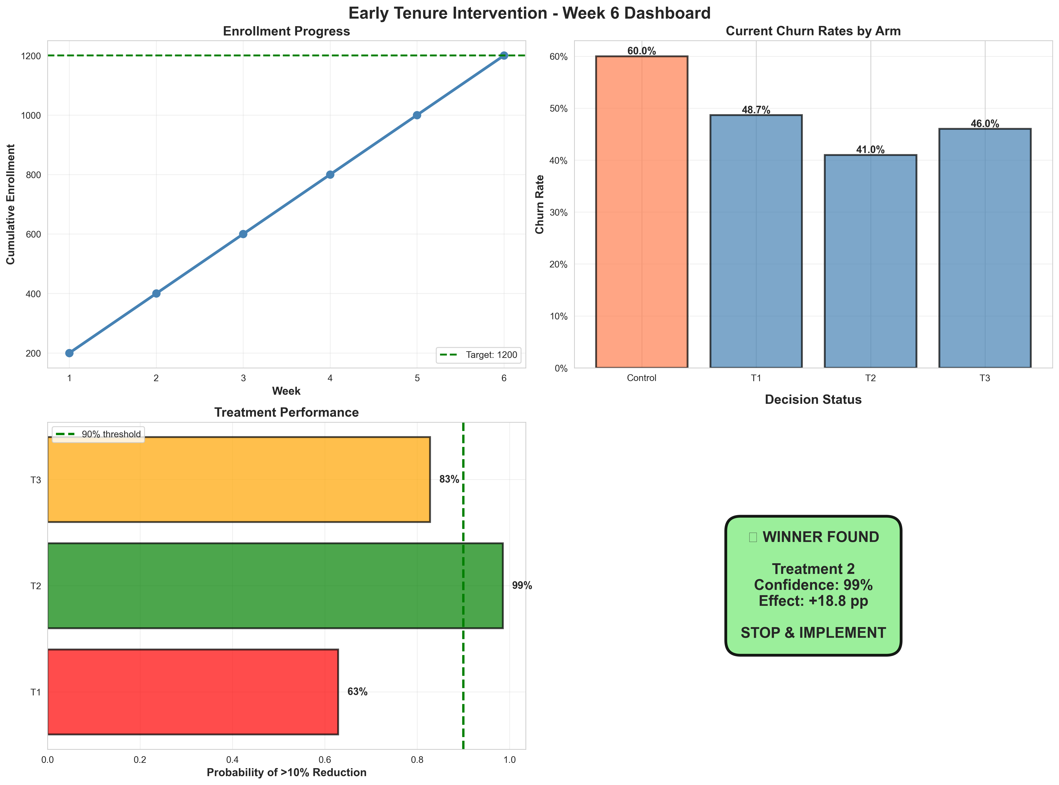
Executive Dashboard — Week 6 Monitoring

Slide 21
Live Dashboard: Model Predictions

Slide 22
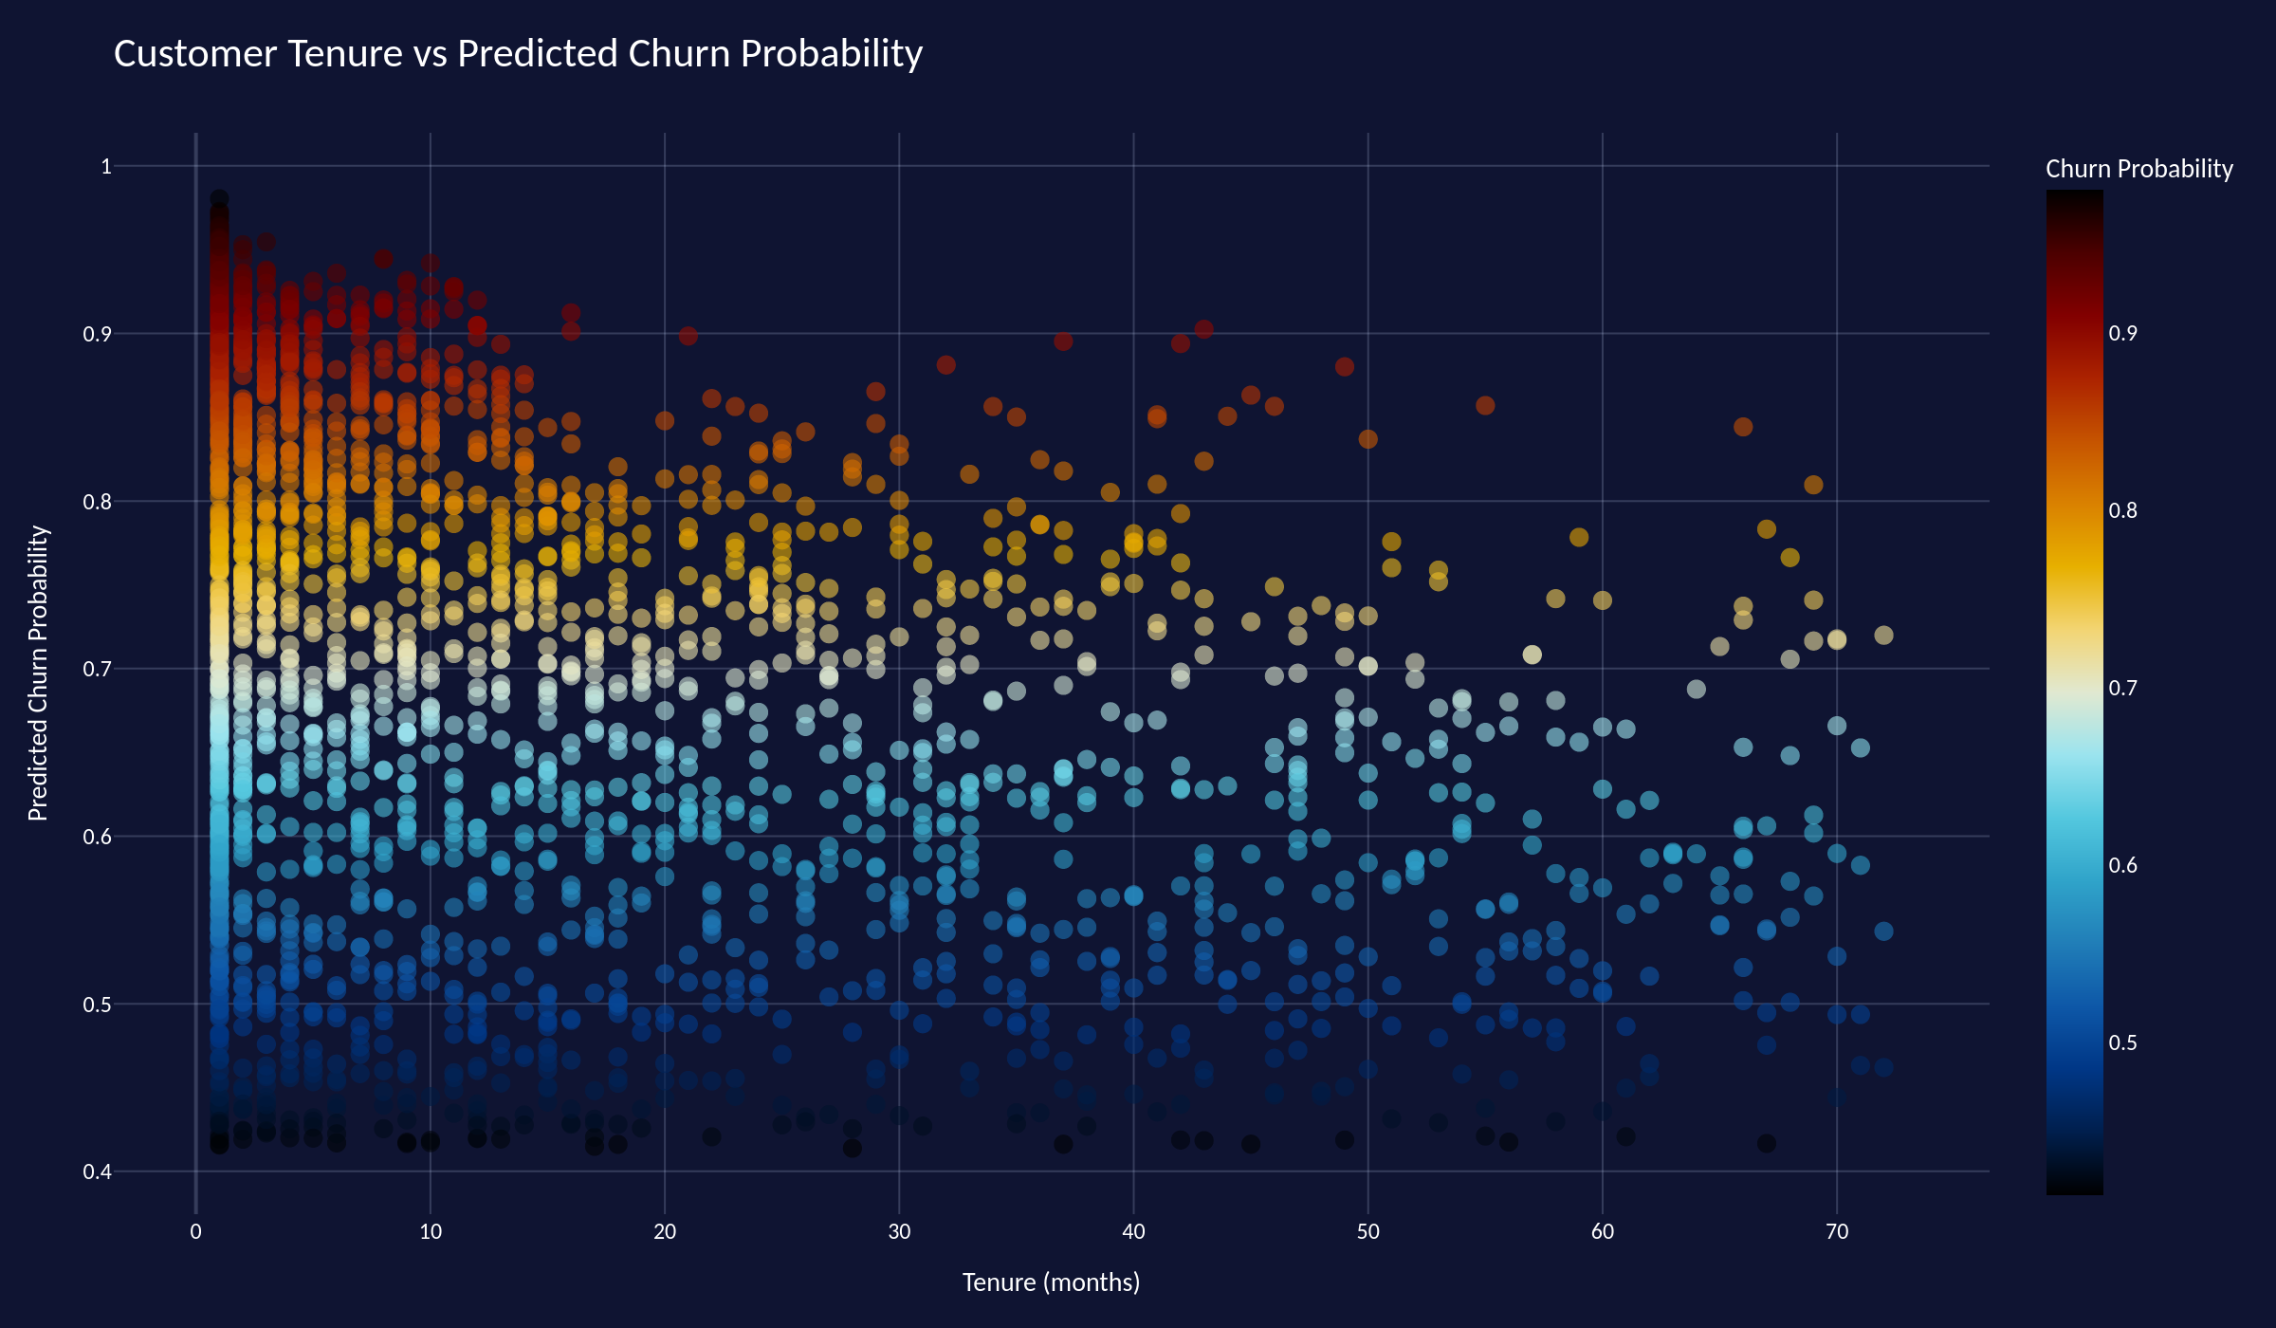
Customer Tenure vs Predicted Churn Probability
Among 2,360 predicted churners · IceFire colour scale: red = highest churn probability (>0.85), blue = marginal (≈0.50)

Slide 23
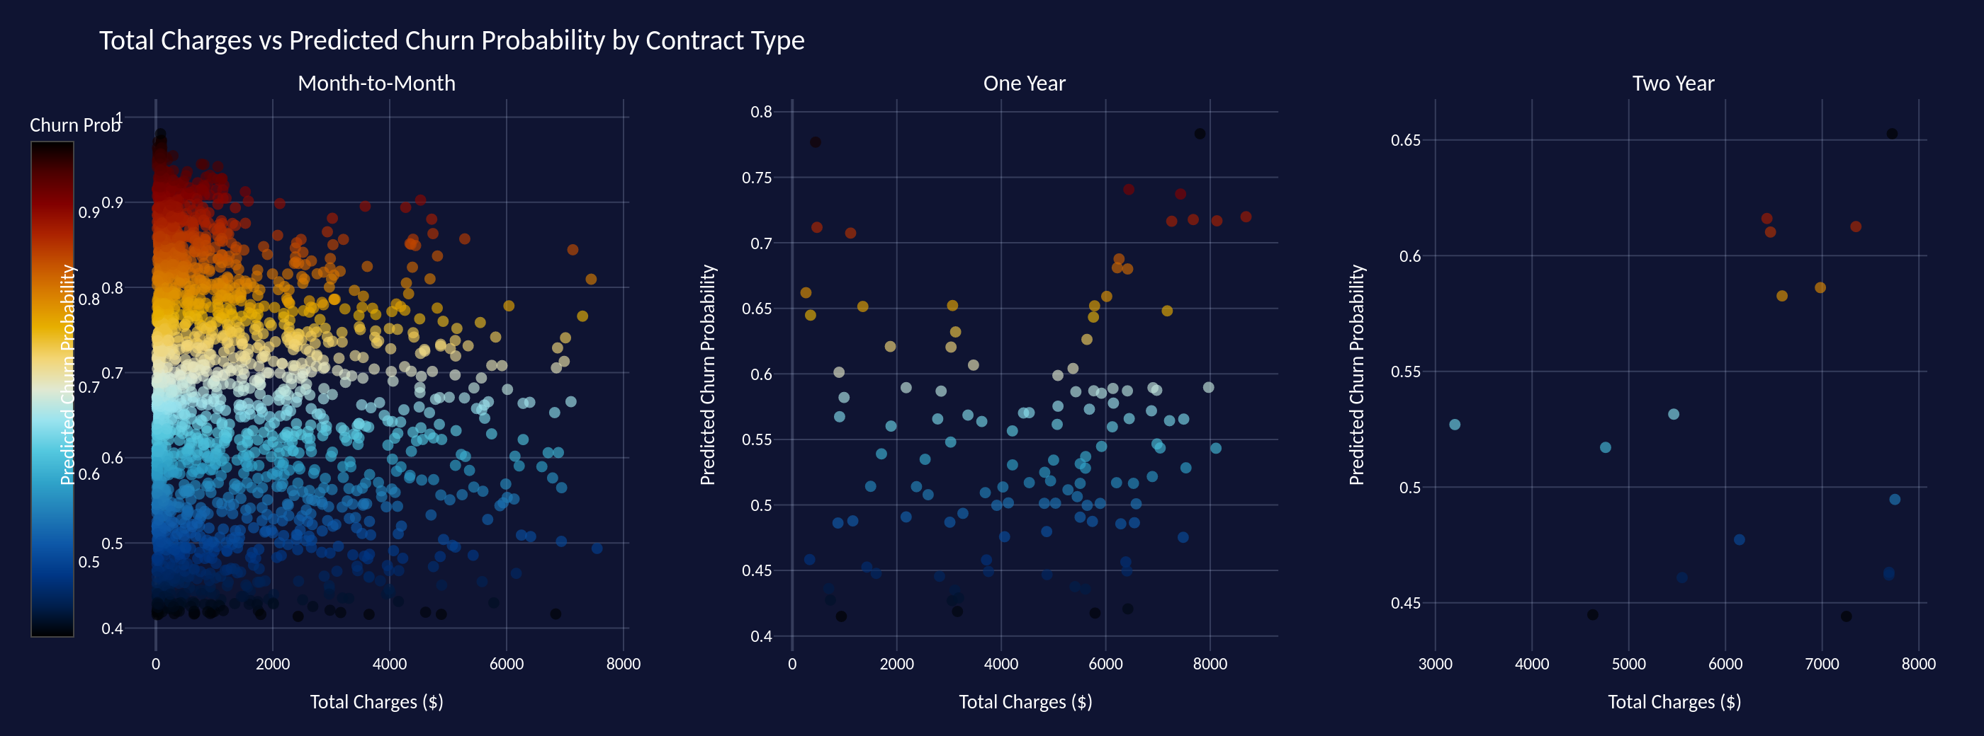
Total Charges vs Churn Probability by Contract Type
Month-to-month customers dominate the high-churn zone at low Total Charges — confirming early exit risk. Annual and two-year contracts cluster at lower churn probability even at high spend.

Slide 24
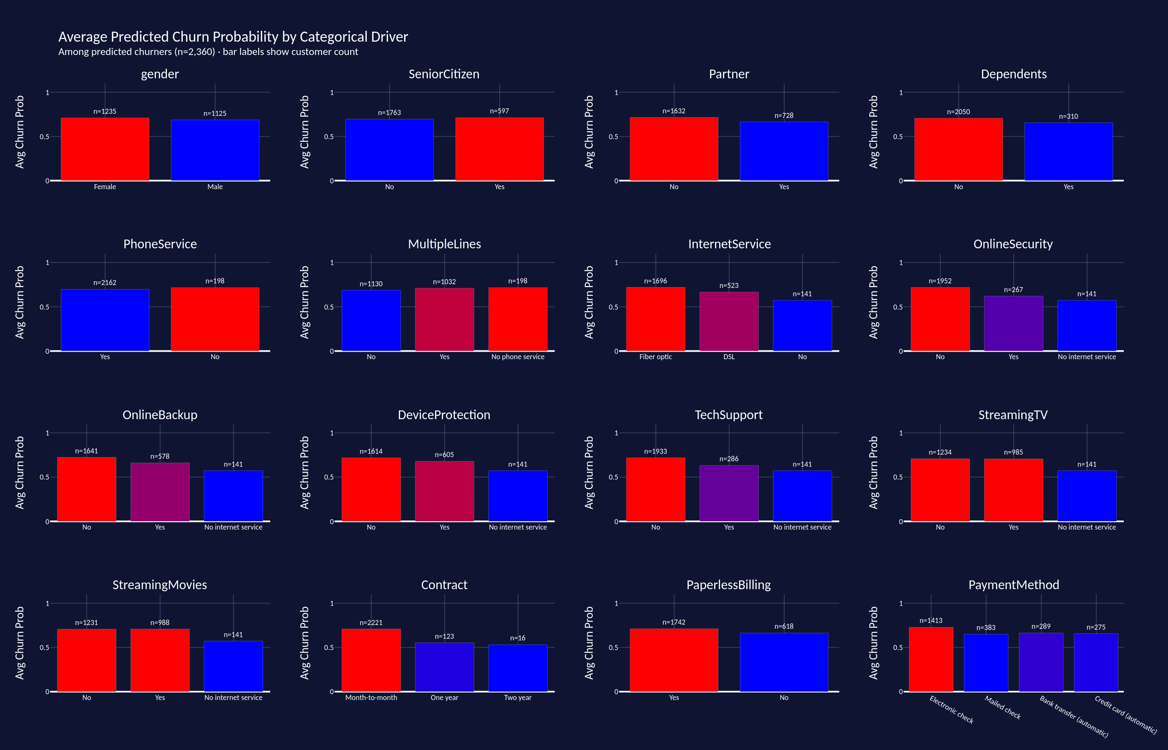
Avg Predicted Churn Probability by Categorical Driver
16 categorical features · bar height = average churn probability among predicted churners · bar label = customer count · Bluered: red = highest risk segment

Slide 25
Business Recommendations & Deployment

Slide 26
Evidence-Based Business Recommendations
Early Intervention Program
Enhanced Contract Plans
Implement retention outreach within first 40 days of customer journey. Early tenure effect is the single strongest churn predictor.
Develop attractive long-term contracts bundled with service add-ons. Month-to-month customers churn at 3× the rate of annual subscribers.
1
2
Service Bundle Promotion
Targeted Marketing
Promote Device Protection, Online Backup, and Tech Support packages. Causal estimates show significant protective effect against churn.
Focus retention campaigns on high-risk segments: senior citizens, customers without dependents, first-90-day cohorts.
3
4

Slide 27
Deployment & Technology Stack
Live Interactive Dashboard — AWS Elastic Beanstalk (US-East-1)
Real-time churn predictions and customer risk scoring available on demand. Deployed Dash/Plotly application with MLflow model registry integration.
Data Processing:
PySpark · Spark SQL · Pandas · NumPy
ML Modeling:
H2O AutoML · Stacked Ensemble · MLflow Tracking
Causal Inference:
PyMC · ArviZ · MCMC (NUTS Sampler)
Visualization:
Dash · Plotly · Matplotlib · Seaborn
Deployment:
AWS Elastic Beanstalk · Docker · Procfile

Slide 28
Key Takeaways
From correlation to causation — a rigorous end-to-end pipeline
1
H2O AutoML Stacked Ensemble achieves 87% AUC-ROC — best predictive performance
2
Identified and corrected methodological bias (collider, mediator, endogenous controls)
3
Bayesian causal model confirms: service add-ons causally reduce churn probability
4
2×2×2 factorial experiment designed with 80% power — ready for A/B rollout
5
Executive dashboard monitors KPIs week-over-week for stakeholder transparency

