Slide 1
Causal Inference
Case Study
Restaurant Rating Attribution Analysis
Ella Ndala | Portfolio Project

Slide 2



The Business Question
What factors causally drive restaurant ratings,
and through which pathways do they operate?
Beyond Correlation
Attribution at Scale
Heterogeneous Effects
Identifying true causal drivers — not just associations — to enable actionable business decisions
Decomposing effects through mediation pathways using Shapley values and DoWhy
Understanding how causal impacts vary across customer segments for targeted strategy

Slide 3
Project Phase Map
4 analytical phases — from raw data to causal insights and actionable recommendations
Phase 1: Data Pipeline & Feature Engineering
Phase 2-3: Causal Graph & Attribution
Phase 4: Mediation Analysis & HTE
Load 9 relational CSVs, merge patrons and restaurants, clean features, engineer distance and match scores
Construct 31-node DAG, identify 7 direct treatments; dual attribution via Shapley values and DoWhy backdoor identification
Decompose treatment effects through food and service mediators; analyse 17 identified HTE pathways for hijos via IPW and propensity scoring

Slide 4
Phase 1-2: Data Analysis & Preprocessing
Phase 1: EDA
Phase 2: Preprocessing
Load 9 relational CSV files from 00_Raw_Data
Merge patrons + restaurants on userID and placeID
Profile distributions with ydata-profiling
Save EDA report: Reports/EDA_Reports/eda_report.html
Replace ? sentinel values with NaN
Parse business hours: Morning/Afternoon/Evening/24H
Impute missing values (most-frequent strategy)
Output: final_data.pkl — 31,559 rows × 52 features
Feature Engineering
Data Pipeline
Patron-restaurant distance (Haversine km)
Location clusters — KMeans k=5 on lat/long
Age groups — 18-25, 26-35, 36-50, 50+
Cuisine match score — Jaccard similarity (0-1)
Orchestrated via data_pipeline.py
Phases: Ingest → Merge → Clean → Engineer → Impute
All 9 source tables joined in sequence
Modular, rerunnable, extensible

Slide 5


Data Pipeline & Feature Engineering
9 Relational Data Sources
Engineered Features
userprofile — Demographics & preferences
usercuisine — Cuisine preferences
userpayment — Payment methods
rating_final — User ratings (target)
geoplaces2 — Restaurant profiles
chefmozcuisine — Restaurant cuisines
chefmozparking — Parking info
chefmozaccepts — Accepted payments
chefmozhours4 — Operating hours
Patron-Restaurant Distance
Geodesic (km) via Haversine
Location Clusters
KMeans (k=5) on lat/long
Age Groups
4 bins from birth year
Cuisine Match Score
Jaccard similarity (0-1)
Business Hours Category
Morning/Afternoon/Evening/24H

Slide 6
Phase 2: Correlation Analysis
Statistical associations flagged by ydata-profiling EDA — reviewed, directed, and encoded as 78 causal edges
EDA → Correlation → Causal Edge
Graph Outputs
78
31
1 — Automated EDA Profiling
ydata-profiling scanned 50+ merged features across patron and restaurant dataset
Alerts extracted via BeautifulSoup HTML parsing
Causal Edges
Nodes (Variables)
7
53
2 — Correlation Review & Direction
Each flagged pair reviewed for domain validity and causal plausibility
Direction: demographics → preferences → rating
Direct Treatments
Cycles Detected
3 — Edge Formalization
Key Hub Variables
Validated pairs encoded as (cause, effect) tuples in correlation_edges list
78 edges passed to networkx DiGraph → causal graph construction
color — 8 incoming edges (most influenced)
height — 8 outgoing edges (most influential)
restaurant_specialty — 14 total connections (hub node)

Slide 7
Phase 2: Causal Graph (DAG)
31 nodes · 78 directed edges · 7 direct treatment variables · 53 cycles detected

Slide 8
Phase 3: Treatment Attribution Results
82.84%
7
42.58%
R² Score
Treatments
Top Driver
food_rating Dominates
service_rating Nearly Equal
42.58% relative importance | Direct effect: +0.3632 | Shapley: 33.66% | Largest single driver of overall rating
41.72% relative importance | Direct effect: +0.3609 | Shapley: 33.34% | Food and service together explain 84% of treatment attribution
hijos — Negative Effect
Demographics Minimal
9.00% relative importance | Direct effect: −0.0950 (controlling for mediators) | Shapley: 16.22% | Total causal effect is POSITIVE (+0.720 IPW ATE) — mediators reverse sign
height 3.16% | interest 2.45% | color 1.05% | personality 0.04% — demographic factors have negligible causal impact

Slide 9
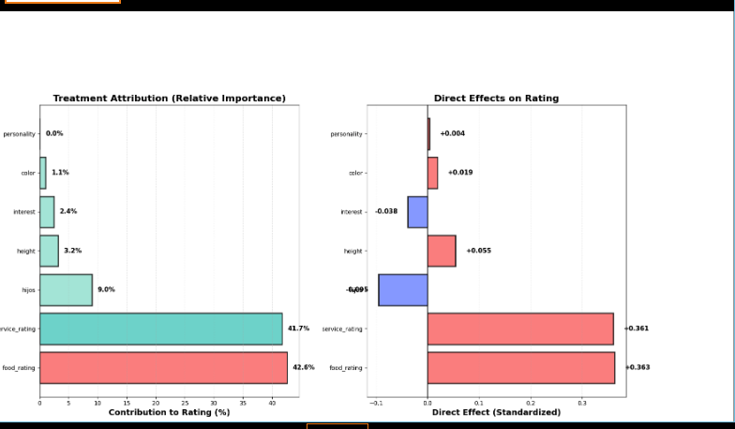
Phase 3: Treatment Attribution — Visualisations
Note: Shapley value decomposition, OLS relative importance, and DoWhy causal estimates across 7 treatment variables. Food rating (42.6%) and service rating (41.7%) dominate attribution (R² = 82.8%).
Notes:
Attribution Analysis by treatment (direct Effect and Relative Importantce

Slide 10
Phase 4: Mediation Analysis
100.2%
62.3%
0.51
Max
Mediated
Avg
Mediated
Food
Path β
activity — Fully Mediated
personality — Food-Dominant
100.2% of effect flows through mediators | Food: 52.9% | Service: 47.2% | Direct effect: +0.0015 (negligible) | Activity affects ratings almost entirely via food and service quality
72.6% total mediated | Food pathway: 75.2% | Service pathway: 24.8% | Direct effect: +0.026 | Personality type shapes food preferences, driving rating differences
age_group — Service-Dominant
User_cuisine — Mostly Direct
62.3% total mediated | Service pathway: 61.8% | Food pathway: 38.2% | Direct effect: −0.022 | Older/younger groups differ mainly in service expectations
Only 40.9% mediated | Indirect via food: 28.1% | Via service: 12.9% | Direct effect: −0.0014 | Cuisine preference has a largely direct impact on rating — not via food/service quality

Slide 11
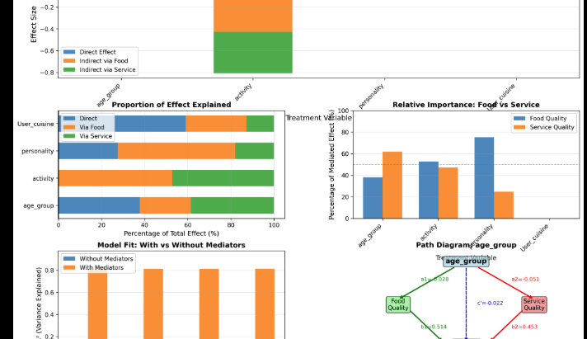
Phase 4: Mediation Analysis — Output Charts
Note: Effect decomposition via food and service quality mediators. Activity is fully mediated (100.2%); personality is food-dominant (75.2%); age group is service-dominant (61.8%); cuisine preference acts mostly directly (59.1%).
Notes:
Mediation analysis for

Slide 12
Phase 4: Hijos — HTE Analysis
Business Question: Why do families with children rate restaurants differently — and through which pathways?
+0.720
17
1.047
IPW ATE
Pathways
ATE Range
Causal Effect of Having Children
Pathway Decomposition (17 Paths)
IPW ATE: +0.720 (95% CI: [+0.627, +0.814]) | Adjusted ATE: +0.206 controlling for 8 confounders | Unadjusted: +0.723 (n=162 treated, 31,397 control) | Families rate restaurants significantly HIGHER
Via Food: +0.506 (19.8%) | Via Service: +0.504 (19.8%) | Via Personality: +0.484 (19.0%) | Via Height: +0.473 (18.6%) | Via Color: +0.451 (17.7%) | Via Interest: +0.130 (5.1%)
HTE by Business Hours
Business Recommendation
Morning: ATE = +1.476 ★ strongest | Night: ATE = +0.803 | Evening: ATE = +0.803 | Afternoon: ATE = +0.758 | Full Day: ATE = +0.430 ★ weakest | Range: 1.047 rating points across segments
Invest in family-friendly features for morning & night windows. Priority: food quality (19.8%), service quality (19.8%), environment. Morning-opening restaurants gain most.

Slide 13
Analytical Methodology
Graph-Informed Analysis
Causal Attribution
Path enumeration (treatment → outcome)
Mediator identification
Confounder detection (backdoor)
Dominance analysis
Relative importance weighting
Naive correlation baseline
Direct effects (OLS, standardized)
Unique R² (drop-one)
Shapley value decomposition
DoWhy backdoor estimation
Mediation Analysis
Heterogeneous Treatment Effects
Direct effect (c’): Treatment → Rating
Indirect via food (a₁×b₁)
Indirect via service (a₂×b₂)
Proportion mediated
R² comparison
17 causal pathways for hijos
IPW with stabilized weights
Bootstrap 95% confidence intervals
Subgroup-specific ATE
Propensity score overlap

Slide 14
Technical Stack
Causal Inference
Python & Data Science
DoWhy, DAGs, Backdoor Criterion, Propensity Scores, Mediation, IPW
pandas, numpy, scikit-learn, scipy, statsmodels, networkx
Visualization
Data Engineering
matplotlib, seaborn, networkx graph viz, path diagrams
Multi-source merging (9 tables), feature engineering, geodesic distance, KMeans clustering
Statistical Methods
SQL-Adjacent
OLS, Logistic Regression, Bootstrap CI, Shapley Values, F-tests, ATE estimation
Complex LEFT JOINs across relational tables (users, restaurants, ratings, cuisines, payments)

Slide 15

Thank You
Ella Ndala
ndallaella@gmail.com
GitHub: Causal_inference-Case_study

