Slide 1
Credit Card
Fraud Detection
Anomaly Detection · Class Imbalance Handling · Feature Discrimination · Temporal Validation
Isolation Forest · SMOTE + Random Forest · Walk-Forward CV · PSI Drift Monitoring
Portfolio Project · Python · scikit-learn · statsmodels

Slide 2
The Business Questions
Q1
Q2
Q3
fraud patterns, no labels
which signals indicate fraud
model viability over time
What each question asks, in full
Q1 — Pattern detection without labels: Can fraud patterns and the transactions behind them be found in unlabeled data, using anomaly behavior alone rather than supervision?
Q2 — Labels that signal fraud: Once labels exist, which of the 28 anonymized features actually separate fraud from non-fraud — determined objectively, not assumed?
Q3 — Viability and longevity: Would a fraud-detection model trained today still be trustworthy weeks or months later, as fraud patterns shift over time?

Slide 3
The Challenge: Extreme Class Imbalance
284,807
577 : 1
0.17%
credit card transactions
imbalance ratio
fraud rate (492 cases)
Why standard metrics fail on this dataset
Accuracy: A model that flags nothing achieves 99.83% accuracy — catching zero fraud. Accuracy is not a metric here.
ROC AUC: Reaches 0.955 even with our unsupervised model — inflated by the 284,315-strong majority class.
Right metrics: Precision, Recall, F1, PR AUC, and MCC — all calibrated to the minority (fraud) class.

Slide 4
End-to-End Approach
00–03
04
05
06
Data & Experiments
Fraud Detection
Feature Discrimination
Temporal Validation
Load creditcard.csv
Class imbalance analysis
Point / time-series /
cluster anomaly probes
Isolation Forest
Contamination fix
Threshold calibration
SMOTE + RF comparison
SCM suitability score
|AUROC − 0.5| × |sep|
Objective PCA ranking
Donor feature: V14
Walk-forward CV
4 folds / 8-hour blocks
IsoForest vs RF balanced
PSI multi-feature drift
All results produced by 7 Python scripts (00–06) operating on 284,807 real credit card transactions.

Slide 5
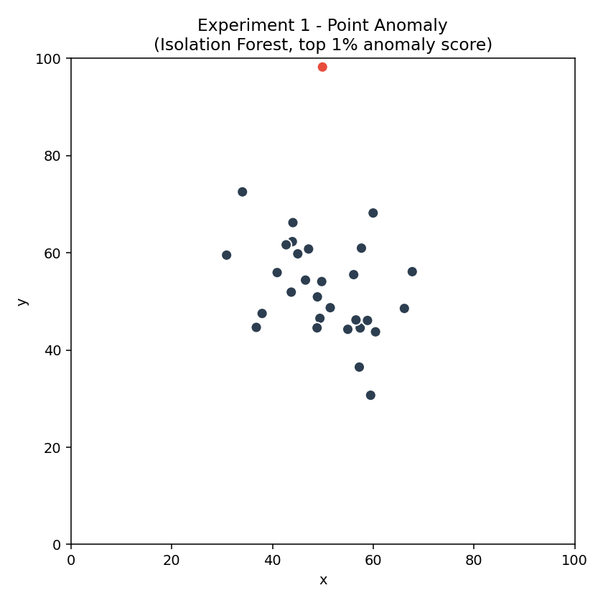
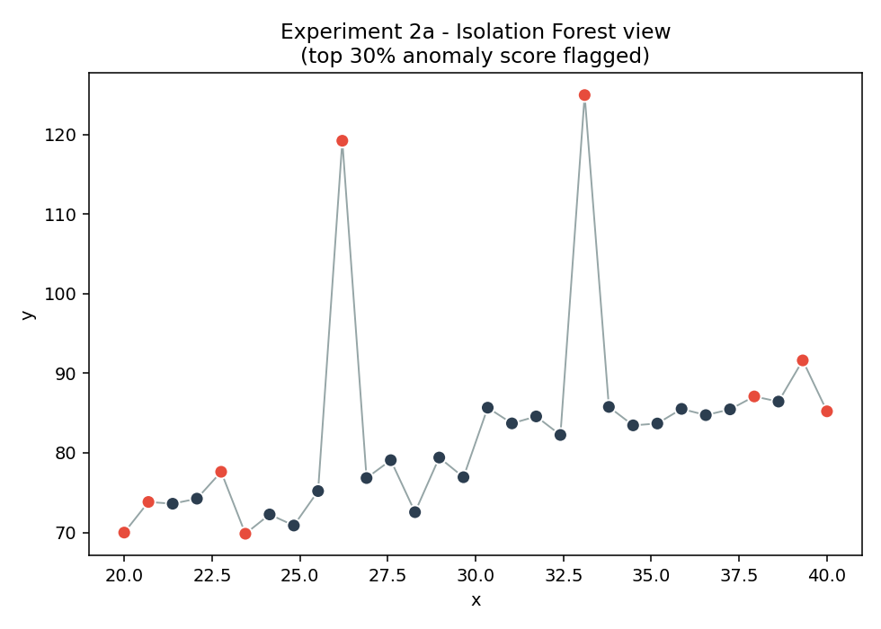
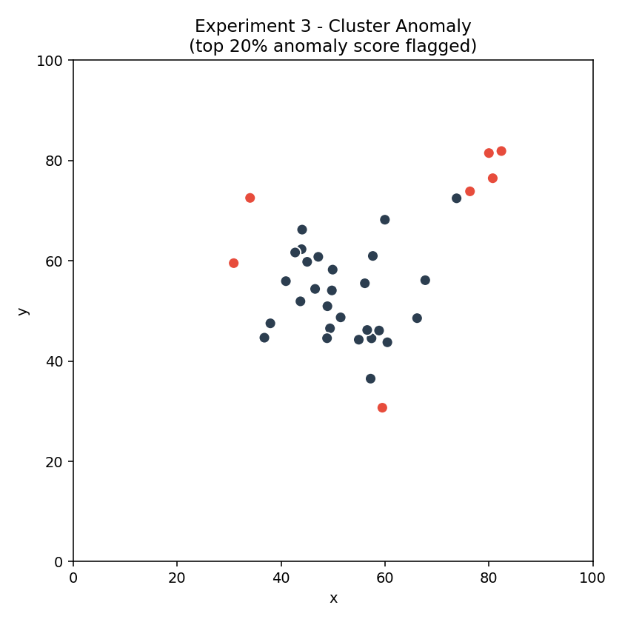
Anomaly Detection: Three Controlled Experiments
Experiment 1: Point Anomaly
Experiment 2: Time-Series Spikes
Experiment 3: Satellite Cluster
99th-pct threshold
70th-pct + STL/IQR
80th-pct threshold
Single outlier lifted 40 units above a Gaussian cluster. IsoForest correctly isolates the lone deviant.
Linear trend with 2 injected spikes. IsoForest (IQR=70%) + STL decomposition flags both reliably.
Base cluster at (50,50) + satellite cluster at (80,80). Model flags the remote group as collective anomalies.

Slide 6
Isolation Forest — and Why contamination='auto' Fails
How Isolation Forest Works
The contamination Fix
Randomly select a feature and a random split value
Repeat until each point is isolated in its own partition
Anomalies require fewer splits → shorter average path length
Unsupervised — no labels needed during training
Fast on large datasets with subsampling per tree
Problem: contamination='auto'
sklearn maps 'auto' → 0.10 (10%)
Expects ~28,480 anomalies
Actual fraud: 492 (0.17%)
Fix: contamination = fraud_rate
Set contamination = 0.001727
Calibrates model to true anomaly fraction
Model now expects exactly 492 anomalies
Model config: 100 trees · max_samples='auto' · n_jobs=-1
Code: IsolationForest(n_estimators=100, contamination=fraud_rate, random_state=1234)

Slide 7
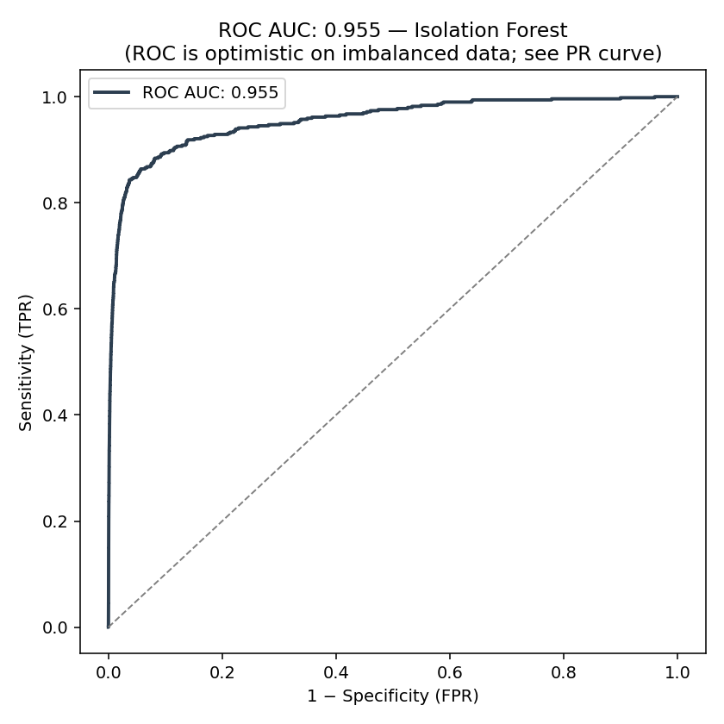
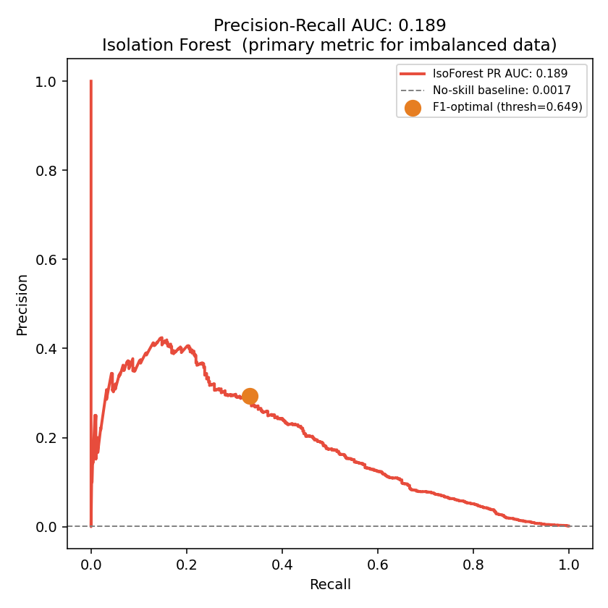
Model Performance: ROC Flatters, PR Tells the Truth
ROC Curve — AUC: 0.955
PR Curve — AUC: 0.189
ROC AUC is inflated because the 284K non-fraud majority dominates the FPR denominator. Even a weak model scores well.
PR AUC of 0.189 vs the no-skill baseline of 0.0017 shows the model is meaningful — but unsupervised has limits.

Slide 8
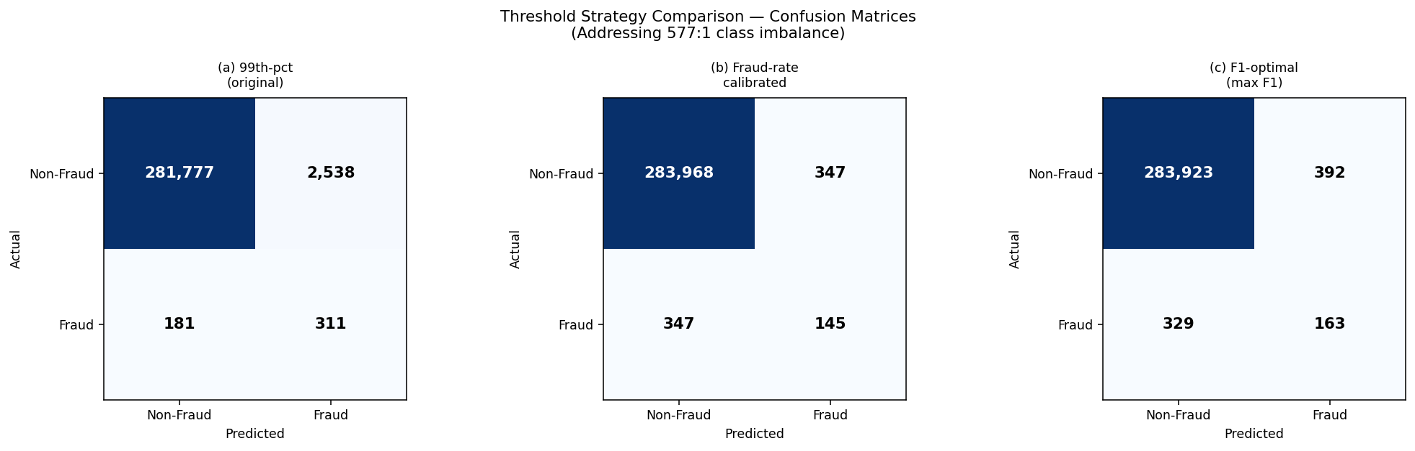
Choosing the Right Operating Point: Three Thresholds
Threshold | Flags | Prec. | Recall | F1
99th-pct | 2,849 | 0.109 | 0.632 | 0.186
Fraud-rate | 492 | 0.295 | 0.295 | 0.295
F1-optimal | 555 | 0.294 | 0.331 | 0.311
99th-pct: 9 in 10 flags are false alarms (Precision = 0.109)
Threshold selection is a business decision: high Recall = catch more fraud; high Precision = fewer wasted investigations.
F1-optimal: Best balance — 163 TP, 392 FP, F1 = 0.311

Slide 9
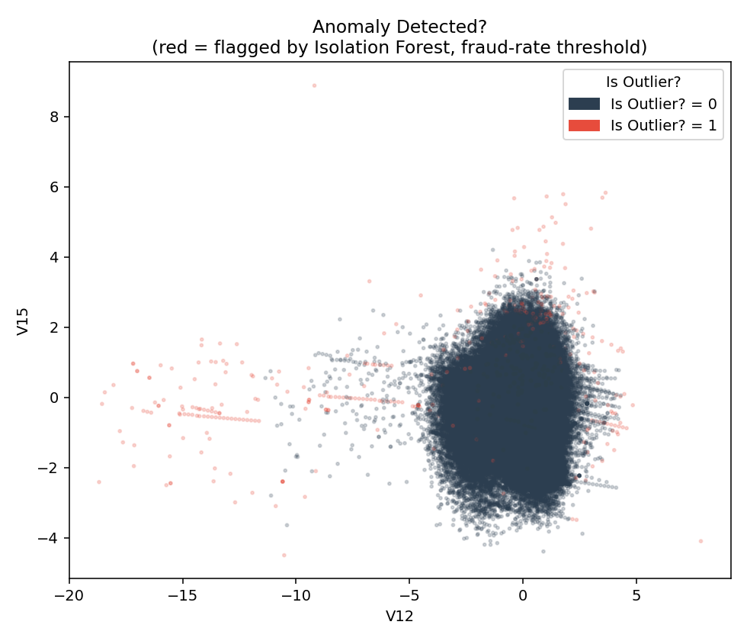
Supervised vs Unsupervised: The Value of Labels
Method Comparison (5-fold stratified CV)
Method | F1 | MCC | Recall | Type
Isolation Forest | 0.311 | 0.311 | 0.331 | Unsupervised
RF balanced | 0.905 | 0.903 | 0.854 | Supervised
SMOTE + RF* | — | — | — | Not run*
Key insight: class_weight='balanced' RF brings F1 from 0.311 (unsupervised) to 0.905 — a 3× gain when labels are available. *SMOTE variant requires imbalanced-learn (pip install imbalanced-learn). The cost is requiring labelled training data, which may not exist at deployment.
V12 vs V15: anomaly-flagged (red) vs clean (dark)

Slide 10
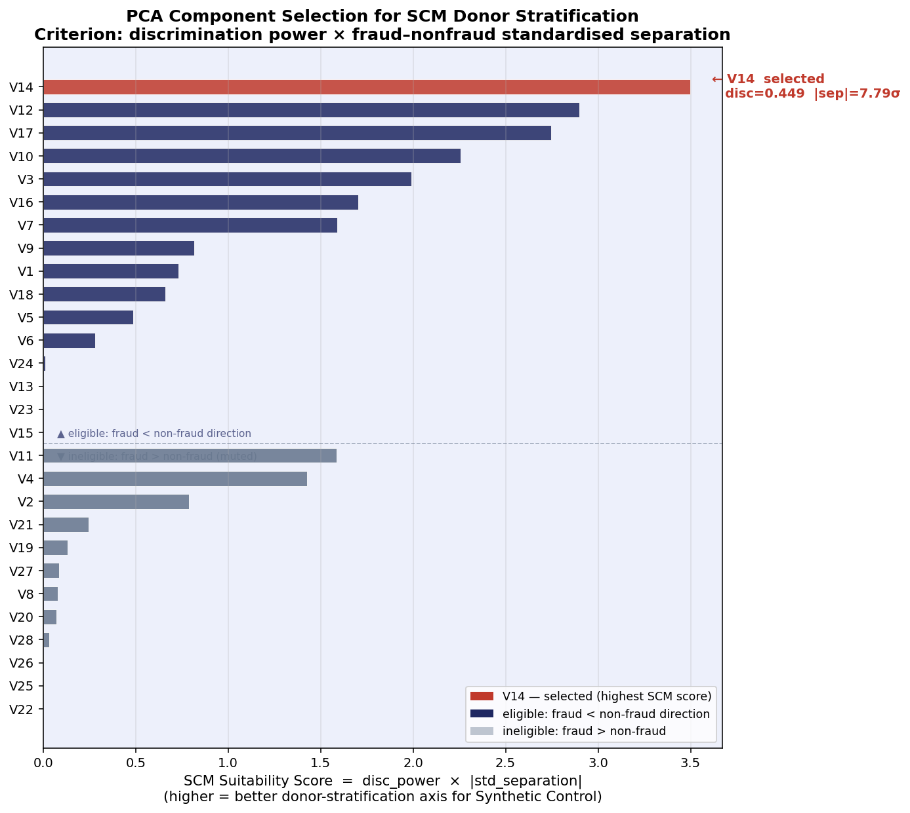
Script 05: Objective PCA Feature Ranking for Model Inputs
SCM Suitability Score
score = disc_power × |std_sep|
disc_power = |AUROC − 0.5|
std_sep = (fraud_mean − nf_mean) / nf_std
Eligible: fraud < non-fraud direction only
Winner: V14
scm_score = 3.497
disc_power = 0.449 |sep| = 7.79σ
V12 rank #2 (score = 2.897)
Why this matters
No feature is pre-selected. Script 05 determines the donor-stratification axis programmatically on every run.
All 28 PCA components ranked — V14 leads on combined score; V12 leads on raw disc_power alone.

Slide 11
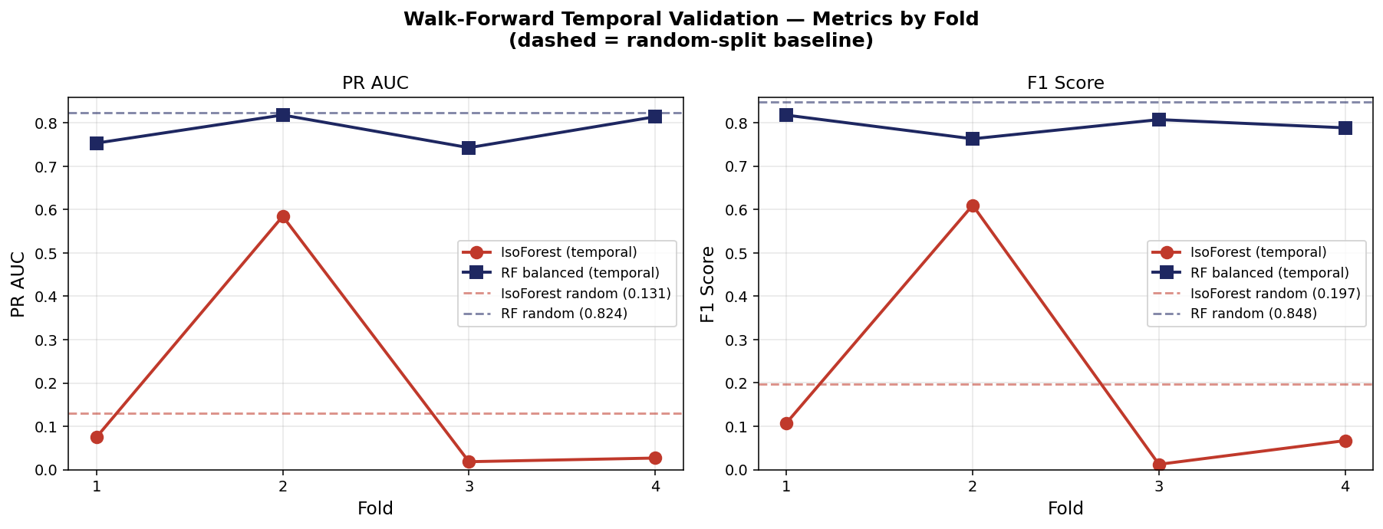
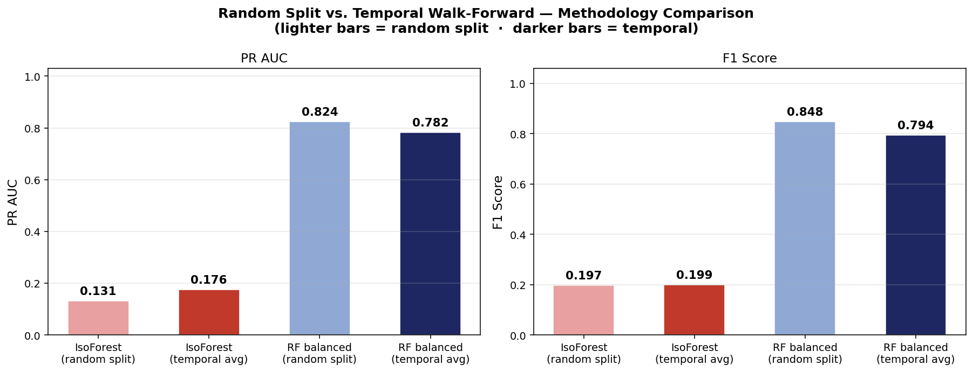
Script 06: Walk-Forward Temporal Validation
Fold Design
48 h split into 6 × 8-hour blocks
4 expanding-window folds
Train → Val → Test per fold
Threshold calibrated on val set
IsoForest — Unstable
PR AUC range: 0.018 – 0.585
High variance (std ≈ 0.23)
Fraud rate shift breaks calibration
RF Balanced — Robust
PR AUC range: 0.743 – 0.818
Low variance (std ≈ 0.03)
class_weight='balanced' stabilises across temporal shifts

Slide 12
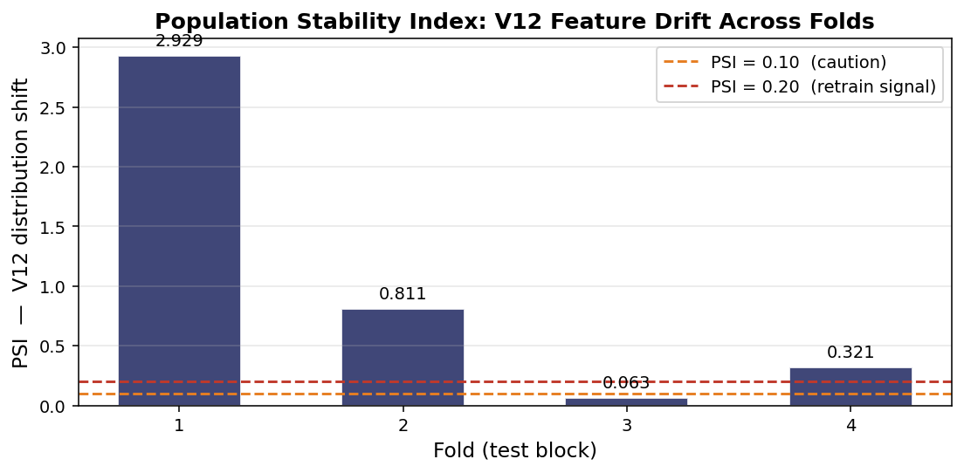
Population Stability Index: Multi-Feature Drift Monitoring
Why Multi-Feature PSI?
A single hardcoded feature misses drift in the rest of the feature space. PSI is computed across the top-5 most discriminating PCA components.
PSI Thresholds
< 0.10 — stable, no action
0.10 – 0.20 — monitor
> 0.20 — retrain signal
Feature source: script 05
feat_discrimination.json
Ranked by disc_power

Slide 13
Key Takeaways
01
Imbalance is the primary challenge
577:1 ratio invalidates accuracy and ROC AUC. Calibrating contamination to the true fraud rate (0.17%) and optimising the threshold by F1 are the critical fixes for unsupervised detection.
02
Unsupervised detects; supervised catches
Isolation Forest (F1=0.311, PR AUC=0.189) provides a no-label baseline. Adding labels with class-weighted RF pushes F1 to 0.905 — a 3× gain. Use IsoForest where labels are absent; supervised when available.
03
Feature selection must be objective, not assumed
All 28 PCA components are scored by SCM suitability (disc_power × |std_separation|). V14 wins with score 3.497 vs V12 at 2.897. Hardcoding a feature without this test risks building the model on a sub-optimal axis.
04
Temporal validation exposes model fragility
Walk-forward CV over 8-hour blocks reveals IsoForest PR AUC swings from 0.018 to 0.585 across folds — effectively unstable. RF balanced stays in the 0.74–0.82 band. PSI drift monitoring across the top-5 discriminating features provides an early retrain signal.

