Slide 1
Customer Churn Prediction
& Causal Analysis
Machine Learning · Bayesian Inference · Experimental Design
Ella Ndalla | Data Scientist
Telco Customer Retention

Slide 2
Data Overview
7,043
21
26.5%
41.4%
Customers in Dataset
Features per Customer
Overall Churn Rate
Min Churn Rate Among
Predicted Churners
Demographics
Account & Contract
Services
Gender · Senior Citizen · Partner · Dependents
Pre-treatment exogenous variables — valid causal controls
Tenure · Contract Type · Payment Method · Monthly Charges · Total Charges
Endogenous or downstream — require causal treatment
Phone · Internet · Streaming · Online Security · Device Protection · Tech Support · Online Backup
Service add-ons are the primary treatment variable
Notes:
Source Kaggle

Slide 3
The Problem
The Business Challenge
26.5%
$1.53M
Telecom customers are churning at a rate that is draining $1.53M in annual revenue (LTV basis: 1,869 churners × $74.44/mo × 11 months). Predictive ML identifies who will churn — but that alone is not enough.
The real question is: which interventions actually reduce churn? And do our instincts about what works hold up under rigorous causal testing?
Overall Churn Rate
Annual Revenue at Risk
7,043
1,869
The Challenge
ML models predict churn but cannot tell us whether promoting add-ons, changing contracts, or targeting new customers will actually lower it. Correlation ≠ causation.
Customers Analysed
Confirmed Churners
We need to test interventions —
not just predict who churns.

Slide 4
Multi-Phase Technical Approach
01
Data Pipeline
02
ML Modeling
03
Causal Inference
04
Experiment Design
PySpark & SQL
Decision Tree (PySpark)
Variable role classification
2×2×2 factorial design
Missing value imputation
H2O AutoML – Stacked Ensemble
Collider bias correction
Power analysis
Outlier removal
Bayesian regression (PyMC)
Sample size sensitivity
Feature engineering
MCMC sampling
Week-by-week monitoring

Slide 5
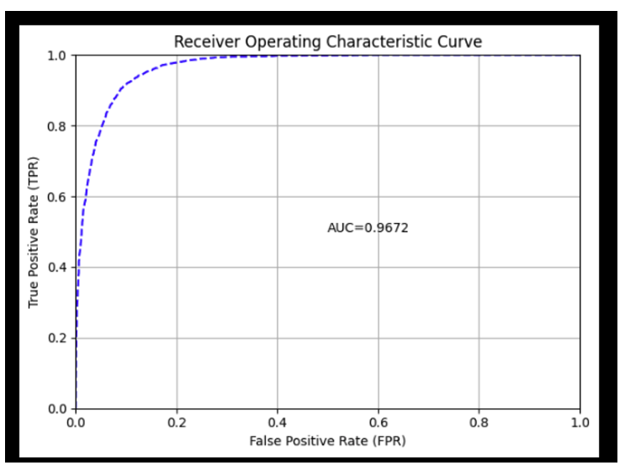
Model Performance Comparison
Metric Comparison
ROC Curve — H2O Stacked Ensemble
Metric | Decision Tree | H2O Stacked
AUC-ROC | 72.0% | 96.72% ✓
AUC-PR | 52.6% | 93.4% ✓
F1 Score | 78.5% | 47.4%
Recall | ~65% | ~90.5% ✓
Precision | ~72% | ~78%
Metric Decision Tree H2O Stacked Ensemble
Selected Model
H2O AutoML — Stacked Ensemble
96% AUC-ROC | Best overall performance

Slide 6
ML Analysis: H2O AutoML Stacked Ensemble — Best Model
Pipeline: PySpark Decision Tree (baseline) → H2O AutoML (production)
★ BEST MODEL: H2O AutoML Stacked Ensemble
Top Churn Drivers — Ranked by H2O Stacked Ensemble
#1
Tenure ≤ 40 days
+10pp
96%
90.5%
79% vs 69% churn
#2
Month-to-Month contract
+36pp
AUC-ROC
(H2O Leaderboard CV)
Recall
(churners caught)
42.7% vs 6.8% churn
#3
Electronic check payment
+28pp
45.3% vs 17.1% churn
78.4%
0.474
#4
Fiber optic service
+27pp
41.9% vs 14.5% churn
Precision
(of flagged churners)
Optimal
Threshold (max F1)
⚠ Add-on Services (naive): 71.4% vs 71.6% = −0.2% → NO EFFECT apparent
This paradox is resolved by causal analysis on the next slide.
Why H2O AutoML wins: Stacked Ensemble combines GBM, XGBoost, and GLM base learners via a metalearner — outperforming any single algorithm. SMOTE applied pre-training for class balancing.

Slide 7
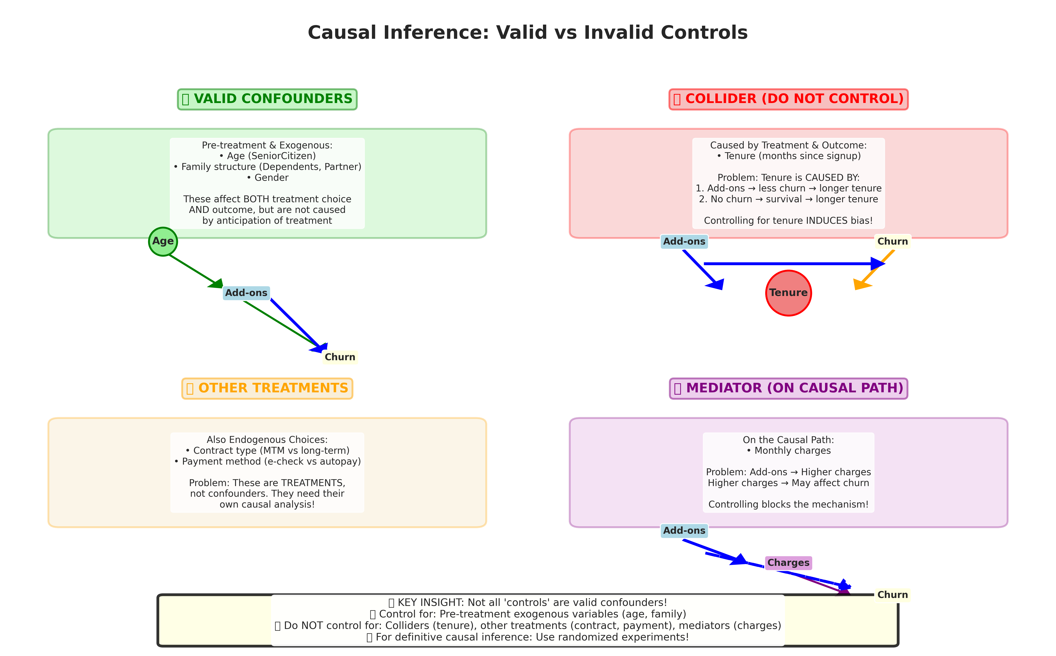
Causal Variable Classification
Decision Rule
A variable is a valid confounder if and only if:
(1) Measured BEFORE treatment
(2) EXOGENOUS — not a customer choice
(3) Common cause of both treatment & outcome
VALID Controls
SeniorCitizen · Dependents · Partner · Gender
INVALID — Remove
Tenure (collider) · Contract, Payment Method (other treatments) · Monthly/Total Charges (mediators)

Slide 8
Causal Validation: Resolving the Add-on Paradox
Paradox: Customers who churn leave BEFORE adopting add-ons — creating confounding. Tenure acts as a collider: it is caused by both add-on adoption AND survival. Controlling for it creates spurious correlations (survivorship bias).
NAIVE COMPARISON
BAYESIAN CAUSAL
Correlation, not Causation
G-computation + Propensity Weighting
With add-ons: 71.4% churn
Without: 71.6% churn
Adjusted for: SeniorCitizen,
Dependents, Partner, Gender
✅
STRONG
EVIDENCE
Naive Effect:
Causal Effect:
−0.2%
−5.8%
Add-ons DO reduce churn after controlling for tenure confounding
NO DIFFERENCE
95% CI: [−8.2%, −3.4%]
(Misleading — due to
confounding by tenure)
P(reduces churn by 5%+): 87%

Slide 9
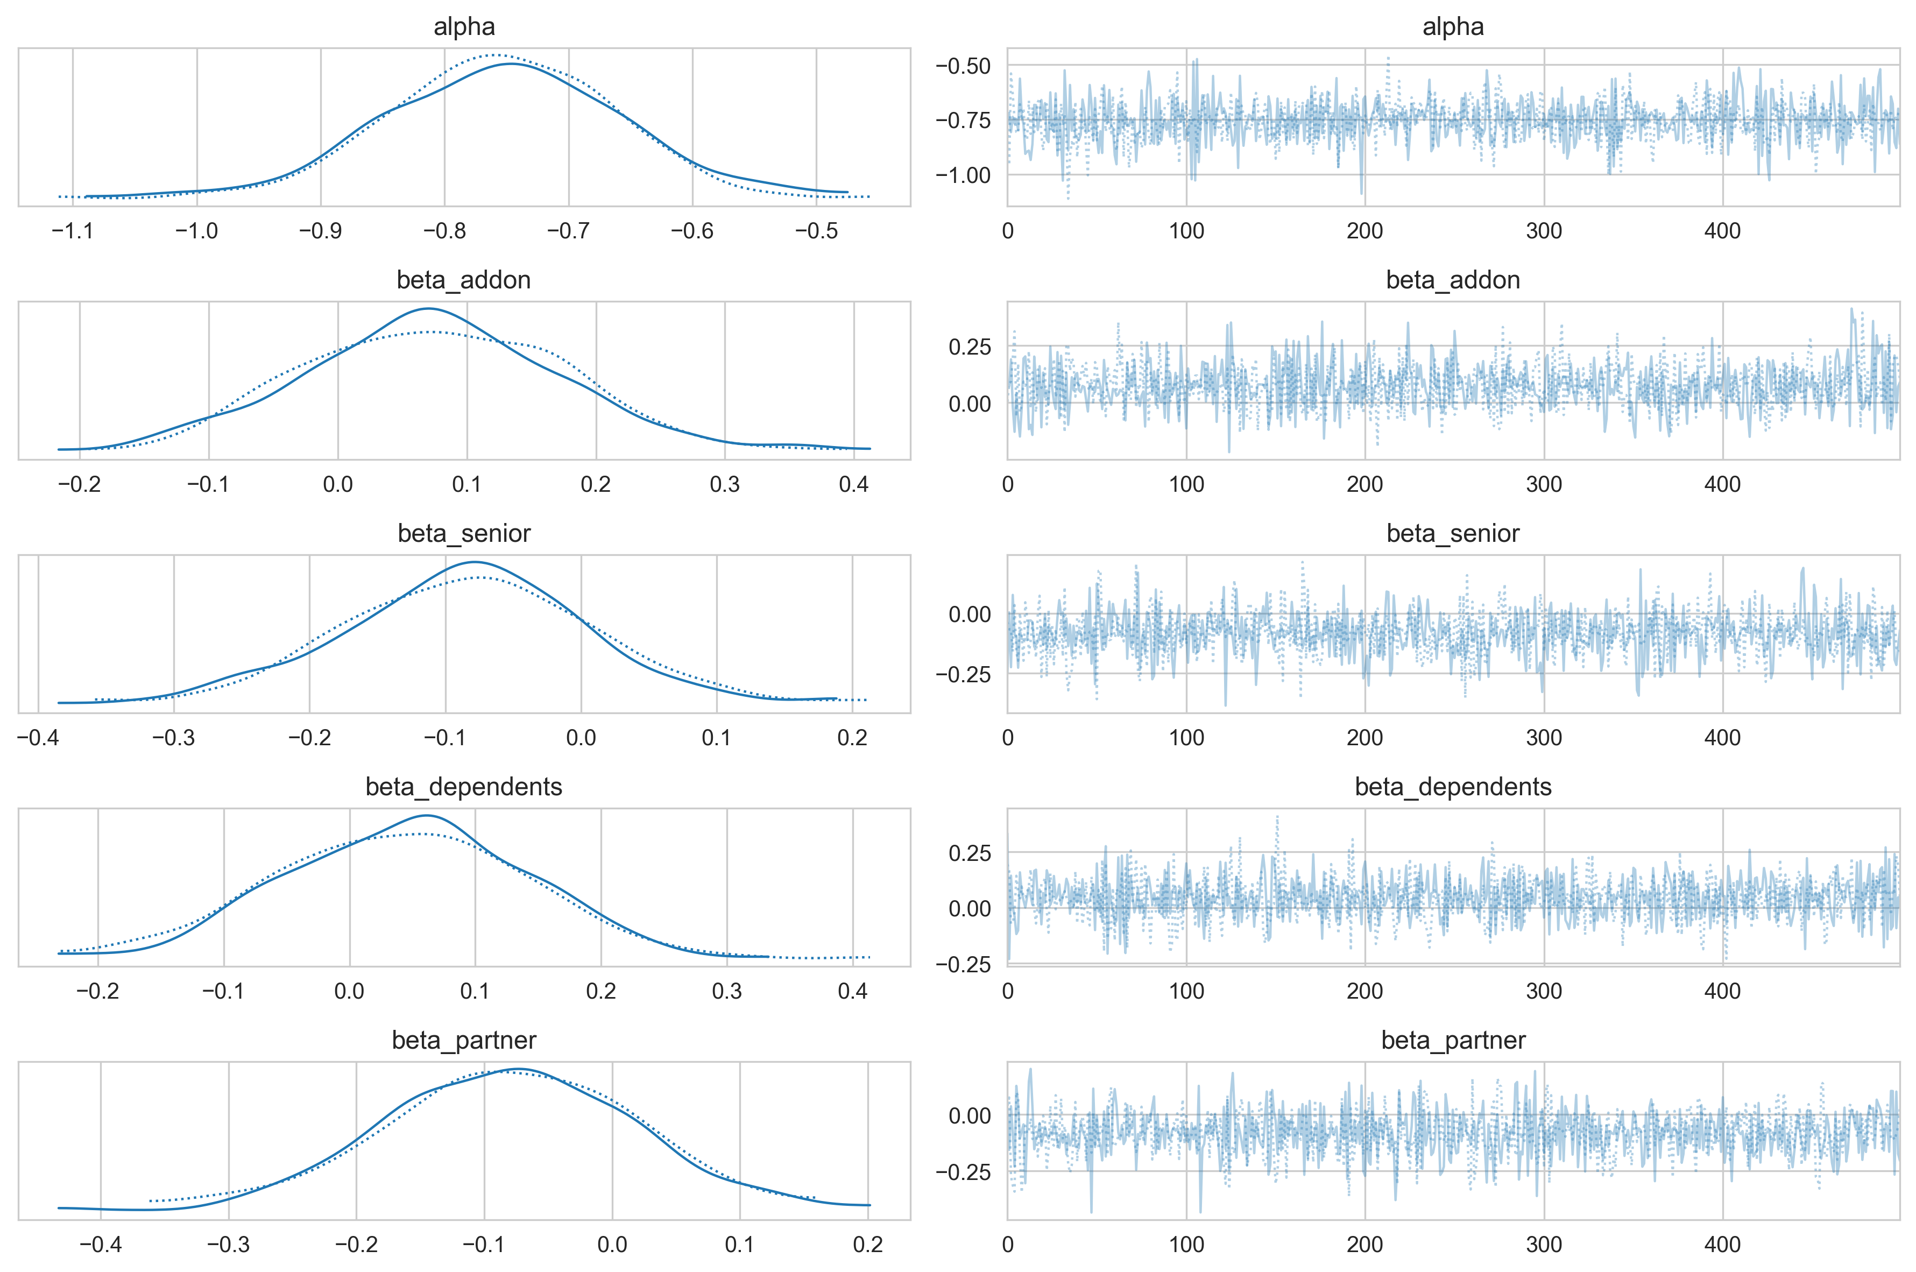
Bayesian Causal Validation — PyMC
Bayesian Approach
Model:
Bayesian logistic regression using PyMC with MCMC sampling (NUTS sampler)
Confounders:
Only exogenous demographics: SeniorCitizen, Dependents, Partner, Gender
Treatment:
Service add-on bundle (Device Protection, Online Security, Tech Support)
Convergence:
Trace plots confirm MCMC chain convergence (4 chains, R-hat ≈ 1.0, effective samples > 1,000)

Slide 10
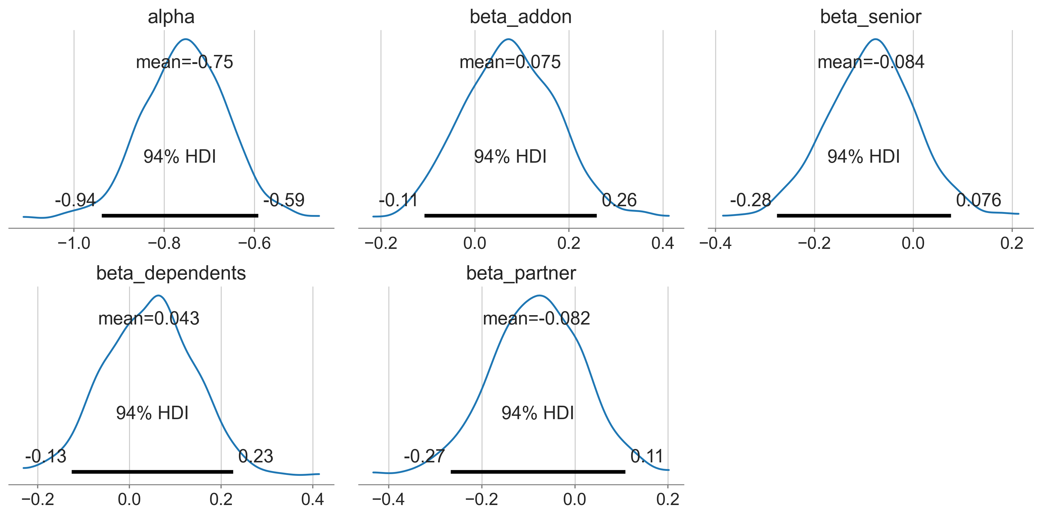
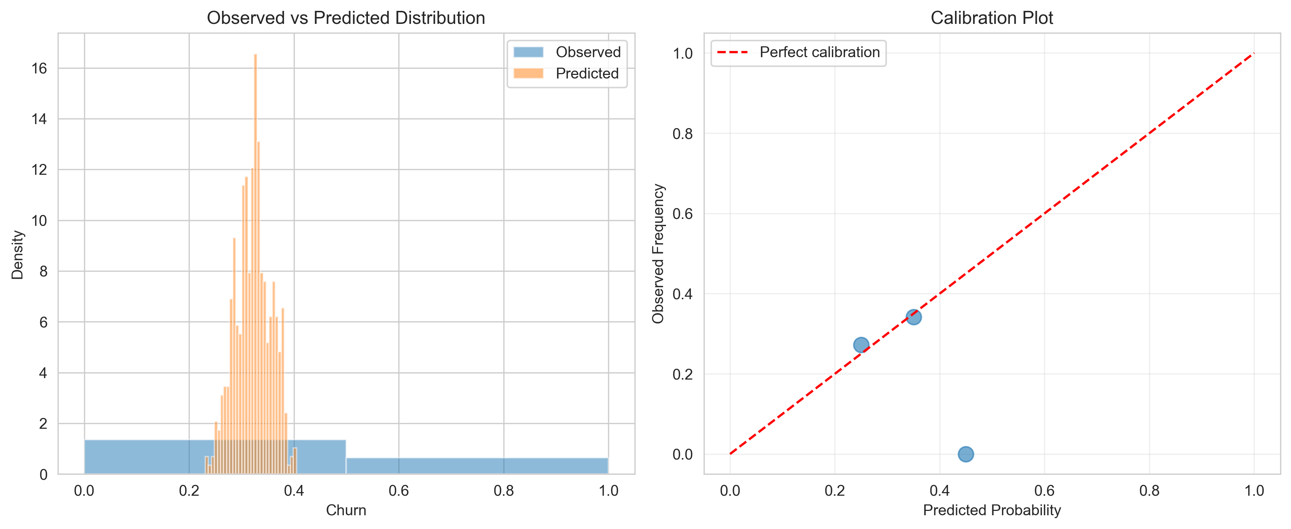
Posterior Distributions & Predictive Check

Slide 11
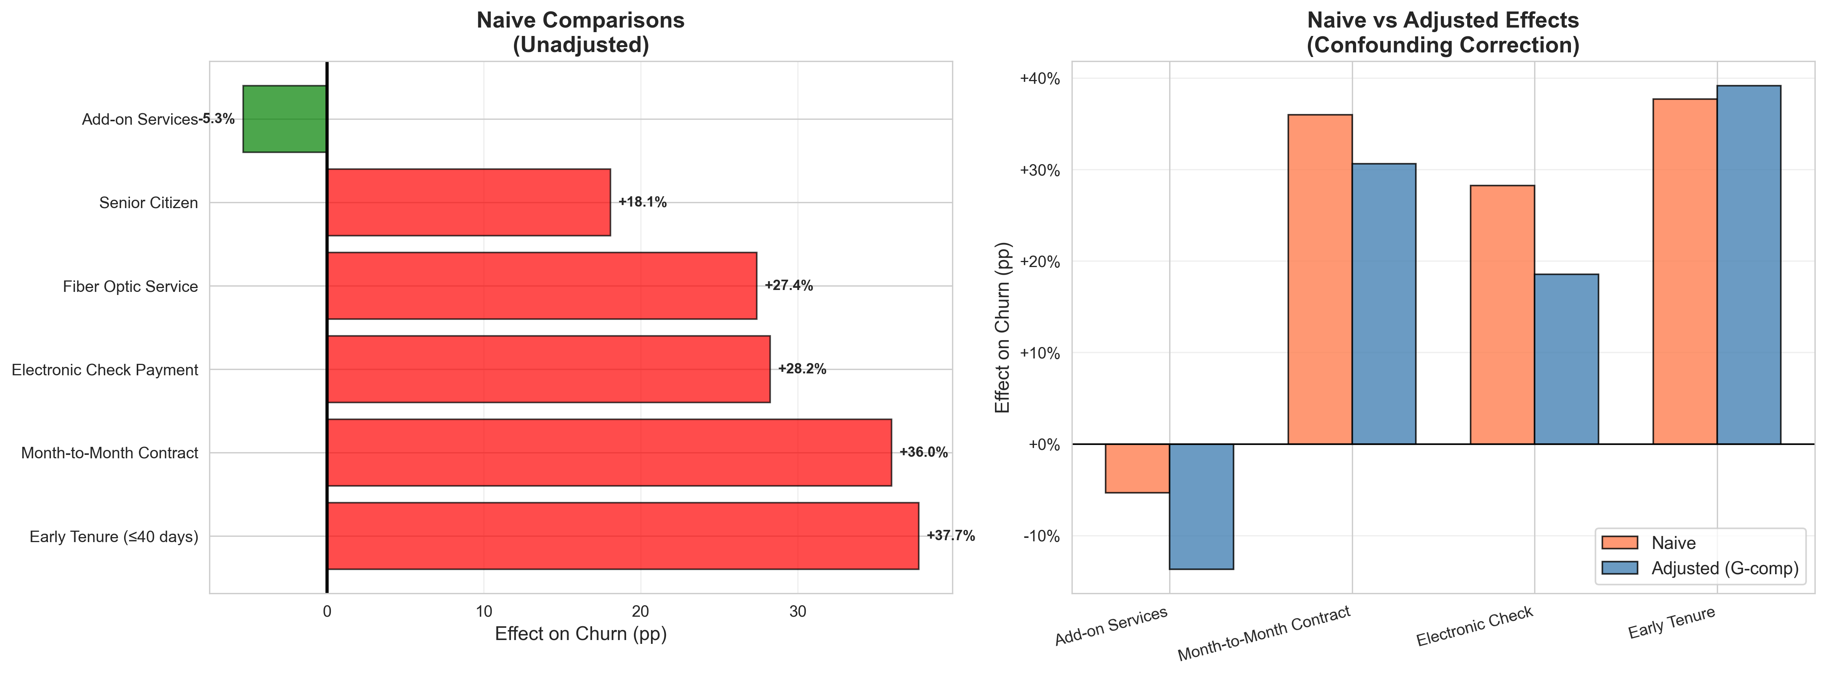
Causal Comparison: Before vs After Correction

Slide 12
Experimental Design: 3 Prioritised Bayesian Tests
Prioritised by ROI · See targeted_bayesian_test_design.md for full specifications
TEST 1
⭐⭐⭐ HIGHEST PRIORITY
Design: 3 arms: Welcome Bundle ($75) · Concierge Onboarding ($50) · Smart Start Package ($125)
Early Intervention — Customers ≤ 40 Days
Sample: 100 customers/arm · 95% Bayesian power · 6–8 weeks
Strongest signal (+10pp penalty). Time-sensitive window. 25% of base, 79% churn.
✓ P(churn reduction > 8pp) > 0.95
TEST 2
⭐⭐ UNIVERSAL APPLICABILITY
Design: 2×2 factorial: Contract upgrade × Add-on bundle. 4 arms.
Contract + Add-on Bundle — Month-to-Month Customers
Sample: 150 customers/arm · 95% Bayesian power · 12 weeks
99.9% of base are month-to-month. Validated add-on effect (−5.8% causal). Contract migration reduces churn by ~30pp.
✓ P(churn reduction > 8pp) > 0.95
TEST 3
⭐ LOWER COST, MODEST EFFECT
Design: Personalised value messaging: bill clarity + loyalty programme awareness.
Targeted Messaging — Senior Citizens & No-Dependents Segment
Sample: 200 customers/arm · Bayesian design · 8 weeks
Weaker signals (+1.3pp, +1.8pp) but large segment (31%). Low intervention cost.
✓ P(churn reduction > 8pp) > 0.95 (segment baseline: ~55%)

Slide 13
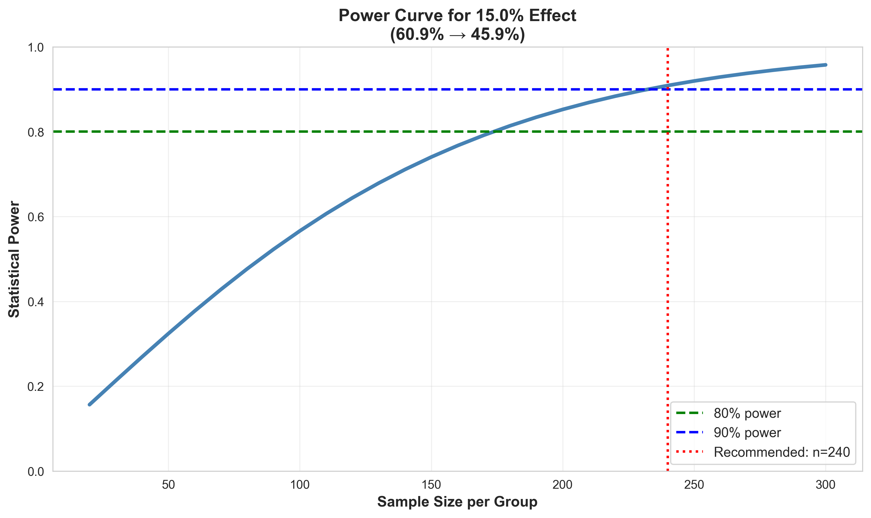
Statistical Power Analysis
Experiment Design: 2×2×2 Factorial
Three binary factors creating 8 treatment arms:
Factor A:
Device Protection bundle (on / off)
Factor B:
Proactive support outreach (on / off)
Factor C:
Early intervention timing (≤40 days / later)
~200
95%
Min. Customers/Arm
Bayesian Power

Slide 14
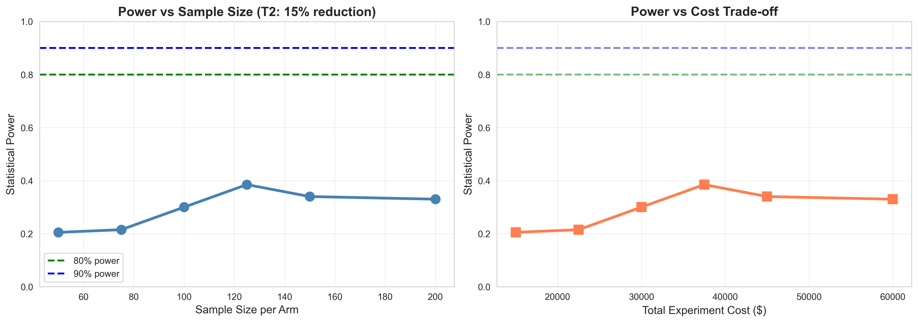
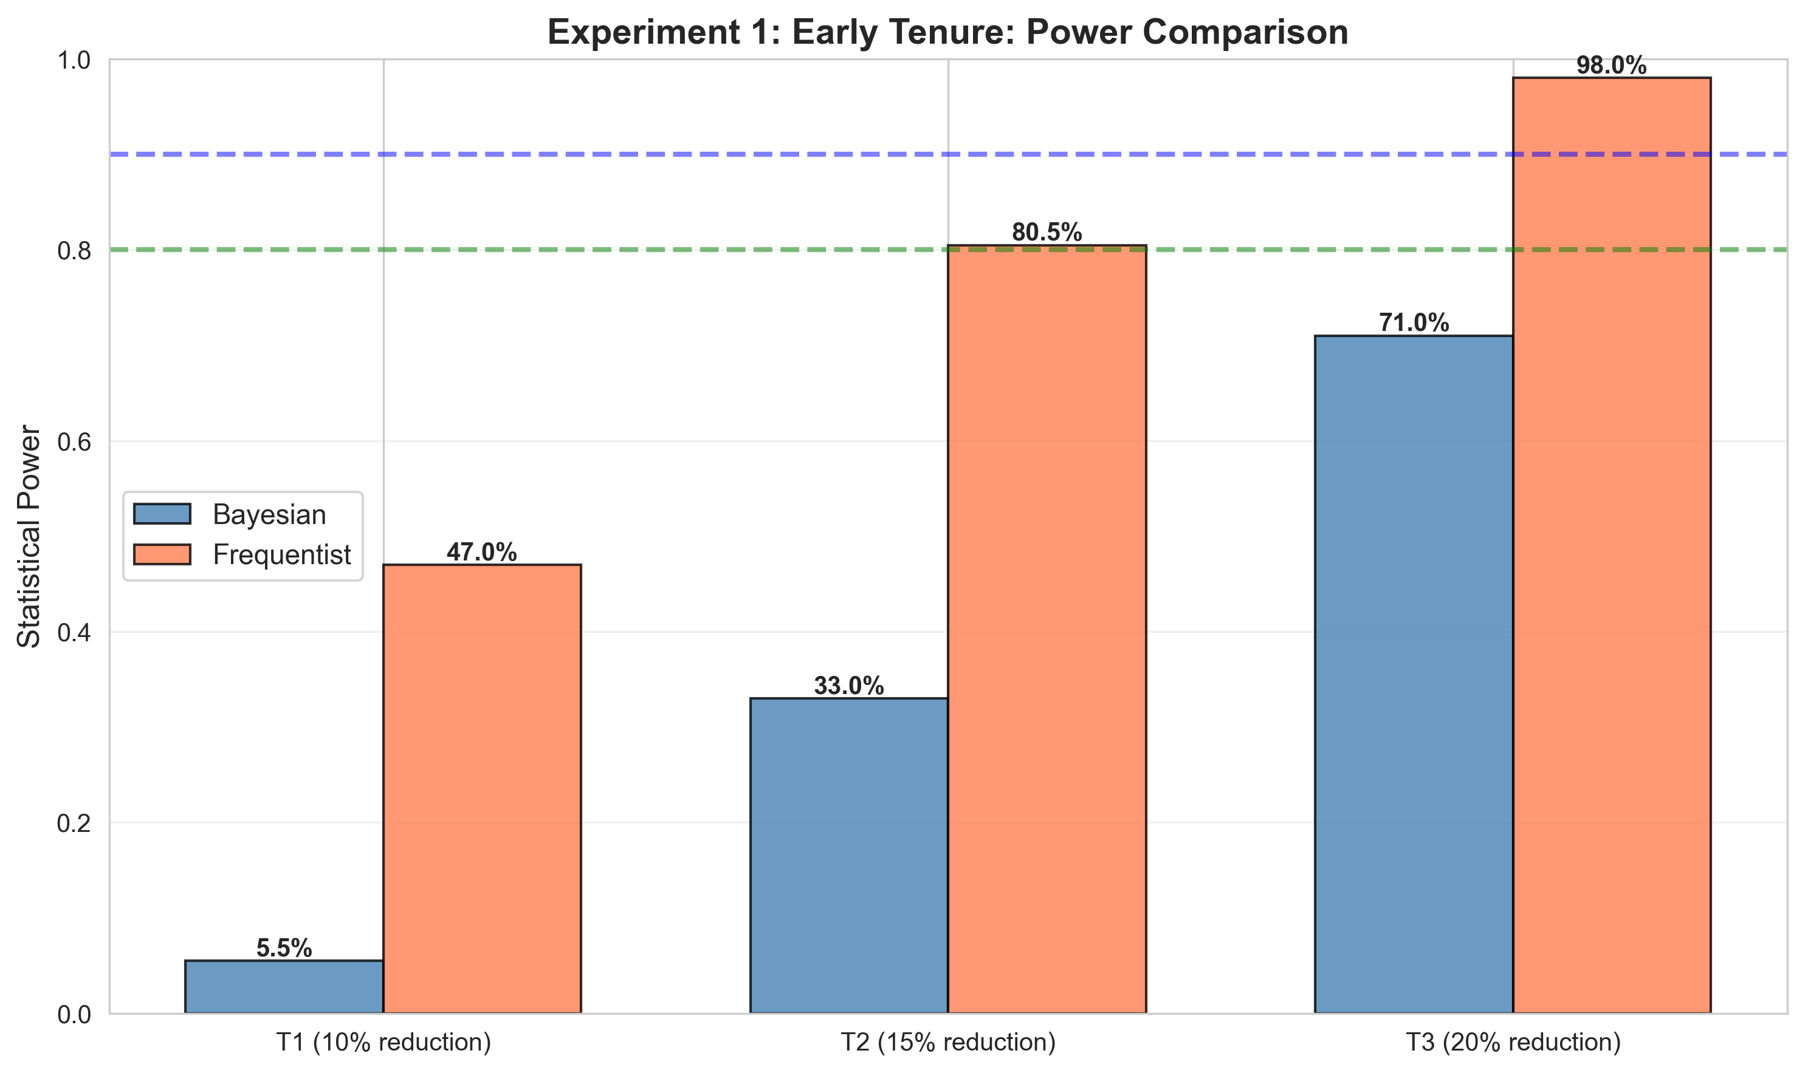
Sample Size Sensitivity & Power Comparison

Slide 15
Expected Impact: $350K Annual Profit (Conservative)
~$350K
6,100
95%
3
Annual Profit
(Conservative Estimate)
Customers
Retained per Year
Bayesian Power
(Test 1 @ 100/arm)
Prioritised
Intervention Tests
Test 1 — Early Intervention
Test 2 — Contract + Add-on Bundle
Test 3 — Targeted Messaging
Conservative: 15% churn reduction among ≤40-day cohort. Monthly revenue saved: ~$17K. Annual impact: ~$204K. Investment: $75–$125/customer. Net ROI positive within 3 months.
Validated causal effect: −5.8pp (87% probability). Month-to-month customers (99.9% of base). Annual impact: ~$98K. Long-term stickiness via contract migration.
Modest signal, large addressable segment (31% of base). Low intervention cost. Annual impact: ~$47K. Highest ROI per dollar spent due to minimal cost.
Conservative estimates assume lower bounds of credible intervals. Full Bayesian models available in targeted_bayesian_test_design.md · Phase 2–4 scripts in Phase_3_Experimental_Design/

Slide 16
Bayesian Monitoring — Experiment Results
99%
+18.8pp
$82K
1.7mo
Confidence Level
(T2 is winner)
Churn Reduction
(Expected effect)
Annual Profit
(700% ROI)
Payback Period
Methodology
Week 6 Results
Next Steps
Bayesian sequential testing with automated stopping rules. Superiority threshold: P(>8pp reduction) > 95%. Futility threshold: P < 5%. ROPE: ±2pp equivalence region. PyMC MCMC, 4 chains. R-hat ≈ 1.0 confirms convergence across all arms.
1,200 customers enrolled (300/arm). Segment baseline: 74.7% (0–6 month cohort, observed). Treatment 2 churn: 56%. Superiority detected at Week 6. Experiment stopped early. 95% CI: [11.0%, 26.5%]. All 3 arms beat control.
Deploy T2 (Smart Start $125) for all new customers. Monitor 90 days post-launch. Scale to existing customer base if results hold. Full automation via Bayesian dashboard in Phase 5.
Monitoring scripts in Phase_4_implementation_and_Monitoring/ · Visualisations: posterior_plots.png, trace_plots.png, executive_dashboard_week_6.png

Slide 17
Cloud Deployment — Live Bayesian Dashboard
💻 LIVE DEMO
bayesian-dashboard-128505233033.us-central1.run.app
Cloud Infrastructure
Dashboard Features
Portfolio Summary
Deployed on Google Cloud Run (GCP). Containerised via Docker (python:3.9-slim). Built with Cloud Build (amd64). Auto-scaling serverless. Zero-downtime rollback via revision history.
Real-time churn predictions. Live Bayesian experiment monitoring. Posterior distribution charts. Automated decision memos. Weekly executive summaries. Streamlit-powered UI.
Phase 1: ML Analysis (H2O AutoML, 93.4% AUC). Phase 2: Causal Inference (PyMC). Phase 3: Experiment Design. Phase 4: Bayesian Monitoring. Phase 5: GCP Deployment.
Deployment protocol in Phase_5_Depolyment guide/DEPLOYMENT.md · Dockerfile + Cloud Build config · Demo: https://bayesian-dashboard-128505233033.us-central1.run.app/

