Slide 1
Email Lead Scoring
Project Summary
From business problem definition to deployed application
Python
PyCaret
XGBoost
FastAPI
Streamlit
MLflow
Google Cloud
2026

Slide 2
Project Overview
End-to-end machine learning solution for email marketing lead prioritization
THE PROBLEM
THE SOLUTION
Mass email blasts cause subscriber churn via unsubscribes
ML model scores each lead on purchase probability
Each unsubscribed lead is a potential lost customer
Threshold optimization maximizes expected business value
Unsub rate × conversion rate × customer value = significant revenue risk
Segment leads into Hot-Lead / Cold-Lead categories
No mechanism to distinguish likely buyers from unlikely ones
REST API + Streamlit UI for marketing team self-service

Slide 3
Project Architecture
Five-layer pipeline: Data → Analysis → Modeling → API → UI
1. Cost Analysis
2. Data Layer
3. EDA
4. Modeling
5. Lead Strategy
cost_calculations.py
database.py · SQLite CRM
exploratory.py
modeling.py · PyCaret / MLflow
lead_strategy.py
FastAPI Backend
Streamlit Frontend
main.py · REST endpoints · Google Cloud Run
app.py · helpers.py · Interactive lead scoring UI

Slide 4
01
STEP
Business Problem
& Cost Calculation

Slide 5
Step 1: Cost Calculation
cost_calculations.py — Quantifying the financial risk of mass email blasting
Cost Formula:
Monthly Cost = List Size × Unsub Rate × Emails/Month × Conversion Rate × Avg Customer Value
cost_calc_monthly_cost_table()
cost_total_unsub_cost()
cost_simulate_unsub_cost() + cost_plot_simulated_unsub_costs()
Projects email list size, lost customers, and costs over N periods — with and without list growth. Key params: list size (100k), growth rate (3.5%), unsub rate (0.5%), conversion rate (5%), avg customer value ($2,000).
Summarises total 12-month unsubscription cost with/without list growth from the monthly table. Returns a single-row DataFrame comparing both scenarios.
Runs a Cartesian parameter grid over growth rates and conversion rates to model cost uncertainty. Visualised as an interactive Plotly heatmap (Lead Cost Simulation).

Slide 6
02
STEP
Data Layer &
Database

Slide 7
Step 2: Data Layer
database.py — SQLite CRM with multi-table join and feature engineering
Subscribers
Tags
Transactions
• mailchimp_id
• mailchimp_id
• user_email
• user_email
• tag
• ...
• member_rating
• optin_time
• country_code
Data Processing Pipeline → db_read_and_process_els_data()
Join Subscribers ⟕ Tags (tag_count aggregation)
Pivot tags to wide binary columns (tag_*)
Extract email_provider from user_email
Filter low-sale countries → label as 'Other'
Calculate optin_days (recency feature)
Add made_purchase label from Transactions join
Compute tag_count_by_optin_day (engagement rate)

Slide 8
03
STEP
Exploratory
Data Analysis

Slide 9
Step 3: Exploratory Data Analysis
exploratory.py — Understanding purchase drivers across categorical and numeric features
explore_sales_by_category()
explore_sales_by_numeric()
Input:
Subscribers DataFrame + category column
Input:
Subscribers DataFrame + numeric column(s)
Groups by:
country_code, member_rating, etc.
Groups by:
made_purchase (0 / 1 binary target)
Outputs:
sales count, prop_in_group, prop_overall, prop_cumsum
Outputs:
Quantile statistics (10th, 50th, 90th percentile)
Used for:
Identifying top-converting countries & ratings
Key feature:
tag_count — more tags = higher purchase signal
Business use:
Filter countries with ≥ 6 sales to reduce noise
Business use:
Segment high-engagement from passive subscribers

Slide 10
04
STEP
ML Modeling
Pipeline

Slide 11
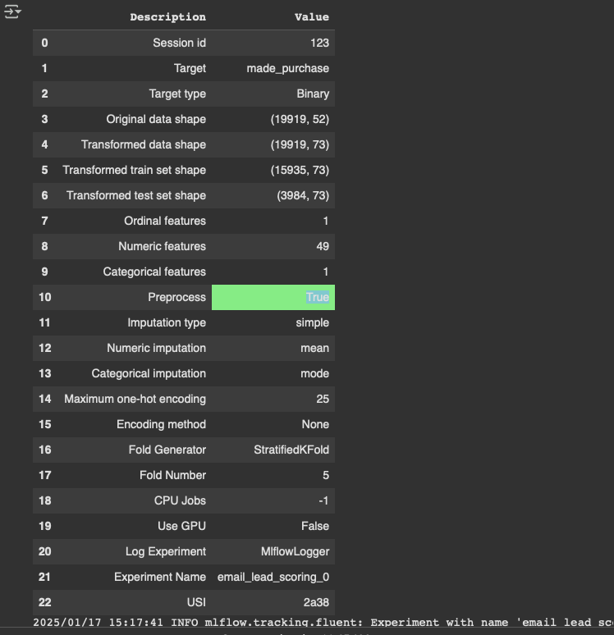
Model Training: PyCaret Setup
Experiment configuration — 19,919 subscribers, 52 → 73 features after preprocessing
Experiment Configuration
Target variable:
made_purchase (binary)
Dataset shape:
19,919 rows × 52 features
After preprocessing:
19,919 rows × 73 features
Train / Test split:
15,935 / 3,984 rows
Numeric features:
49 | Categorical: 1 | Ordinal: 1
Cross-validation:
StratifiedKFold, 5 folds
Imputation:
Numeric: mean | Categorical: mode
Encoding:
Ordinal (member_rating) + OneHot (country_code)
Experiment tracker:
MLflowLogger → email_lead_scoring_0
Random state:
123

Slide 12
Step 4: Machine Learning Modeling
modeling.py — PyCaret AutoML, XGBoost pipelines, Blended Ensemble, and MLflow tracking
XGBoost Pipeline
CatBoost (Tuned)
pipeline_xgb.pkl
catboost_model_tuned.pkl
Production sklearn pipeline with preprocessing + XGBoost
Categorical feature-native boosting model
XGBoost (Tuned)
xgb_model_tuned.pkl
Blended Ensemble
Gradient boosted trees, hyperparameter tuned via PyCaret
blended_models_final.pkl
Weighted blend of top PyCaret models

Slide 13
Step 4 (cont.): MLflow Experiment Tracking
Automated logging of model runs, AUC metrics, and artifact versioning
Train Models
Log Runs
Rank by AUC
Load Best Model
Score Leads
PyCaret AutoML
mlflow.search_runs()
mlflow_get_best_run()
mlflow.pyfunc.load_model()
mlflow_score_leads()
Key Functions in modeling.py
model_score_leads(data, model_path)
Loads PyCaret model and generates lead_score = 1 − prediction_score. Validates required columns before scoring.
mlflow_get_best_run(experiment_name, n, metric)
Queries MLflow experiment runs, filters by tag source (finalize_model), ranks by AUC descending.
mlflow_score_leads(data, run_id)
Loads a model from an MLflow run ID using pyfunc. Handles both standard predict and model_impl fallback. Returns scores merged with original data.

Slide 14
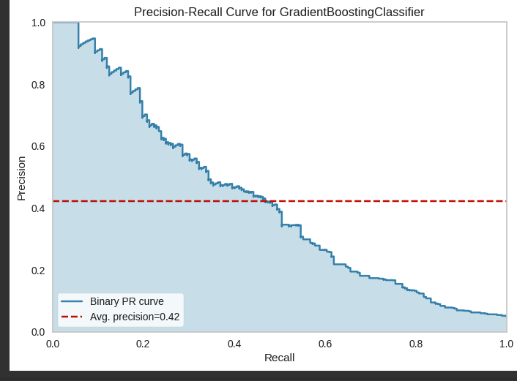
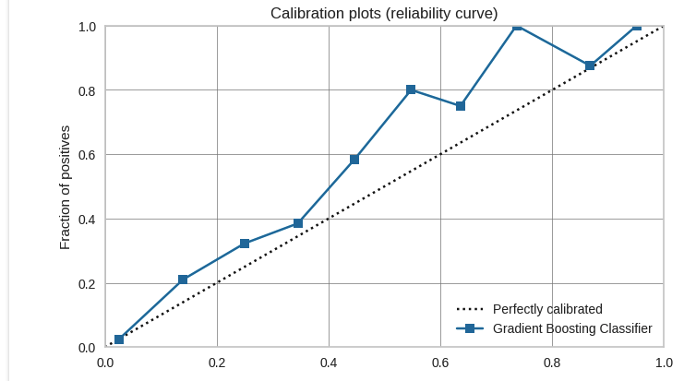
Best Model: Precision-Recall Curve & Calibration
Avg. precision = 0.42 | Calibration plot shows prediction probability reliability
Precision-Recall Curve (avg. precision = 0.42)
Calibration Plot (Gradient Boosting Classifier)
The model trades recall for precision — ideal for lead scoring where targeting false positives is costly. Calibration shows probability estimates are roughly reliable in the 0.2–0.5 range.

Slide 15
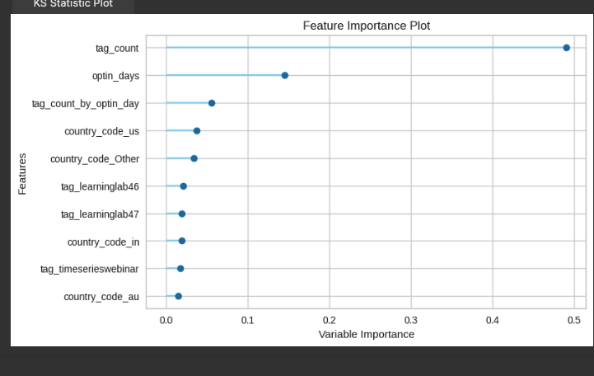
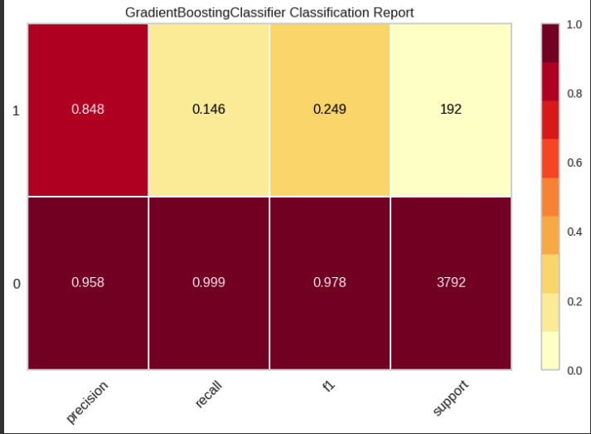
Best Model: Feature Importance & Classification Report
tag_count dominates at ~50% importance | Class 1 precision 84.8%, recall 14.6%
Feature Importance (Top 10)
Classification Report (Heatmap)
Class 0: Precision 0.958 | Recall 0.999 | F1 0.978 (3,792 samples) Class 1: Precision 0.848 | Recall 0.146 | F1 0.249 (192 samples)

Slide 16
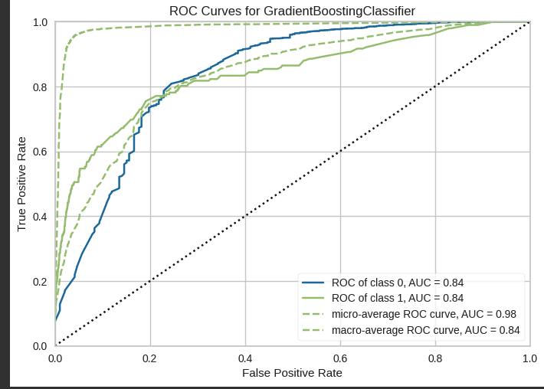
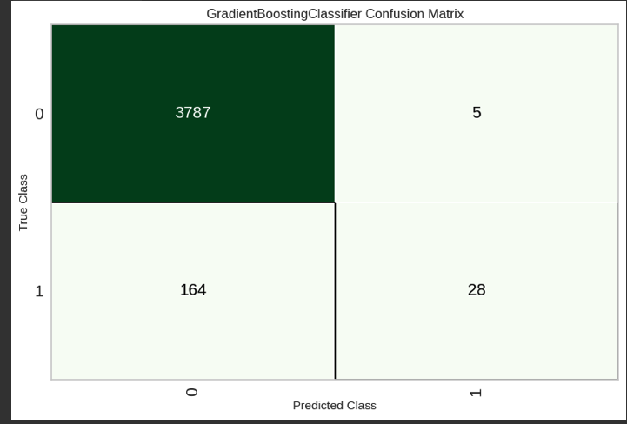
Best Model: GradientBoostingClassifier — Performance
After refitting with full training dataset | macro-average AUC = 0.84
ROC Curve (AUC = 0.84)
Confusion Matrix
TN 3,787 | FP 5 | FN 164 | TP 28 High precision on positives (84.8%) — very few false alarms

Slide 17
Project Summary
Email Lead Scoring — end-to-end ML system
01
Business-First Design
02
Clean Data Architecture
Project starts with cost simulation to quantify the financial impact of lead churn before any modelling begins.
SQLite CRM with Subscribers, Tags & Transactions tables; feature engineering produces engagement-rate features.
03
Multi-Model Comparison
04
Value-Optimised Thresholding
XGBoost, CatBoost, AdaBoost, blended ensemble (CalibratedClassifierCV) — all tracked via MLflow with AUC ranking.
100-point threshold sweep with expected-value calculus and a monthly-sales safeguard ensures real ROI.
05
Production-Ready Deployment
FastAPI backend on Google Cloud Run + Streamlit frontend for marketing team self-service — fully deployable.

Slide 18
05
STEP
Lead Strategy
& Optimization

Slide 19
Step 5: Lead Strategy & Expected Value
lead_strategy.py — Threshold optimization to maximize business return
Lead Segmentation Logic
Expected Value Components
HOT LEAD
+ Savings: Cold Not Targeted
gain ≤ threshold
→ Target with sales emails
Prevents unsub-driven customer loss from unlikely buyers
+ Sales: Hot Leads Retained
COLD LEAD
Revenue from email sales to high-probability purchasers
gain > threshold
→ Withhold sales emails (nurture instead)
− Cost: Missed Cold Purchases
Ranking Approach:
Revenue foregone by not emailing cold leads who buy
Sort by lead_score descending
= Expected Value (EV)
Assign cumulative gain (% of total buyers captured)
Optimise EV across 100 threshold values (0 → 1)
Apply threshold cut-off to generate categories

Slide 20
Step 5 (cont.): Threshold Optimization
Finding the optimal Hot/Cold cut-off that maximises expected value with a sales safeguard
Optimization Logic
Primary:
Maximise expected_value across 100 thresholds
Safeguard:
Monthly sales must stay ≥ 90% of max (configurable)
Override:
If optimum fails safeguard → pick smallest safe threshold
Output:
lead_strategy_df, expected_value, thresh_plot
Key Output Metrics
expected_value
expected_savings
monthly_sales
expected_customers_saved

Slide 21
06
STEP
Model Training Results

Slide 22
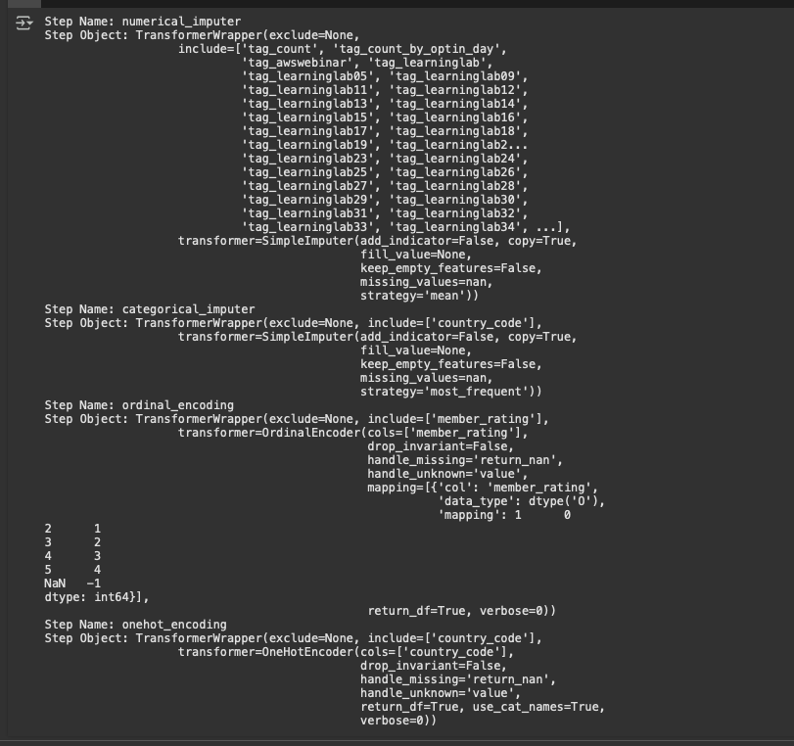
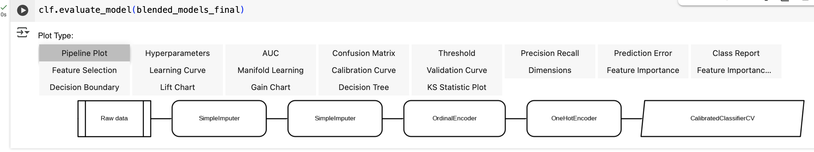
XGBoost vs Blended — Pipeline Comparison
XGBoost sklearn pipeline steps vs CalibratedClassifierCV blended ensemble pipeline
Pipeline (sklearn steps: impute → encode → XGBClassifier)
Blended Model Pipeline (→ CalibratedClassifierCV)
Both pipelines share the same preprocessing (imputation, ordinal + onehot encoding). The blended model wraps a Voting Ensemble in CalibratedClassifierCV for improved probability calibration.

Slide 23
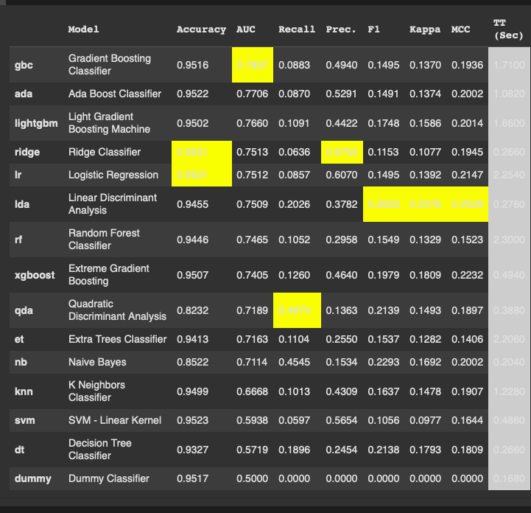
Model Training: All-Models Comparison (PyCaret)
14 classifiers benchmarked via 5-fold StratifiedKFold — ranked by AUC | Best: Gradient Boosting (AUC 0.7837)

Slide 24
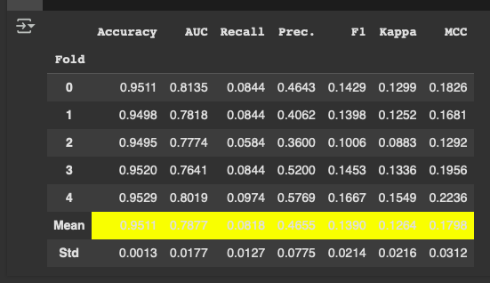
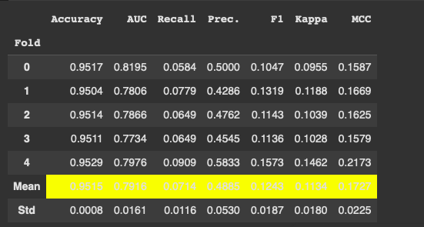
Tuned Models: Cross-Validation Results
XGBoost after hyperparameter tuning vs Blended ensemble — 5-fold StratifiedKFold means
XGBoost After Tuning — CV Results Mean AUC: 0.7877 | Mean Accuracy: 0.9511
Blended Models (Voting Ensemble) — CV Results Mean AUC: 0.7914 | Mean Accuracy: 0.9515
Model
AUC
Acc.
Note
Gradient Boosting (base)
0.7837
0.9516
Best initial model from PyCaret compare
XGBoost (tuned)
0.7877
0.9511
Marginal AUC gain after hyperparameter tuning
Blended Ensemble
0.7914
0.9515
Best AUC — used for lead strategy optimization

Slide 25
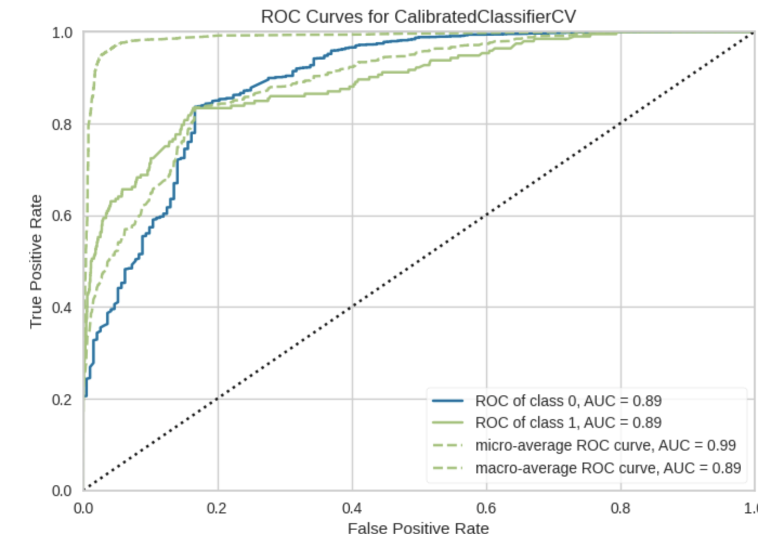
XGBoost vs Blended — AUC / ROC Improvement
AUC improves from 0.84 (GradientBoosting) → 0.89 (CalibratedClassifierCV blended ensemble)
XGBoost / GradientBoosting ROC (macro-avg AUC = 0.84)
Blended Model ROC (AUC = 0.89) ▲ +5.9%
Blended ensemble with calibration raises AUC from 0.84 → 0.89. Micro-avg AUC rises from 0.98 → 0.99. Stronger separation of buyers vs non-buyers.

Slide 26
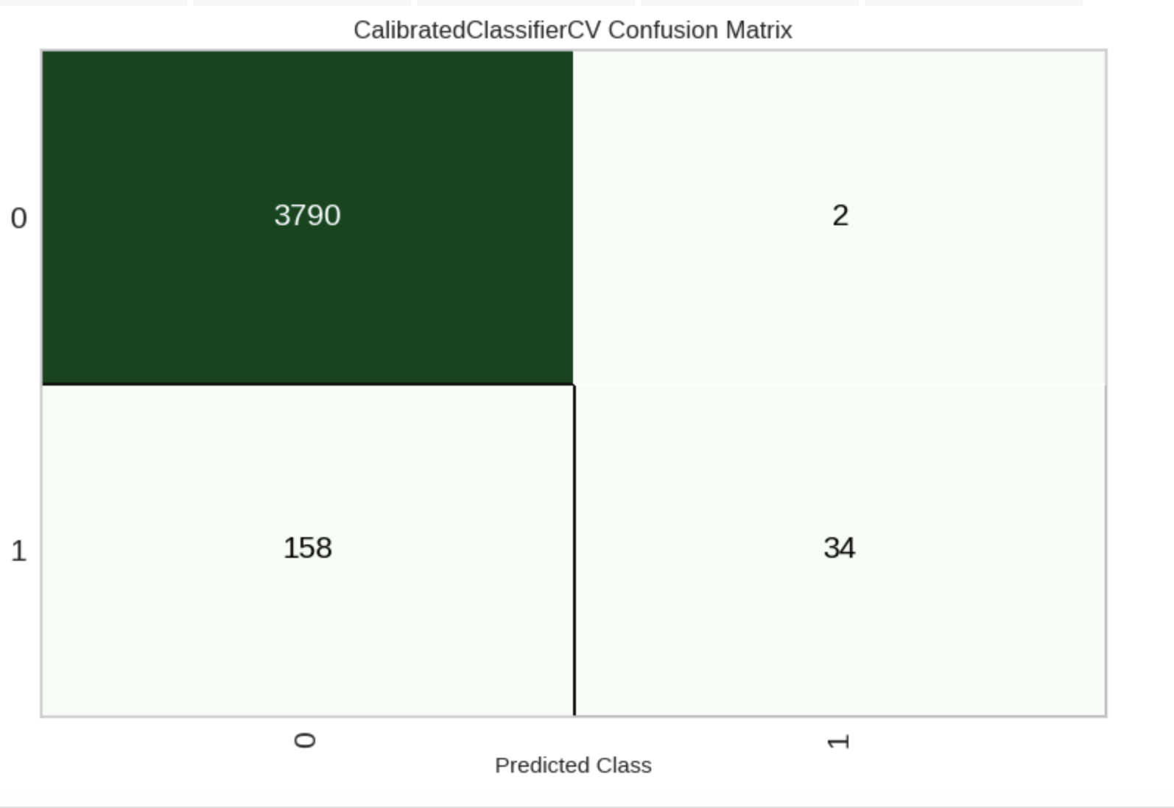
XGBoost vs Blended — Confusion Matrix (Improved)
FP reduced 5→2 | TP improved 28→34 | Precision up, false alarms down
GradientBoostingClassifier — TN 3787 | FP 5 | FN 164 | TP 28
Blended Model — TN 3790 | FP 2 | FN 158 | TP 34 ▲
Blended model cuts false positives by 60% (5→2) and increases true positives by 21% (28→34), reducing wasted email sends and capturing more buyers.

Slide 27
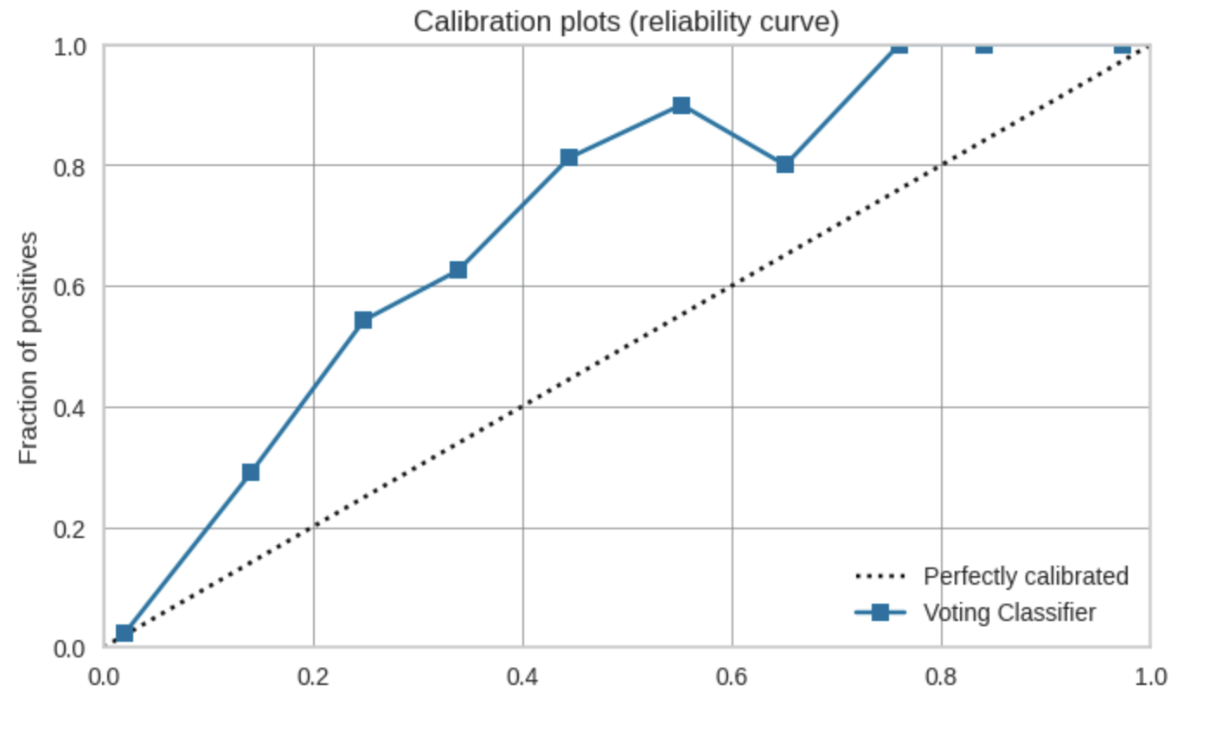
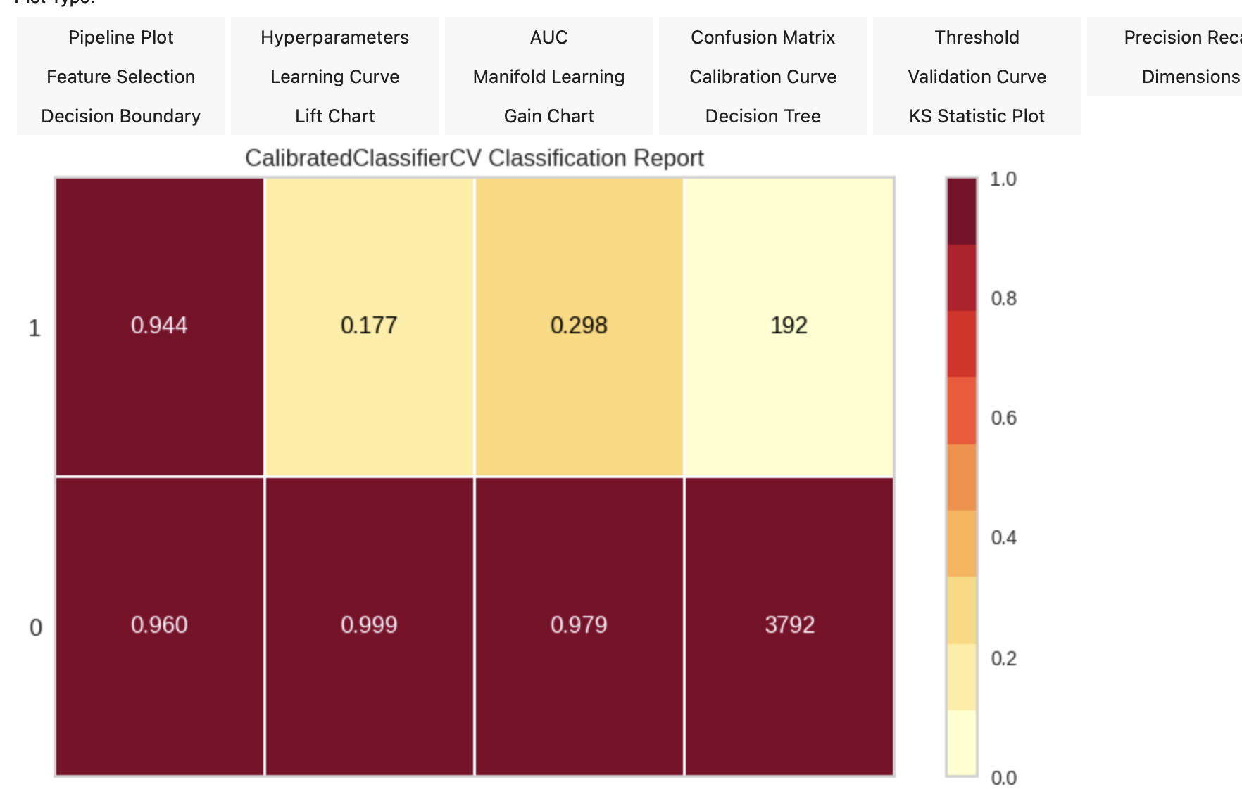
Blended Model — Calibration & Classification Report
CalibratedClassifierCV wraps Voting Ensemble — improved probability reliability for lead scoring
Calibration Plot (Voting Classifier — reliability curve)
Classification Report — Class 1: Precision 0.944 | Recall 0.177 | F1 0.298
Calibration ensures predicted probabilities match observed outcomes (0.2–0.5 range reliable). Class 1 precision of 0.944 means very few false alarms when targeting hot leads.

Slide 28
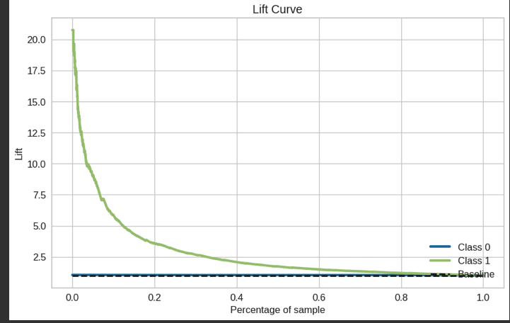
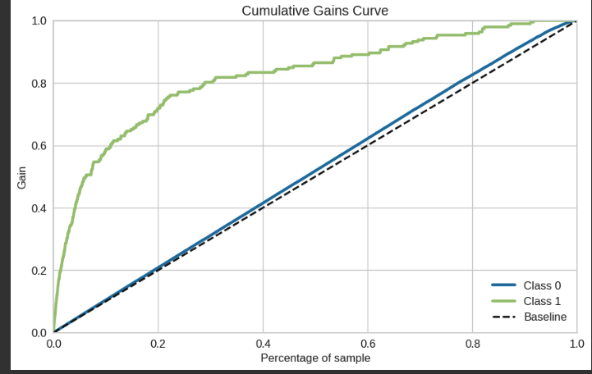
Best Model: Lift & Cumulative Gains Curves
Class 1 (buyers) lift ~21× at the very top of the scored list — strong ranking ability
Lift Curve
Cumulative Gains Curve
Targeting the top 40% of scored leads captures ~80% of all buyers — enabling precise email suppression

Slide 29
07
STEP
FastAPI
Backend

Slide 30
Step 7: FastAPI Backend
main.py — REST API exposing lead scoring and strategy endpoints
GET
/
Animated HTML welcome page with link to /docs (Swagger UI)
GET
/get_email_subscribers
Returns all email subscribers from SQLite database as JSON
POST
/data
Accepts JSON lead data and echoes it back (data passthrough utility)
POST
/predict
Scores leads using xgb_model_tuned.pkl; returns lead_score dict
POST
/predict_xgb
Scores using sklearn pipeline_xgb.pkl; drops non-feature cols, returns probabilities
POST
/calculate_lead_strategy
Full pipeline: score → optimize → return strategy DF, expected value, and threshold table

Slide 31
08
STEP
Streamlit
Frontend

Slide 32
Step 8: Streamlit Frontend
app.py + helpers.py — Interactive self-service lead scoring for the marketing team
1
2
3
4
5
Select File
Configure
Run Analysis
View Results
Download
Use default leads.csv or upload a custom subscriber CSV
Set monthly sales estimate & sales safeguard % via UI controls
POST to FastAPI /calculate_lead_strategy endpoint with spinner
Expected value summary, interactive Plotly threshold chart, lead table
Export full lead_strategy CSV with Hot/Cold categories
Key Features
st.cache_data() for fast data reload
Plotly interactive charts via st.plotly_chart()
Configurable parameters (sales, safeguard %)
CSV download with st.download_button()

Slide 33
Deployment & Tech Stack
Production-ready setup with Google Cloud and modern Python ecosystem
Deployment
Core Tech Stack
Backend Server:
Data:
Google Cloud Run (containerised FastAPI)
uvicorn, port 8080, asyncio event loop
pandas 2.1.4, numpy 1.26.4, SQLAlchemy 2.0
Frontend:
ML / Modeling:
Google Cloud Run (containerised Streamlit app)
uvicorn, port 8501, asyncio event loop
pycaret 3.3.1, xgboost 2.0.3, catboost 1.2.5,
scikitlearn 1.4.2, imbalanced-learn 0.12.2
Config:
Experiment Tracking:
mlflow 2.12.1
CORS enabled for all origins (*)
Environment variables via .env file
API Framework:
fastapi 0.110.2, uvicorn 0.29.0, pydantic 2.7.0
Google SDK:
Visualisation:
google-cloud-sdk included for GCP deployment
gcloud, gsutil, bq CLI tools
plotly 5.21.0, plotly-resampler 0.10.0
Utilities:
pyjanitor 0.27.0, pandas-flavor 0.6.0

Slide 34
Live Application
🚀
Email Lead Scoring — Streamlit Frontend
https://frontend-els-741818216556.us-central1.run.app/
Upload subscriber CSV or use the built-in leads dataset
Try it now
Configure monthly sales target & safeguard threshold
Deployed on Google Cloud Run
Run ML scoring via FastAPI backend on Google Cloud Run
Download Hot-Lead / Cold-Lead strategy as CSV

