Slide 1
Evaluating an Ensemble Score Filter Against the LETKF
in the SPEEDY Atmospheric General Circulation Model
Master's Project Defense | Jack Schwartz
July 2026
EnSF and LETKF in a global atmospheric testbed

Slide 2
A promising nonlinear filter needs an atmospheric test
Score filters have shown promise in idealized settings. This project asks whether that promise survives in a global, multivariable atmosphere.
The goal is not to assume that EnSF should win. It is to compare EnSF with an established atmospheric baseline under controlled changes in the observation system.
Why this matters
What this project does
Forecast uncertainty can be non-Gaussian, and observations can depend nonlinearly on the state. A score-based update is designed to follow that more complex probability structure.
EnSF and LETKF use the same SPEEDY model, initial ensembles, synthetic truth, observations, and verification. Only the analysis method changes.
Research question: How does EnSF compare with a carefully tuned LETKF as observation geometry changes?

Slide 3
Roadmap
1. Atmospheric testbed
2. Two ensemble filters
3. Four experiments
Problem
Methods
Results
SPEEDY, state variables, observing systems, and controlled experiment design.
LETKF from local ensemble weights; EnSF from posterior scores and a reverse SDE.
Linear, arctangent, nonlinear wind, pressure only, and the implications.
Atmospheric testbed → filter mechanics → controlled experiments → synthesis

Slide 4
Sequential data assimilation is a repeated Bayesian update
Prior
Posterior
Forecast ensemble
p(xₖ | y₁:ₖ₋₁)
Model dynamics
Flow-dependent uncertainty
Posterior ensemble
p(xₖ | y₁:ₖ)
Observation likelihood
Reduced state uncertainty
likelihood × prior → posterior

Slide 5
Why move beyond low-dimensional benchmark systems?
Toy models
Operational NWP
SPEEDY bridge
Excellent for isolating mechanisms and testing algorithms cheaply.
Realistic, high-dimensional, and expensive to modify or sweep systematically.
Global, multivariable primitive-equation dynamics at intermediate computational cost.

Slide 6
SPEEDY and AMLCS-DA provide the controlled atmospheric testbed
T21 spectral resolution
32 × 64 latitude-longitude grid
8 vertical levels
Simplified primitive-equation physics
Hybrid Fortran 77 / Fortran 90 model
Why SPEEDY
Global circulation and atmospheric coupling without operational-model cost.
Why AMLCS-DA
Common forecast-analysis loop, observation network, model execution, and diagnostics.
Role in this project
A reproducible bridge from method-development benchmarks to a global AGCM.

Slide 7
What this project implemented
EnSF in AMLCS-DA
Nonlinear wind observations
Evaluation pipeline
Adapted the collaborator-provided reverse-SDE prototype into sequential_methods.py.
Modified observation handling to assimilate wind direction and wind speed within both methods.
Added parameter sweeps, RMSE summaries, Gaussianity tests, maps, and SDE trajectories.

Slide 8
State vector and vertical structure
UG1
Zonal wind | m s⁻¹ | levels 0-7
Vertical indexing
VG1
Meridional wind | m s⁻¹ | levels 0-7
For 3D variables, level 0 is highest and level 7 is the lowest, nearest-surface level. PSG1 is a separate surface field indexed at 0.
TG1
Temperature | K | levels 0-7
TRG1
Specific humidity | g kg⁻¹ | levels 2-7
PSG1
Log surface pressure | log(ps/P₀)
Grid
32 latitudes × 64 longitudes at T21

Slide 9
Common configuration across every comparison
80 ensemble members
Controlled comparison
Same synthetic truth, initial ensemble, observations, cycle schedule, and NoDA baseline within each experiment.
30 assimilation cycles
2 days between observation times
60-day total assimilation window
100% eligible horizontal grid points observed
1,000 EnSF pseudotime steps per analysis

Slide 10
Four observation systems stress different filter mechanisms
1
All linear: direct U, V, T, q, and pressure
Flagship variables
2
All arctangent: nonlinear transform for every variable
Humidity for linear and arctangent; U and V for nonlinear wind; surface pressure for pressure only.
3
WDG/WSG/TPH: speed and direction plus direct T, q, and pressure
4
Pressure only: direct surface pressure and no other observations

Slide 11
The comparison is governed by three interacting questions
Distributional shape
Observation geometry
Information transfer
How close is the background ensemble to a Gaussian cloud?
Is H linear, componentwise nonlinear, coupled, or partial?
How does an observed correction reach other variables and locations?

Slide 12
LETKF repeats one local ensemble-space update across the grid
At each location, LETKF uses nearby observations to compute one affine transform of the background ensemble.
1
2
3
4
5
Background ensemble
xᵇ
Predict observations
H(xᵇ)
Select nearby
observations
Solve weights
and transform
Local analysis
xᵃ
One localized affine transform at each grid point

Slide 13
LETKF step 1: solve the analysis covariance in ensemble space
Y′ᵇ
Local observation-space perturbations: mlocal × Nₑ.
Why it is tractable
P̃ᵃ is Nₑ × Nₑ. With 80 members, the inverse is 80 × 80 rather than full state dimension. Inflation ρ adjusts prior spread.
R⁻¹
Observation confidence: precise observations receive more weight.

Slide 14
LETKF step 2: shift the mean and transform the perturbations
Innovation
y − ȳᵇ measures the mismatch between observation and ensemble prediction.
Read it in two pieces
The weight vector moves the mean. The square-root matrix rotates and contracts perturbations. Both remain affine in the background ensemble span.
Mean update
X′ᵇw̄ᵃ maps ensemble weights back into physical state space.

Slide 15
LETKF uses localization and inflation to manage finite ensembles
Twenty LETKF parameter combinations were tested for each experiment.
Localization radius r
Inflation ρ
Selected settings
Limits each state component to observations in a local grid box. Tested r = 1, 2, 3, 4.
Restores ensemble spread lost to sampling error and repeated assimilation. Tested 1.00 to 1.60.
Linear: 1.00, r3 | arctan: 1.00, r3 | wind: 1.15, r2 | pressure: 1.30, r2.

Slide 16
EnSF transports each sample toward the analysis through pseudotime
The prior and likelihood scores are reevaluated as 1,000 reverse-SDE steps move samples from pseudotime 1 toward 0.
1
2
3
4
5
Noisy sample
pseudotime 1
Prior score
from ensemble
Likelihood score
from observation
Reverse-SDE
integration
Analysis sample
pseudotime 0
Many nonlinear, score-guided steps for each ensemble member

Slide 17
The score is a local direction toward higher probability density
Vector field
The score gives a direction at every state x, not a probability value.
Gaussian example
If p is Gaussian, s(x) = −Σ⁻¹(x − μ): a covariance-scaled pull toward the mean. For nonlinear p, the direction varies with x.
Why log p?
Products become sums, which matches the Bayesian prior-plus-likelihood structure.

Slide 18
The posterior score combines background structure and observation fit
Residual
H(x) − y measures the current mismatch in observation space.
Paired prior score
Each evolving sample stays tied to one background member through the prior-score term. The (1−τ) factor gradually activates the likelihood.
Chain rule
Jᴴ(x)ᵀ maps the likelihood gradient back into state space.

Slide 19
The reverse SDE uses 1,000 Euler-Maruyama steps
Drift
The scheduled drift reverses the prescribed forward diffusion process.
Pseudotime, not forecast time
The model does not advance during these steps. They form an analysis path from pseudotime 1 to 0; the noise term preserves stochastic sampling.
Score term
The posterior score steers samples toward high-probability states.

Slide 20
LETKF and EnSF normalize different parts of the problem
LETKF: transform predicted observations
For nonlinear observations, every member follows H Xᵇ → z → h(z). Local anomalies and innovations are formed in transformed observation space. Linear cases remain in original units.
EnSF: standardize the evolving state
Each observed component uses the current background ensemble:
x* = (x − x̄ᵇ) / sᵇ.
Linear y and σ use the same scaling. For a nonlinear likelihood, x* is returned to physical units before applying the shared h and its chain-rule Jacobian.
Key distinction
The filters share the same nonlinear observation scaling, but only EnSF integrates in flow-dependent, background-normalized state coordinates.

Slide 21
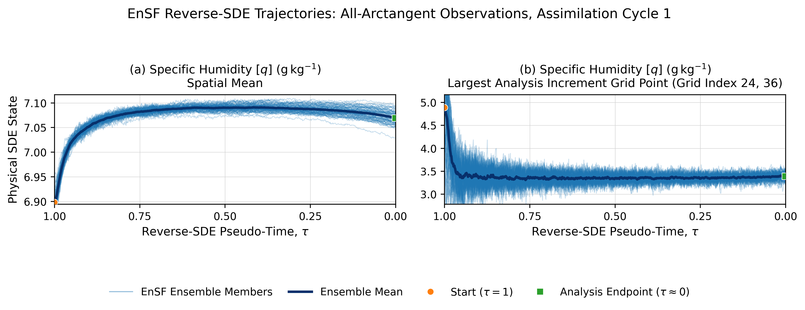
What the reverse SDE does to the ensemble
80 trajectories move from noisy pseudotime 1 states toward the analysis near pseudotime 0.

Slide 22
Evaluation focuses on sustained error, level structure, and Gaussianity
Analysis RMSE
Level average
Shapiro-Wilk diagnostic
Unweighted horizontal RMSE of the ensemble mean against truth at each cycle and level.
Mean of per-level RMSE: U/V/T levels 0-7, humidity 2-7, pressure surface level 0.
Humidity is least Gaussian: level average 0.2509 versus 0.4249-0.4396 for other fields.

Slide 23
Expected strengths before seeing the results
LETKF home field
EnSF home field
Critical stress test
Dense linear observations and approximately Gaussian forecast uncertainty.
Non-Gaussian state structure and a nonlinear likelihood throughout the state.
Coupled or partial observations where cross-variable information transfer matters.

Slide 24
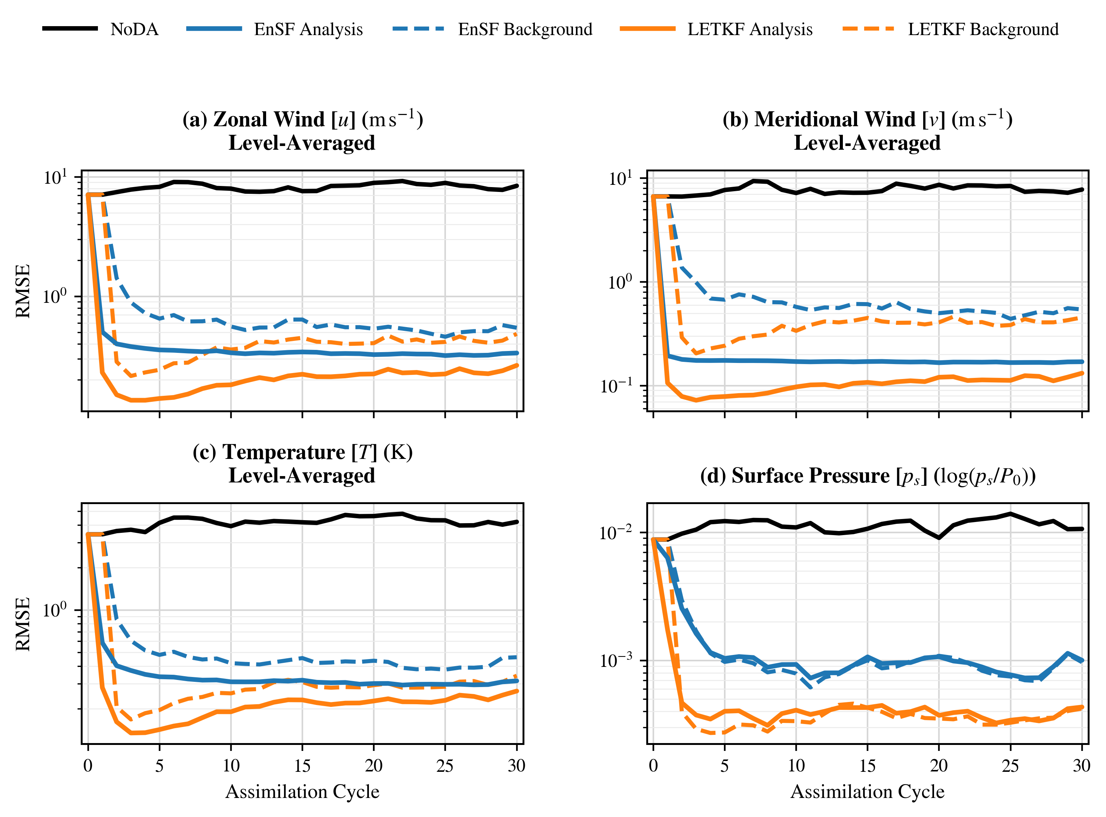
All linear: LETKF wins the other fields
Zonal wind, meridional wind, temperature, and surface pressure; logarithmic RMSE.

Slide 25
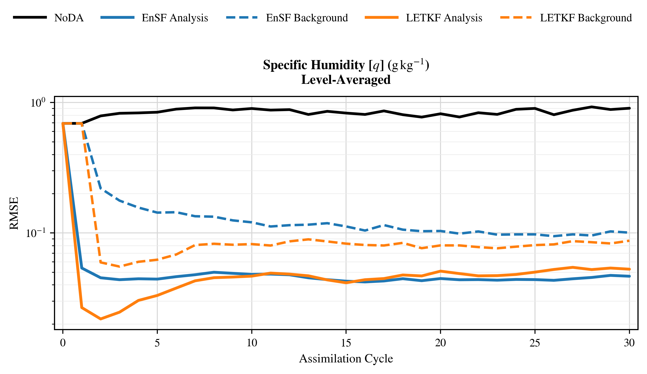
All linear: humidity reaches near parity
Level-averaged humidity RMSE, log scale | LETKF: ρ=1.00, r=3 | EnSF: ρ=1.00.

Slide 26
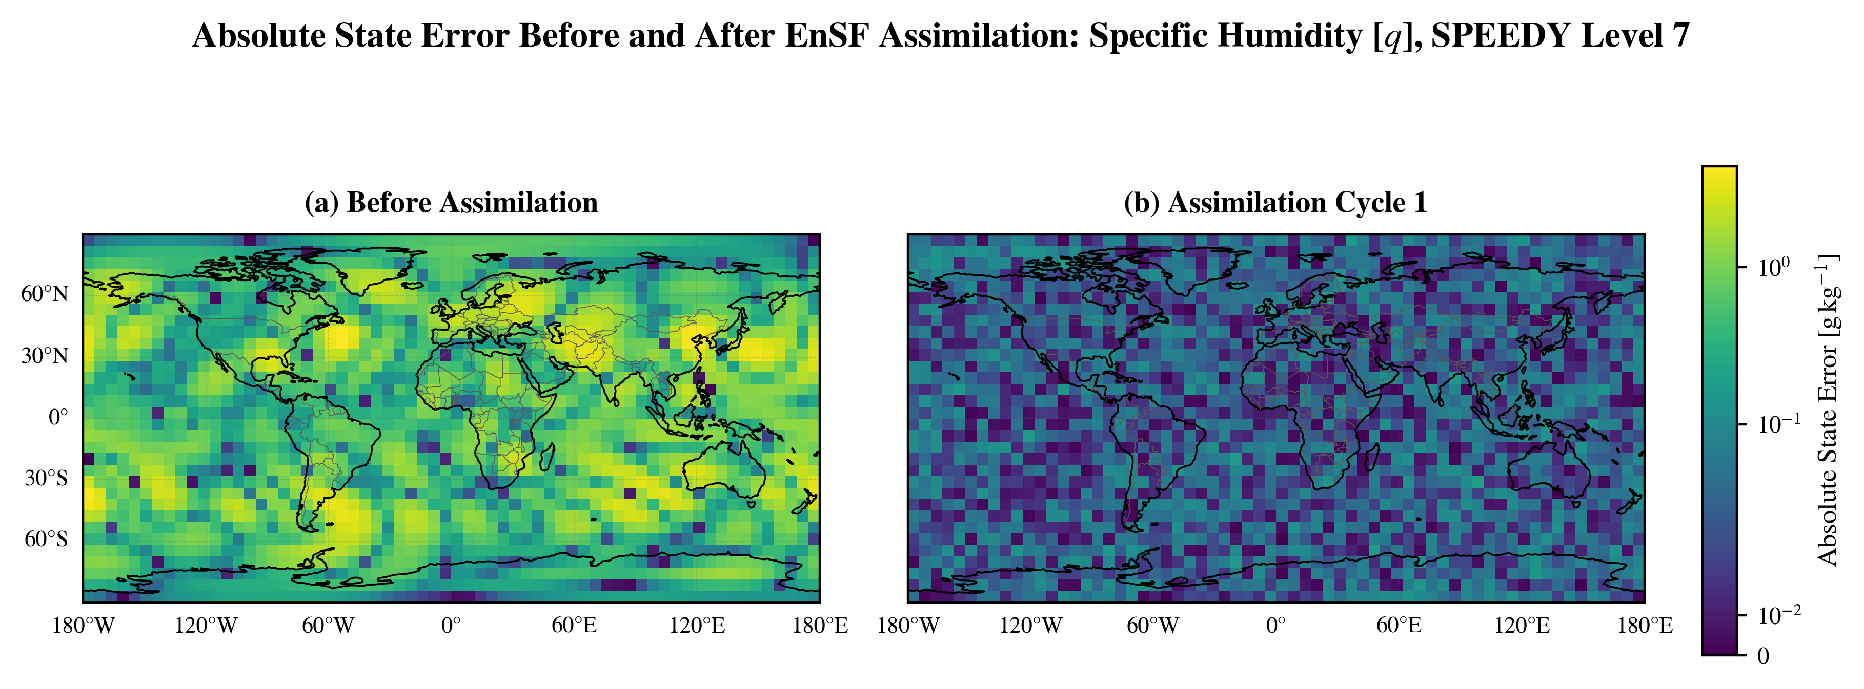
All linear: EnSF makes a broad first humidity correction
Absolute level-7 humidity error before assimilation and after the first EnSF analysis.

Slide 27
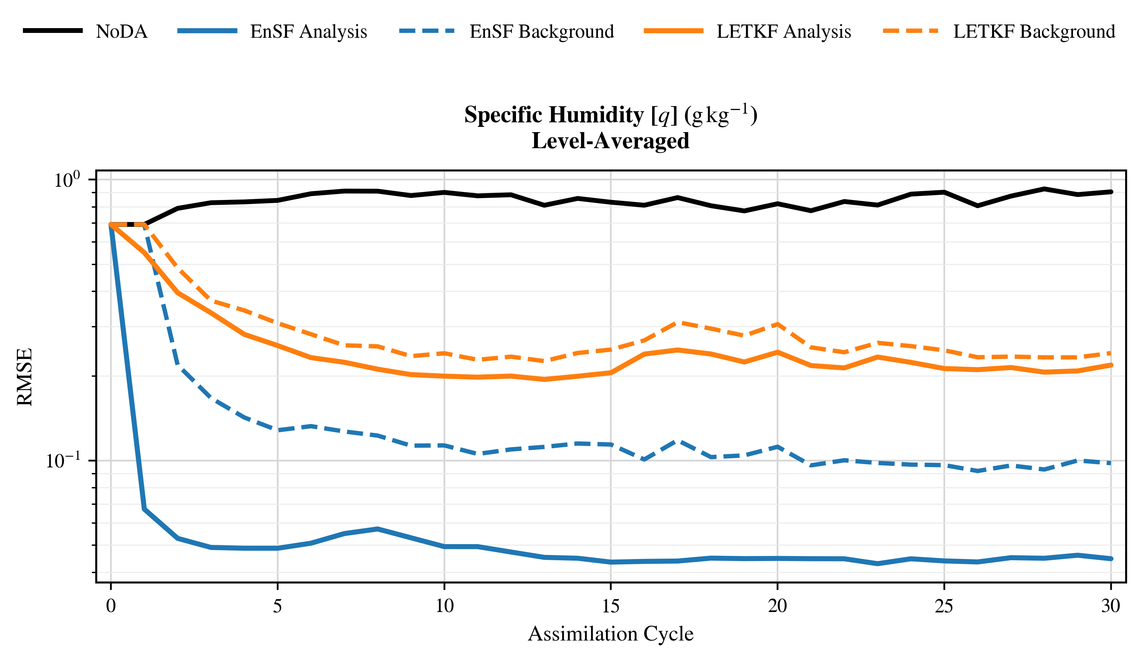
All arctangent: EnSF wins the flagship
Nonlinear likelihood plus the least-Gaussian variable produces the clearest EnSF advantage.

Slide 28
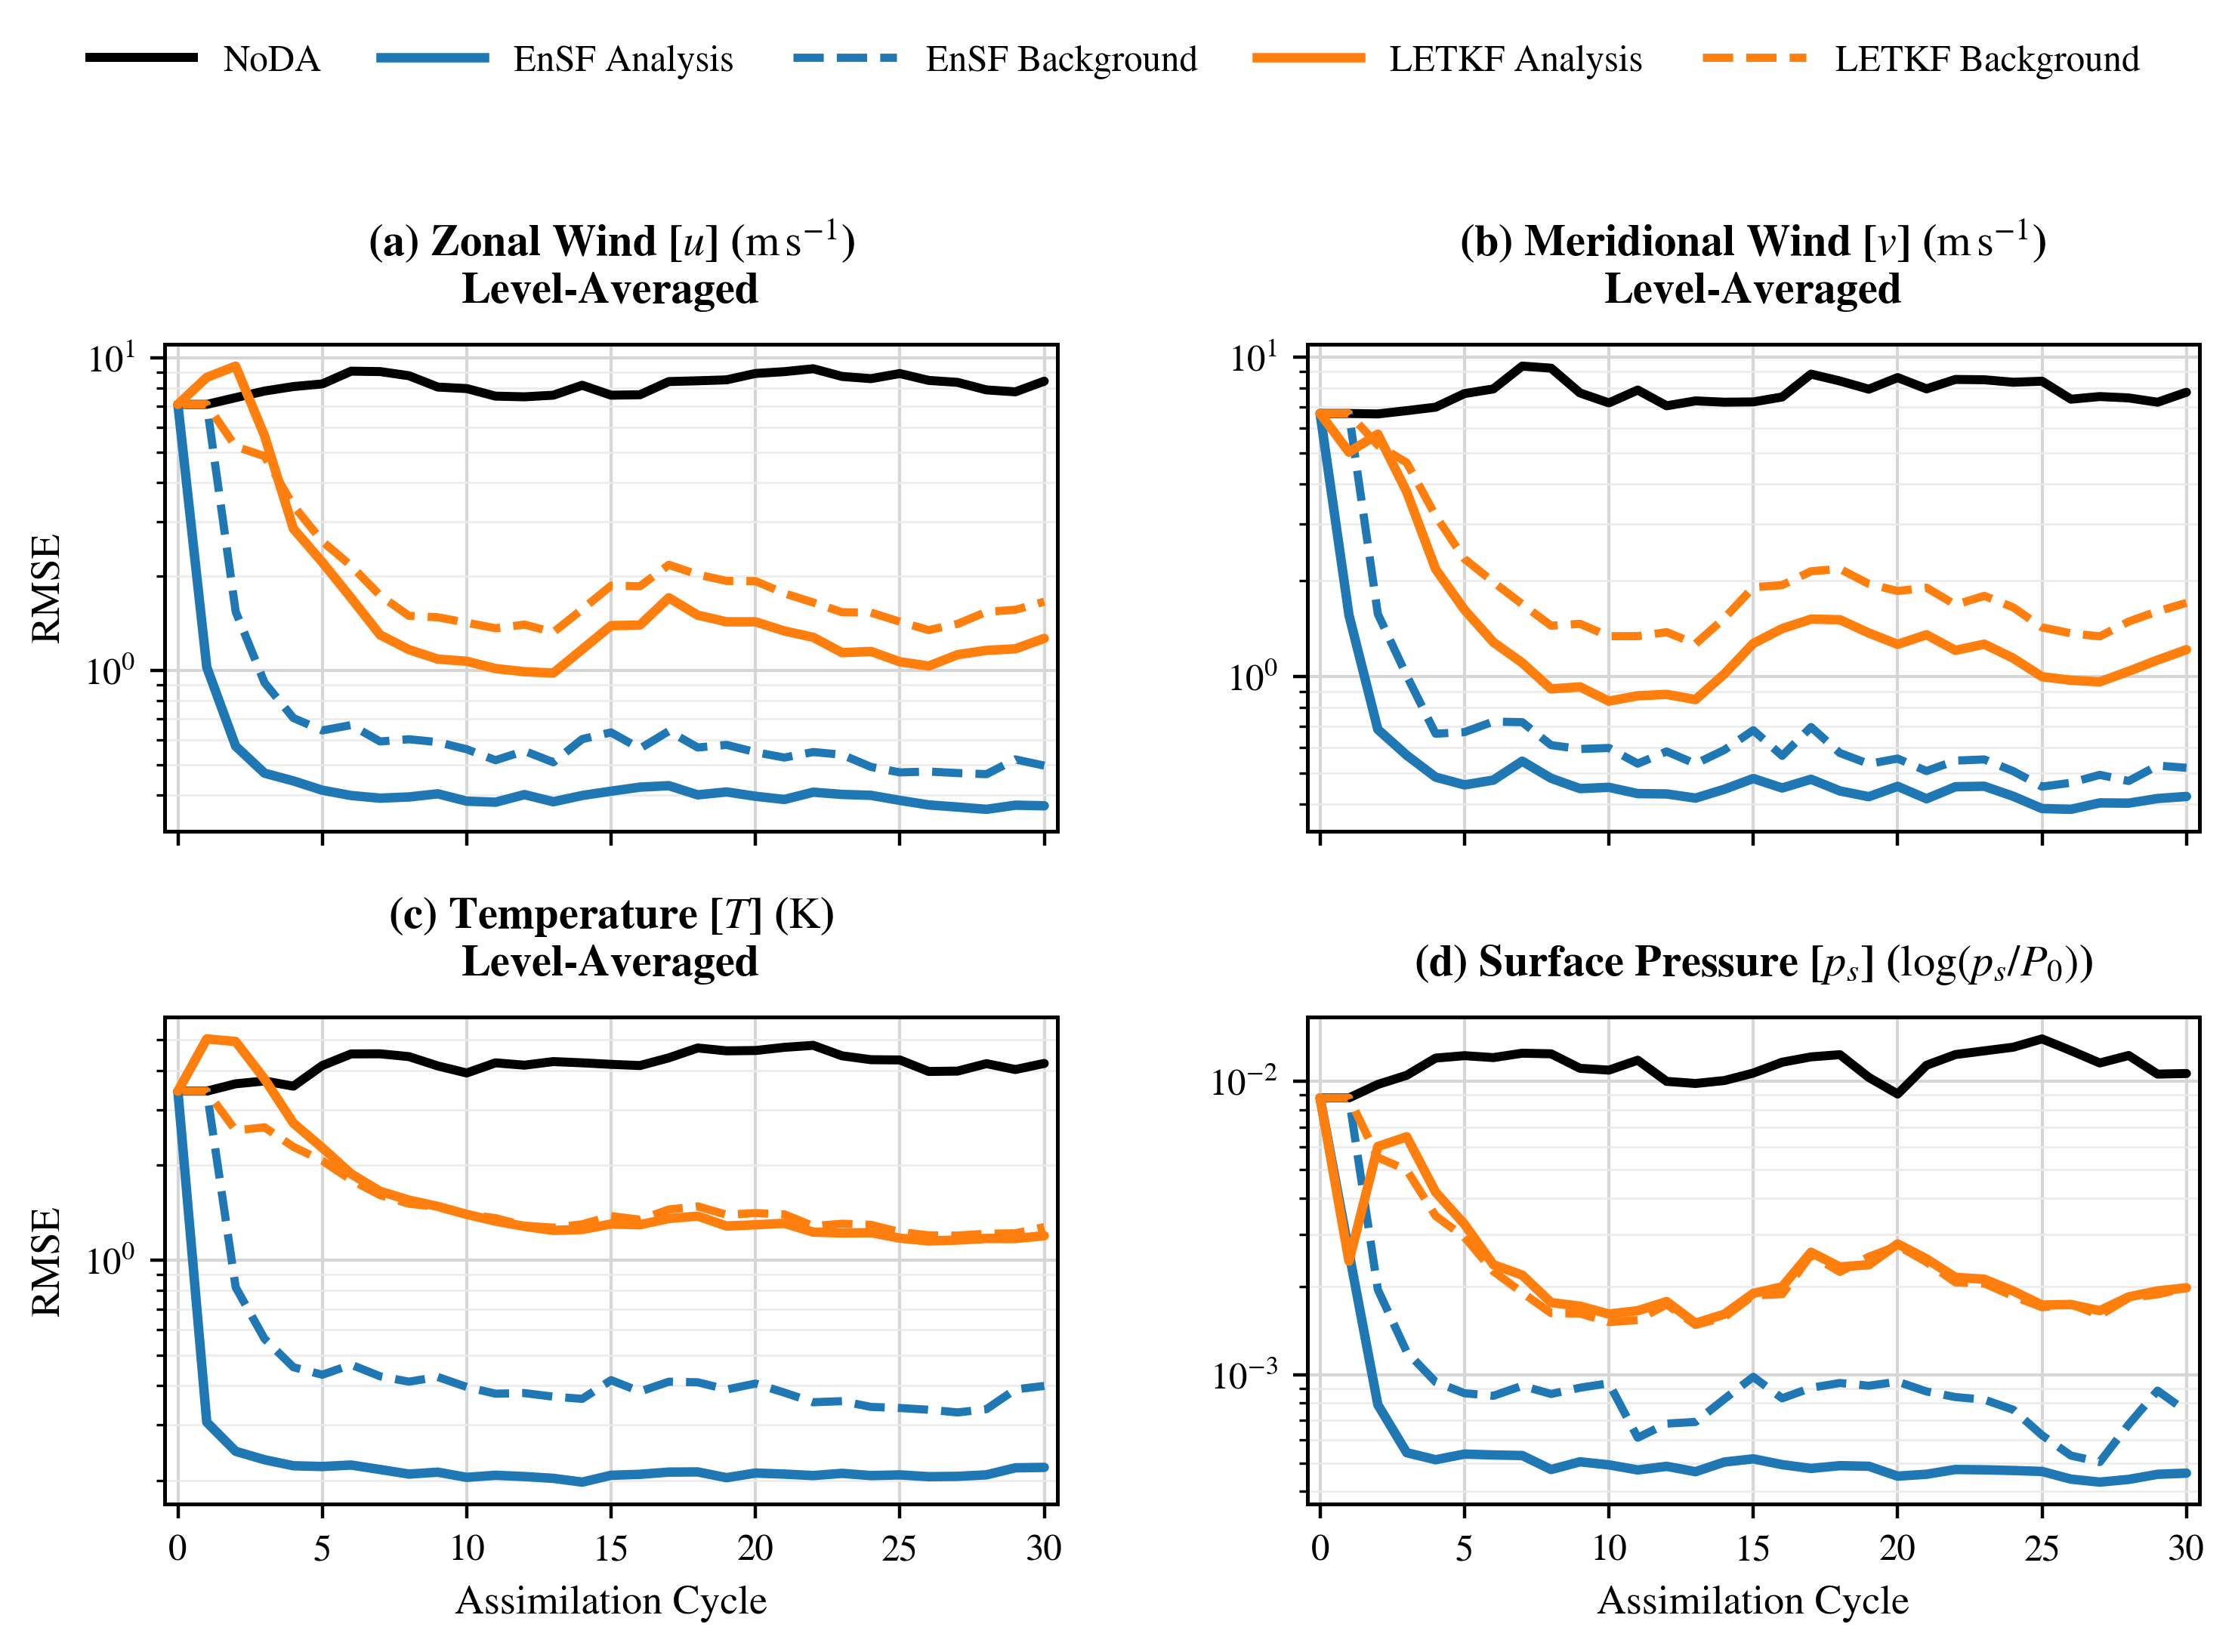
All arctangent: EnSF wins every field
EnSF lowers analysis RMSE for wind, temperature, humidity, and surface pressure.

Slide 29
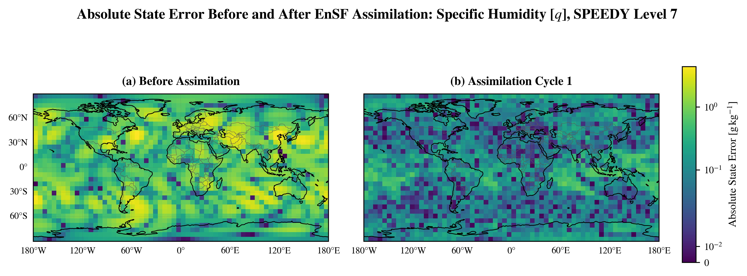
All arctangent: first-cycle humidity error falls globally
The first EnSF analysis reduces level-7 humidity error across most of the globe.

Slide 30
Wind is observed through speed and direction
Locally recoverable
Away from calm winds and the branch cut, speed plus direction recover the wind vector.
Observation design
Direction innovations are wrapped to [−π,π]. T, q, and pressure remain direct, creating a dense and physically interpretable nonlinear observing network.
Difficult regimes
Weak winds and the angular branch cut produce the strongest curvature or discontinuity.

Slide 31
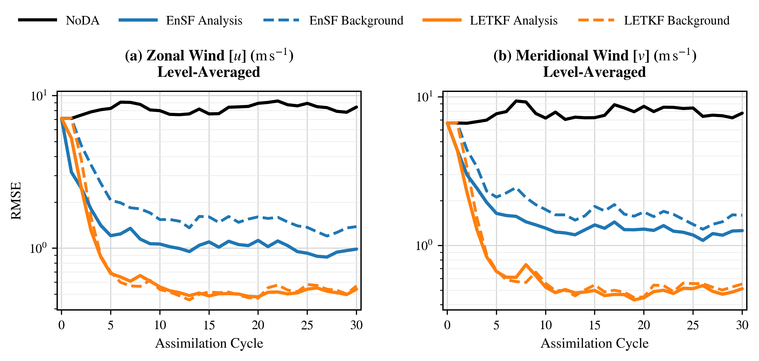
Nonlinear wind: LETKF wins both components
U and V are observed only through speed and direction | LETKF: ρ=1.15, r=2.

Slide 32
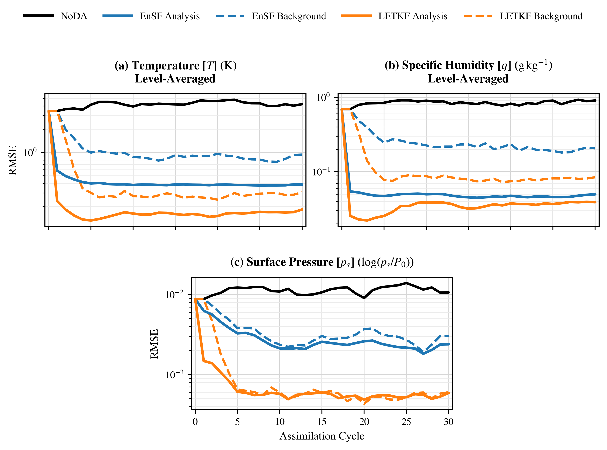
Nonlinear wind: LETKF also wins the thermodynamic fields
The advantage persists for the directly observed temperature, humidity, and pressure fields.

Slide 33
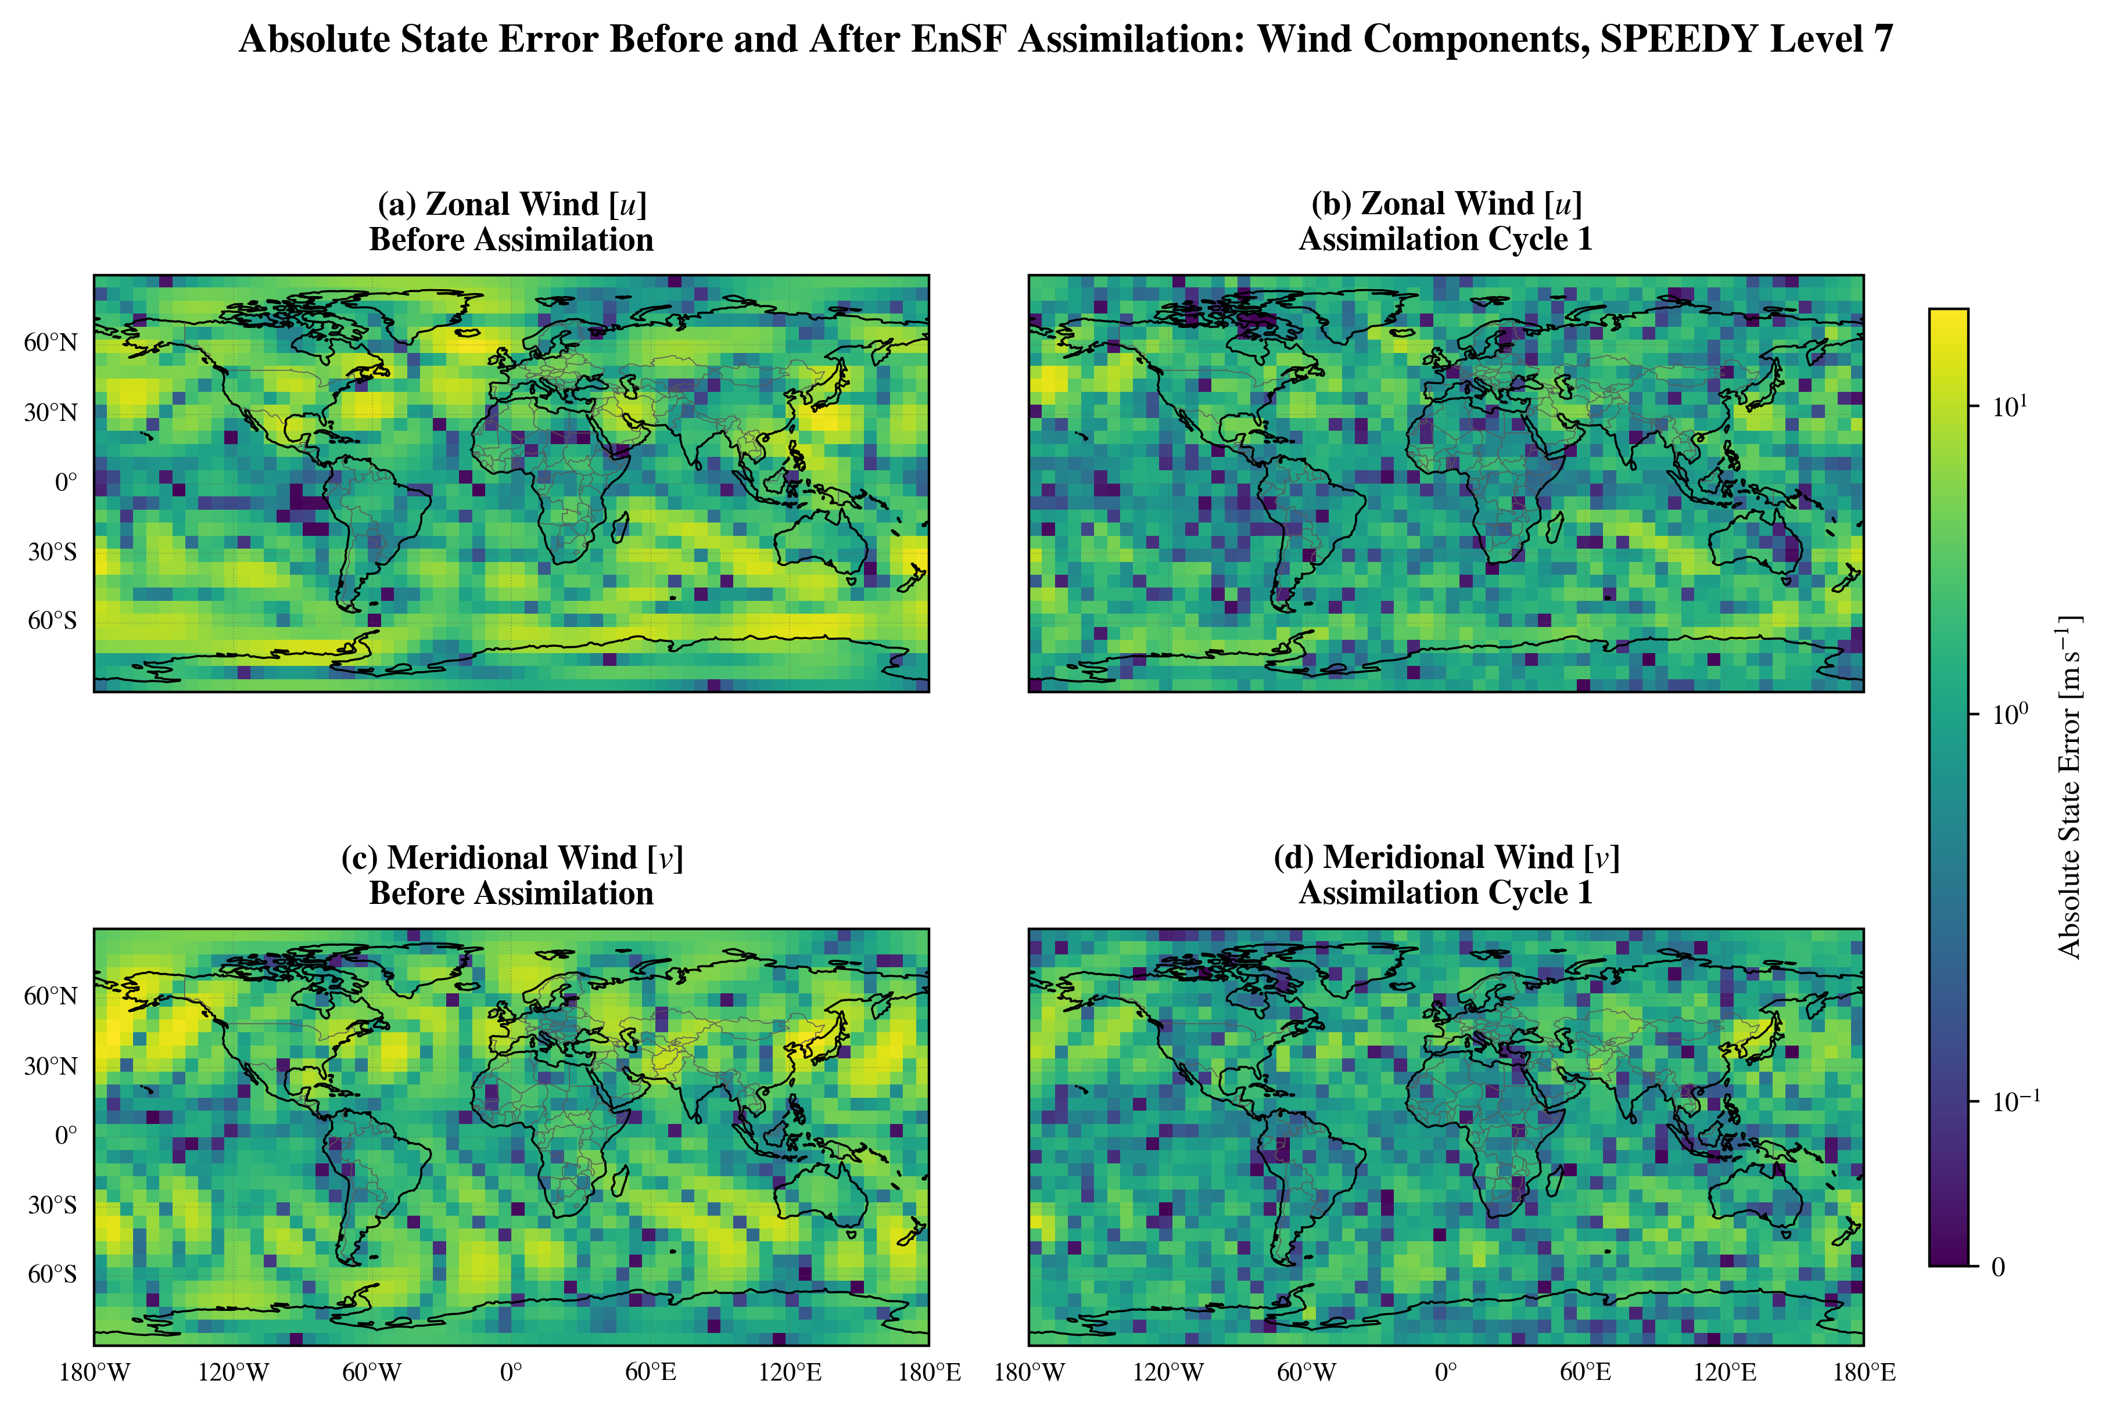
Nonlinear wind: EnSF still makes a large first correction
Absolute level-7 U and V error before assimilation and after the first EnSF analysis.

Slide 34
Why could LETKF handle the nonlinear wind observations?
Locally mild nonlinearity
Localization advantage
Finite-ensemble score limits
Over a compact ensemble cloud, speed and direction may be nearly linear except near calm winds and the angular branch cut.
LETKF solves small local problems and suppresses distant sampling noise; this EnSF implementation has no analogous localization.
With 80 members, a high-dimensional prior score may be harder to approximate reliably than local ensemble covariances.

Slide 35
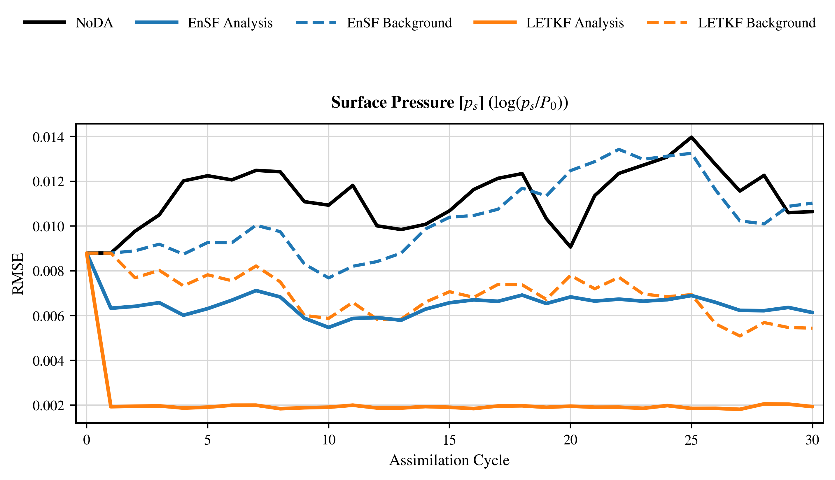
Pressure only: LETKF is the clear winner
Surface-pressure RMSE on a linear scale; EnSF improves NoDA but remains higher.

Slide 36
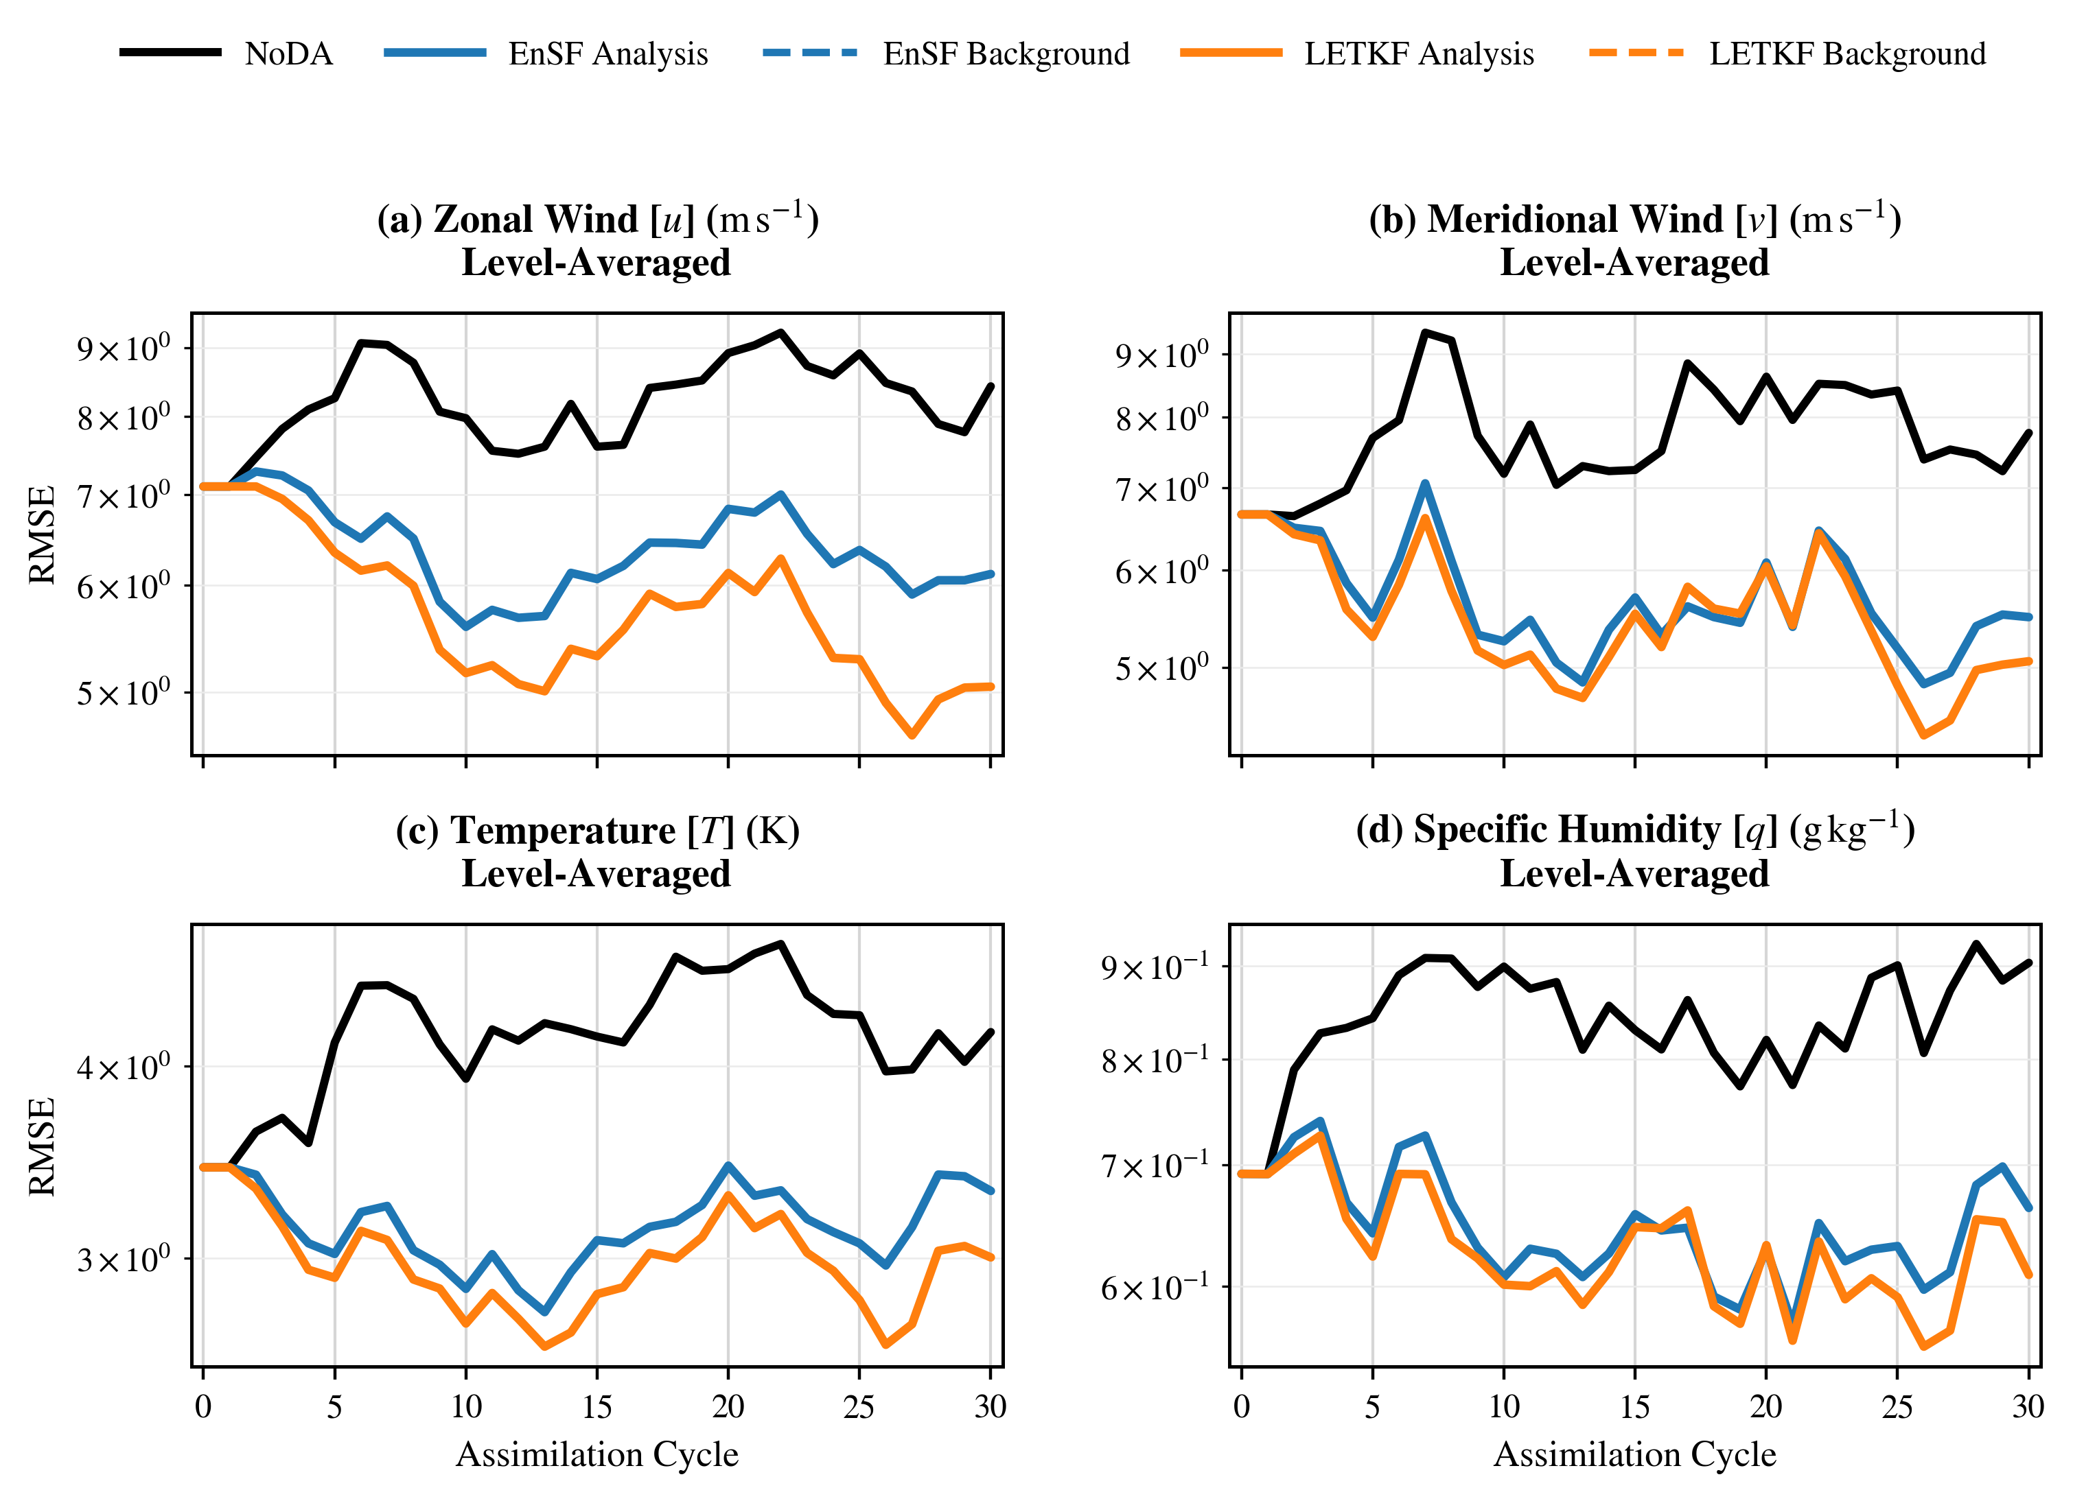
Pressure only: little information reaches other EnSF fields
Unobserved variables change only through later model evolution in the original EnSF.
Notes:
Timing: about 45 seconds.
U, V, temperature, and humidity are unobserved. In the original EnSF implementation used here, the score update replaces observed components but does not use a regression or localized forecast covariance to spread the correction into unobserved components at analysis time.
Those fields can respond only through subsequent model evolution. LETKF can update them immediately through ensemble cross-covariances, which explains its broader advantage.
[Sources]
- Jack Schwartz, "Evaluating an Ensemble Score Filter Against the LETKF in the SPEEDY Atmospheric General Circulation Model," master's project manuscript and project-generated figures (2026).
- Xiong et al. (2026), "A two-step ensemble score filter for data assimilation in partially observed systems," https://doi.org/10.48550/arXiv.2606.28264.

Slide 37
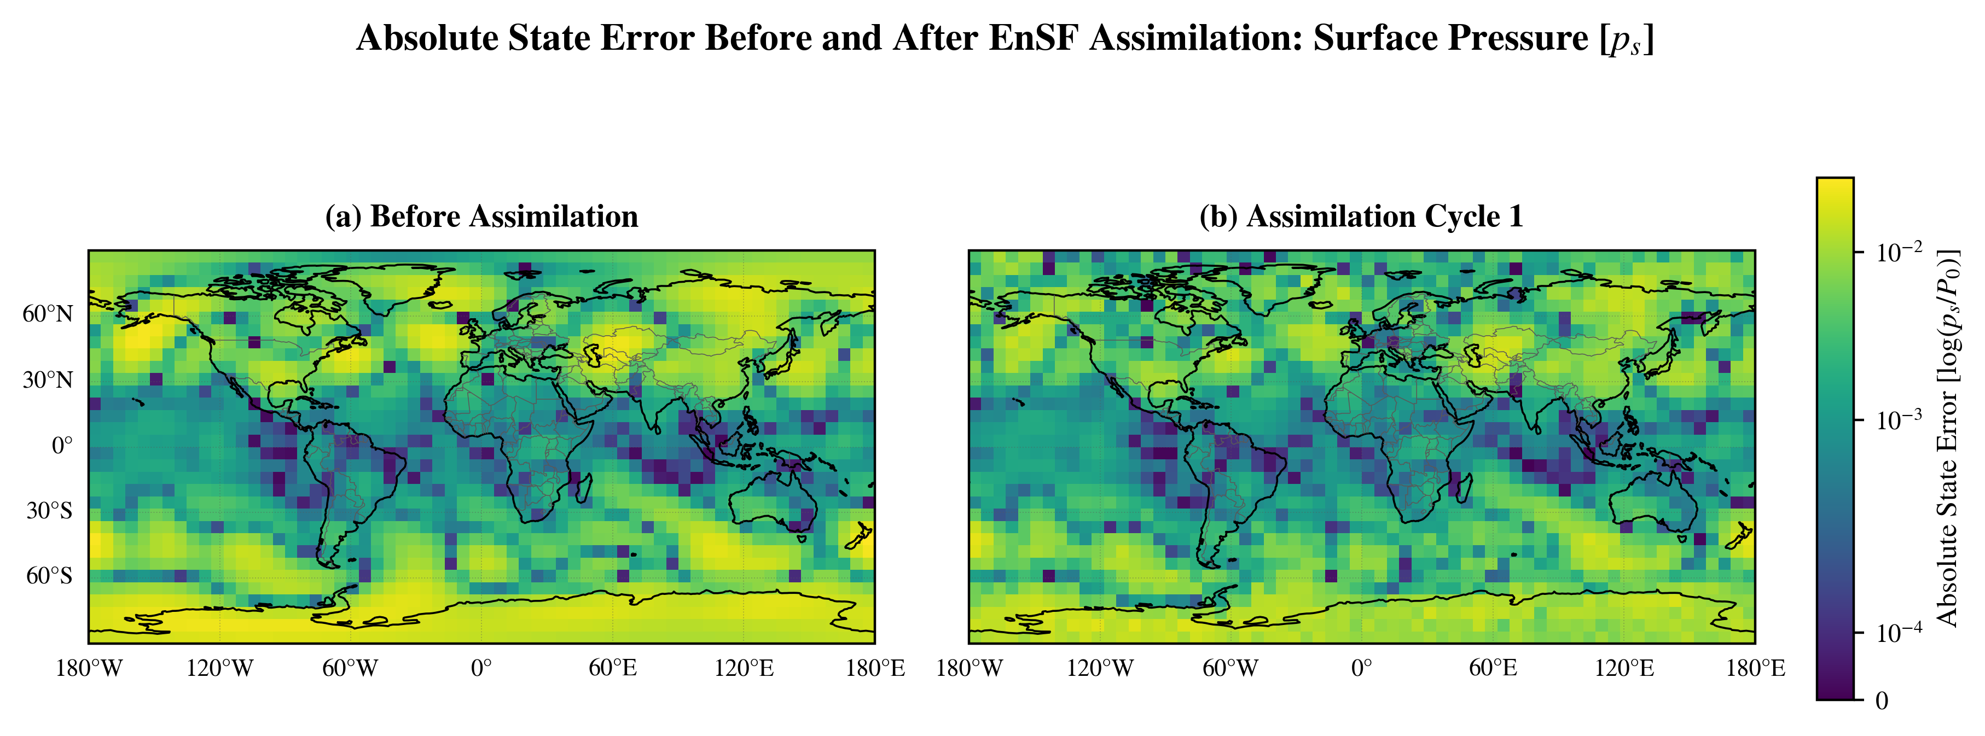
Pressure only: EnSF still reduces observed pressure error
Absolute level-0 surface-pressure error before assimilation and after EnSF cycle 1.

Slide 38
Relative RMSE reveals a clear experiment-dependent pattern
Each cell is EnSF RMSE ÷ LETKF RMSE. Below 1 favors EnSF; above 1 favors LETKF.

Slide 39
Limitations point directly to the next experiments
Idealized OSSE
Incomplete comparison
Highest-value next steps
Perfect model, dense horizontal coverage, one truth trajectory, one ensemble size, and one cycle length.
Unequal tuning dimensions, no timing study, and RMSE without spread or calibration metrics.
Localize or hybridize EnSF (linear regression), vary observation density and ensemble size, test multiple seeds, and add spread-skill and cost metrics.

Slide 40
Three takeaways
1. LETKF remains a demanding baseline
2. EnSF wins when nonlinearity is global
3. Hybridization is the opportunity
Localization and multivariate ensemble covariances excel in linear, coupled, and partially observed settings.
The score update was best for all five variables in the all-arctangent experiment.
Combine nonlinear score updates with reliable covariance-based transfer to unobserved variables.

Slide 41
Questions?
Which strengths should a next-generation hybrid preserve?

