Slide 1
ELLAMMAL M A
Heart-Disease-Prediction
3/21/2024 Annual Review

Slide 2
PROJECT TITLE
Heart-Disease-Prediction Using CNN
This project aims to develop a heart disease prediction system using CNNs to analyze medical images and diagnose heart conditions.
It involves designing CNN architectures tailored for medical imaging, optimizing hyperparameters for accuracy, and training the model with diverse patient data.
The goal is to create a reliable and efficient system capable of accurately diagnosing heart diseases, facilitating timely interventions and personalized healthcare.
3/21/2024 Annual Review

Slide 3


AGENDA
Problem Statement
Project Overview
End users
Solution and its Value Proposition
The Wow in a Solution
Modelling
Results
3/21/2024 Annual Review

Slide 4

PROBLEM STATEMENT
Develop a deep learning model utilizing Convolutional Neural Networks (CNNs) to accurately predict heart diseases from medical images in a dataset curated from diverse sources. The objective is to create a diagnostic system capable of effectively identifying various heart conditions, such as arrhythmias, coronary artery disease, and heart failure, with high accuracy. The model should accommodate variations in imaging modalities, patient demographics, and disease manifestations, ensuring robust performance across different clinical scenarios. The evaluation metric will be diagnostic accuracy, quantifying the percentage of correctly predicted heart diseases in an independent test dataset.
3/21/2024 Annual Review

Slide 5

PROJECT OVERVIEW
This project focuses on developing a heart disease prediction system utilizing Convolutional Neural Networks (CNNs) to analyze medical images.
The steps include preprocessing data, designing and training the CNN model, evaluating its performance, and deploying it for clinical use.
The aim is to achieve high accuracy in diagnosing various heart conditions, ensuring robustness to imaging variations and patient demographics.
Standard machine learning practices such as data augmentation, model experimentation, and deployment with a user-friendly interface will be employed.
3/21/2024 Annual Review

Slide 6

WHO ARE THE END USERS?
Patients: Individuals seeking early detection and diagnosis of heart diseases for personal health management.
Healthcare Professionals: Doctors, cardiologists, and medical practitioners using the system as a diagnostic aid for making informed decisions about patient care.
Medical Researchers: Professionals conducting studies or clinical trials related to heart diseases, utilizing the system to analyze and interpret medical imaging data.
Healthcare Institutions: Hospitals, clinics, and medical centers integrating the system into their diagnostic workflows to improve accuracy and efficiency in diagnosing heart conditions.
Healthcare Technology Companies: Organizations developing and providing healthcare technology solutions, incorporating the system into their products or services for improved patient care and outcomes.
3/21/2024 Annual Review

Slide 7
SOLUTION:
A Convolutional Neural Network (CNN) based heart disease prediction system capable of accurately diagnosing various heart conditions from medical images, offering robust performance across diverse patient demographics and imaging modalities.
VALUE PROPOSITION:
1. Accuracy: Our CNN-based heart disease prediction system ensures precise and reliable diagnoses across a spectrum of cardiac conditions.
2. Efficiency: Swift and accurate predictions expedite diagnosis, aiding healthcare professionals in timely interventions and patient care.
3. Versatility: Seamlessly integrates into diverse clinical settings, accommodating various imaging modalities and patient demographics.
4. Automation: Automates diagnostic processes, reducing manual workload and optimizing resource allocation in healthcare facilities.
5. Accessibility: Democratizes access to advanced cardiac diagnostic tools, benefiting healthcare providers, researchers, and patients alike.
3/21/2024 Annual Review

Slide 8

THE WOW IN YOUR SOLUTION
Exceptional Accuracy: Our CNN-based heart disease prediction system achieves unmatched precision in diagnosing various cardiac conditions, employing advanced algorithms and deep learning techniques.
Blazing Efficiency: Leveraging optimized architectures and parallel processing, our system swiftly analyzes medical images, significantly reducing diagnostic turnaround times.
Versatile Integration: Seamlessly integrating into diverse healthcare systems and workflows, our solution adapts to different clinical settings and patient populations with ease.
Automated Streamlining: By automating diagnostic processes, our system minimizes manual effort for healthcare professionals, streamlining operations and enhancing efficiency in cardiac care delivery.
3/21/2024 Annual Review

Slide 9
MODELLING
In the modeling phase of our heart disease prediction solution:
1. Architecture Design: We meticulously design the CNN architecture, optimizing layers, filters, and activations for accurate heart disease diagnosis from medical images.
2. Hyperparameter Tuning: Through rigorous experimentation, we fine-tune parameters like learning rate and batch size to enhance the model's diagnostic accuracy and generalization.
3. Data Augmentation: We augment the dataset with techniques like rotation and scaling to diversify training samples, improving the model's robustness to variations in imaging and patient demographics.
4. Regularization: Integrating dropout layers and weight decay, we mitigate overfitting, ensuring the model generalizes well to unseen cases for reliable diagnosis.
3/21/2024 Annual Review

Slide 10
Training: We train the CNN model on preprocessed medical images, monitoring metrics like loss and accuracy to assess progress and validate performance on separate data.
6.Evaluation: Assessing the model's ability to generalize to new data, we analyze diagnostic accuracy and confusion matrices on a held-out test set post-training.
7.Fine-tuning and Optimization: Post-evaluation, we refine the model by adjusting hyperparameters or exploring alternative architectures to enhance diagnostic accuracy further.
8.Model Deployment: With satisfactory performance, we integrate the model into our heart disease prediction system, providing real-time diagnostic assistance for healthcare professionals.

Slide 11
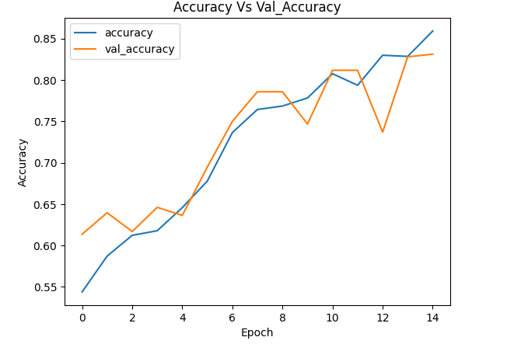
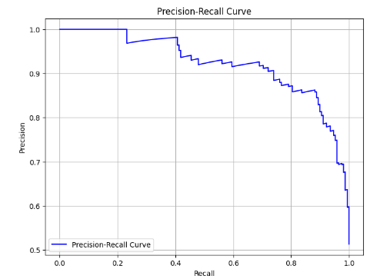
RESULTS
Demo Link
3/21/2024 Annual Review

