Slide 1
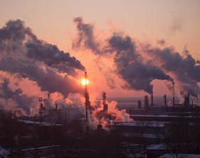
Why are we worried about the climate change

Slide 2
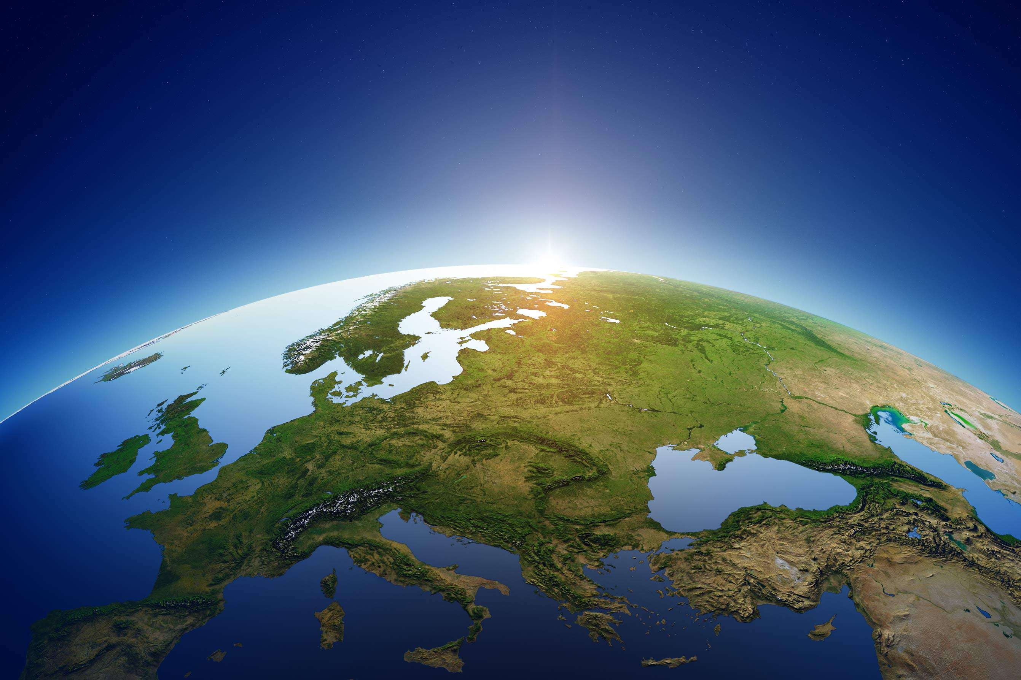
We are worried that it will get worse in the future and that we can´t stop the climate changes

Slide 3
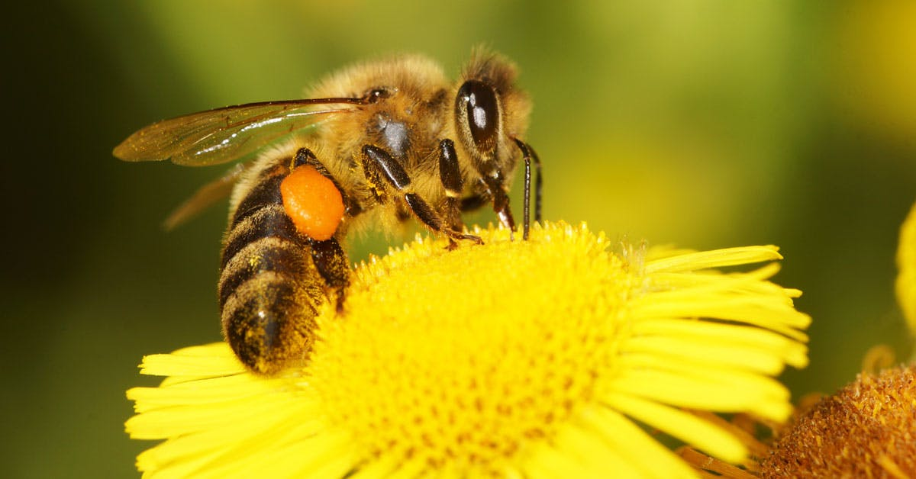
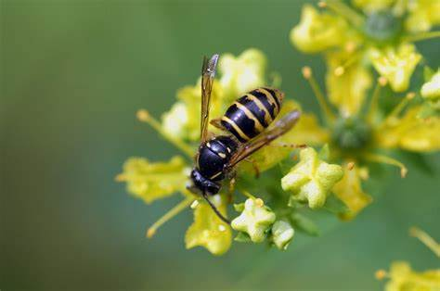
consequences
Some species going to die and disappear
Example bees
Problems with fruits because they can not pollinate

Slide 4
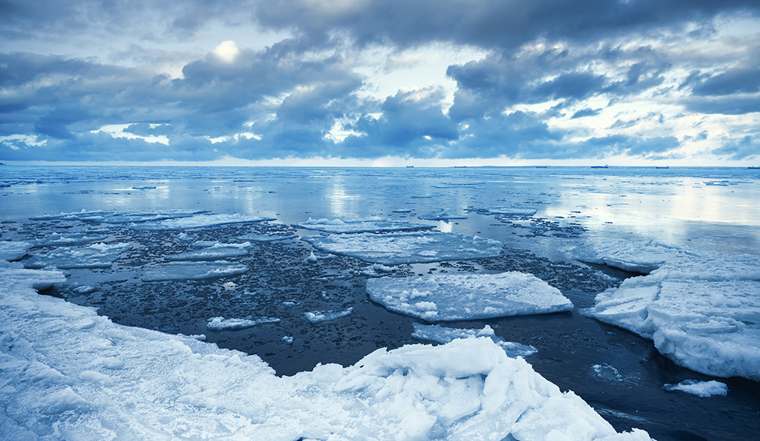
consequences
If glaciers melt and countries disappear due to floods, it will mean that people will have to flee

