Slide 1


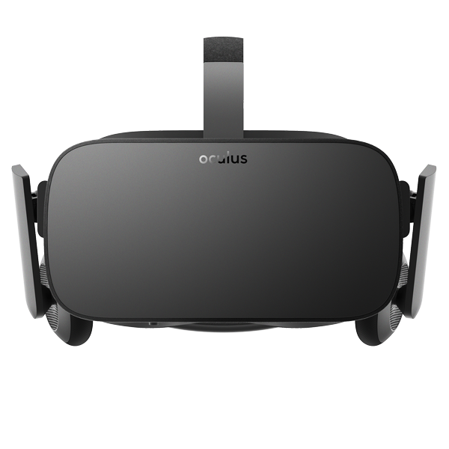
ACM -VR Demo and Discussion
February 16, 2018
Matthew Henry will be hosting a VR demo and discussion.
Bring your own device or try one out!
LH 133 at 4pm

