Slide 1
Git & Github
Crash course
Alyanne de Haan, Marc Teunis

Slide 2
Leervraag casussen:
Wat als github voorbij komt in overleg en ik wil toelichten?
→ vandaag: algemene kennis over git(hub) systeem
→ vandaag: met verdieping op security, licensing, privacy, version control
Knowledge base: reader blijft voorlopig online
Wat als wij bijv. een reprohack gaan begeleiden?
→ vandaag: zelf github gebruikt hebben
→ vandaag: je weg vinden op github.com
→ vandaag: bekend met main workflow, snappen wat coders bedoelen met github-termen

Slide 3
Starting with github

Slide 4
What is git?
Distributed Version Control system written by Linus Torvalds (Linux)
Open Source software written for the command line But many GUI-clients exist

Slide 5
Version control

Slide 6
Why version control?
“I will just finish my work and then you can start with your changes.”
“Oh, co-authors A and B both worked on this file synchronously, and now I have to merge their changes. Also, they disagree.”
“Can you please send me the latest version?”
“thesis_final_final_v2_thisone_THISONE.docx”

Slide 7
What is version control?
“management of changes to documents, computer programs, large web sites, and other collections of information.” (Wikipedia)
E.g. track changes (which is a pain to use and you cannot go back to a previous version)
Always find the latest version on the same spot
No more “thesis_final_final_v2_thisone_THISONE.docx”
Notes:
Although track changes is actually horrible, as it involves lots of clicking and accepting, and you cannot easily go back to a previous version.

Slide 8
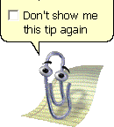
Crappy version control: track changes
Does not actually let you control versions.
Pros:
Editors love it
Notes:
Which is weird, because journals then import your document to indesign or QuarkXPress, which want plain text. Not executables (a docx is actually an executable, not a text document)

Slide 9
Low-fi version control
deHaan_etal_Nature_try315_2019_01_18
deHaan_etal_Nature_try315_2019_01_22
deHaan_etal_Nature_try315_2019_02_01

Slide 10
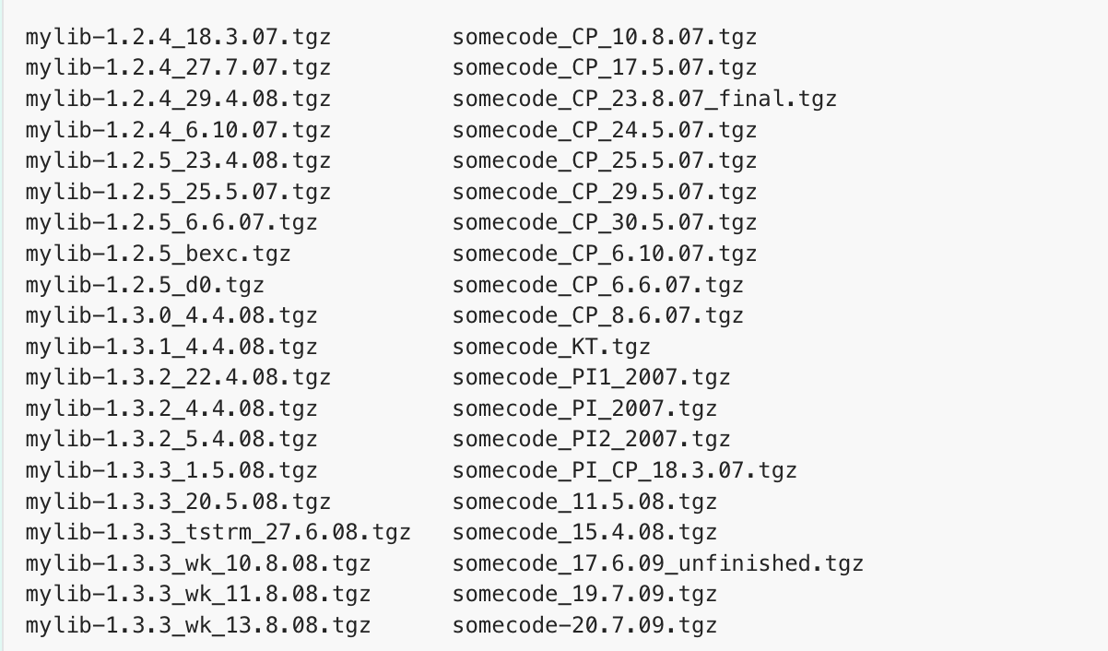
Low-fi version control
Pros
Works with every file
No software needed
Cons:
Collaboration
Bugs
Compatibility between files
It makes a mess of my laptop
Notes:
Nadeel?
Giving a version to a collaborator and merging changes later with own changes sounds like lots of work.
What if you discover a bug and want to know since when the bug existed?
Not clear which versions of mylib and somecode are compatible

Slide 11
“A yes, you must be older than you look.
We use onedrive / google docs nowadays!”

Slide 12
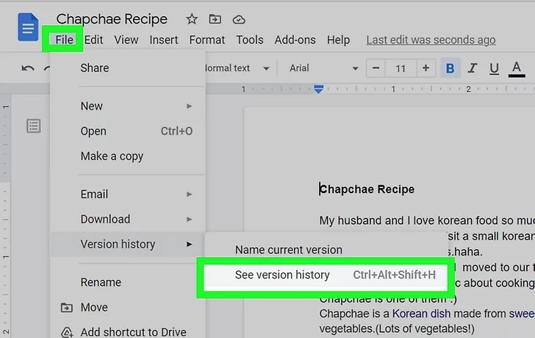
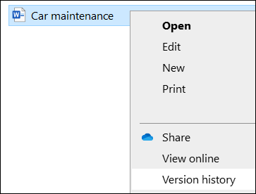
Medium-fi version control: google docs, onedrive
Image: microsoft.com
Image: https://www.wikihow.com/Check-Google-Doc-History
Notes:
Noth platofrm offer a version history. Better than track changes or low-fi options

Slide 13
Medium-fi version control: google docs, onedrive
Pros:
Easy
Stored in the cloud
Does merge changes by collaborators
Cons:
No branching (we’ll get to that)
No meta data, so not actually more insightful than the low-fi option: going back to “before a bug” means manually scrolling and guessing which version to use.
Reproducibility = low
No releases (other than low-fi)
Not distributed (easy to destroy the backup)

Slide 14
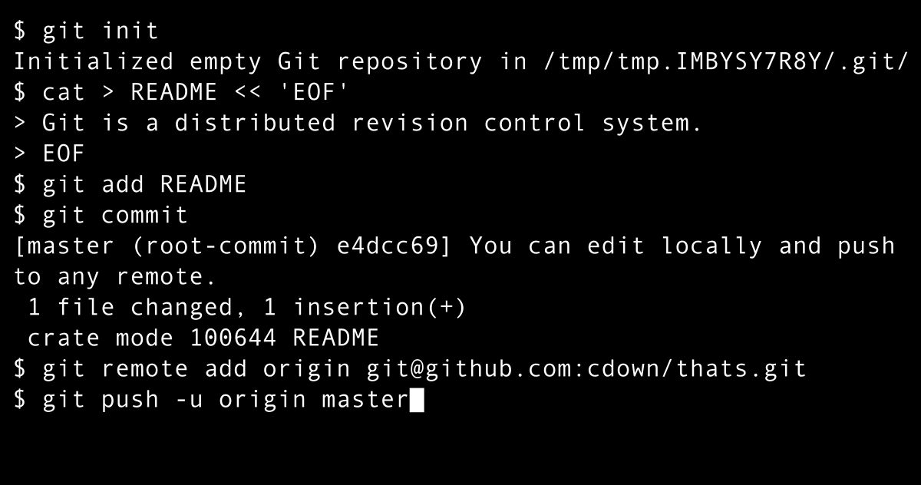
High-fi version control : Git
image: Chris Down Vector: Holek, Public domain, via Wikimedia Commons
Notes:
Zoals zoveel handige tools: je meot wel kunnen programmeren

Slide 15
High-fi version control : Git
“Oh great. But we are not programmers. So helaas pindakaas.”

Slide 16
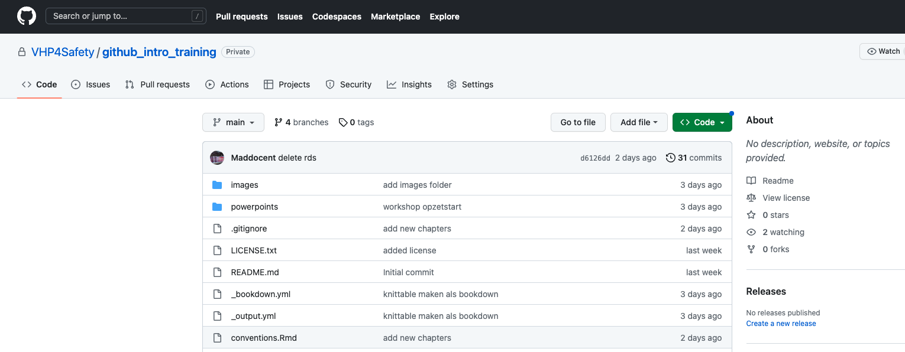




High-fi version control : Git with Github

Slide 17
High-fi version control : Git with Github
GitHub is a cloud storage system for git repositories.
Offers additional tools for collaboration
Works with web interface, or Github Desktop App , or Connects to Rstudio, or command line, or..

Slide 18
High-fi version control : Git with Github
Git handles version control on your repo
When you use GitHub, Git is working behind the scenes.

Slide 19
High-fi version control : Git with Github
Cons
Designed for and by IT crowd
Prefers text files (but can handle all)
No automatic syncing

Slide 20
High-fi version control : Git
Pros:
No automatic syncing! You are in control
Go back to a working version (releases)
Work on stuff without breaking the working version (branches)
Work on the same file with multiple people and have git solve the merging .. also when you worked offline and upload later (distributed)
When you find a bug, you can retrace when it was (meta data on changes)

Slide 21
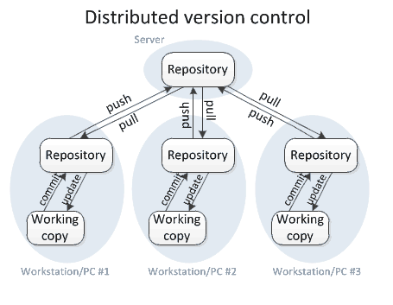
Distributed?
You do not add changes directly to the base camp (aka github)
No single point of failure:
Every local repo is a backup
You can mess up locally

Slide 22
Where do you publish code?
Living project: github
Version control
allows publication of different releases
platform for collaboration
Done: repositories such as OSF
Why → Gives a doi : makes code citeable
Notes:
Used for living documents. When done: give it a doi

Slide 23
So what about data?
Git is not a data platform
But used to version control workflows surrounding data
Git workflow stimulates documentation, meta data, accessibility, transparency

Slide 24
Let’s do this
Explore a github repo (Exercise 1)
Make a github repo , change stuff in your repo and see what happens (Exercise 2)

