Slide 1
Git(hub) workflow

Slide 2
https://www.youtube.com/watch?v=PhyUy7z4S-M

Slide 3
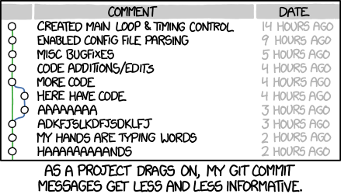
commits
Xkcd.com
Commit often. Each commit should be a package of changes that can be described in 1 commit message
Don’t edit for a day and commit it all at once
Gitignore files you do not want tracked
Work in branches, keep a stable version in the main

