Slide 1
Git & Github
Crash course
Alyanne de Haan, Marc Teunis

Slide 2
Leervraag casussen:
Wat als github voorbij komt in overleg en ik wil toelichten?
→ vandaag: algemene kennis over git(hub) systeem
→ vandaag: met verdieping op security, licensing, privacy, version control
Knowledge base: reader blijft voorlopig online
Wat als wij bijv. een reprohack gaan begeleiden?
→ vandaag: zelf github gebruikt hebben
→ vandaag: je weg vinden op github.com
→ vandaag: bekend met main workflow, snappen wat coders bedoelen met github-termen

Slide 3
Git/github: why would you use it?
Ca 20-30 minutes while we drink coffee

Slide 4
What is git?
Distributed Version Control system written by Linus Torvalds (Linux)
Open Source software written for the command line But many GUI-clients exist

Slide 5
Okay then, why version control

Slide 6
Why version control? To solve:
“I will just finish my work and then you can start with your changes.”
“Oh, co-authors A and B both worked on this file synchronously, and now I have to merge their changes. Also, they disagree.”
“Can you please send me the latest version?”
“thesis_final_final_v2_thisone_THISONE.docx”

Slide 7
What is version control?
“.. management of changes to documents, computer programs, large web sites, and other collections of information.” (Wikipedia)
E.g. track changes (which is a pain to use and you cannot go back to a previous version)
Notes:
Although track changes is actually horrible, as it involves lots of clicking and accepting, and you cannot easily go back to a previous version.

Slide 8
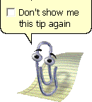
Crappy version control: track changes
Does not actually let you control versions.
Pros:
Editors love it
Notes:
Which is weird, because journals then import your document to indesign or QuarkXPress, which want plain text. Not executables (a docx is actually an executable, not a text document)

Slide 9
Low-fi version control: copy and rename
deHaan_etal_Nature_hopelesstry315_2019_01_18.docx
deHaan_etal_Nature_hopelesstry315_2019_01_22.docx
deHaan_etal_Nature_hopelesstry315_2019_02_01.docx

Slide 10
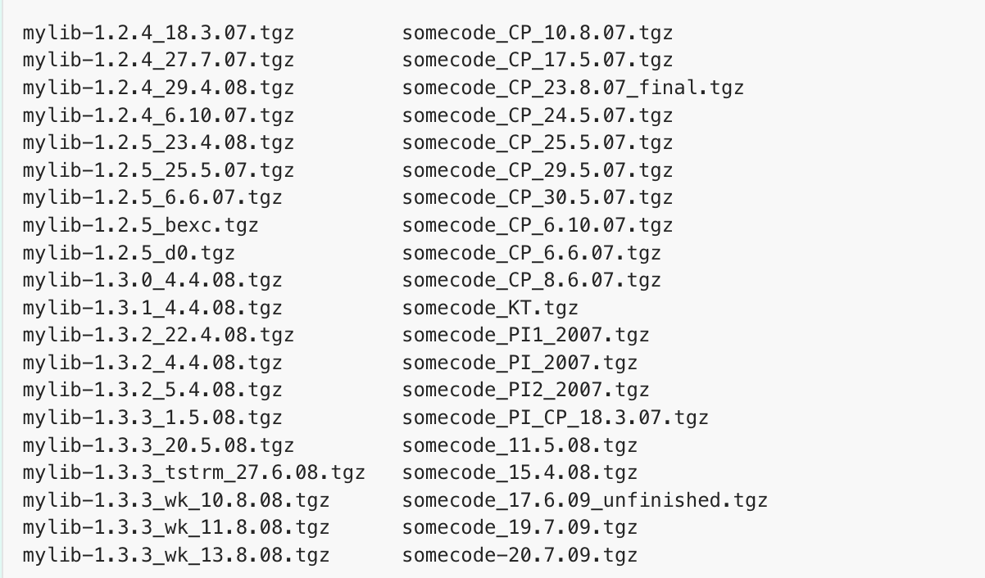
Low-fi version control: copy and rename
Pros
Works with every file
No software needed
Cons:
Collaboration
Bugs
Compatibility between files
It makes a mess of my laptop
Notes:
Collaboration: merging changes later with own changes ...
Bugs: want to know since when the bug existed?
Compatibility: Not clear which versions of mylib and somecode are compatible

Slide 11
“A yes, you must be older than you look.
We use onedrive / google docs nowadays!”

Slide 12
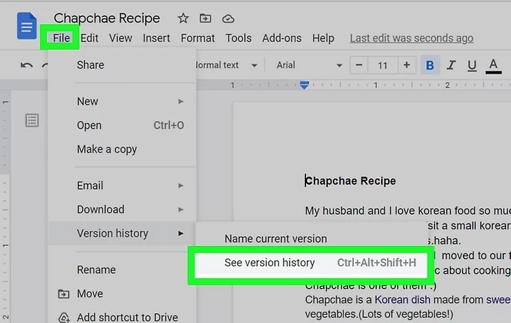
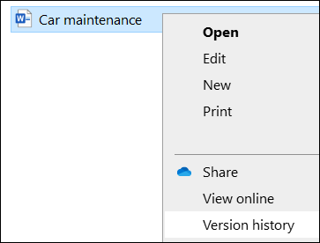
Medium-fi version control: google docs, onedrive
Image: microsoft.com
Image: https://www.wikihow.com/Check-Google-Doc-History
Notes:
Both platforms offer a version history. Better than track changes or low-fi options

Slide 13
Medium-fi version control: google docs, onedrive
Pros:
Easy
Stored in the cloud
Does merge changes by collaborators
Cons:
No branching (we’ll get to that)
No meta data, so not actually more insightful than the low-fi option: going back to “before a bug” means manually scrolling and guessing which version to use.
Reproducibility = low
No releases (other than low-fi)
Not distributed (easy to destroy the backup)

Slide 14
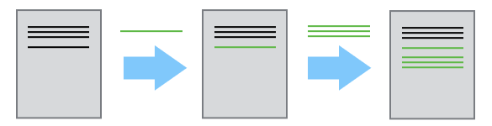
High-fi: Version control systems
Version control systems start with a base version of the document and then save just the changes
Image from: Version control with git (https://carpentries-incubator.github.io/git-novice-branch-pr/01-basics/)

Slide 15
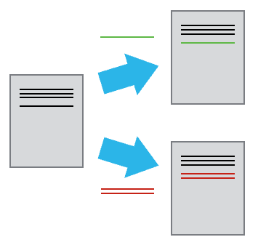
High-fi: Version control systems
Version control systems start with a base version of the document and then save just the changes
Image from: Version control with git (https://carpentries-incubator.github.io/git-novice-branch-pr/01-basics/)
Notes:
Also with different sets of changes

Slide 16
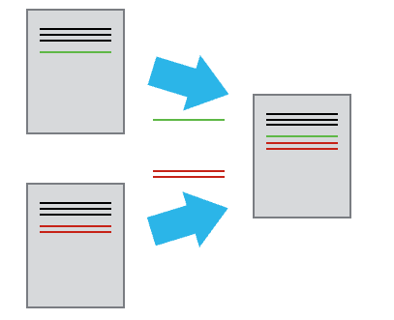
High-fi: Version control systems
Version control systems start with a base version of the document and then save just the changes
Image from: Version control with git (https://carpentries-incubator.github.io/git-novice-branch-pr/01-basics/)
Notes:
Which can be merged later

Slide 17
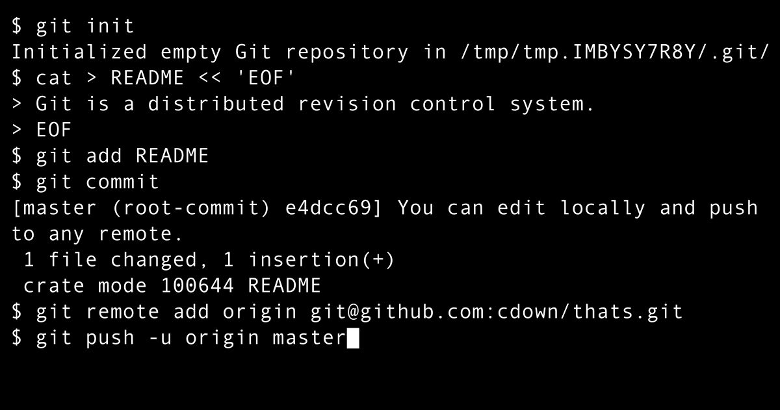
High-fi version control : Git
image: Chris Down Vector: Holek, Public domain, via Wikimedia Commons
Notes:
Zoals zoveel handige tools: je meot wel kunnen programmeren

Slide 18
“Oh great. But we are not programmers.
So unfortunately peanutbutter.”

Slide 19
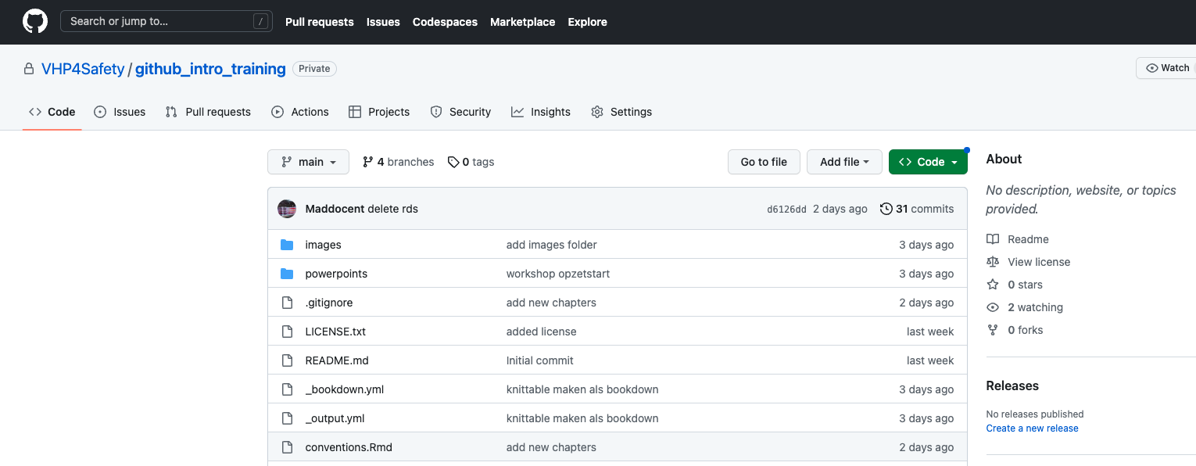
High-fi version control : Git with Github
Git handles version control on your repo
When you use GitHub, Git is working behind the scenes.
Notes:
Or gitlab or bitbucket

Slide 20
High-fi version control : Git with Github
GitHub is a cloud storage system for git repositories.
Does not need to be code, also text, or just any file
Reproducible data analysis = code (join a course!)
Offers additional tools for collaboration (demo this afternoon)

Slide 21

High-fi version control : Git with Github
Cons
Designed for and by IT crowd *
Prefers text files (but can handle all)
No automatic syncing
* Highly recommended by the way as a TV series

Slide 22
High-fi version control : Git with Github
Pros:
No automatic syncing! You are in control
Go back to a working version (releases)
Work on stuff without breaking the working version (branches)
When you find a bug, you can retrace when it was (meta data on changes)
have git solve merging .. also when you worked offline and upload later (distributed)

Slide 23
What is git?
Distributed Version Control system written by Linus Torvalds (Linux)
Open Source software written for the command line But many GUI-clients exist

Slide 24
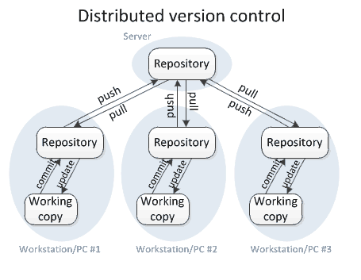
Distributed?
You do not add changes directly to the base camp (aka github)
No single point of failure:
Every local repo is a backup
You can mess up locally
Notes:
Covered the version control part, what about distributed?

Slide 25
When to use github
Living project: github
Version control
allows publication of different releases
platform for collaboration
Done: repositories such as OSF
Why → Gives a doi : makes code citeable
Notes:
Used for living documents. When done: give it a doi

Slide 26
So what about data?
Git is not a data platform
But used to version control workflows surrounding data
Git workflow stimulates documentation, meta data, accessibility, transparency

Slide 27
Maxime’s video:
Some people are way better at explaining stuff than at visual animations.
https://www.youtube.com/watch?v=PhyUy7z4S-M

Slide 28
Before lunch
This was the only powerpoint
Watch a video together
Explore a github repo (Exercise 1)
Make a github repo (Exercise 2)
change stuff in your repo and see what happens (Exercise 3)
Demo : git workflow from Rstudio

Slide 29
After lunch:
github tools and options: releases, issues and projects
collaborating on someone else’s project
When things won’t merge: git conflicts
Licenses and security

Slide 30
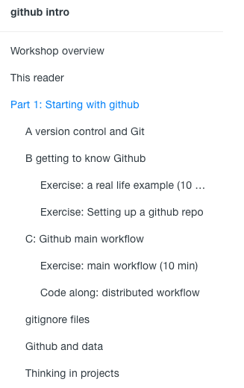
https://lesmaterialen.rstudio.hu.nl/github_intro

