Slide 1


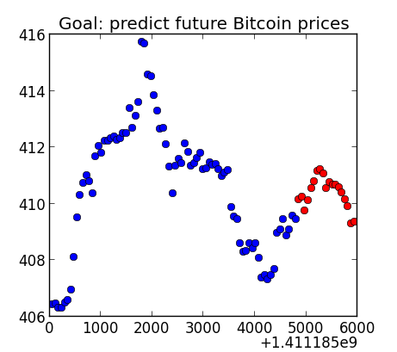

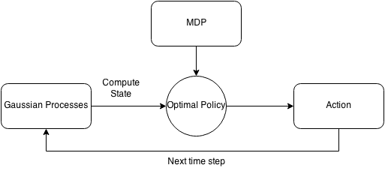
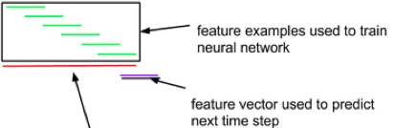
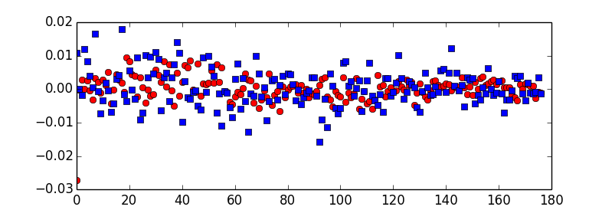
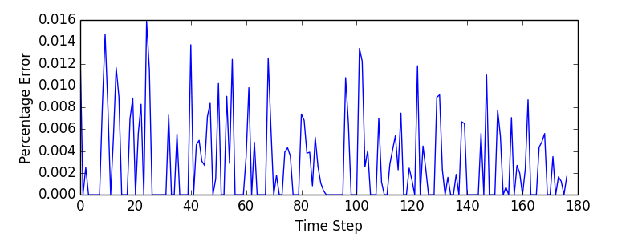
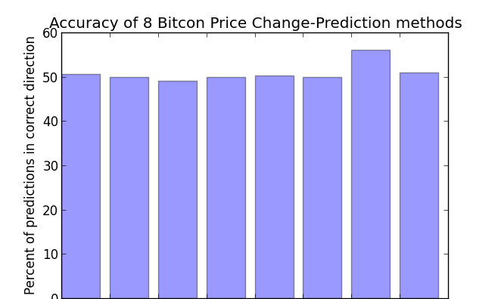
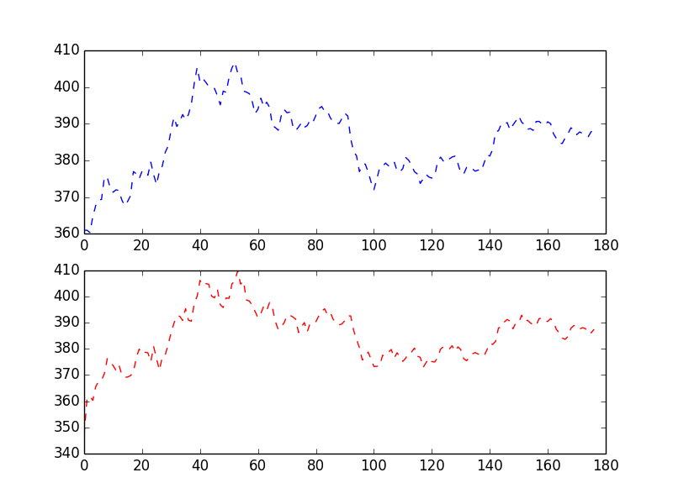
How to Succeed in BitCoin Without Really Trying
Abaho Katabarwa, Guoxing Li, Ellen Sebastian
Introduction
Price prediction algorithms & results
Trading decision algorithms
Bitcoin is the world’s first decentralized cryptocurrency. In this project, we take advantage of various concepts in artificial intelligence and the vast amount of transactional data surrounding Bitcoin to create a Bitcoin trading bot. This bot will maximize profit by predicting future Bitcoin prices.
We split the task into two phases: price prediction and trading decisions. Since trading decisions can be made easily given perfect price predictions, the main challenge in this project was to generate accurate price predictions.
Goal: predict n future Bitcoin price changes over dt from past bitcoin prices and other data
Neural Networks
Neural Networks past future
Our most effective method of price
Prediction was a Neural Network
In which we trained the network on
Multiple windows of past prices and
Used a final window to predict an
Unseen future price.
Regression
Gaussian regression outputs a standard deviation for the prediction (useful for MDP transition probabilities).
We combined Bayesian regression with k-means trend clustering learn from hidden Bitcoin price trends.
We framed the trading decision as a recommendation of the optimal time(s) to sell a fixed number of Bitcoins within an allotted amount of time.
Markov Decision Process
States: (time remaining, bitcoins remaining, price diff (predicted price – bought price), stdev of predicted price)
Actions: {sell i bitcoins, do nothing}
Rewards(s, a, s): -#bitcoins sold in action a * s[price diff]
Transition probabilities: T(s,a,s) ~ N(s[price diff],s[std]2)
IsEnd(s): s[time remaining] = 0
Constraint Satisfaction Problem
Variables: number of bitcoins to sell at each timestamp.
Potential: earlier, more certain predictions are weighted higher.
Potential:
Potential: do not sell more Bitcoins than you own.
Potential: more profit→higher weight.
Gaussian regression
Stdev for price for t_{i+dt}
Price + other features for t₁…t_{i}
Ridge/Bayesian/Linear/Logistic regression, neural network, SVM
Predicted price for t_{i+dt}
Historical price & trading data
Regression, Neural Net, SVM
Future predicted prices
CSP, MDP
Trading decisions
Bitcoin bot
Max(predicted profit,1)
Max(profit,1)
Profit!
Sum <= bitcoins in wallet
Data Acquisition and processing
Sell at t=1?
Sell at t=2?
Minute-granularity historical prices
Various Bitcoin statistics, e.g. market volume
Sampled order book data → buy/sell ratios
Missing data was cubic-spline interpolated or imputed when appropriate
1/log(i+1)
1/log(i+1)
Future work
Take the second derivative of price in order to predict its first derivative.
Use a binary classifier to predict negative or positive changes.
Include more non-price data; continue searching for granular data.
Integrate with Bitcoin trading APIs to create bot
Analysis
Price prediction continues to be the most difficult and most important aspect of bitcoin bot creation
CSP chooses the optimal action given perfect price predictions
Notes:
Ellen: Intro, CSP, Regression, data collection
Guoxing: gaussian regression, bayesian, MDP
Abaho: neural networks, SVM
Neuralnet – 56%
Gaussian – 50.2% (rerun)
Bayesian regression – 51%
SVM – 50%
Analysis:
We predict price very well (figure)
However, it is more important to predict that change in price.
We also predict an optimal policy well given perfect price predictions in pilot studies.
The challenge that remains is to predict the change in price; we currently achieve about 55% accuracy.
Future ideas: taking the second derivative of price to predict its first derivative; using a binary classifier for +/- changes; including more data
Actual=blue, predicted=red

