Slide 1


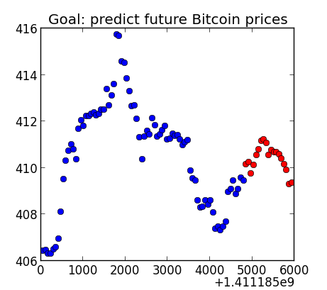

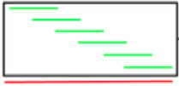
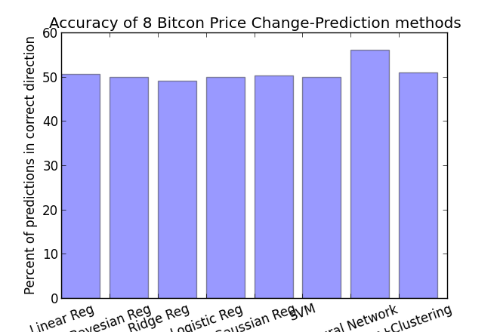
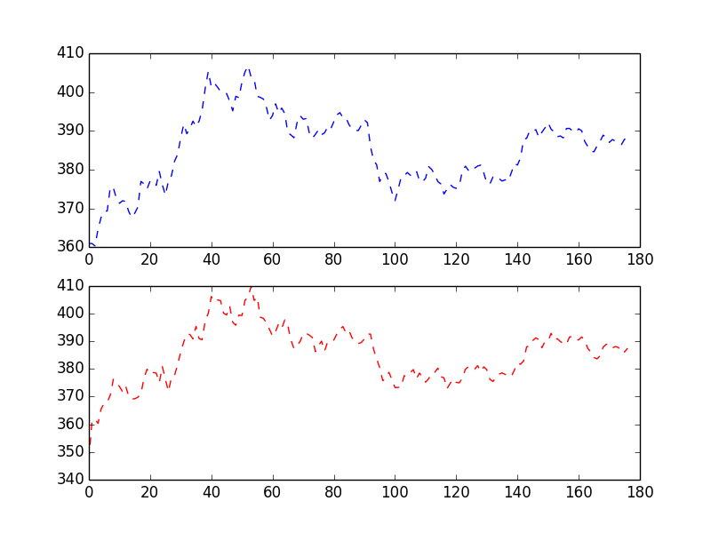
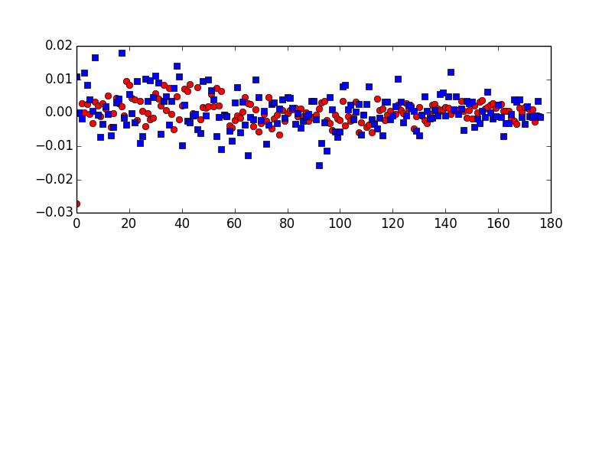
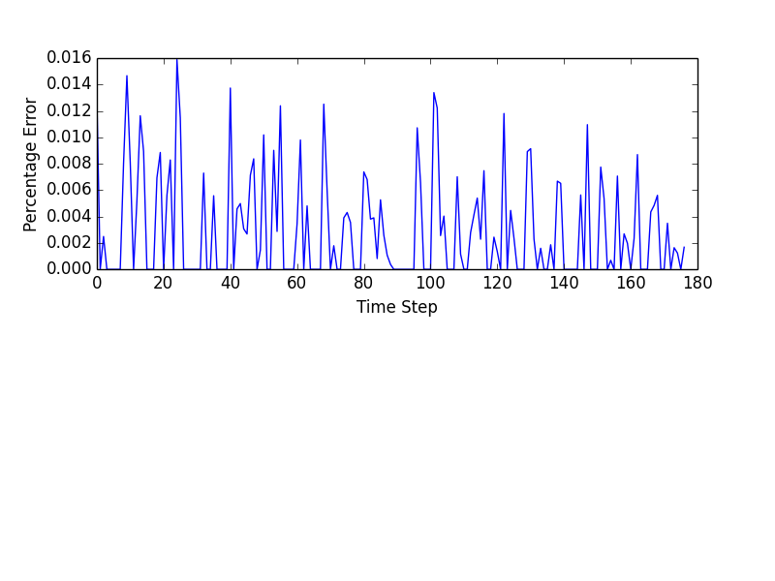

How to Succeed in BitCoin Without Really Trying
Abaho Katabarwa, Guoxing Li, Ellen Sebastian
Introduction
Price prediction algorithms & results
Trading Decision Algorithms
Bitcoin is the world’s first decentralized cryptocurrency. In this project, we take advantage of the vast amount of transactional data surrounding Bitcoin to create a Bitcoin trading bot. This bot will maximize profit by predicting future Bitcoin prices.
We split the task into two phases: price prediction and trading decisions. Since trading decisions can be made easily given perfect price predictions, the main challenge in this project isto generate accurate price predictions.
Goal: predict n future Bitcoin price changes over dt from past bitcoin prices and other data
Neural Networks
Neural Networks past future
Our most effective method of price
Prediction was a Neural Network
In which we trained the network on
Multiple windows of past prices and
Used a final window to predict an
Unseen future price.
Regression
Gaussian regression outputs a standard deviation for the prediction (useful for MDP transition probabilities).
We combined Bayesian regression with k-means trend clustering learn from hidden Bitcoin price trends.
We framed the trading decision as a recommendation of the optimal time(s) to sell a fixed number of Bitcoins within an allotted amount of time.
Markov Decision Process
Standard deviations come from Gaussian regression in the Price Prediction stage.
States: (time remaining, bitcoins remaining, pricediff (predicted price – bought price), stdev of predicted price)
Actions: {sell i bitcoins, do nothing}
Rewards(s, a, s): -#bitcoins sold in action a * s[pricediff]
Transition probabilities: T(s,a,s) ~ N(s[pricediff],s[stdev]²)
IsEnd(s): s[time remaining] = 0
Constraint Satisfaction Problem
Variables: number of bitcoins to sell at each timestamp.
Potential: Do not sell more Bitcoins than you own.
Potential: timestamps with more certain (earlier) predictions are weighted higher: 1/log(timestamp+2)
Potential: timestamps with higher predicted prices have higher weight=max(predicted profit,1)
Re-calculate CSP when new data received.
Gaussian regression
St.dev. for price for t_{i+dt}
Price + other features for t₁…t_{i}
Ridge/Bayesian/Linear/Logistic regression, neural network, SVM
Predicted price for t_{i+dt}
Historical price & trading data
Regression, Neural Net, SVM
MDP
Future predicted prices
Feature examples used
to train neural network
Gaussian process
Compute state
Optimal policy
Action
CSP, MDP
Trading decisions
Feature examples used
To predict next time step
Next time step
Bitcoin bot
A
Accuracy of 8 Bitcoin Price Change-Prediction methods
Predicted vs. Actual Bitcoin Price Changes (Neural Net)
Profit!
B
Data Acquisition & Processing
Max(predicted profit,1)
Max(profit,1)
Minute-granularity historical prices
Various Bitcoin statistics, e.g. market volume
Sampled order book data → buy/sell ratios
Missing data was cubic-spline interpolated or imputed when appropriate
Sum <= bitcoins in wallet
Sell at t=1?
Sell at t=2?
Linear Reg.
Bayesian Reg.
Ridge Reg.
Logistic Reg.
Gaussian Reg.
SVM
Neural Net
Bayes+Cluster
Predicted vs. Actual Bitcoin Price Changes (Neural Net)
Bitcoin Price Change Prediction Errors
1/log(1+2)
1/log(2+2)
Analysis
C D
Future work
CSP chooses the optimal action given perfect price predictions
Neural network is the best price prediction method
Price prediction is poor overall, achieving maximum 56% accuracy
Price prediction continues to be the most difficult and most important aspect of bitcoin bot creation
The main objective of future work will be to improve price prediction.
Take the second derivative of price in order to predict its first derivative.
Use a binary classifier to predict negative or positive changes.
Include more non-price data; continue searching for granular data.
Integrate with Bitcoin trading APIs to create bot
Bitcoin price prediction errors. (A) Different methods of price prediction achieve 50-56% accuracy, where an “accurate” prediction has the same sign as the actual price change. (B) Price predictions (derived from price change predictions) vs. Actual bitcoin price. They follow the same trend due to the small change at each time step. (C) Predicted vs. actual price changes for SVM; other algorithms are similar.
(D) Price change prediction errors; other algorithms are similar. Errors are roughly uniform across examples.
Notes:
Ellen: Intro, CSP, Regression, data collection
Guoxing: gaussian regression, bayesian, MDP
Abaho: neural networks, SVM
Neuralnet – 56%
Gaussian – 50.2% (rerun)
Bayesian regression – 51%
SVM – 50%
Analysis:
We predict price very well (figure)
However, it is more important to predict that change in price.
We also predict an optimal policy well given perfect price predictions in pilot studies.
The challenge that remains is to predict the change in price; we currently achieve about 55% accuracy.
Future ideas: taking the second derivative of price to predict its first derivative; using a binary classifier for +/- changes; including more data
Actual=blue, predicted=red

