Slide 1


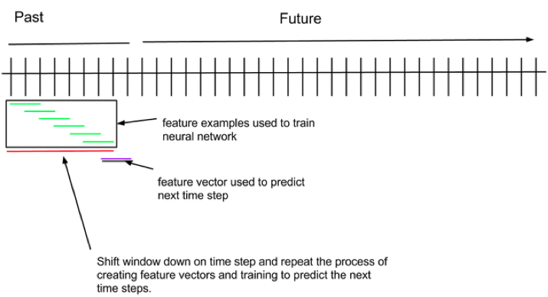
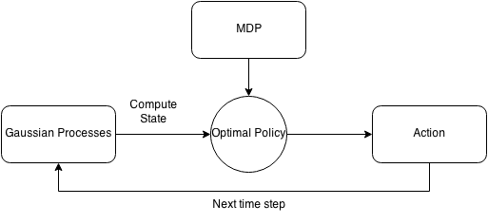
How to Succeed in Bitcoin Without Really Trying
Abaho Katabarwa, Guoxing Li, Ellen Sebastian
Introduction
Introduction
Introduction
Introduction
Introduction
Price prediction algorithms & results
Trading decision algorithms & results
Bitcoin is the world’s first decentralized cryptocurrency. In this project, we take advantage of various concepts in artificial intelligence and the vast amount of transactional data surrounding Bitcoin to create a Bitcoin trading bot. This bot will maximize profit by predicting future Bitcoin prices.
We split the task into two phases: price prediction and trading decisions. Since trading decisions can be made easily given perfect price predictions, the main challenge in this project was to generate accurate price predictions.
Stdev for price for t_{i+dt}
We framed the trading decision as a recommendation of the optimal time(s) to sell a fixed number of Bitcoins within an allotted amount of time.
Markov Decision Process
Our MDP model is formulated as follows, the predicted price and standard deviation is computed from Gaussian Processes:
States: (time remaining, bitcoins remaining, price diff (predicted price – bought price), std of predicted price)
Actions: {sell i bitcoins, do nothing}
Rewards(s, a, s): -#bitcoins sold in action a * s[price diff]
Transition probabilities: T(s,a,s) ~ N(s[price diff],s[std]2)
IsEnd(s): s[time remaining] = 0
Constraint Satisfaction Problem
Imrpove this diagram
Neural Networks
Bayesian Regression
In this method, we utilized the algorithm proposed by [1]. Studies suggest that there are hidden geometric patterns for price movements, which could be used to predict future price changes. We constructed tens of most common and effective patterns of different lengths by running k-means algorithm, and then use them to train a linear model which predicts price changes.
SVMs
Comparison of Price Prediction Algorithms
Gaussian regression
Price + other features for t₁…t_{i}
Ridge/Bayesian/Linear/Logistic regression, neural network, SVM
Predicted price for t_{i+dt}
Historical price & trading data
Regression, Neural Net, SVM
Future predicted prices
CSP, MDP
Trading decisions
Bitcoin bot
Profit!
Data Acquisition and processing
Minute-granularity historical Bitcoin-USD conversion rates
Various Bitcoin statistics, e.g. market volume
Sampled order book data, which generates buy/sell ratios
Missing data was cubic-spline interpolated when appropriate
Notes:
Ellen: Intro, CSP, Regression, data collection
Guoxing: gaussian regression, bayesian, MDP
Abaho: neural networks, SVM
Neuralnet – 56%
Gaussian – 50.2% (rerun)
Bayesian regression – 51%

