Slide 1

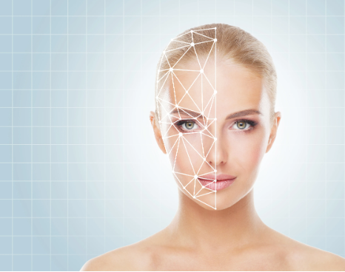
DEPARTMENT OF ELECTRONICS & COMMUNICATION ENGINEERING
BEAUTY.AI
Presented By:
P.RUCHITHA(21KE1A0444)
S.DHANASRI(21KE1A0454)
E.SUKANYA(21KE1A0415)
J.GAYATRI(21KE1A0418)
P.SRAVANTI(21KE1A0449)

Slide 2
CONTENTS
I
Introduction
Problem statement
Existing System
Proposed Method
Features
Customer segment
Conclusion

Slide 3
INTRODUCTION:
Beauty.Ai is an innovative technology that uses artificial intelligence to analyze facial features and provide personalized beauty recommendations. The platform offers innovative solutions for personalized beauty recommendations, skin analysis, and virtual try-on experiences, providing users with an enhanced beauty journey.

Slide 4
PROBLEM STATEMENT:
Traditional beauty products and services often fail to provide personalized recommendations tailored individual needs and preferences. Oily skin has a thick barrier. Dry skin has a very poor barrier and loses water easily. Oily skin products are formulated to control excess oil production and May contain ingredients that can be too drying for already dry skin. It's important to use products specifically designed for dry skin and oily skin

Slide 5
EXSISTING SYSTEM:
Consumers rely on conventional beauty products and services without the benefits of advanced technology and personalized insights. A morning skincare routine for oily skin begins with cleansing your skin with a gentle cleanser, toning with a non-alcoholic toner, applying a serum, and a lightweight moisturizer, eye cream, and sunscreen, and incorporating an exfoliat or twice a week. Next, add a clay-based face mask twice a week. Dry skin lacks moisture, causing dry, rough, or flakey skin. It's common to experience dry skin during cooler months. dry skin for the elements by adding moisture to your lacking skin barrier. Dry skin products are ceramids and hyaluronic acid.

Slide 6
PROPOSED SYSTEM:
Beauty.Ai aims to enhance personalization through advanced algorithms and user-centric beauty solutions. transforming the traditional beauty landscape. consumers to enhance their beauty routines and make informed skincare and makeup choices. To provide highly personalised product recommendations.

Slide 7
FEATURES:
Personalized Recommendations
Advanced Skin Analysis
Trends of the Future.
AI-Enhanced Retail Experiences. ...
Advanced Skin Analysis.

Slide 8
CUSTOMER SEGMENT:
Beauty Enthusiasts:
Targeting individuals passionate about exploring and embracing innovative beauty solutions and experiences.
Tech-Savvy Consumers:
Aimed at tech-savvy individuals who appreciate the integration of artificial intelligence and advanced technology in their beauty routines.

Slide 9
CONCLUSION:
Beauty.Ai has revolutionized the beauty by offering personalized skincare and makeup recommendations.
Beauty tech brand beauty stack takes its users through an entertaining sign up journey that immerses
audiences in the process and brands tone of voice before they reach the general platform.

