Slide 1

Designing On-farm Research Trials with R
Brittani Edge
Graduate Research Assistant with Data Intensive Farm Management Project

Slide 2
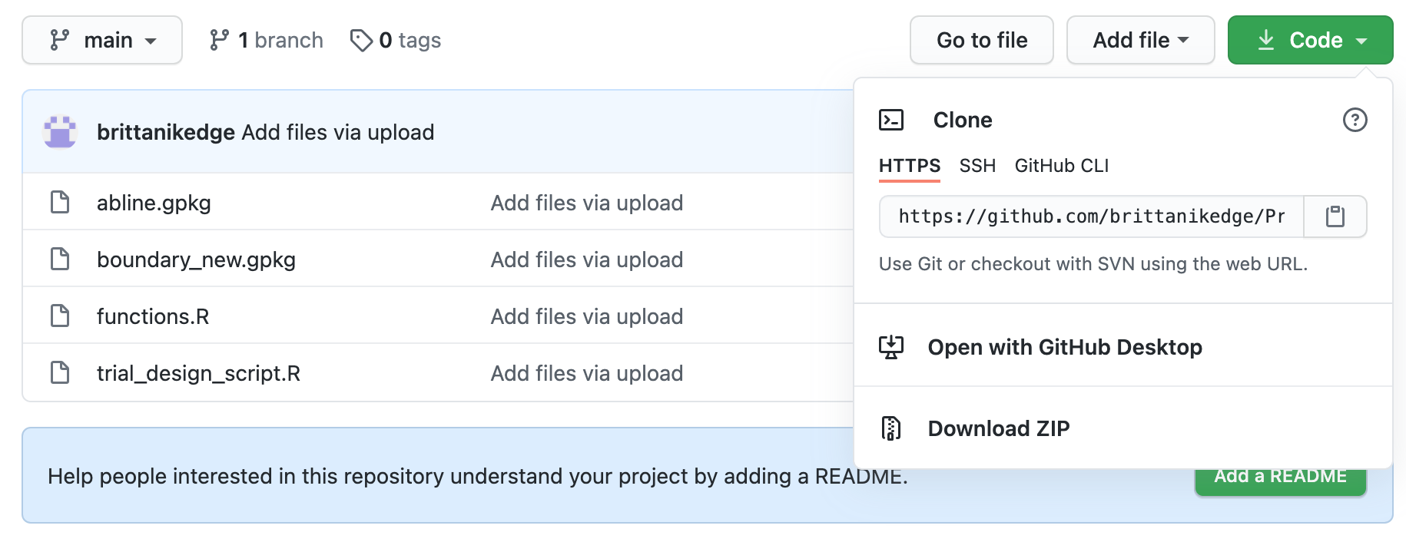
Goals for Today’s Presentation
Know the inputs needed to design a trial
Introducing common issues seen in agricultural trials
Give you resources to learn about designing your own trials
This presentation and sample scripts can be found here https://github.com/brittanikedge/Precision-Agriculture-Producer-Materials.
Download the files by clicking the green Code button and select Download ZIP

Slide 3
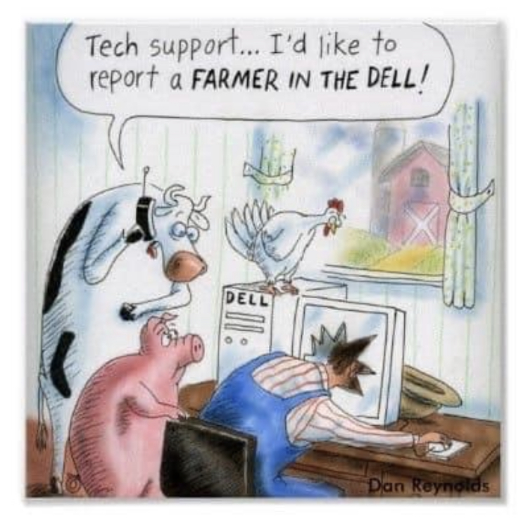
R Resources
The method for designing trials relies on the use of R, a free software available for Mac and Windows.
Below is a guide for downloading R and R Studio on your computer. R Studio is a more user-friendly environment for writing and running R scripts, but you cannot use R Studio without downloading R first!
R Download Source
How to Execute R Code
Learning a new computer program is always frustrating, but there are many resources when you have problems.
And I’m happy to answer any questions you may have!

Slide 4
Trial Design Basics
To design a trial, you need the following components:
The boundary file for the study area (this should be a shapefile)
The guidance line that will be used for operation (if multiple guidance lines are used, we should talk more)
The machinery widths and section numbers
The desired trial rates

Slide 5
R Scripts
An R script is a set of instructions that are read each time you want to perform a specific task.
There is an R script called trial_design.R in the GitHub repository.
If you download the repository on your personal computer and have downloaded R, you can run the script with your own data or use the sample field we will see here.

Slide 6
Bringing Data Into R
The following code reads the boundary file called boundary_new.shp. This will need to be changed to the name of your field’s boundary when you go to design a trial.
We will also read the abline and then we can design the trial.
boundary <- file.path(here("boundary_new.gpkg")) %>% st_read() %>% st_make_valid() %>% st_transform_utm()

Slide 7
Trial Design Code
The function trial_design() designs a trial with your trial rates, following the guidance line and machinery widths for your field.
The functions saves the trial with the name trial.shp, but this will be changed for your specific field and year of the trial.
trial <- trial_design(boundary = boundary, abline = ab_line,
width = conv_unit(60, "ft", "m"),
length = 200,
rates = c(120, 160, 220, 260),
file_name = "trial.shp")

Slide 8
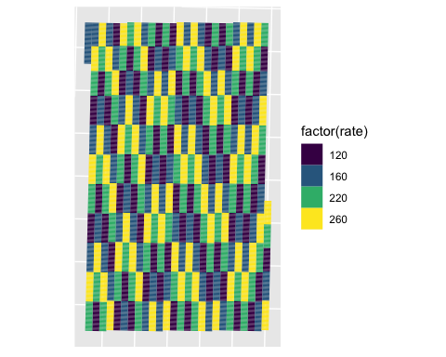
Trial Map

Slide 9
Issues with Trial Design
Machinery Widths - Are your machinery widths compatible? Are the widths multiples of each other.
Alignment - Do you line the edge of your machine to the guidance line or the center of your machine?
Machinery Age - How responsive is your VR equipment? Can it quickly change applied rates when entering a new trial plot?

Slide 10
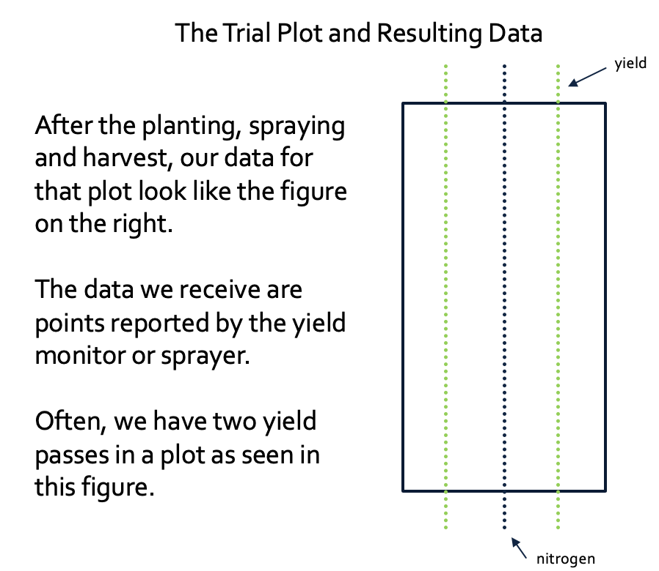
Machinery Widths
Ideally, machinery widths will be something like 60-foot planter and sprayer and a 30-foot yield monitor.
Then we can have two harvest passes in a 60-foot-wide trial plot as shown on the right.
We generally make the trial plots the width of the least common multiple.
If that is very wide, you might have to accept some data loss.

Slide 11
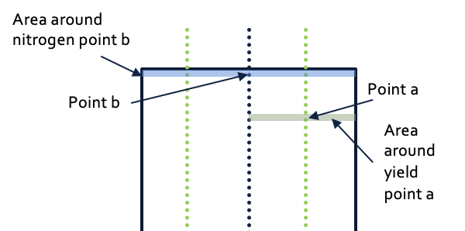
Why do Machinery Widths Matter?
A good yield measurement comes from a harvest area that was all given the same treatment.
If there was a misalignment, the harvester is collecting partially from an area with a different treatment.
Then the yield value reported is the average of the yield from the two different treatment.
This presents a challenge when analyzing the effect of treatments.

Slide 12
Misapplication Examples
These yield observations did not receive the nitrogen rate seen in the plot
This is the most challenging case as you have the machinery switching rates and zones much faster than intended
These yield observations came from two different nitrogen applications
1. Example with misaligned nitrogen application
2. Example with misaligned harvesting
3. Example with wrong farming direction in design

Slide 13
Age of Machinery
Not all machinery is suitable for an agronomic trial.
There may be a significant lag for the applied rate to stabilize after entering a new target rate.
We try to minimize this issue by not allowing large jumps in the target rate along the guidance lines.
In the trial map, you will not see any changes from the lowest rate to the highest rate in a single pass.

Slide 14
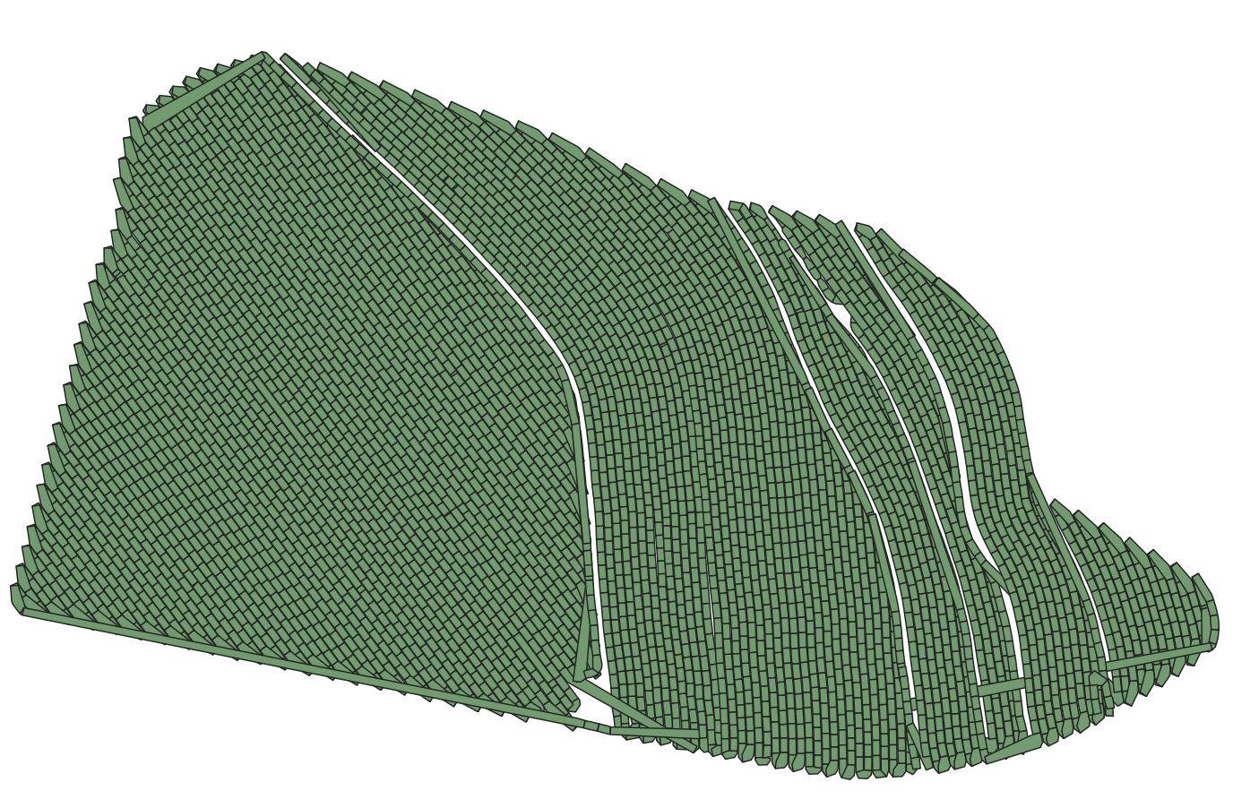
Curved or Multiple Guidance Lines
If you have multiple guidance lines across the field, we need to use an asapplied or harvest file to create the trial
The code for this case is still being developed by DIFM. Early products look like the field on the right.
We make polygons from a harvest or planting file and then create the trial from there.
We hope to be able to do this in a fast and consistent way in the future!

Slide 15
Thank you!
I’m happy to take any additional questions, comments, or concerns!

