Slide 1


www.students.aberrobotics.club
Aberystwyth Robotics Club
News
07/03/2018

Slide 2
www.students.aberrobotics.club
Committee
Positions Available:
President
Treasurer
Secretary
Publicity Officer
http://students.aberrobotics.club/committee

Slide 3
www.students.aberrobotics.club
Manchester Robotics Exhibition
Wednesday 21st March 2018
Museum of Science and Industry, Manchester
~ £40 – includes two way train ticket and admission.
https://www.msimanchester.org.uk/whats-on/robots

Slide 4
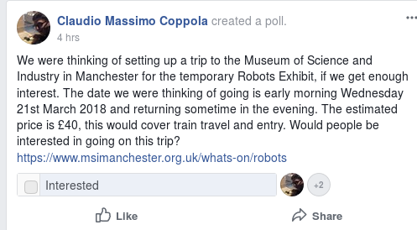
www.students.aberrobotics.club
Manchester Robotics Exhibition
Let AberCompSoc know on Facebook:
https://www.facebook.com/groups/AberCompSoc/

