Slide 1

“
Stocks Comparison
EA VS ACTIVISION BLIZZARD
Ziqi Gong / Tianyao Feng / Siying Yang / Xi Yang
”
Group I

Slide 2
PART 01.
Source and Manipulation
Introduction about the two companys
and basic analysis in Tableau

Slide 3
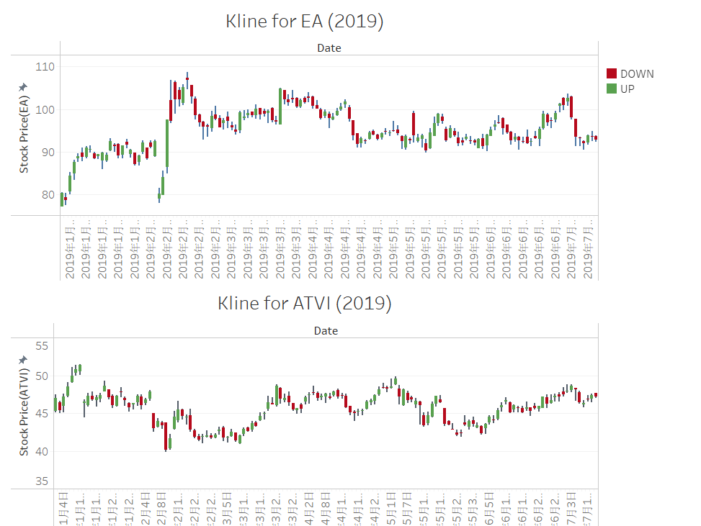


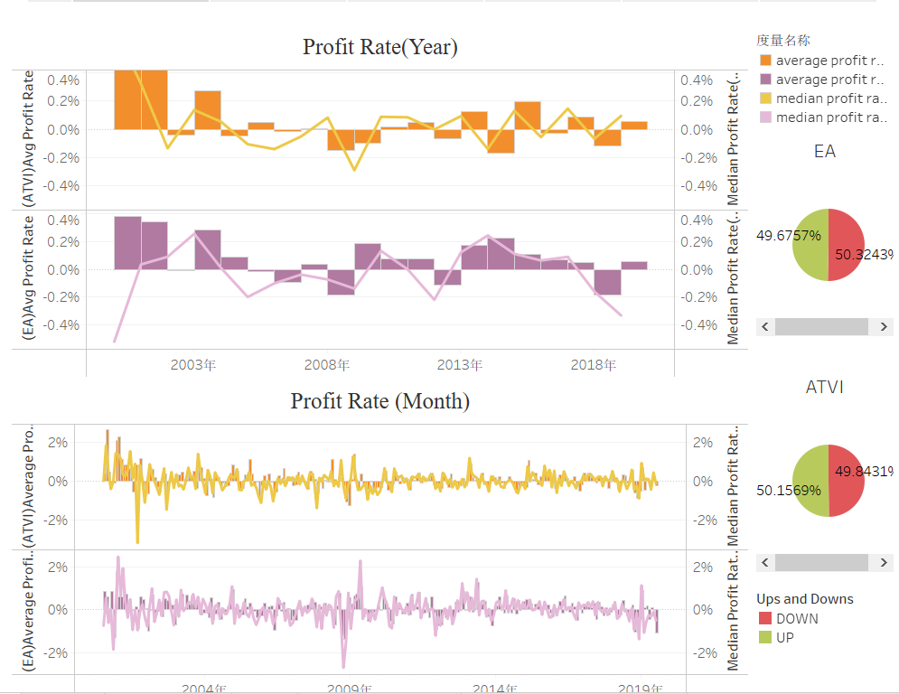
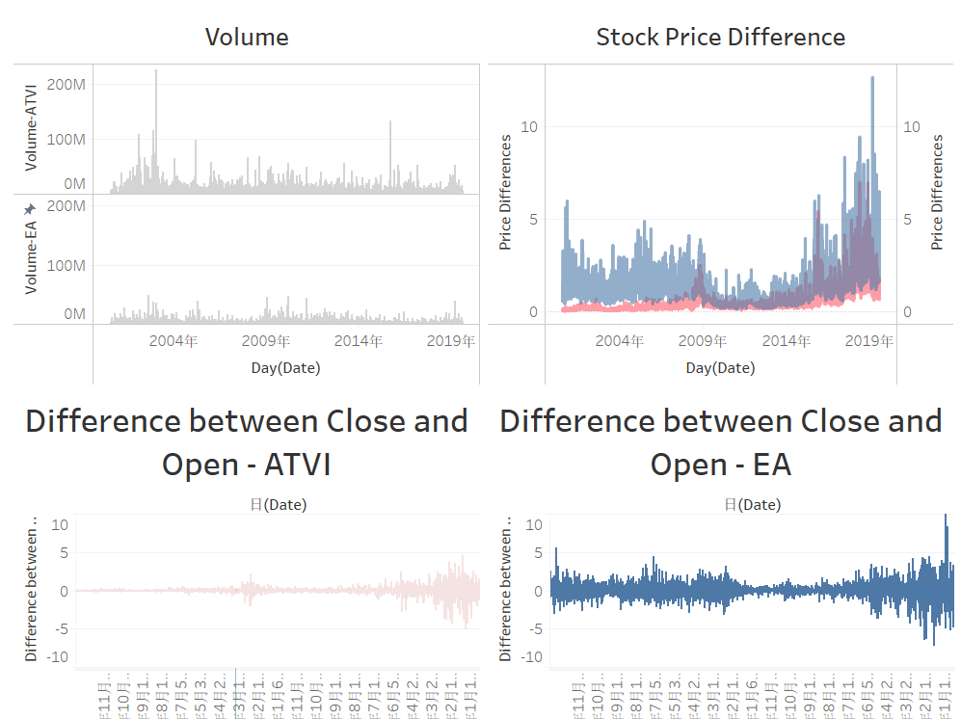
Source and Manipulation
PART ONE
Data Source
Kline
Basic Analysis
EA
ATVI
Less funds
more fluctuation
more activity
Better profitability
Bigger funds
less fluctuation
less activity
Less profitability

Slide 4
PART 02.
KPIs in Tableau
Introduction about two KPI: MA & BBI

Slide 5
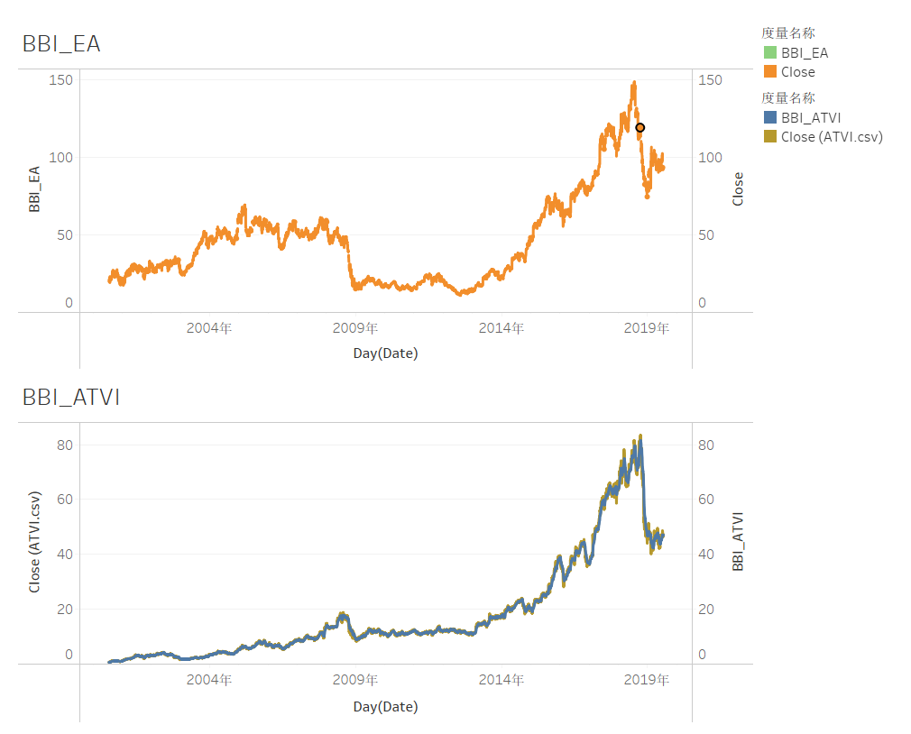
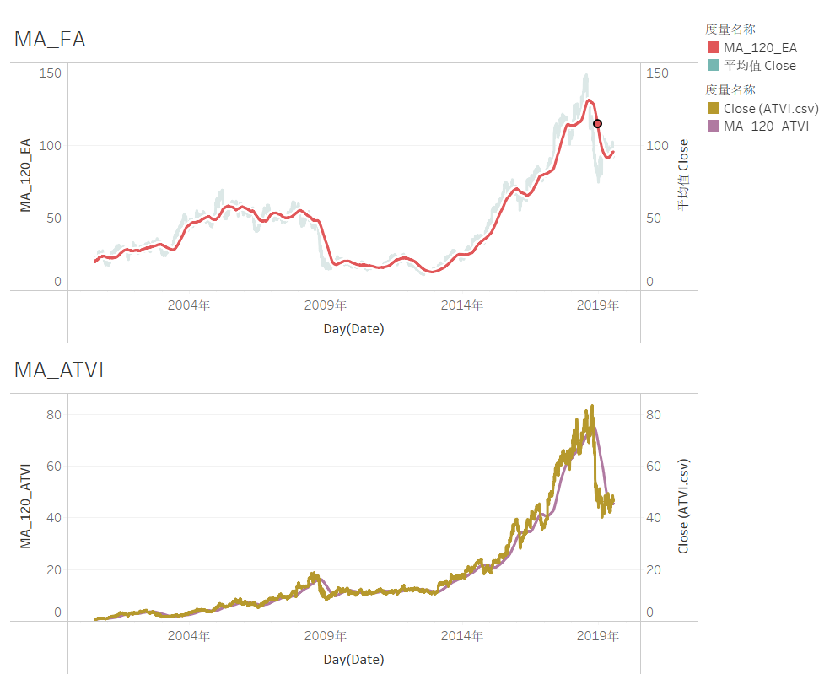
KPIs
PART TWO
KPI - BBI EA shows the descending trend, while ATVI has a short-term investment chance.
KPI- MA
The situation in ATVI is not quite positive for its downward trend.

Slide 6
PART 03.
Forecast Models in Python
Moving Average Method/ Simple Linear Regression /Multiple Regression/ Regression for Volume / Light GBM .

Slide 7
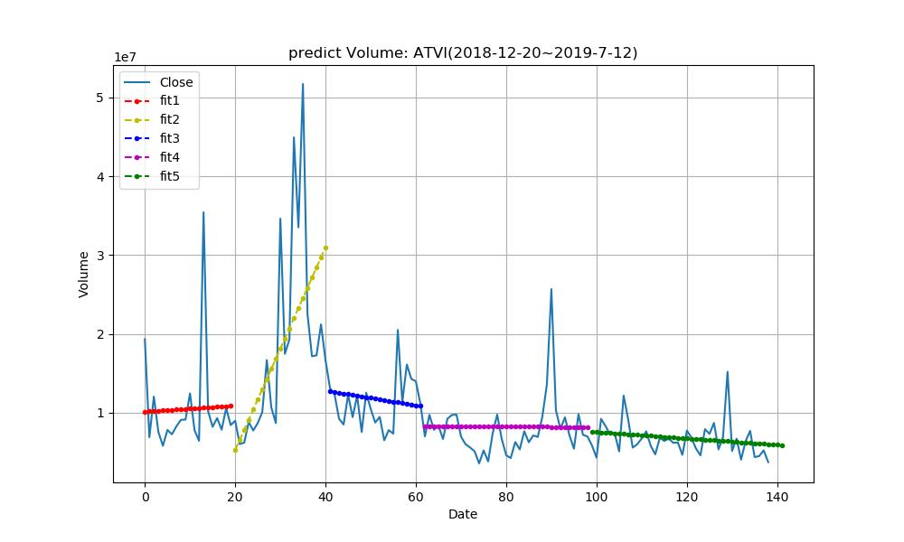
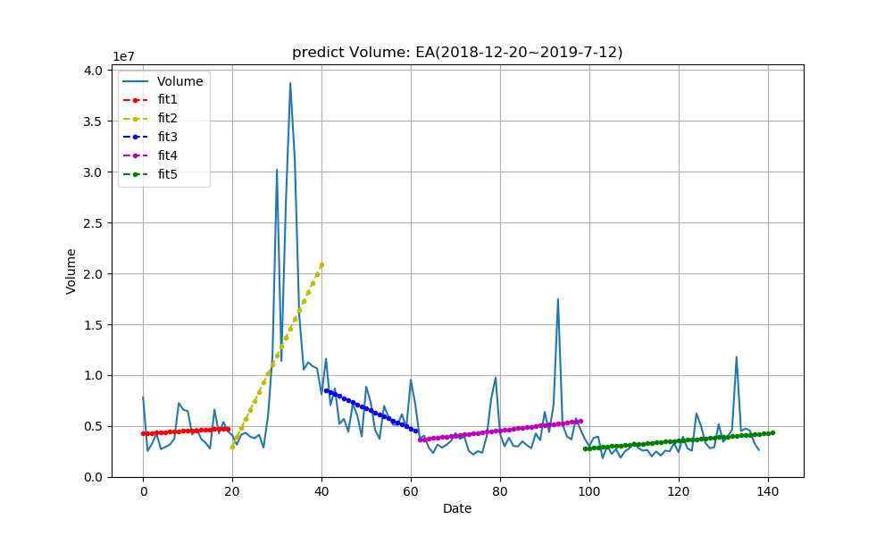
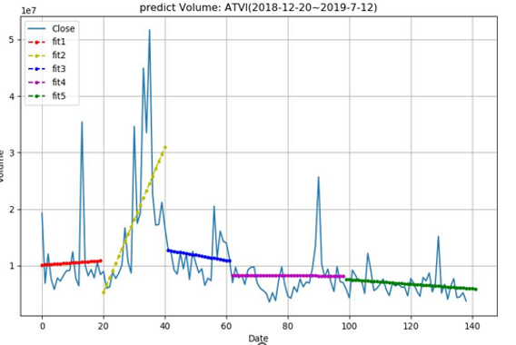
Forecast Models in Python
Regression for volume
PART THREE
EA
ATVI
ATVI: Volume=-40600*Date+11596994.8
EA: Volume=36595.96*Date-826041

Slide 8
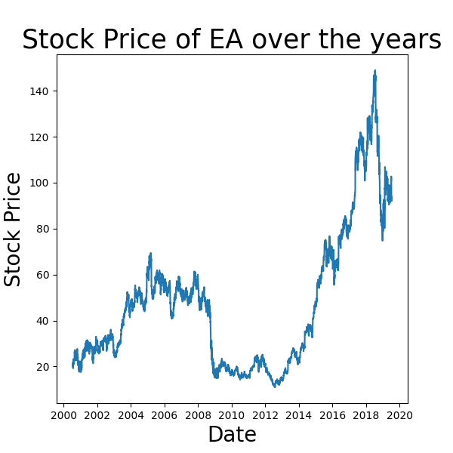
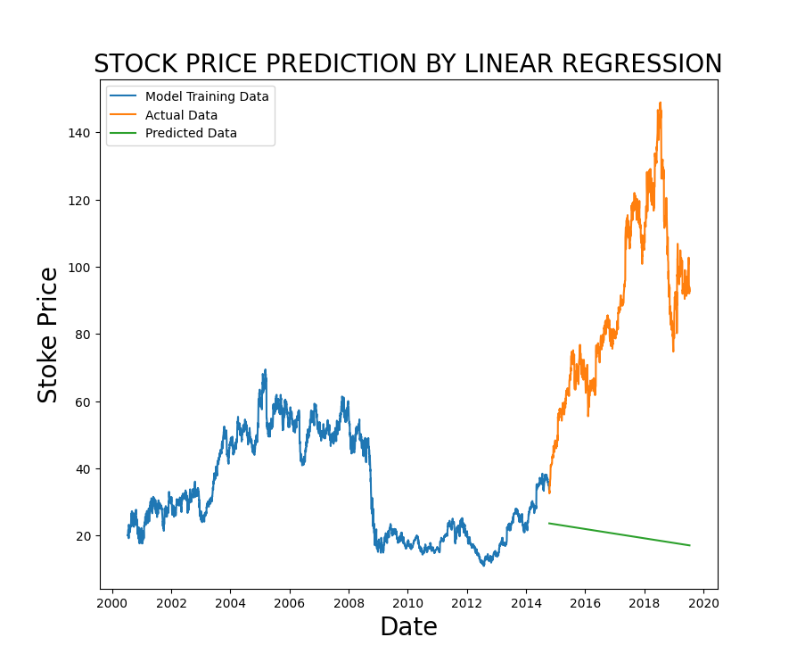
Forecast Models in Python-Basic Regression
PART THREE
Simple Linear Regression (EA)

Slide 9
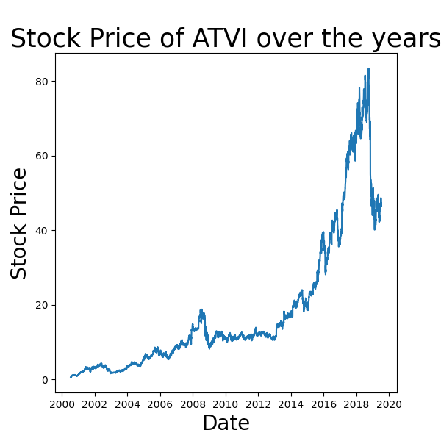
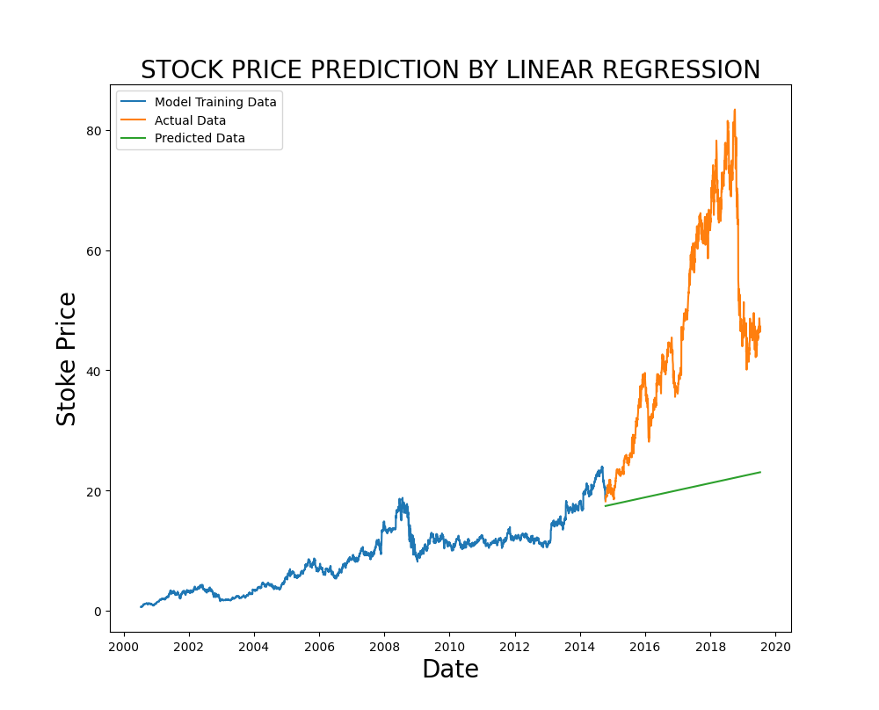
Forecast Models in Python-Basic Regression
PART THREE
Simple Linear Regression (ATVI)

Slide 10
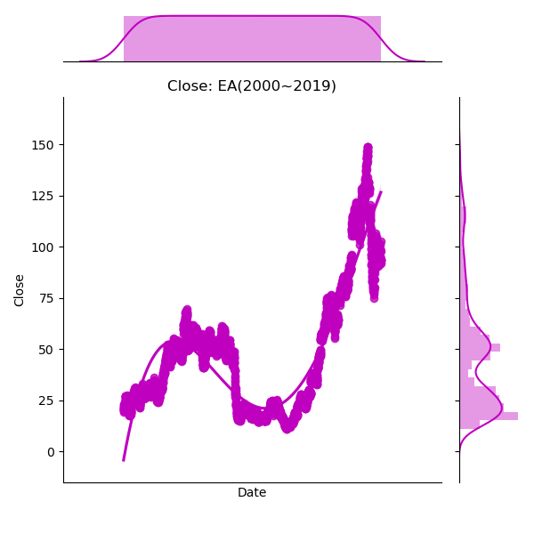
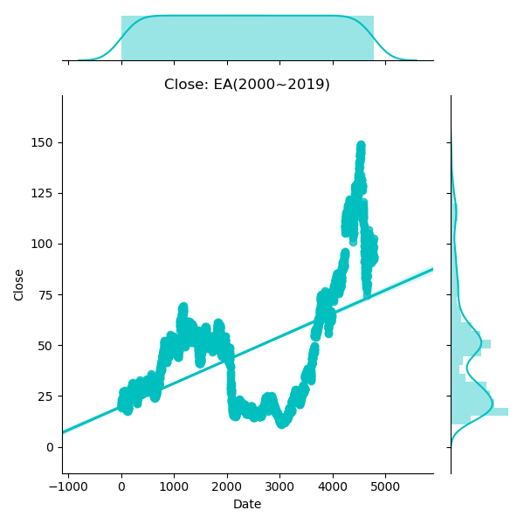
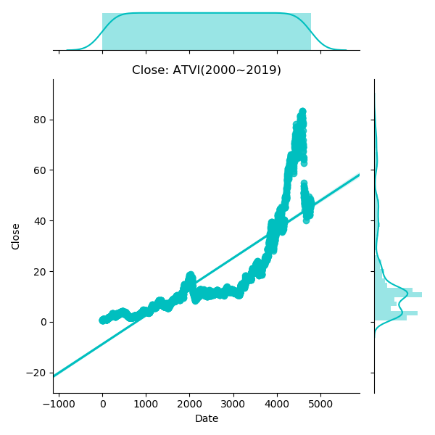
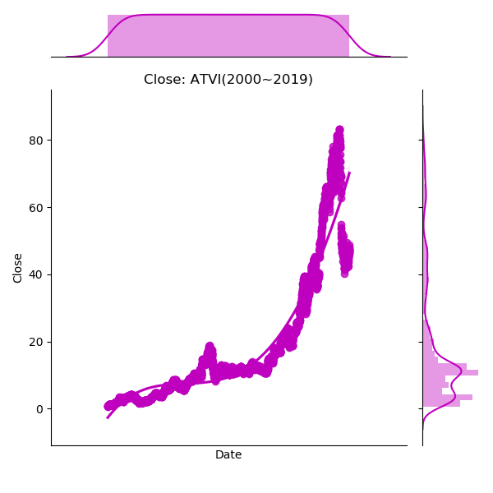
Forecast Models in Python-Basic Regression
PART THREE
Regression for Close(2000-2019）
Regression of
4 Orders
√ Better Fit
Linear Regression
√General Growing Trend

Slide 11
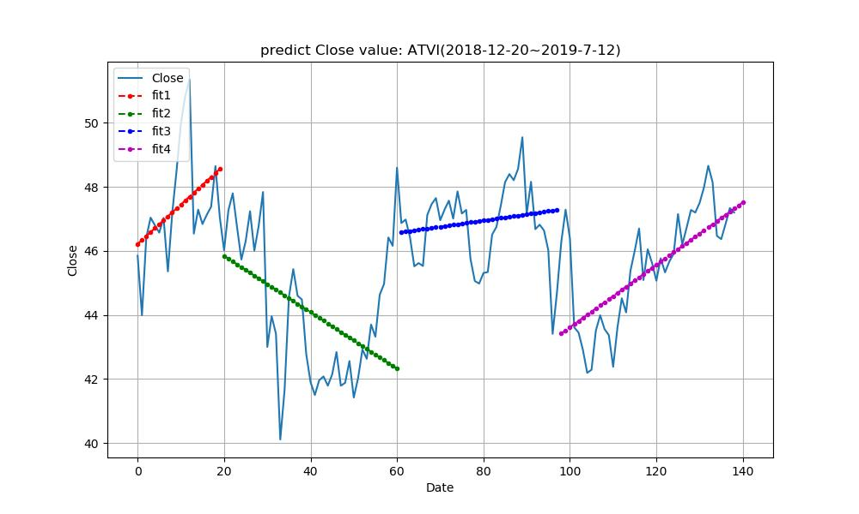
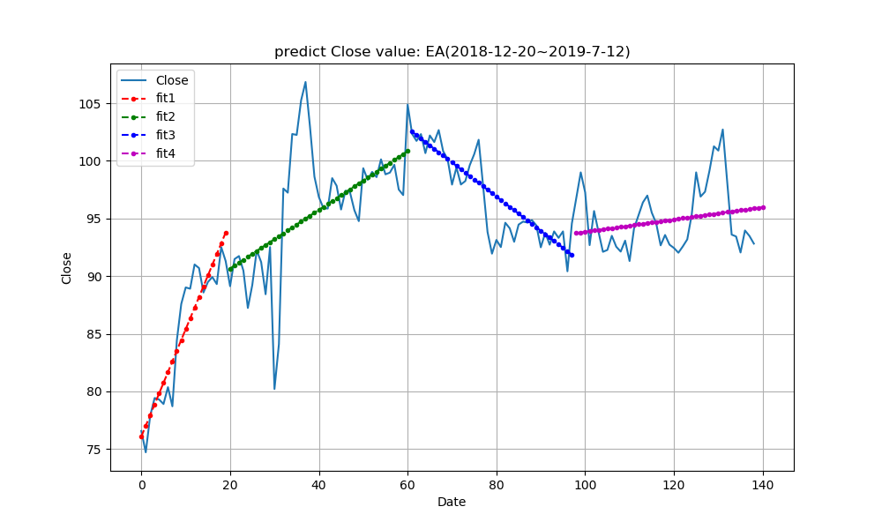
Forecast Models in Python-Basic Regression
PART THREE
Linear Regression
for Close
(2018.12-2019.7)
EA: Close=0.0546*Date+88.492
ATVI: Close=0.975*Date+33.862

Slide 12
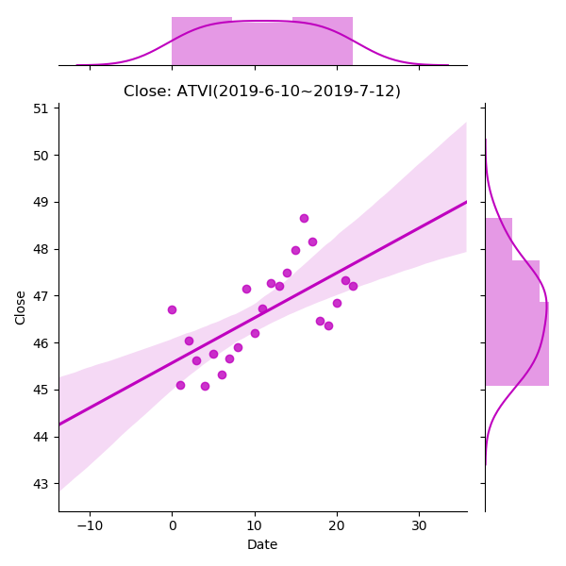
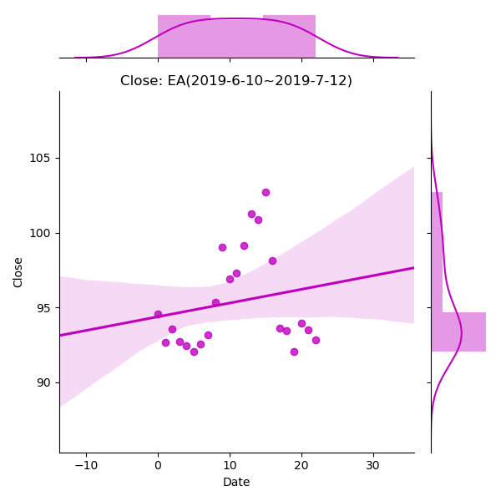
Forecast Models in Python-Basic Regression
PART THREE
Regression for Close( most recent month)
EA
ATVI

Slide 13
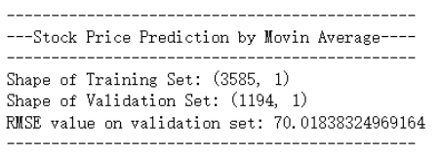
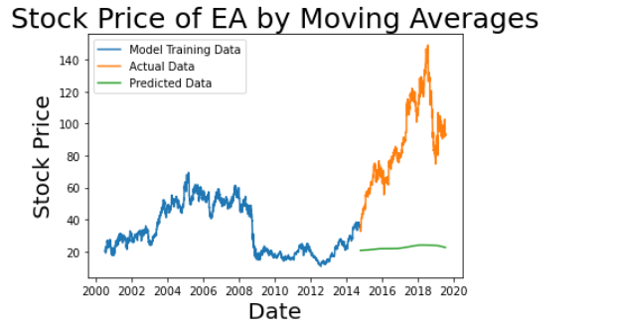
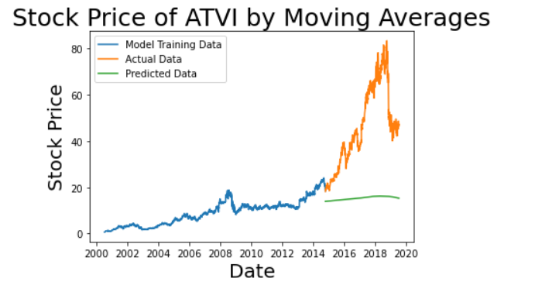
Forecast Models in Python-Advanced Prediction
PART THREE
Moving Average Method

Slide 14
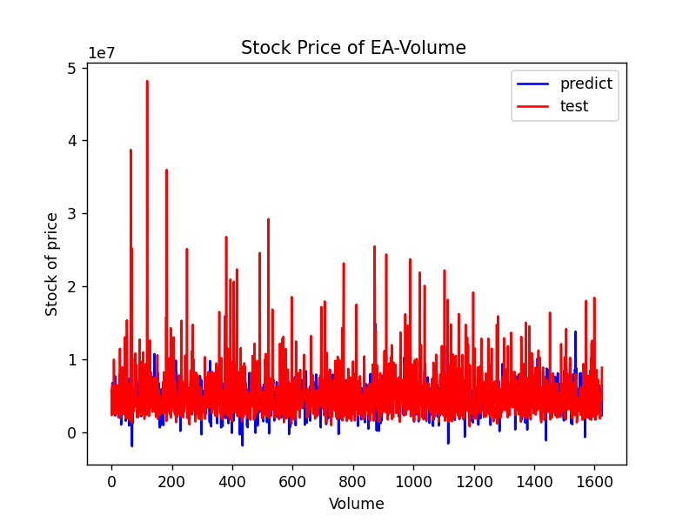
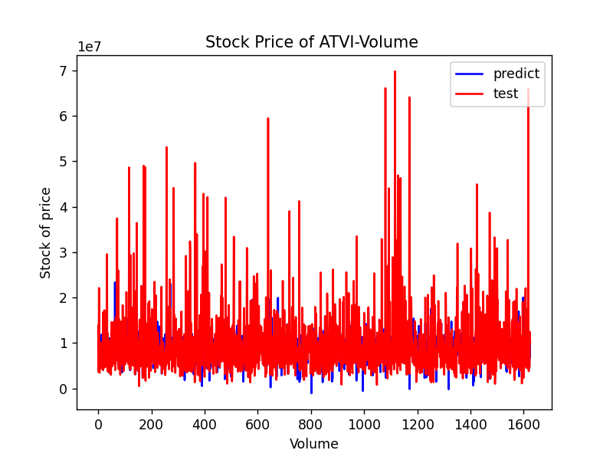
Forecast Models in Python-Advanced Prediction
PART THREE
Multiple
Regression

Slide 15
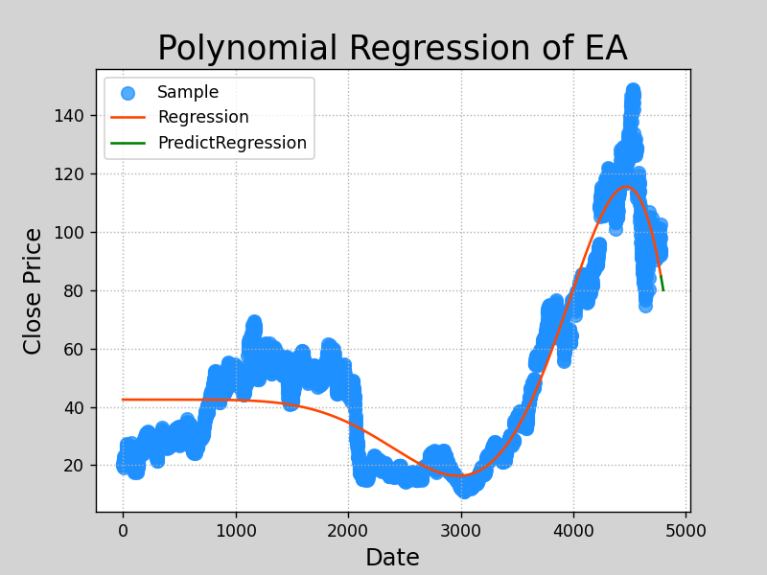
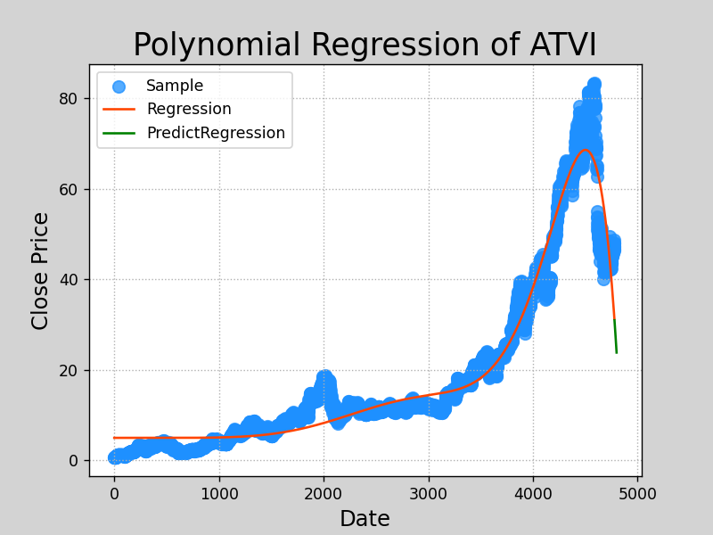
Forecast Models in Python-Advanced Prediction
PART THREE
Polynomial
Regression

Slide 16
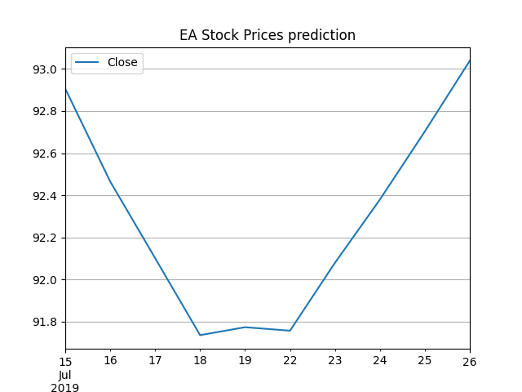
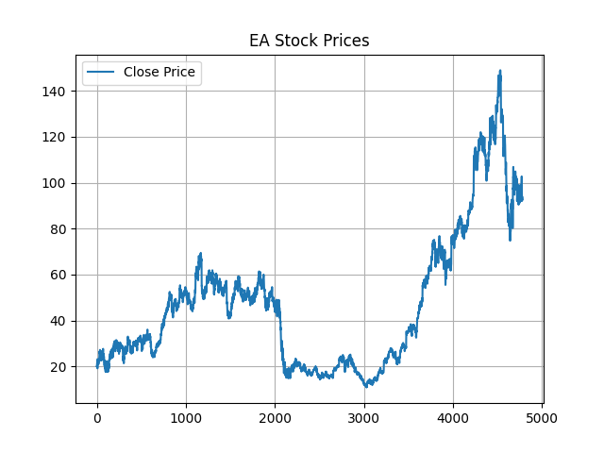
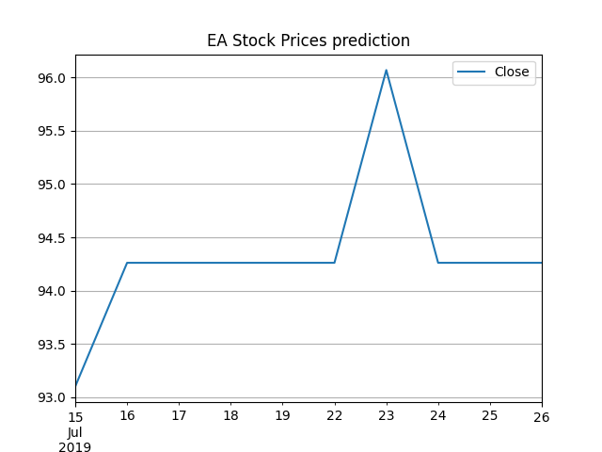
Forecast Models in Python-Advanced Prediction
PART THREE
AutoTS Prediction(EA)

Slide 17
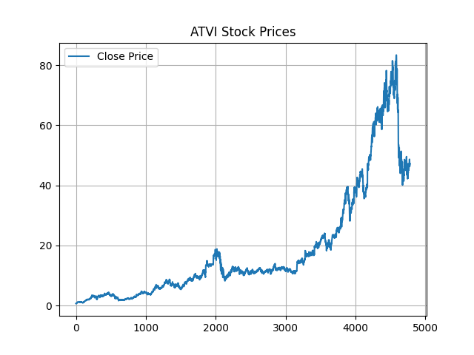
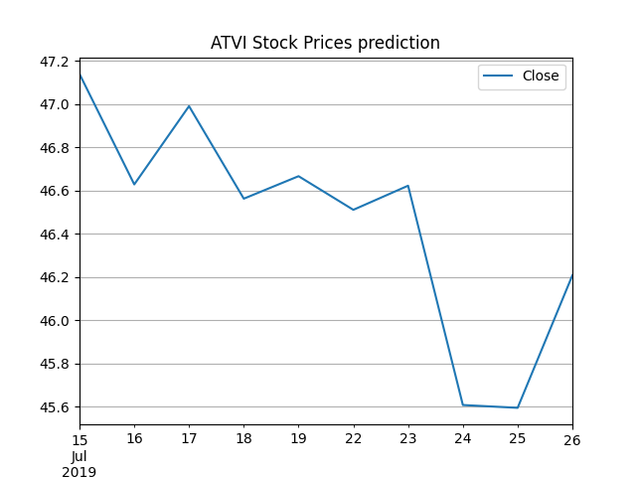
Forecast Models in Python-Advanced Prediction
PART THREE
AutoTS Prediction(ATVI)

Slide 18
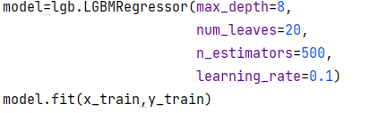
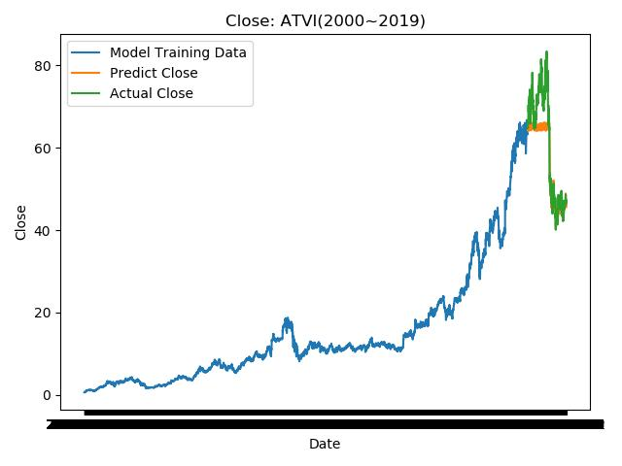
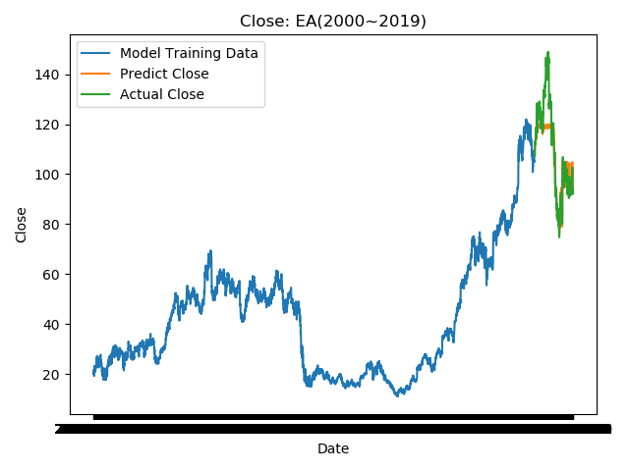
Forecast Models in Python-Advanced Prediction
PART THREE
LightGBM
LightGBM：MSE=0.21
√Outstanding Accuracy！

Slide 19
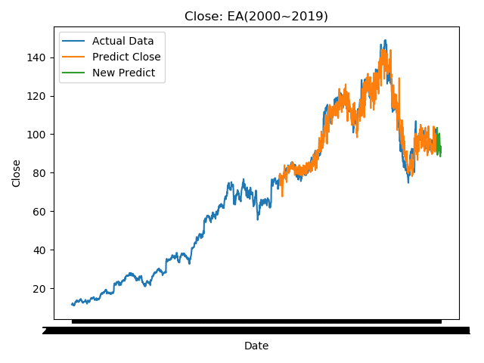
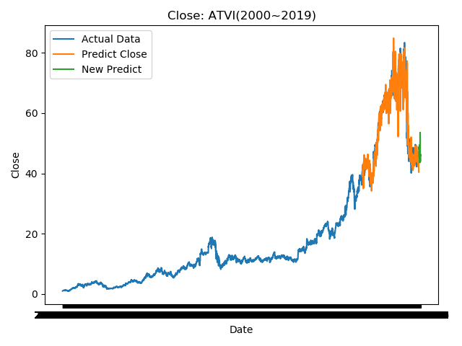
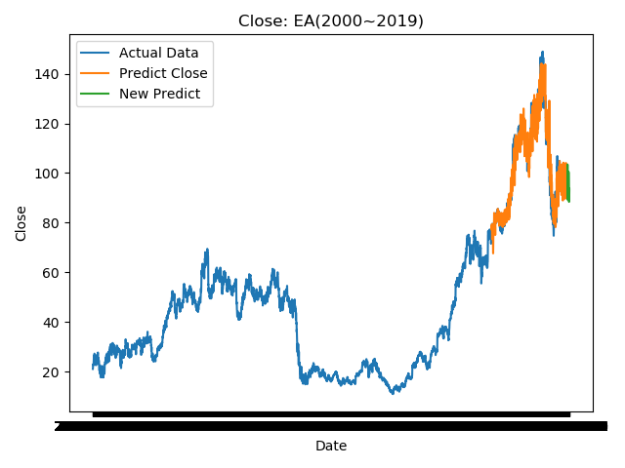
Forecast Models in Python-Advanced Prediction
PART THREE
LightGBM
ATVI
EA

Slide 20
Forecast Models in Python
PART THREE
Linear Regression
Basic Regression
4-Orders Regression
Predict-Close
Moving Average Methods
Multiple Regression
Further Prediction
Polynomial Regression
Auto TS
LightGBM

Slide 21
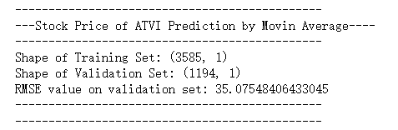
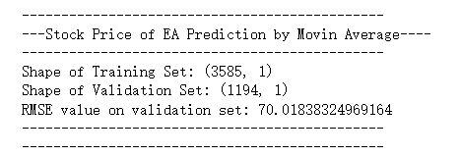

Conclusion
PART Four
WE Recommend:
ATVI
ATVI
Accuracy
ATVI has a more accurate outcome.
EA is more complex to predict.
EA
Long Term
Both have an upward trend.
But ATVI will go up more.
Short Term
ATVI has an upward trend
EA has an down trend
ATVI: Close=0.975*Date+33.862
EA: Close=0.0546*Date+88.492
=> ATVI has a higher slope

Slide 22
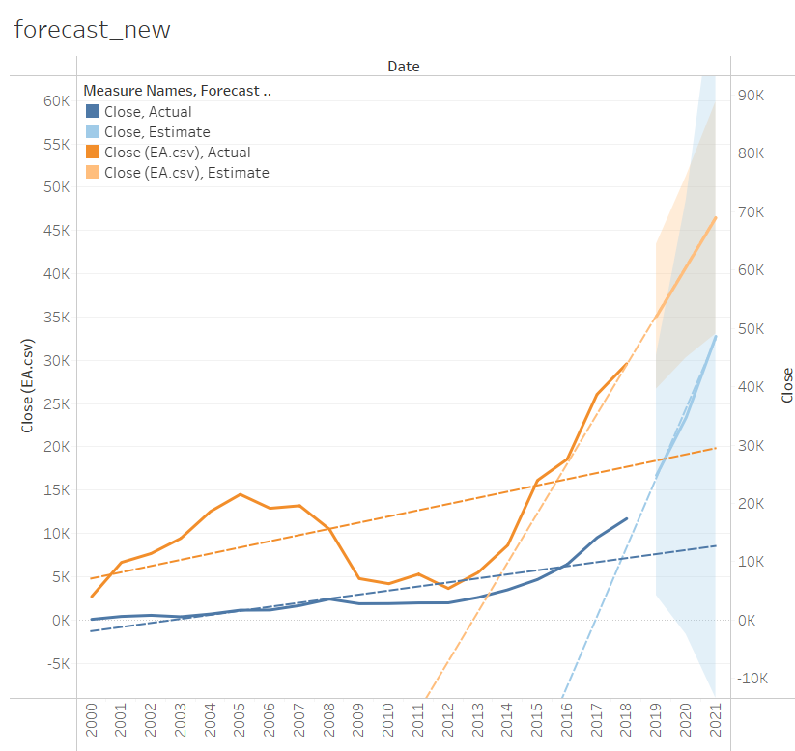
Conclusion
PART Four
Tableau
Focus more on descriptive analysis；
Very simple but inaccurate；
more accurate conclusion
have various choices of packages and models
evaluation index
Pycharm
Tableau is more suitable for data visualization
PyCharm is a better choice for complex data analysis and fulfill the high desire of precision
Forecast in Tableau

Slide 23
Codes
preds = []
for i in range(0,valid_set.shape[0]):
a = train_set['Close'][len(train_set)-valid_set.shape[0]+i:].sum()+sum(preds)
b = a/(valid_set.shape[0])
preds.append(b)
rms = np.sqrt(np.mean(np.power((np.array(valid_set['Close'])-preds),2)))
print('RMSE value on validation set:',rms)
print('----------------------------------------------')
print('----------------------------------------------')
valid_set['Predictions'] = preds
plt.plot(train_set['Close'])
plt.plot(valid_set[['Close','Predictions']])
plt.xlabel('Date',size = 20)
plt.ylabel('Stock Price',size = 20)
plt.title('Stock Price by Moving Averages',size = 25)
plt.legend(['Model Training Data','Actual Data','Predicted Data'])
plt.show()
moving_avg_prediction("EA.csv")
moving_avg_prediction("ATVI.csv")
PART Five
#EA MA
import numpy as np
import pandas as pd
import matplotlib.pyplot as plt
import warnings
from pandas.core.common import SettingWithCopyWarning
warnings.simplefilter(action="ignore", category=SettingWithCopyWarning)
from math import floor,ceil,sqrt
def moving_avg_prediction(fname):
df = pd.read_csv(fname)
df['Date'] = pd.to_datetime(df.Date, format='%Y/%m/%d')
df.index = df['Date']
shape = df.shape[0]
df_new = df[['Close']]
df_new.head()
train_set = df_new.iloc[:ceil(shape*0.75)]
valid_set = df_new.iloc[ceil(shape*0.75):]
print('----------------------------------------------')
print('---Stock Price Prediction by Movin Average----')
print('----------------------------------------------')
print('Shape of Training Set:',train_set.shape)
print('Shape of Validation Set:',valid_set.shape)

Slide 24
pred_y_train=model.predict(x_train)
pred_y_test=model.predict(x_test)
print(df0)
x_date=['2019-07-13','2019-07-14','2019-07-15','2019-07-16','2019-07-17','2019-07-18','2019-07-19','2019-07-20','2019-07-21','2019-07-22','2019-07-23','2019-07-24','2019-07-25','2019-07-26','2019-07-27','2019-07-28','2019-07-29','2019-07-30','2019-07-31','2019-08-01']
dfnewnew=df0.iloc[4759:,:]
print(dfnewnew)
x_give20=dfnewnew[['Open','High','Low','Volume']]
y_date_predict=model.predict(x_give20)
dfnew0=dfnew.iloc[4000:,:]
dfnew111=dfnew.iloc[3000:,:]
x0=dfnew111['Date']
x1=dfnew0['Date']
y0=dfnew111['Close']
pred_y0=model.predict(factors)
pred_y0=pred_y0[4000:len(pred_y0)]
plt.plot(x0,y0)
plt.plot(x1,pred_y0)
plt.plot(x_date,y_date_predict)
plt.title('Close: EA(2000~2019)' )
plt.xlabel('Date')
plt.ylabel('Close')
plt.tight_layout()
plt.legend(['Actual Data','Predict Close','New Predict'])
plt.show()
Codes
PART Five
# -*- coding = utf-8 -*- LGBM
# @Time : 2022/7/22 14:45
# @Author : 杨思颖
# @File : LGBM_to_predict.py
import pandas as pd
import lightgbm as lgb
import matplotlib.pyplot as plt
from sklearn.model_selection import train_test_split
df0=pd.read_csv('EA.csv',encoding="utf-8")
print(df0)
dfnew=df0.iloc[20:,:]
print(dfnew)
df=df0.iloc[:-20,:]
print(df)
target=dfnew['Close']
factors=df[['Open','High','Low','Volume']]
x_train,x_test,y_train,y_test=train_test_split(factors,target,test_size=0.30,random_state=2)
model=lgb.LGBMRegressor(max_depth=8,
num_leaves=20,
n_estimators=500,
learning_rate=0.1)
model.fit(x_train,y_train)

Slide 25
Codes
pred_y_train=model.predict(x_train)
pred_y_test=model.predict(x_test)
print('MSE：{}'.format(round(metrics.mean_absolute_error(y_train,pred_y_train),2)))
print("-"*80)
#validation
df0 = df[df['Date'] >'2018-01-02']
target0=df0['Close']
df0_factors=df0[['Open','High','Low','Volume']]
pred_y0=model.predict(df0_factors)
df0['pred_y0']=pred_y0.copy()
df0.index = pd.to_datetime(df0.Date)
y = df0['pred_y0'].values
x=df0['Date'].values
y_actual=df0['Close'].values
#x = np.arange(0, len(y), 1)
plt.plot(x0,y0)
plt.plot(x,y)
plt.plot(x,y_actual)
plt.title('Close: EA(2000~2019)' )
plt.xlabel('Date')
plt.ylabel('Close')
plt.tight_layout()
plt.legend(['Model Training Data','Predict Close','Actual Close'])
plt.show()
PART Five
# @File : LGBM.py LGBM
# @Software : PyCharm
import pandas as pd
import lightgbm as lgb
import matplotlib.pyplot as plt
from sklearn import metrics
from sklearn.model_selection import train_test_split
df=pd.read_csv('EA.csv',encoding="utf-8")
df1 = df[df['Date'] < '2018-01-02']
x0=df1['Date']
y0=df1['Close']
target=df1['Close']
df1_factors=df1[['Open','High','Low','Volume']]
print(df1_factors)
print("-"*80)
print(target)
x_train,x_test,y_train,y_test=train_test_split(df1_factors,target,test_size=0.30,random_state=2)
model=lgb.LGBMRegressor(max_depth=8,
num_leaves=20,
n_estimators=500,
learning_rate=0.1)
model.fit(x_train,y_train)

Slide 26
# @File : 1D according to date 2000-2019.py 1D
# @Software : PyCharm
import numpy as np
import matplotlib.pyplot as plt
import pandas as pd
import seaborn as sn
df = pd.read_csv("EA.csv")
df.index = pd.to_datetime(df.Date)
y = df['Close'].values
x = np.arange(0, len(y), 1)
print(x)
sn.jointplot(x=x,
y=y,
data=df,
kind='reg',
color='m',
fit_reg=True,
order=4,
truncate=True)
plt.title('Close: EA(2000~2019)' )
plt.xlabel('Date')
plt.ylabel('Close')
plt.tight_layout()
plt.xticks([])
plt.show()
Codes
PART Five

Slide 27
Codes
# @File : 1D according to date 2000-2019.py
import numpy as np
import matplotlib.pyplot as plt
import pandas as pd
import seaborn as sn
df = pd.read_csv("EA.csv")
df.index = pd.to_datetime(df.Date)
y = df['Close'].values
x = np.arange(0, len(y), 1)
print(x)
sn.jointplot(x=x,
y=y,
data=df,
kind='reg',
color='m',
fit_reg=True,
order=4,
truncate=True)
plt.title('Close: EA(2000~2019)' )
plt.xlabel('Date')
plt.ylabel('Close')
plt.tight_layout()
plt.xticks([])
plt.show()
PART Five

Slide 28
# 2
dates = pd.date_range('2019-01-22', '2019-03-20')
df2 = df[df.index.isin(dates.values)]
y2 = df2['Close'].values
x2 = np.arange(begin, begin + len(y2), 1)
x2 = x2.reshape(-1, 1)
y2 = y2.reshape(-1, 1)
begin = begin + len(y2)
# 3
dates = pd.date_range('2019-03-20', '2019-05-10')
df3 = df[df.index.isin(dates.values)]
y3 = df3['Close'].values
x3 = np.arange(begin, begin + len(y3), 1)
x3 = x3.reshape(-1, 1)
y3 = y3.reshape(-1, 1)
begin = begin + len(y3)
# 4
df4 = df[df['Date'] > '2019-05-10']
y4 = df4['Close'].values
x4 = np.arange(begin, begin + len(y4), 1)
x4 = x4.reshape(-1, 1)
y4 = y4.reshape(-1, 1)
begin = begin + len(y4)
Codes
PART Five
# @File : 1Dlast year seperate.py
# @Software : PyCharm
# coding=utf-8
import numpy as np
import matplotlib.pyplot as plt
import pandas as pd
from sklearn.linear_model import LinearRegression
df = pd.read_csv("ATVI.csv")
df = df[df['Date'] > '2018-12-20']
df.index = pd.to_datetime(df.Date)
y = df['Close'].values
x = np.arange(0, len(y), 1)
x = x.reshape(-1, 1)
y = y.reshape(-1, 1)
# 1
dates0= pd.date_range('2018-12-20', '2019-01-22')
df1 = df[df.index.isin(dates0.values)]
y1 = df1['Close'].values
x1 = np.arange(0, len(y1), 1)
x1 = x1.reshape(-1, 1)
y1 = y1.reshape(-1, 1)
begin = len(y1)

Slide 29
model = LinearRegression()
model.fit(x1, y1)
Y1 = model.predict(x1)
model.fit(x2, y2)
Y2 = model.predict(x2)
model.fit(x3, y3)
Y3 = model.predict(x3)
model.fit(x4, y4)
Y4 = model.predict(x4)
predictions = {}
predictions['intercept'] = model.intercept_
predictions['coefficient'] = model.coef_
print(predictions)
fig, ax = plt.subplots(figsize=(10, 6))
ax.plot(x, y, '-', label='Close')
ax.plot(x1, Y1, 'r--.', label='fit1')
ax.plot(x2, Y2, 'g--.', label='fit2')
ax.plot(x3, Y3, 'b--.', label='fit3')
ax.plot(x4, Y4, 'm--.', label='fit4')
ax.legend(loc='upper left')
plt.title('predict Close value: ATVI(2018-12-20~2019-7-12)' )
plt.xlabel('Date')
plt.ylabel('Close')
plt.grid()
plt.show()
Codes
PART Five

Slide 30
model = LinearRegression()
model.fit(X_train, Y_train)
a = model.intercept_
b = model.coef_
print("Best Fit Curve:intercept", a, ",regression coefficient：", b)
# y=2.668+0.0448∗TV+0.187∗Radio-0.00242∗Newspaper
score = model.score(X_test, Y_test)
Y_pred = model.predict(X_test)
print(Y_pred)
plt.plot(range(len(Y_pred)), Y_pred, 'b', label="predict")
plt.figure()
plt.plot(range(len(Y_pred)), Y_pred, 'b', label="predict")
plt.plot(range(len(Y_pred)), Y_test, 'r', label="test")
plt.legend(loc="upper right")
plt.title("Stock Price of ATVI-Volume ")
plt.xlabel("Volume")
plt.ylabel('Stock of price')
# plt.savefig("ROC.jpg")
plt.show()
Codes
PART Five
import pandas as pd
import seaborn as sns
from sklearn.linear_model import LinearRegression
import matplotlib.pyplot as plt
import numpy as np
from sklearn.preprocessing import PolynomialFeatures
from sklearn.model_selection import train_test_split
dash="-"*80
adv_data = pd.read_csv("ATVI.csv")
new_adv_data = adv_data.iloc[:, 1:]
# new_adv_data=adv_data
print('head:', new_adv_data.head(), '\nShape:', new_adv_data.shape)
print(new_adv_data.describe())
print(new_adv_data[new_adv_data.isnull() == True].count())
new_adv_data.boxplot()
print(new_adv_data.corr())
sns.pairplot(new_adv_data, x_vars=['Open','High', 'Volume'], y_vars='Close', size=7, aspect=0.8, kind='scatter')
plt.show()
print("iloc:",new_adv_data.iloc[:, :6])
print(dash)
X_train, X_test, Y_train, Y_test = train_test_split(new_adv_data.iloc[:, :3], new_adv_data.Volume, train_size=.66)

Slide 31
Codes
x0=[4779,4780,4781,4782,4783,4784,4785,4786,4787,4788,4789,4790,4791,4792,4793,4794,4795,4796,4797,4798,4799]
x0=np.array(x0)
x0 = x0.reshape(-1, 1)
print("x---",x)
# for i in x:
# j=str(i)
# j=j.replace("-","")
# j = j.replace("'", "")
# j = j.replace("[", "")
# j = j.replace("]", "")
# j = j.replace(" ", "")
# print(j)
# j=float(j)
# print("jtype",type(j))
print("xtype:",type(x))
print("ytype:",type(y))
print(df)
print(y)
model = pl.make_pipeline(
sp.PolynomialFeatures(10),
lm.LinearRegression())
PART Five
import numpy as np ('Polynomial Regression
import pandas as pd
import sklearn.pipeline as pl
import sklearn.preprocessing as sp
import sklearn.linear_model as lm
import sklearn.metrics as sm
import matplotlib.pyplot as mp
df=pd.read_csv("ATVI.csv")
x=df.iloc[:,:1].values
y=df.iloc[:,4].values
print("x:",x)
print("y",y)
x = np.arange(0, len(y), 1)
print("x----",x)
x = x.reshape(-1, 1)
# x0=['4779,'4780','4781','4782','4783','4784','4785','4786','4787','4788','4789','4790','4791','4792','4793','4794','4795','4796','4797','4798','4799']

Slide 32
Codes
PART Five
model.fit(x, y)
pred_y = model.predict(x)
pred_y0 = model.predict(x0)
test_x = np.linspace(x.min(), x.max(), 1000).reshape(-1, 1)
pred_test_y = model.predict(test_x)
mp.figure('Polynomial Regression', facecolor='lightgray')
mp.title('Polynomial Regression of ATVI', fontsize=20)
mp.xlabel('Date', fontsize=14)
mp.ylabel('Close Price', fontsize=14)
mp.tick_params(labelsize=10)
mp.grid(linestyle=':')
mp.scatter(x, y, c='dodgerblue', alpha=0.75, s=60, label='Sample')
mp.plot(test_x, pred_test_y, c='orangered', label='Regression')
mp.plot(x0, pred_y0, c='green', label='PredictRegression')
mp.legend()
mp.show()

Slide 33
df=pd.read_csv('EA.csv')
df.head(8)
df['Date']=pd.to_datetime(df.Date,format='%Y-%m-%d')
df.index=df['Date']
plt.figure(figsize=(6,6))
plt.plot(df['Close'], label="Close Price History")
plt.xlabel('Date', size=20)
plt.ylabel('Stock Price', size=20)
plt.title('Stock Price of EA over the years', size=25)
plt.show()
def Linear_regression_prediction(df):
shape=df.shape[0]
df_new=df[['Close']]
df_new.head()
train_set=df_new.iloc[:ceil(shape*0.75)]
valid_set=df_new.iloc[ceil(shape*0.75):]
print(dash)
print("---------------STOCK PRICE PREDICTION BY LINEAR REGRESSION---------------")
print(dash)
print('shape of Training set', train_set.shape)
print('shape of Validation set', valid_set.shape)
train=train_set.reset_index()
valid=valid_set.reset_index()
x_train=train['Date'].map(dt.datetime.toordinal)
y_train=train[['Close']]
x_valid=valid['Date'].map(dt.datetime.toordinal)
y_valid=valid[['Close']]
Codes
PART Five
#EA LR
import sys
import math
import os,io,csv
import datetime
import numpy as np
import matplotlib.pyplot as plt
from matplotlib.pylab import rcParams
rcParams['figure.figsize']=10,10
from sklearn.preprocessing import MinMaxScaler
scaler=MinMaxScaler(feature_range=(0,1))
import pandas as pd
import seaborn as sn
from math import floor,ceil,sqrt
import datetime as dt
import warnings
if not sys.warnoptions:
warnings.simplefilter('ignore')
from sklearn.linear_model import LinearRegression
from pmdarima.arima import auto_arima
from sklearn import neighbors
from sklearn.model_selection import GridSearchCV
from sklearn.preprocessing import MinMaxScaler
dash ="-" *80
print(dash)

Slide 34
Codes
#ATVI SLR
rcParams['figure.figsize']=10,10
from sklearn.preprocessing import MinMaxScaler
scaler=MinMaxScaler(feature_range=(0,1))
import pandas as pd
import seaborn as sn
from math import floor,ceil,sqrt
import warnings
import datetime as dt
if not sys.warnoptions:
warnings.simplefilter('ignore')
from sklearn.linear_model import LinearRegression
from pmdarima.arima import auto_arima
from sklearn import neighbors
from sklearn.model_selection import GridSearchCV
from sklearn.preprocessing import MinMaxScaler
dash ="-" *80
print(dash)
PART Five
# SLR
model=LinearRegression()
model.fit(np.array(x_train).reshape(-1,1),y_train)
preds=model.predict(np.array(x_valid).reshape(-1,1))
rms=np.sqrt(np.mean(np.power((np.array(valid_set['Close'])-preds),2)))
print('RMSE value on validation set:',rms)
print(dash)
print(dash)
valid_set['Predictions']=preds
plt.plot(train_set['Close'])
plt.plot(valid_set[['Close', 'Predictions']])
plt.xlabel('Date',size=20)
plt.ylabel('Stoke Price', size=20)
plt.title("STOCK PRICE PREDICTION BY LINEAR REGRESSION",size=20)
plt.legend(['Model Training Data','Actual Data','Predicted Data'])
plt.show()
Linear_regression_prediction(df)

Slide 35
Codes
PART Five
def Linear_regression_prediction(df):
shape=df.shape[0]
df_new=df[['Close']]
df_new.head()
train_set=df_new.iloc[:ceil(shape*0.75)]
valid_set=df_new.iloc[ceil(shape*0.75):]
print(dash)
print("---------------STOCK PRICE PREDICTION BY LINEAR REGRESSION---------------")
print(dash)
print('shape of Training set', train_set.shape)
print('shape of Validation set', valid_set.shape)
train=train_set.reset_index()
valid=valid_set.reset_index()
x_train=train['Date'].map(dt.datetime.toordinal)
y_train=train[['Close']]
x_valid=valid['Date'].map(dt.datetime.toordinal)
y_valid=valid[['Close']]
df=pd.read_csv('ATVI.csv')
df.head(8)
df['Date']=pd.to_datetime(df.Date,format='%Y-%m-%d')
df.index=df['Date']
plt.figure(figsize=(6,6))
plt.plot(df['Close'], label="Close Price History")
plt.xlabel('Date', size=20)
plt.ylabel('Stock Price', size=20)
plt.title('Stock Price of ATVI over the years', size=25)
plt.show()

Slide 36
Codes
# SLR
model=LinearRegression()
model.fit(np.array(x_train).reshape(-1,1),y_train)
preds=model.predict(np.array(x_valid).reshape(-1,1))
rms=np.sqrt(np.mean(np.power((np.array(valid_set['Close'])-preds),2)))
print('RMSE value on validation set:',rms)
print(dash)
print(dash)
valid_set['Predictions']=preds
plt.plot(train_set['Close'])
plt.plot(valid_set[['Close', 'Predictions']])
plt.xlabel('Date',size=20)
plt.ylabel('Stoke Price', size=20)
plt.title("STOCK PRICE PREDICTION BY LINEAR REGRESSION",size=20)
plt.legend(['Model Training Data','Actual Data','Predicted Data'])
plt.show()
Linear_regression_prediction(df)
PART Five

Slide 37
Codes
PART Five
from autots import AutoTS
model1=AutoTS(forecast_length=10, frequency='infer',
ensemble='simple', drop_data_older_than_periods=200)
model1=model1.fit(df, date_col='Date', value_col='Close',id_col=None)
prediction=model1.predict()
forecast=prediction.forecast
dash = "-" * 80
print(dash)
print("Stock Price Prediction of EA")
print(forecast)
forecast['Close'].plot(title="EA Stock Prices prediction")
plt.legend()
plt.grid()
plt.show()
prediction_model(df)
#EA AUTOTS
import sys
import math
import os,io,csv
import datetime
import pandas as pd
import seaborn as sn
import numpy as np
import matplotlib.pyplot as plt
df=pd.read_csv('EA.csv')
df.head(8)
def prediction_model(df):
df['Date']=pd.to_datetime(df.Date)
df['Close'].plot(title="EA Stock Prices",label="Close Price")
plt.legend()
plt.grid()
plt.show()

Slide 38

THANK YOU!
❤
Group I

